Slide 1
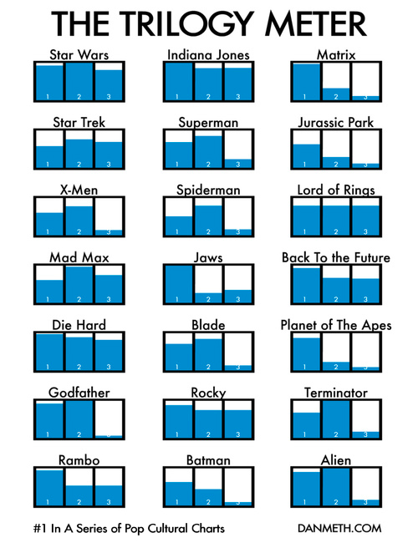
Notes:
http://media.juiceanalytics.com/images/smallmultiples2.jpg

Slide 2
Information Visualization 2
Perceptively Awesome Information Encoding
CPSC 481: HCI I
Winter 2014
Anthony Tang, acknowledgements to Tamara Munzner
Notes:
This is a borrowed talk from Tamara Munzner, with examples thrown in there by Tony Tang
http://vimeo.com/26205288
http://www.cs.ubc.ca/~tmm/talks/vizbi11/vizbi11.pdf

Slide 3
Which is easier to read? Why?
70
Maintenance cost / year
65
60
55
50
45
40
35
30
25
20
15
10
5
0
Ford
GM
Pontiac
Toyota

Slide 4
Learning Objectives
By the end of this lecture, you should be able to:
» Identify characteristics of different data types
» Understand encoding in terms of marks and visual channels
» Relate different visual channel types to data types (and effectiveness)
» Understand and apply Steven's Psychophysical Power Law
» In terms of rankings of visual channels, define and describe accuracy, discriminability, and separability vs. integrality, popouts
» Describe the dangers of using 3D in visualizations

Slide 5
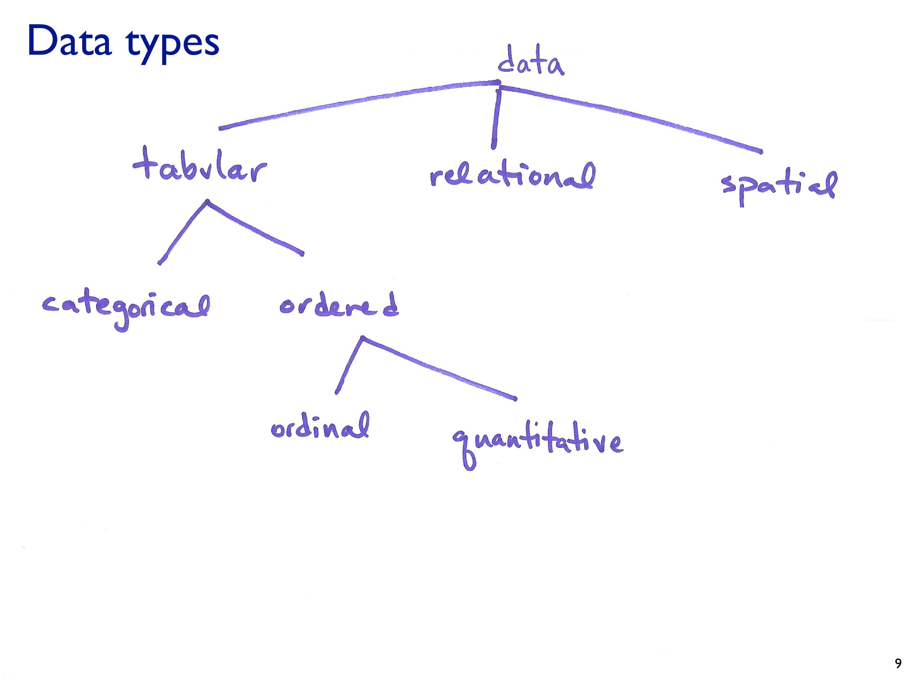

Slide 6
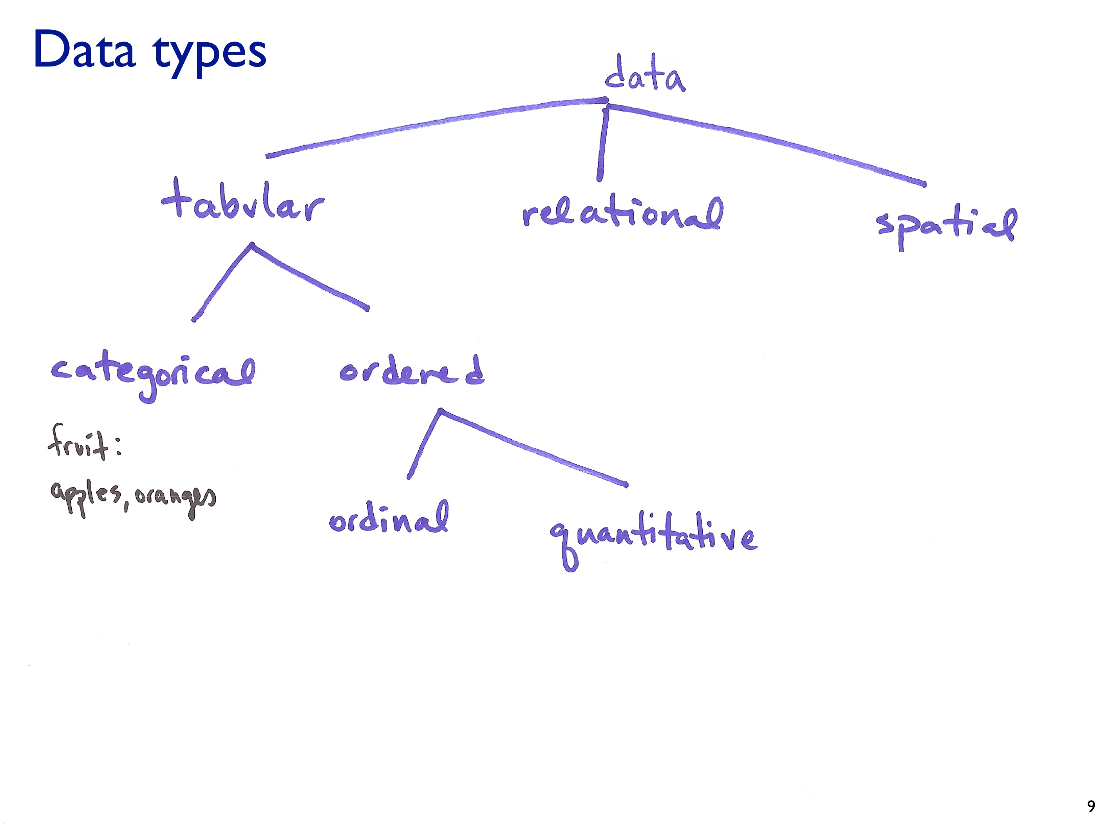

Slide 7
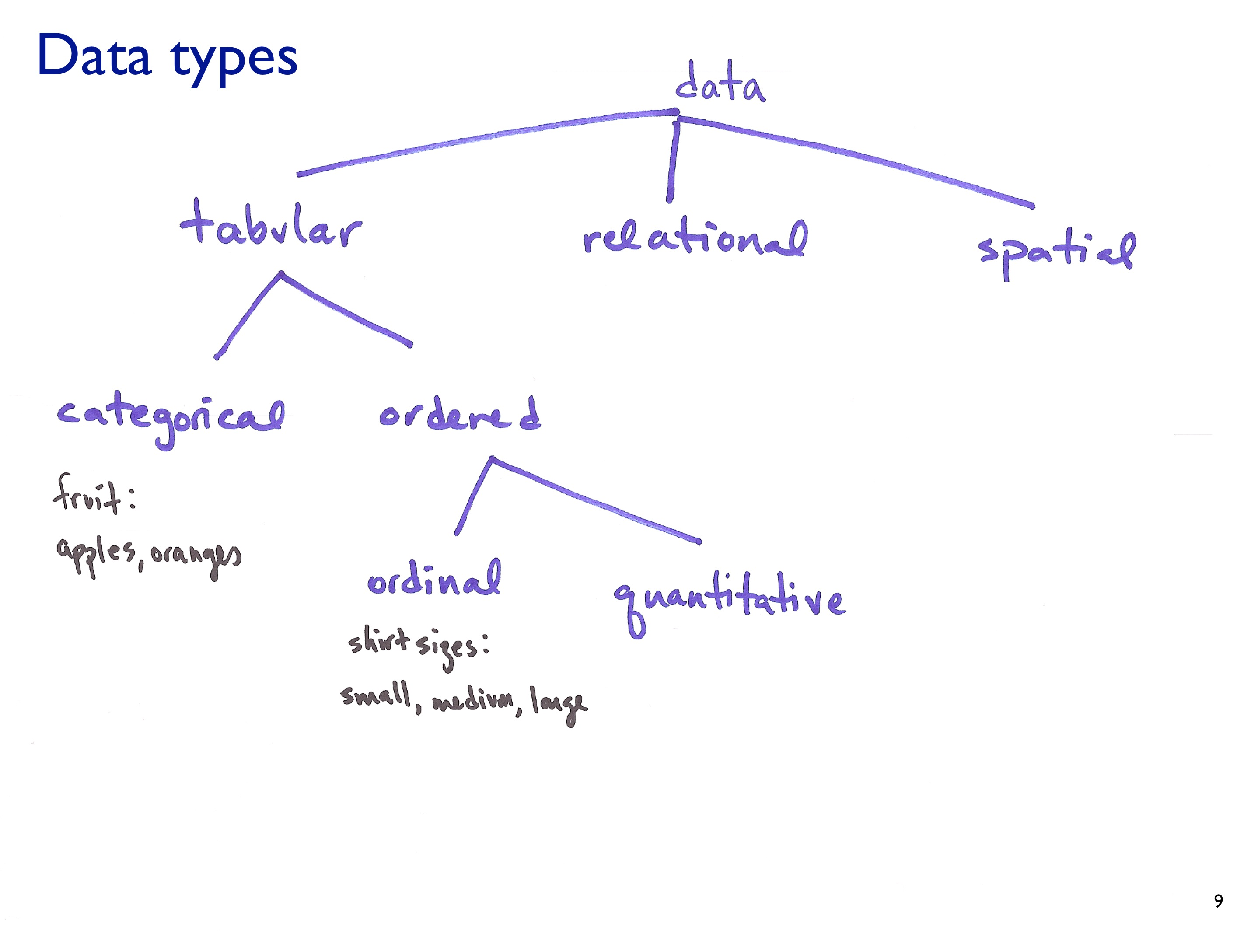

Slide 8
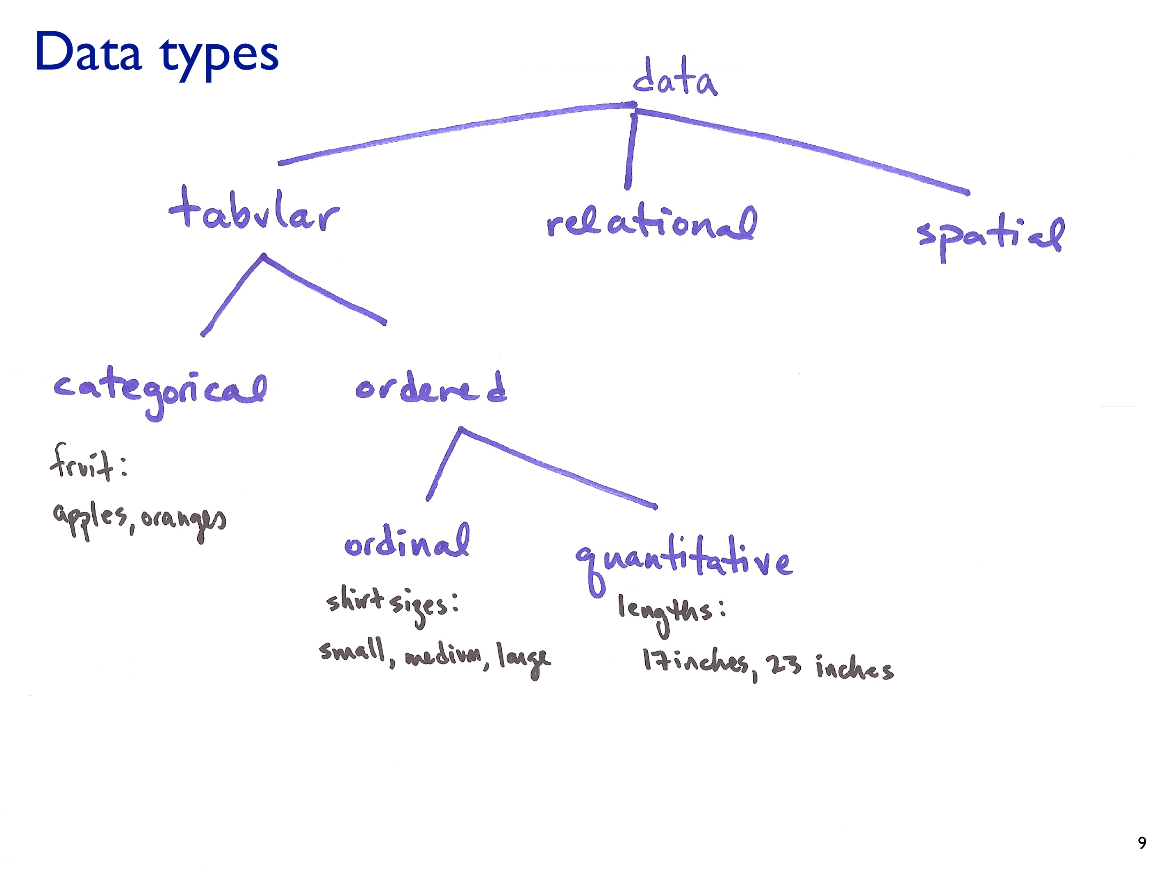

Slide 9
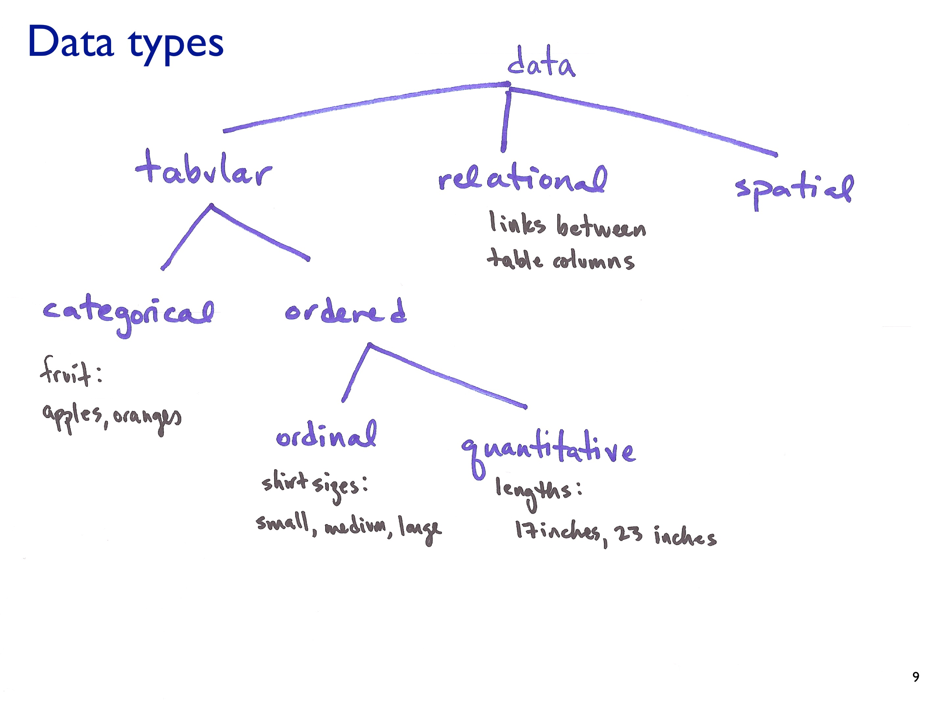

Slide 10
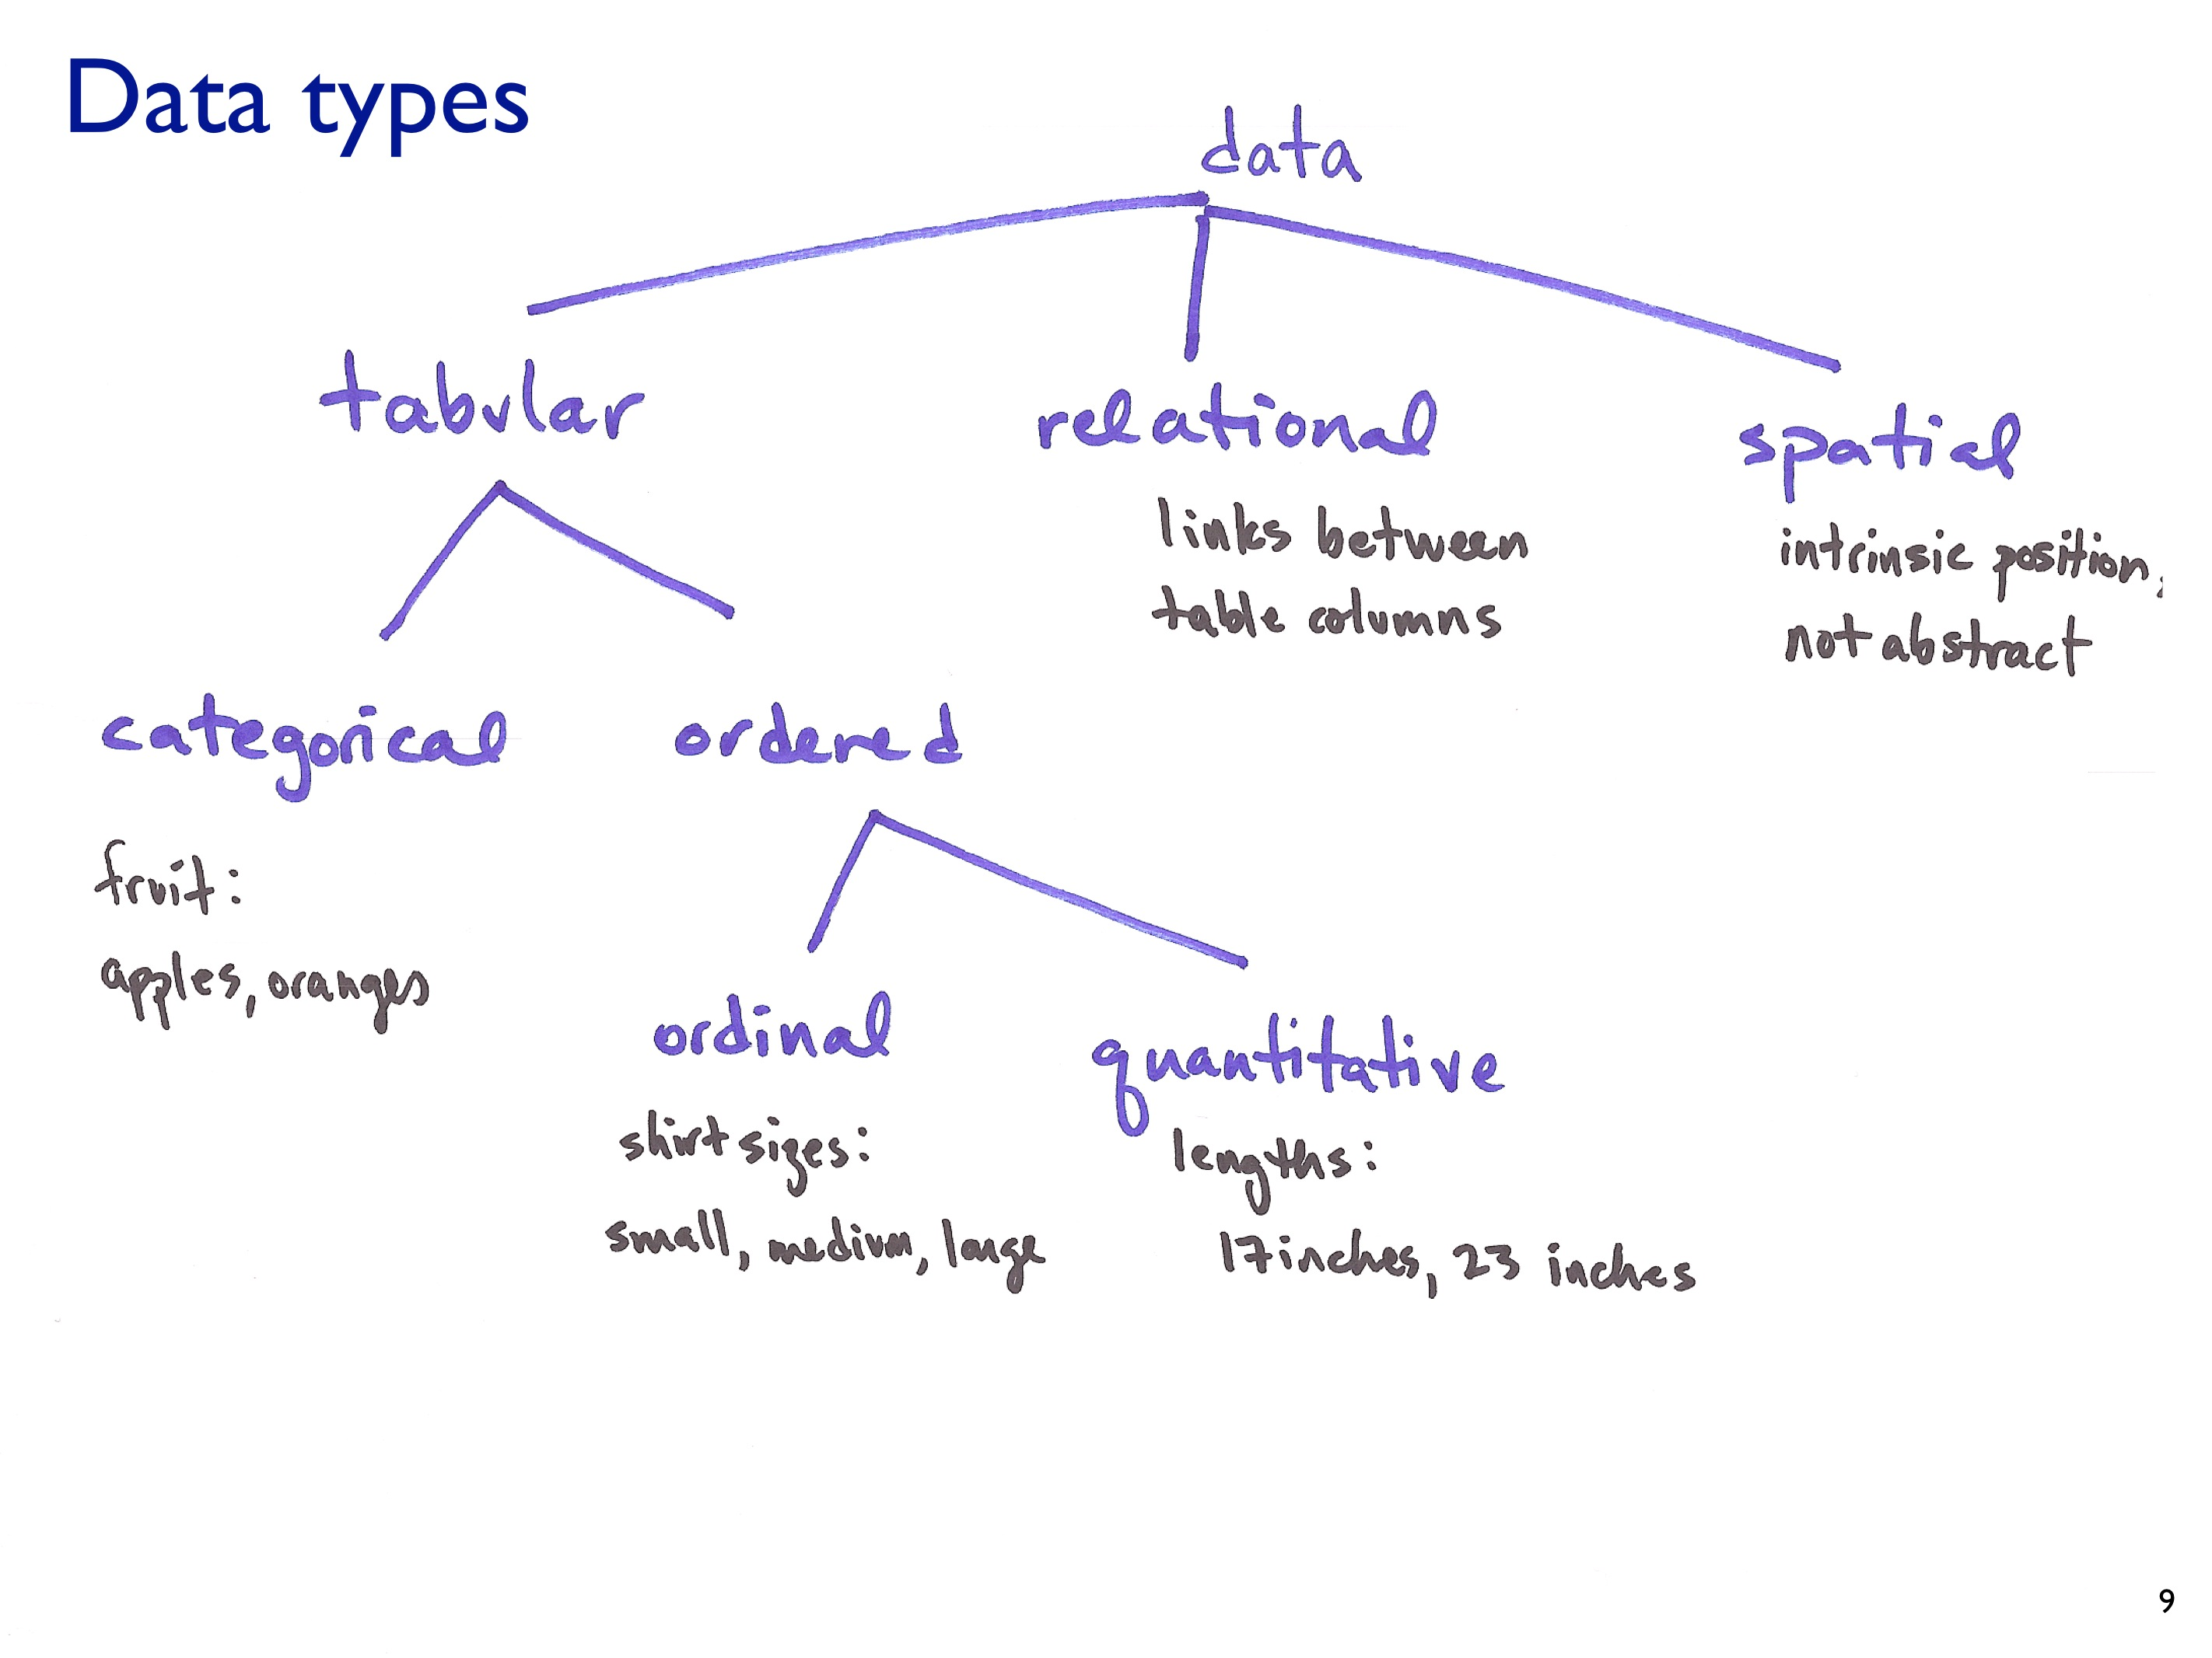

Slide 11
So what types of Facebook data are each of these?
Ages of your friends
Gender of your friends
How many friends you have?
The first names of your friends
All of your status updates
Consider a group of friends: the links between those friends
The hometowns of all of your friends

Slide 12
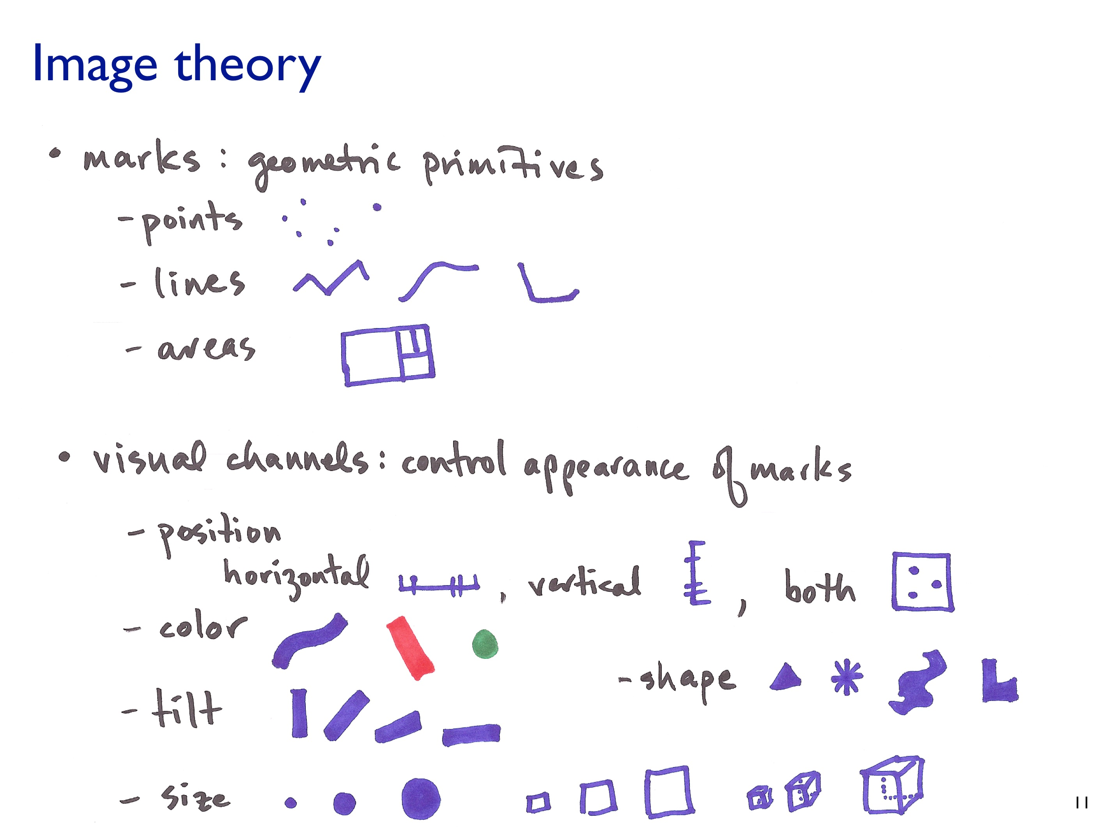

Slide 13
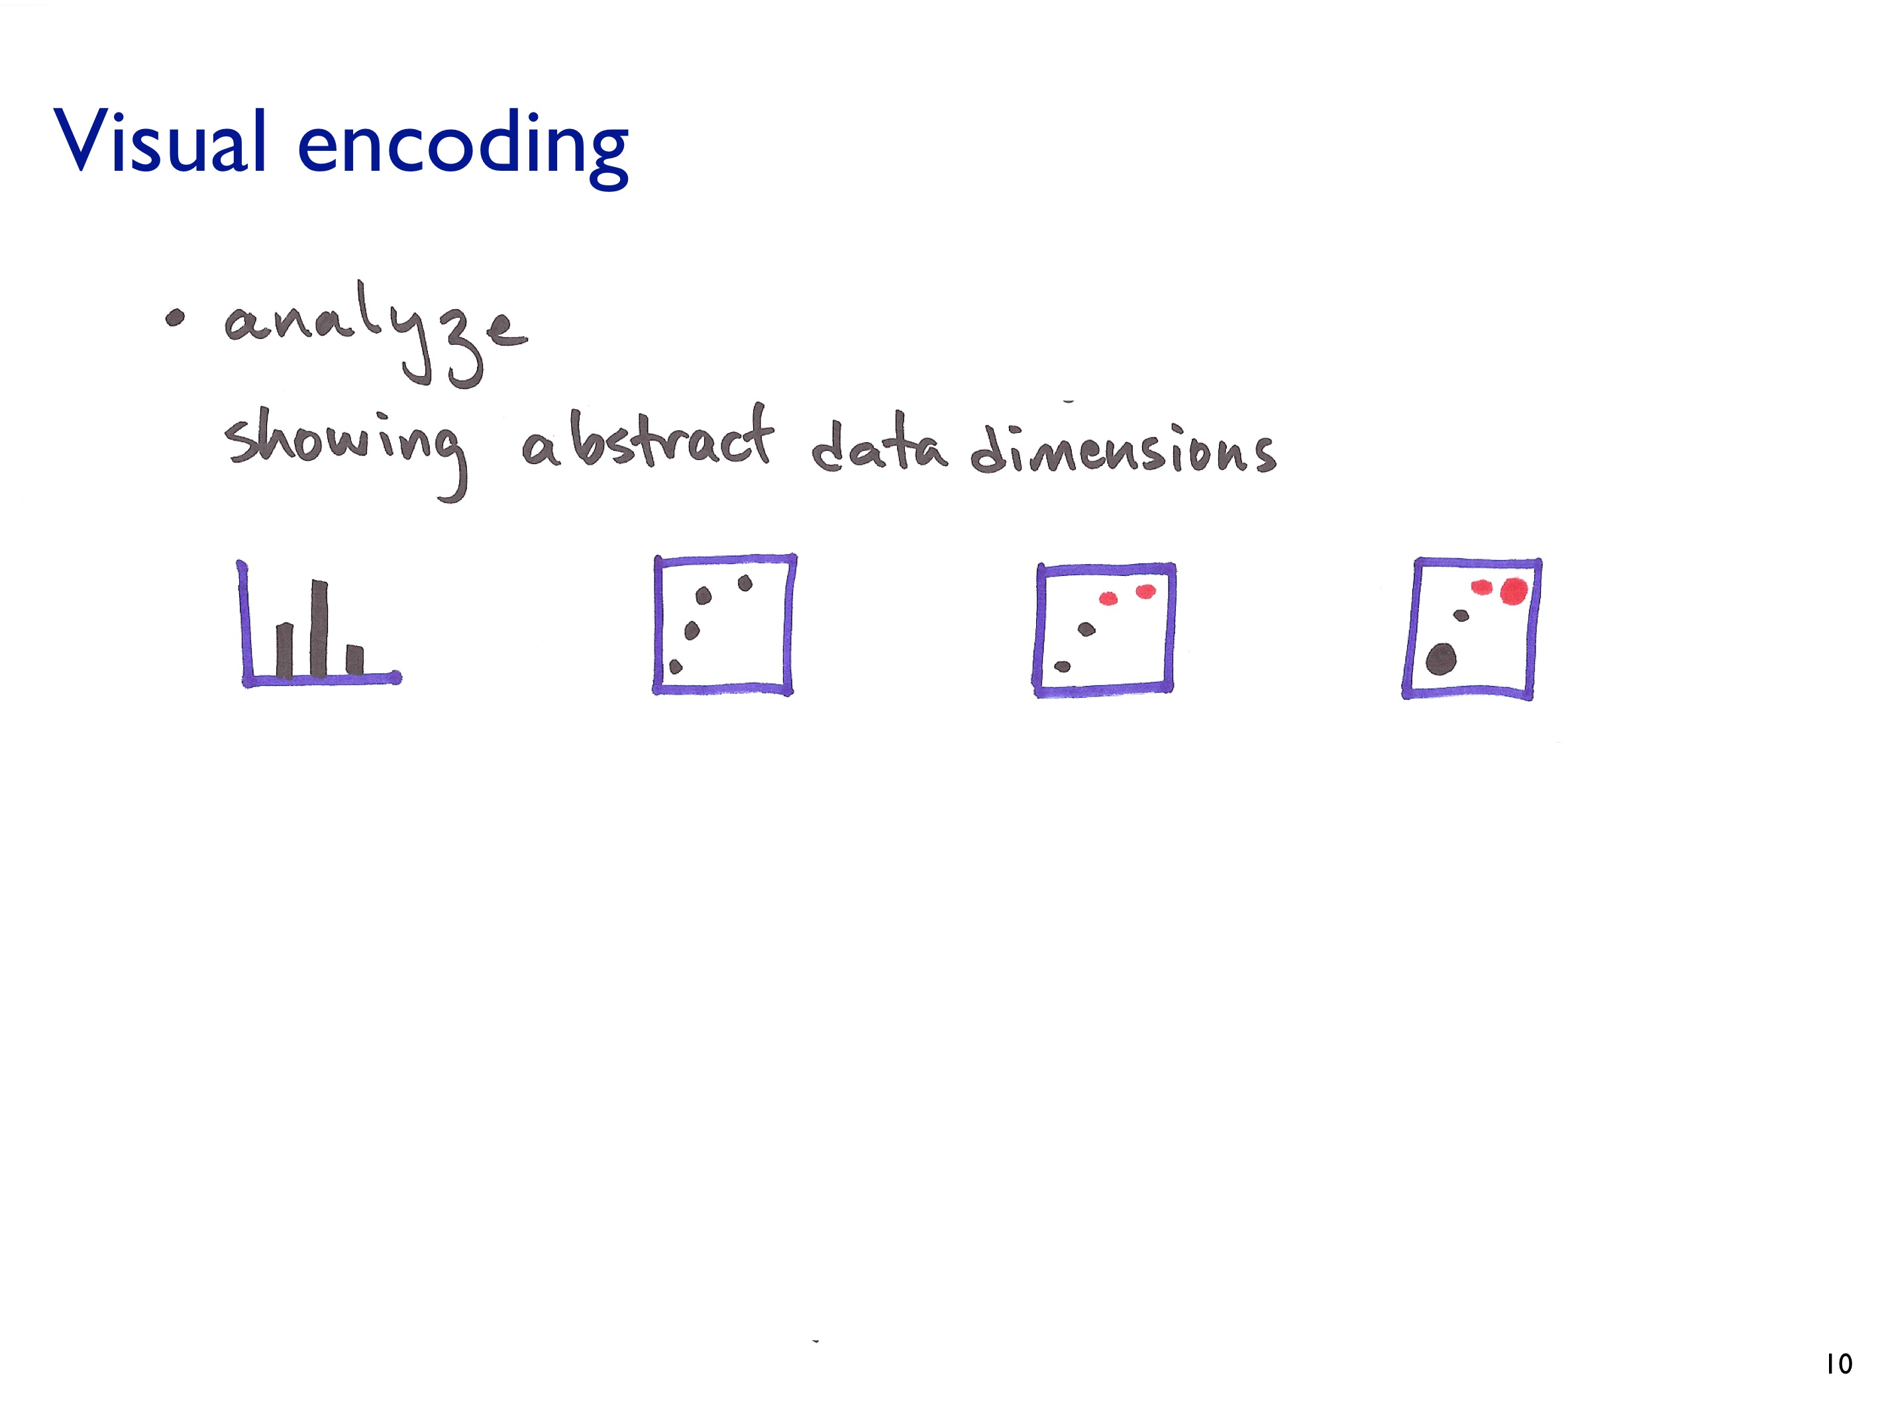

Slide 14
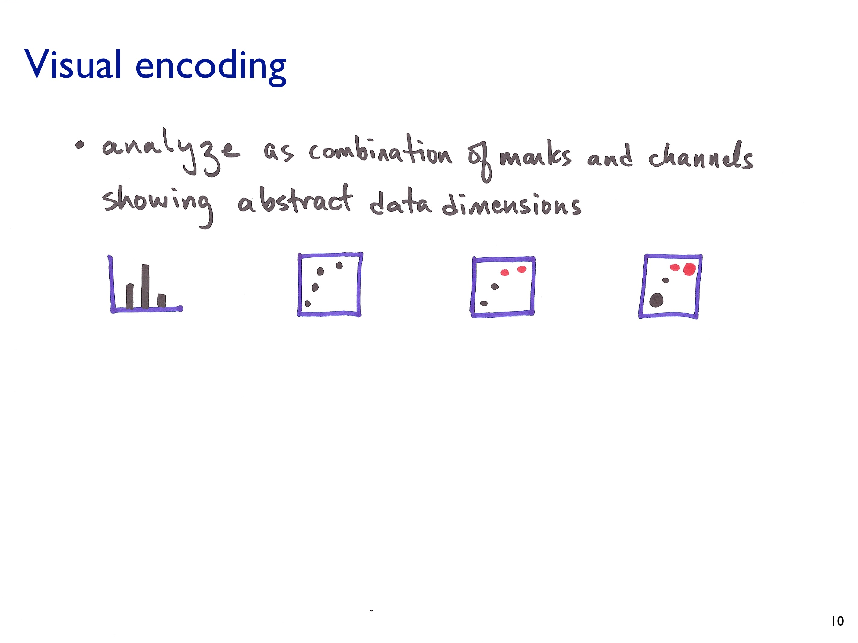

Slide 15
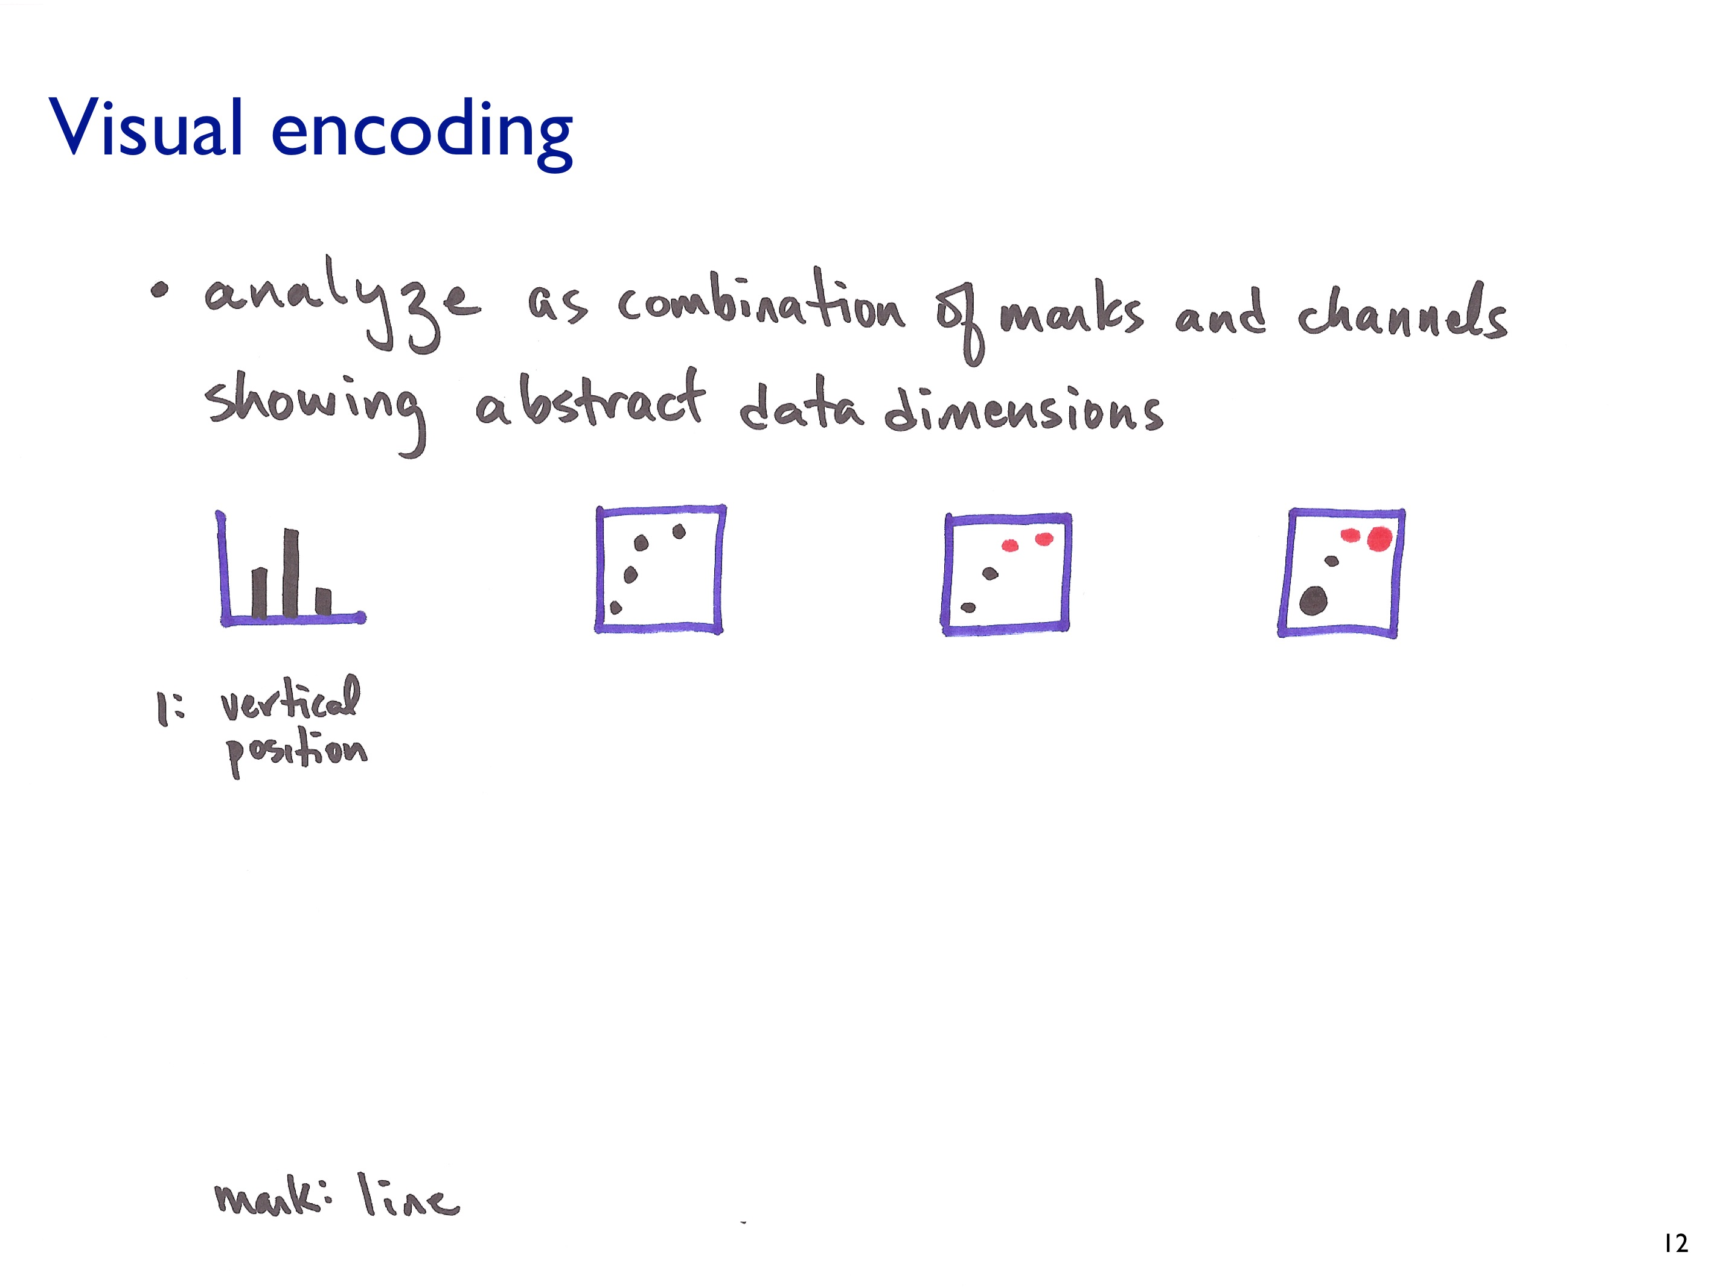

Slide 16
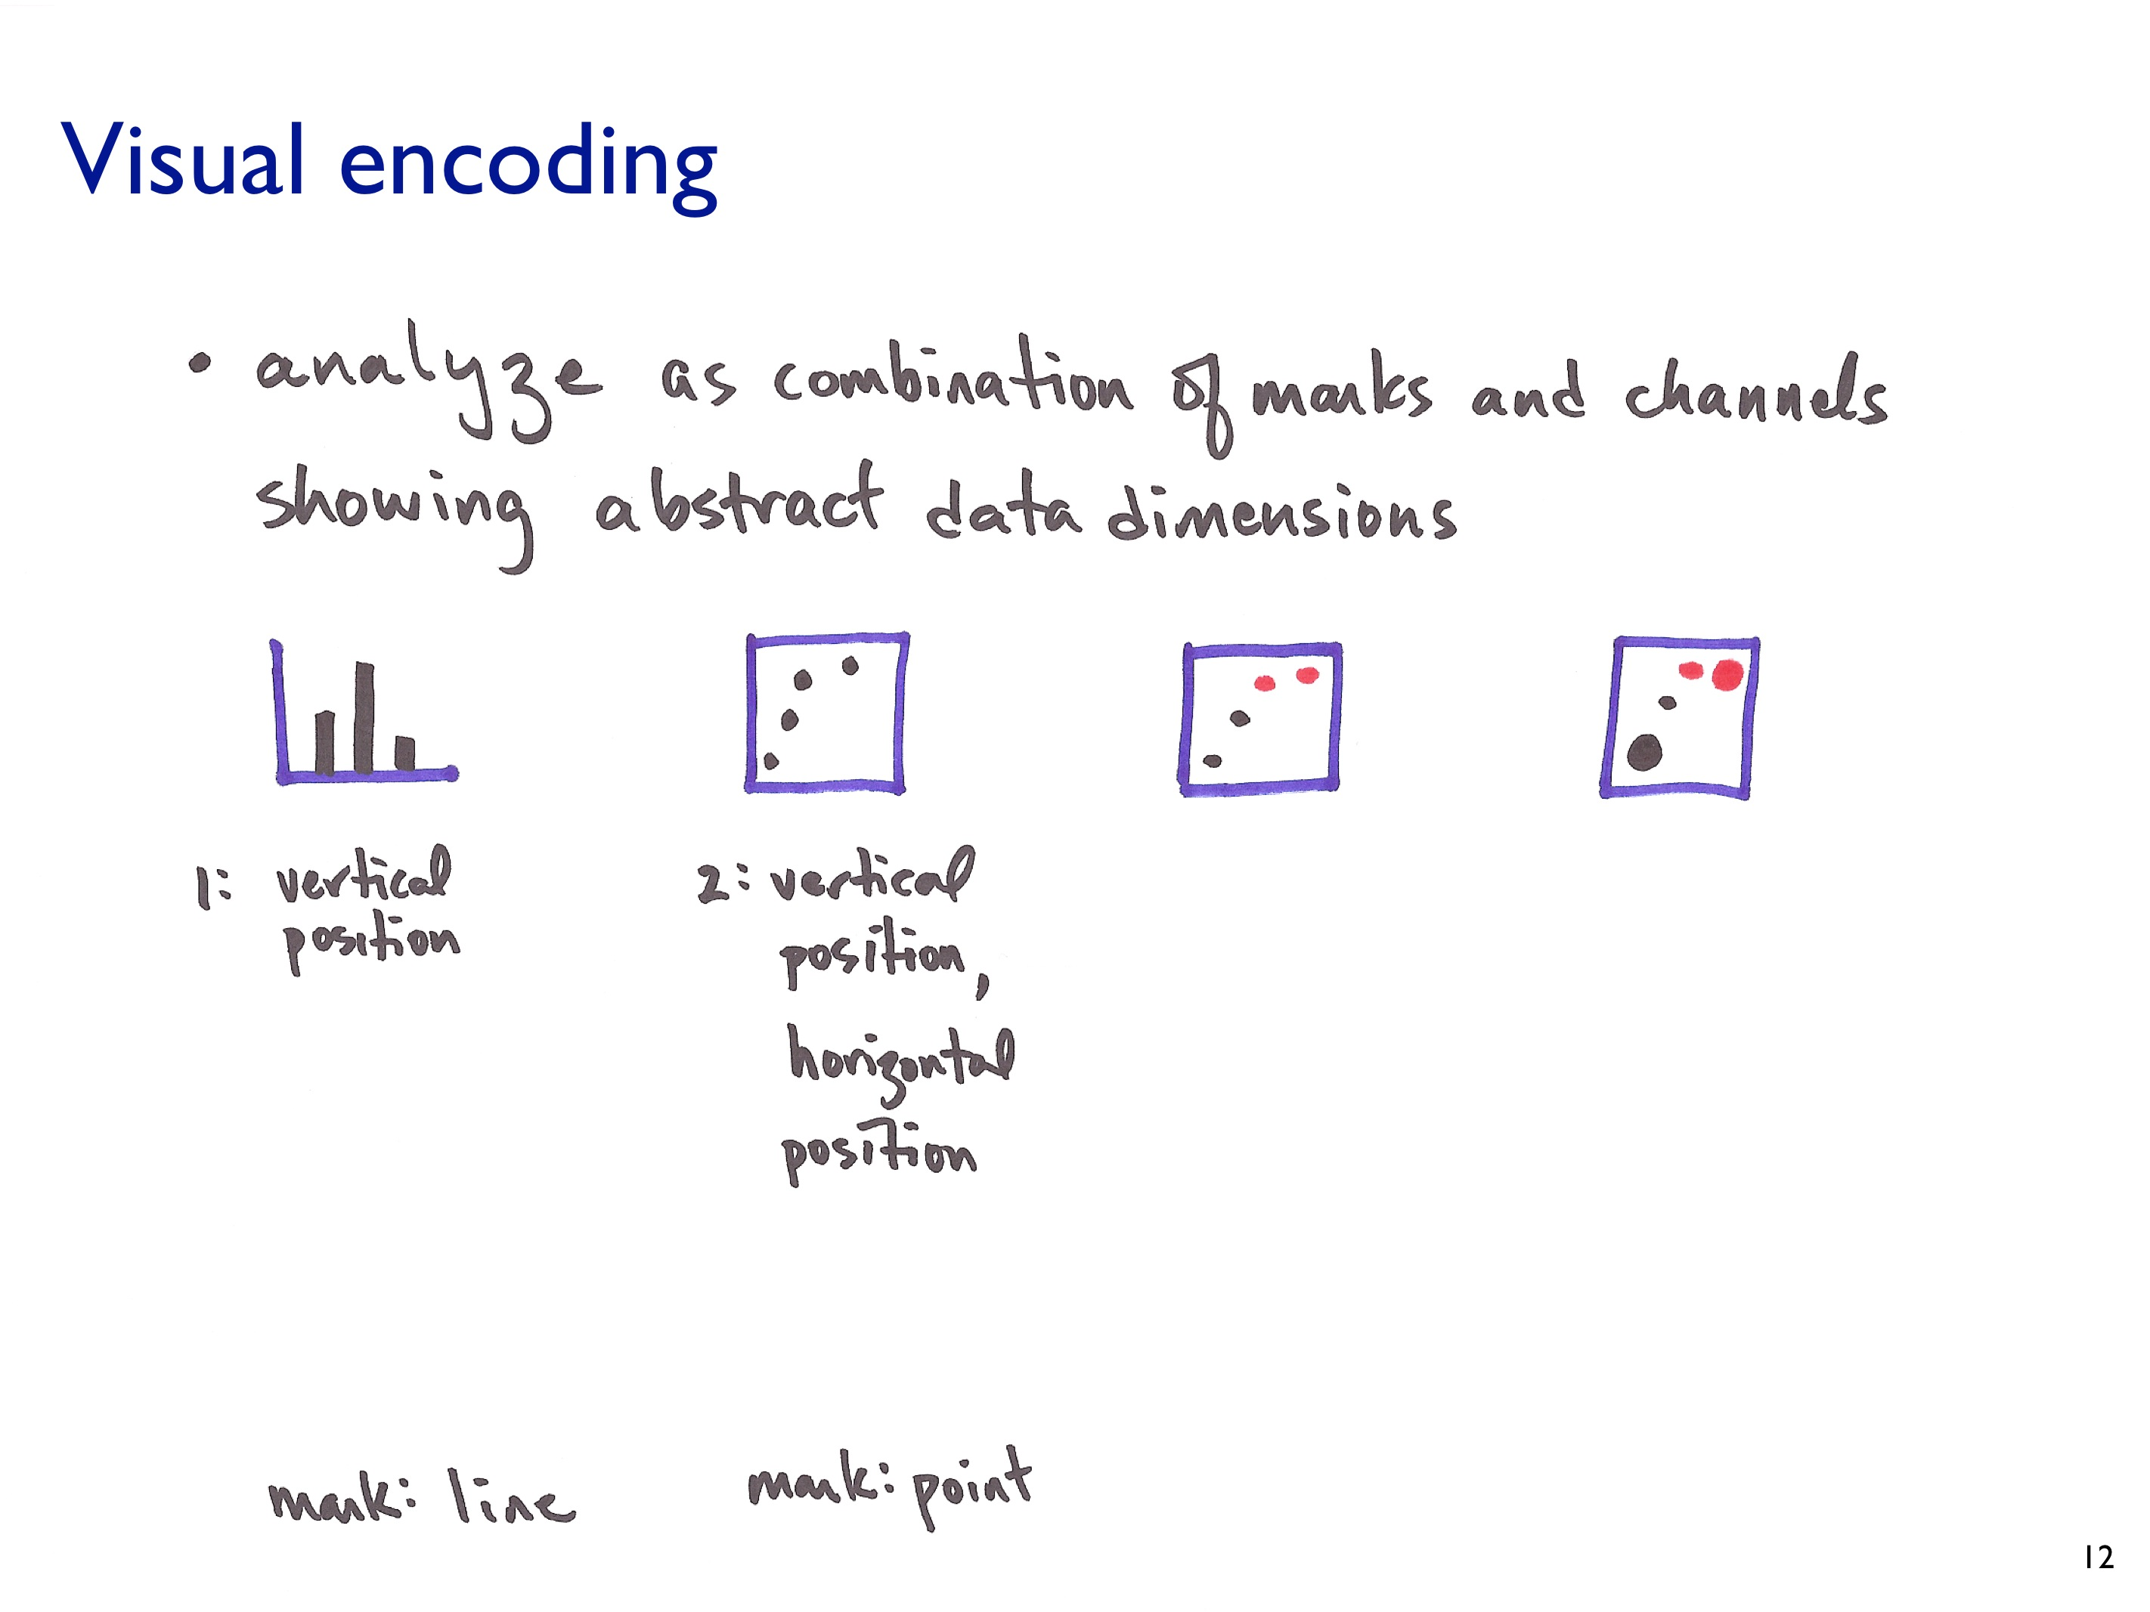

Slide 17
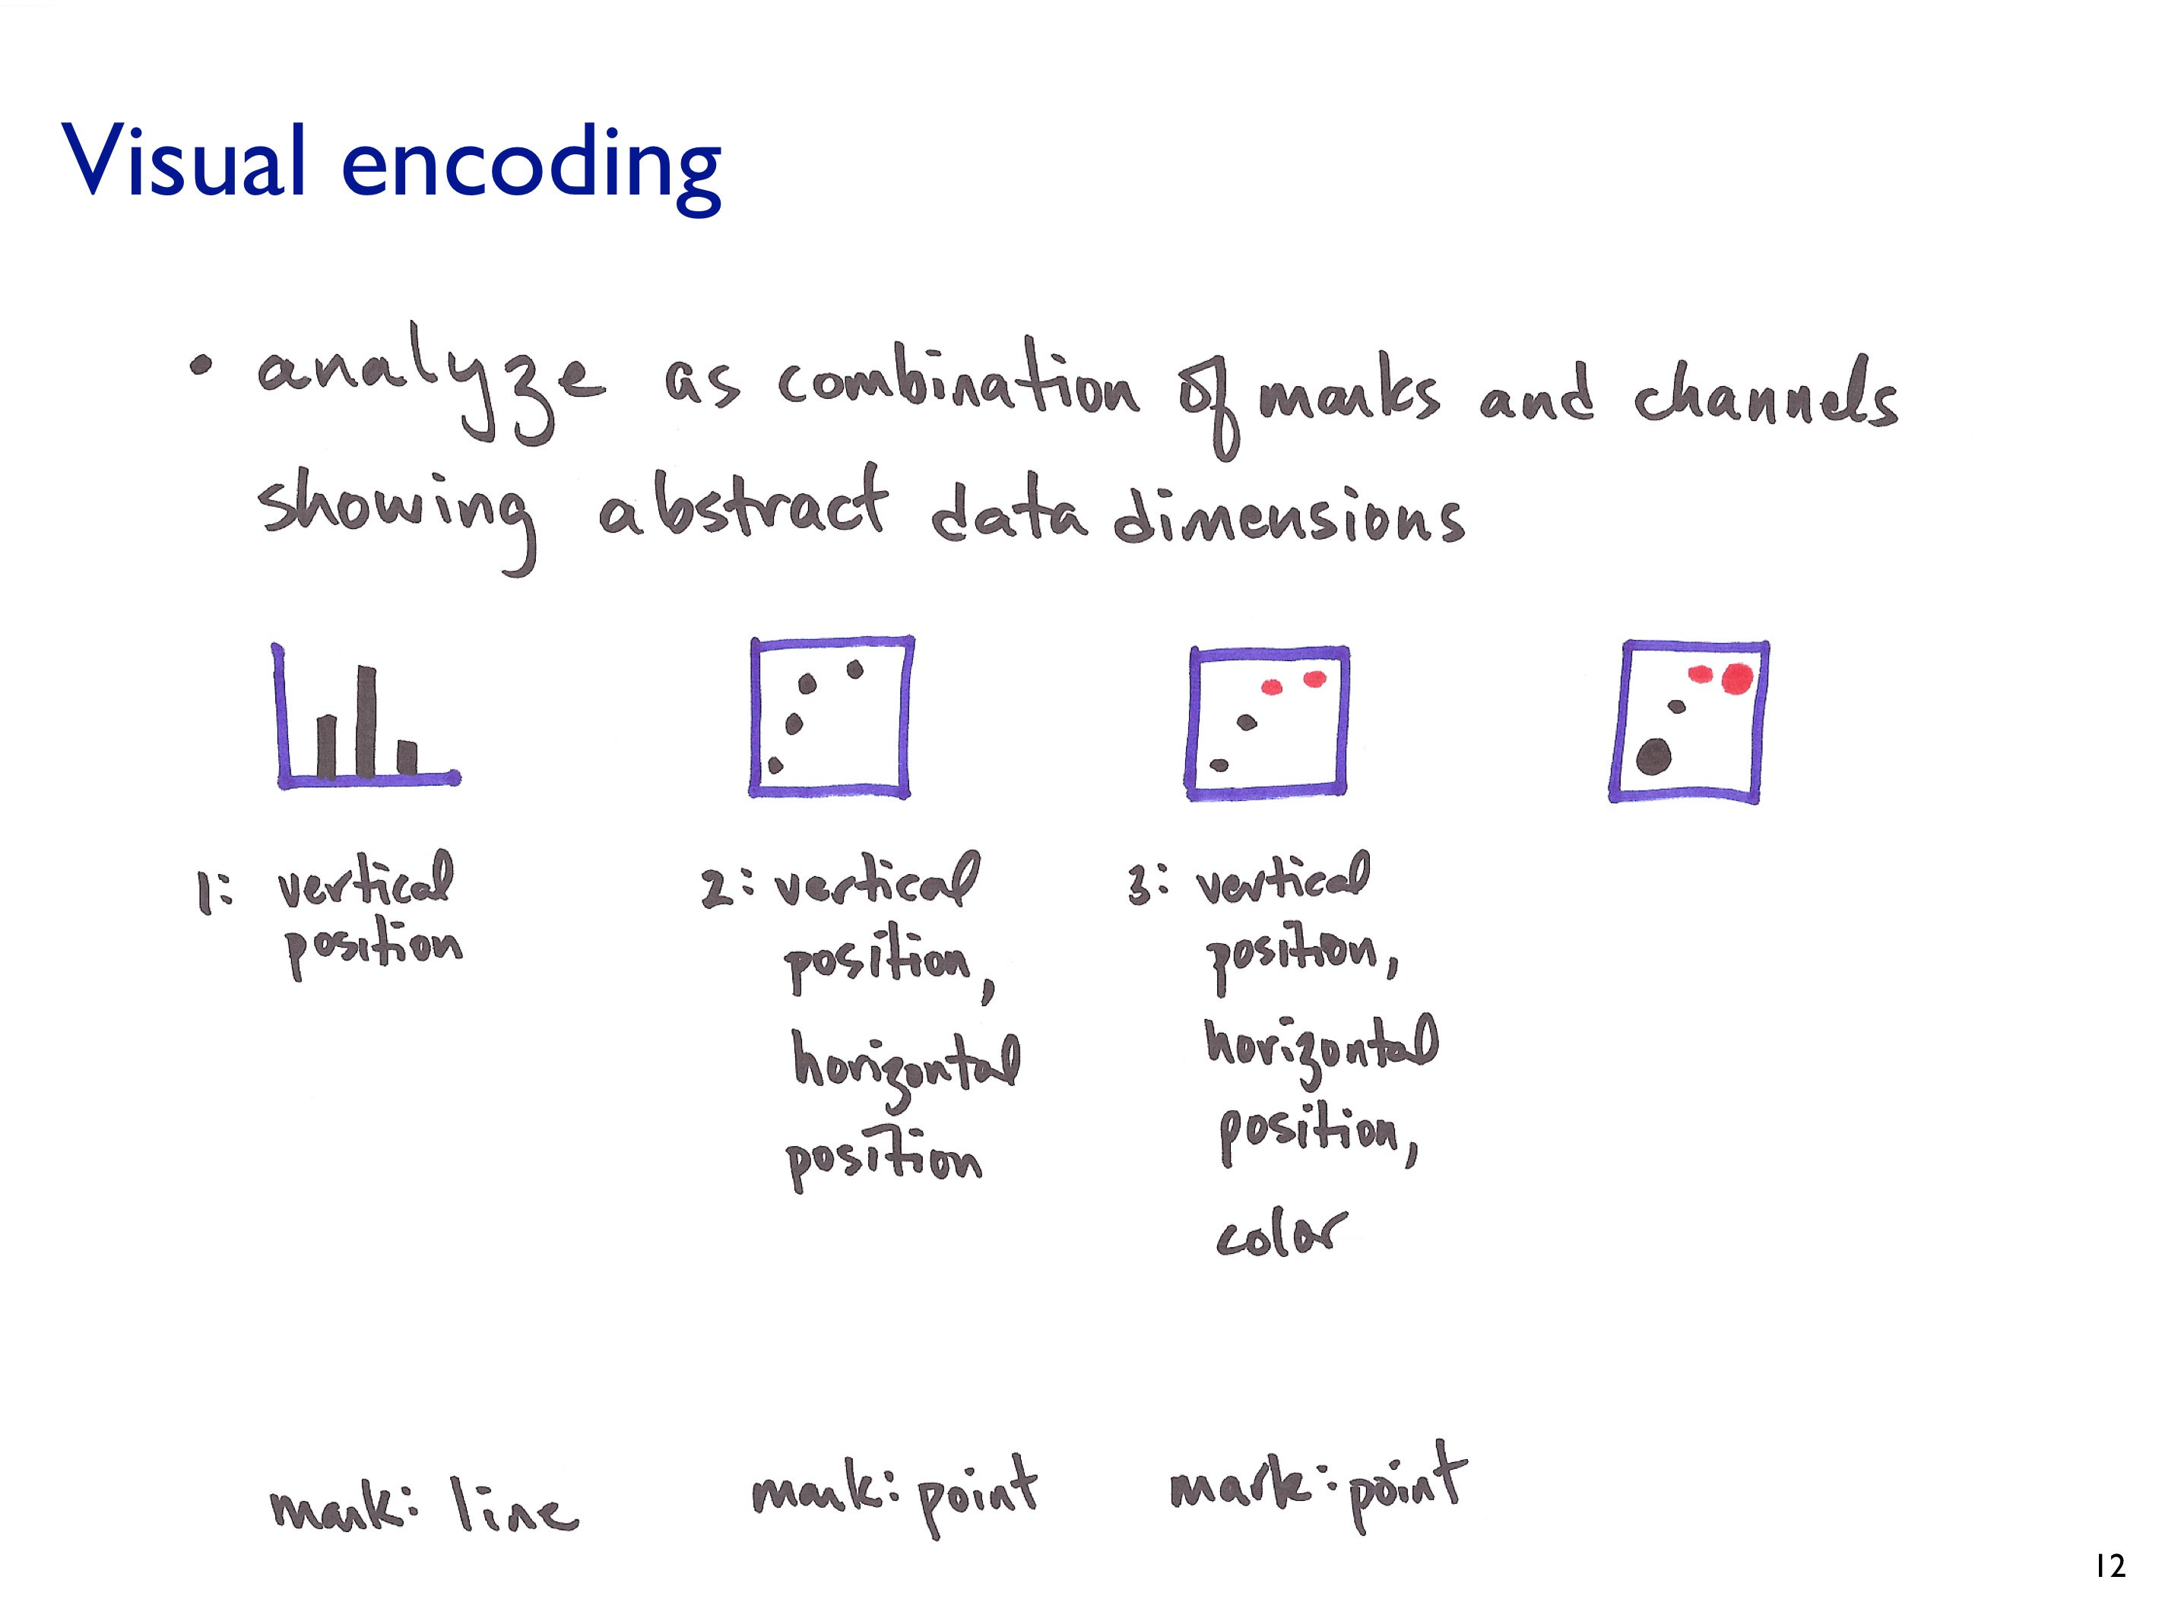

Slide 18
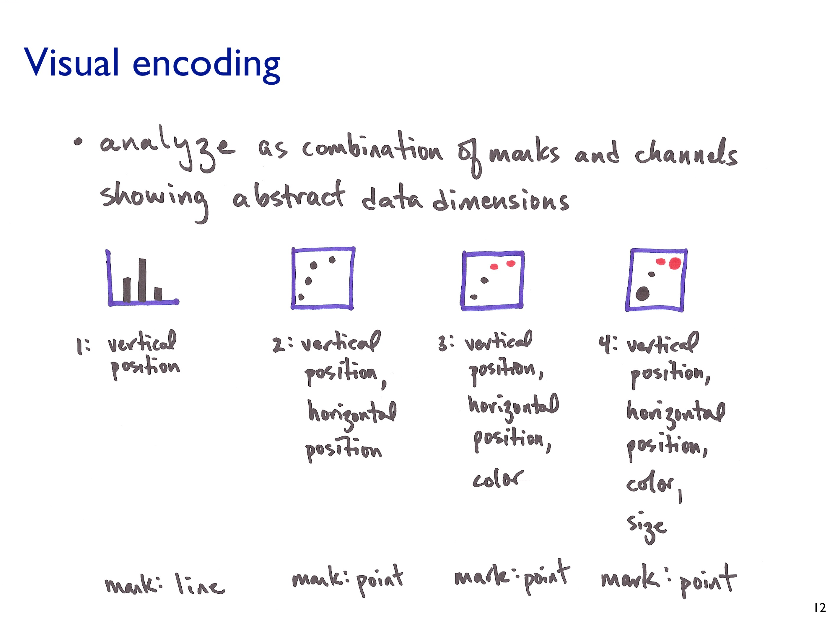

Slide 19
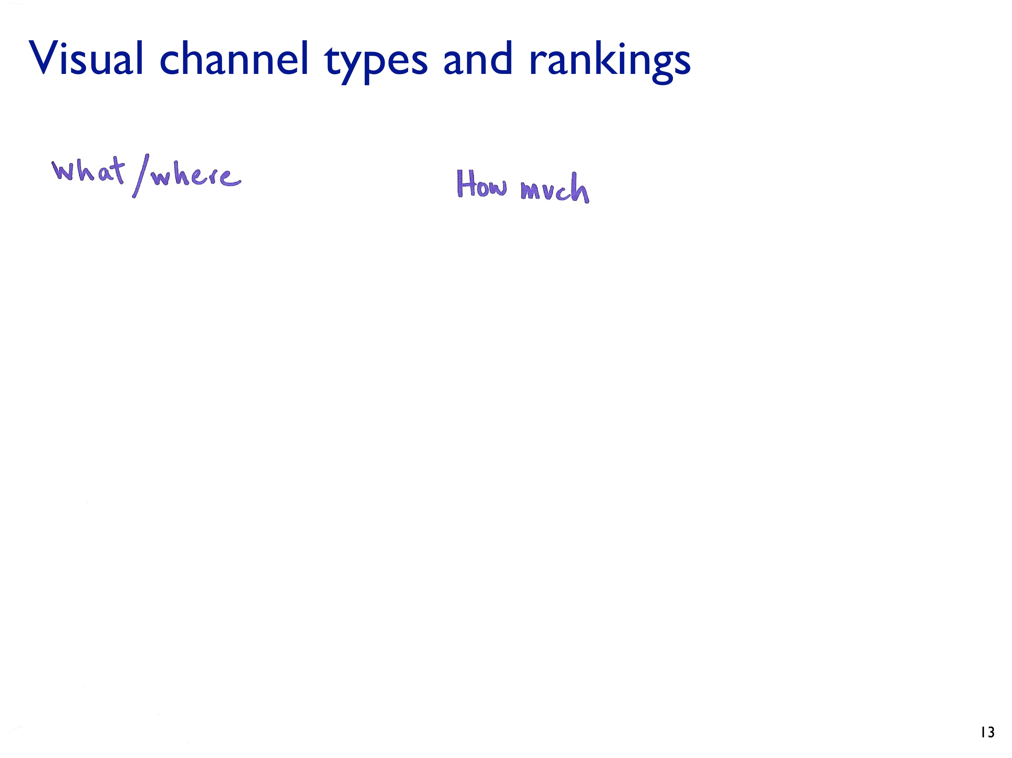

Slide 20
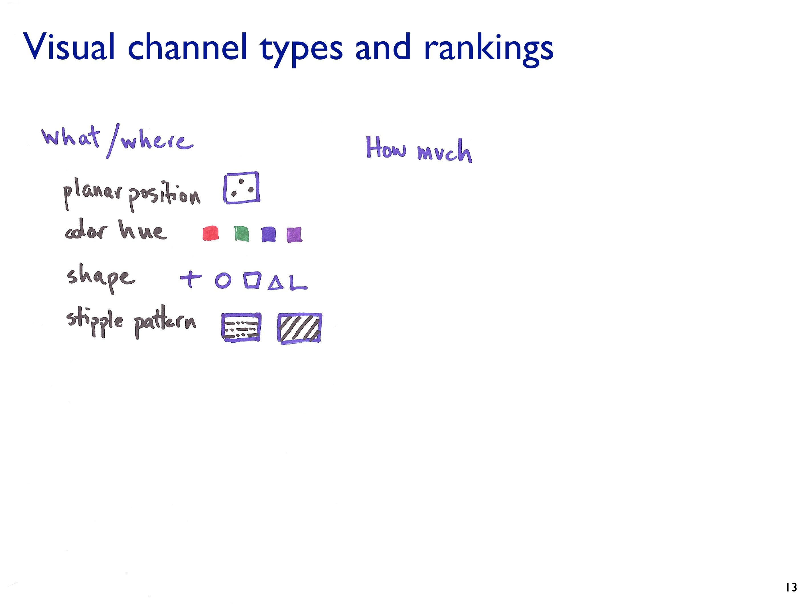

Slide 21
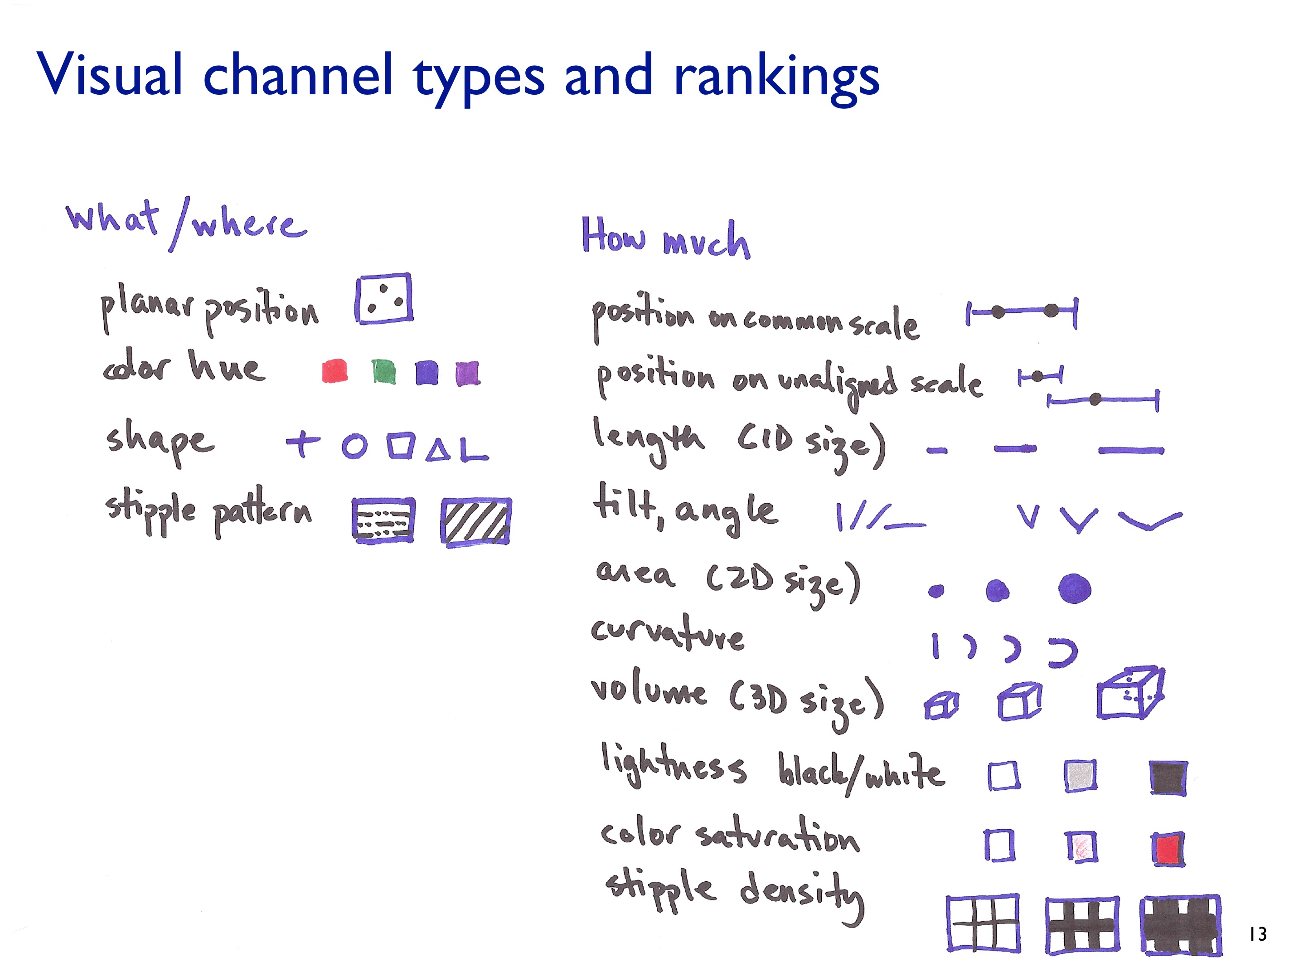

Slide 22
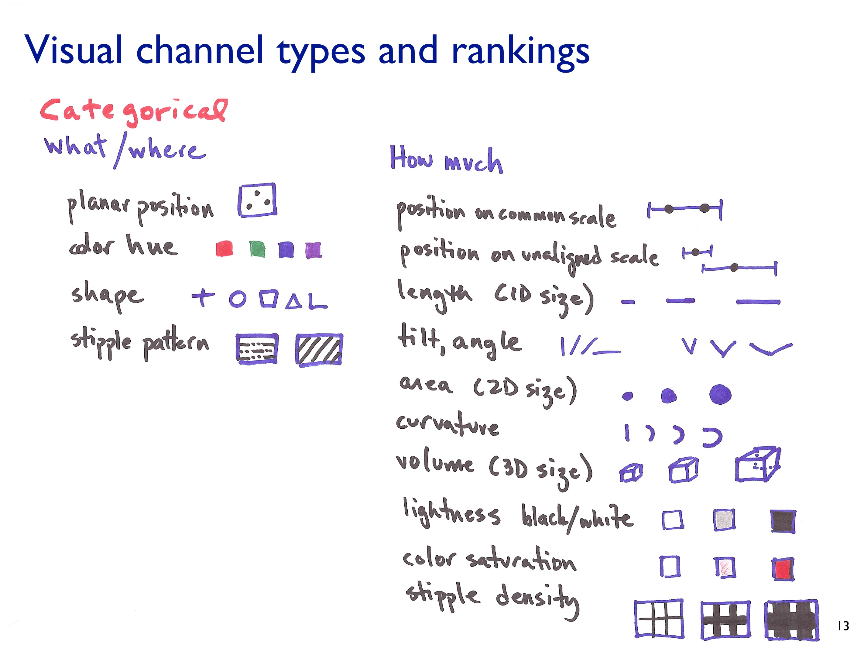

Slide 23
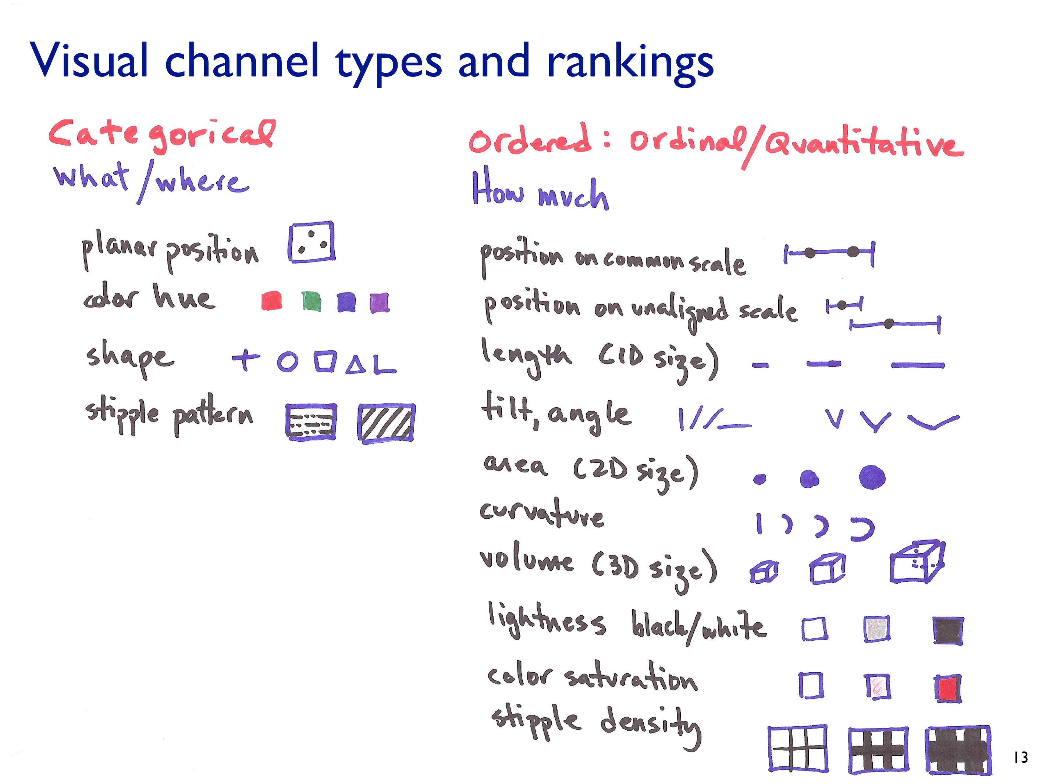

Slide 24
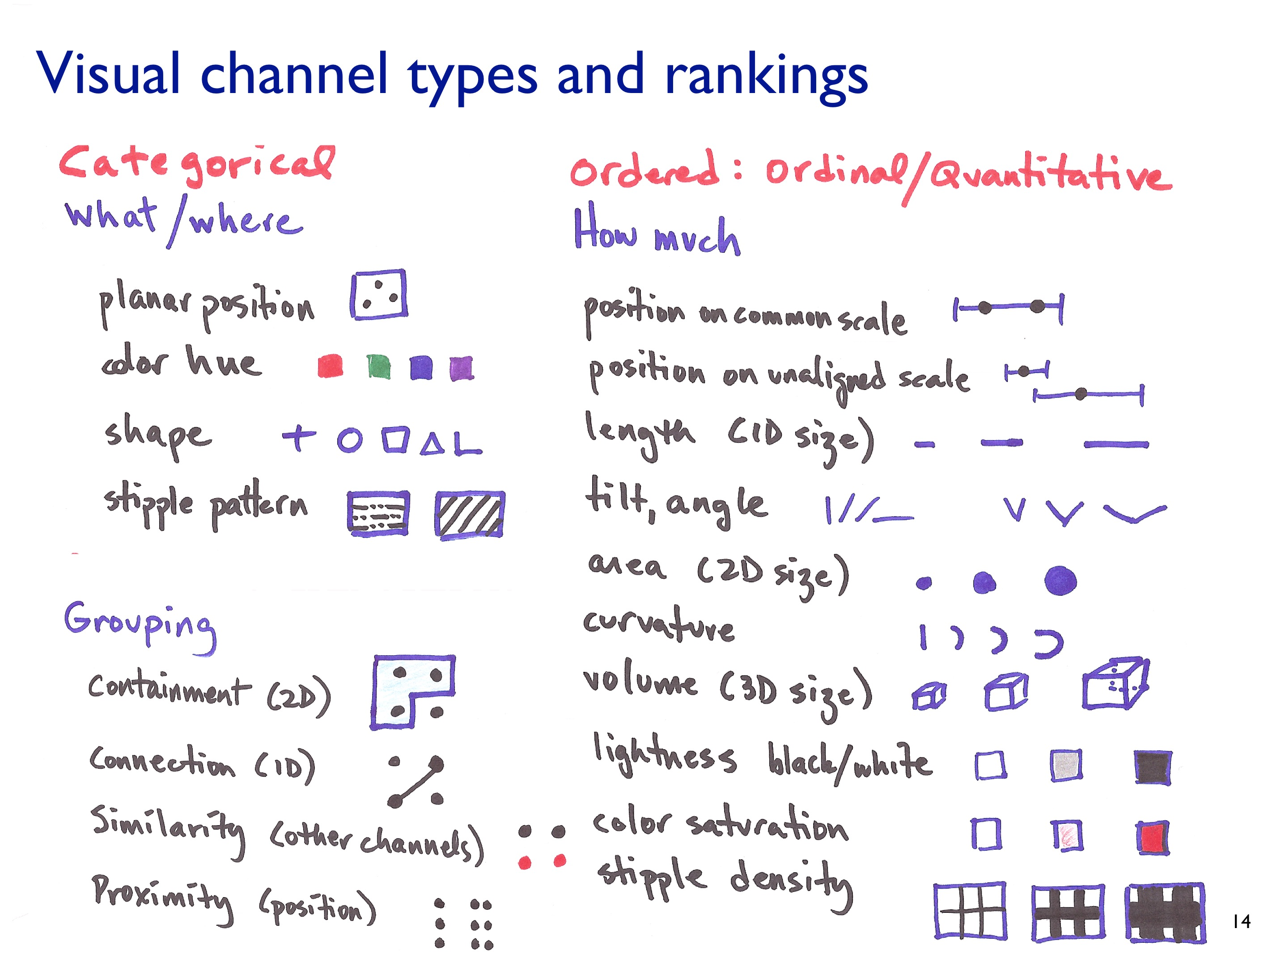

Slide 25
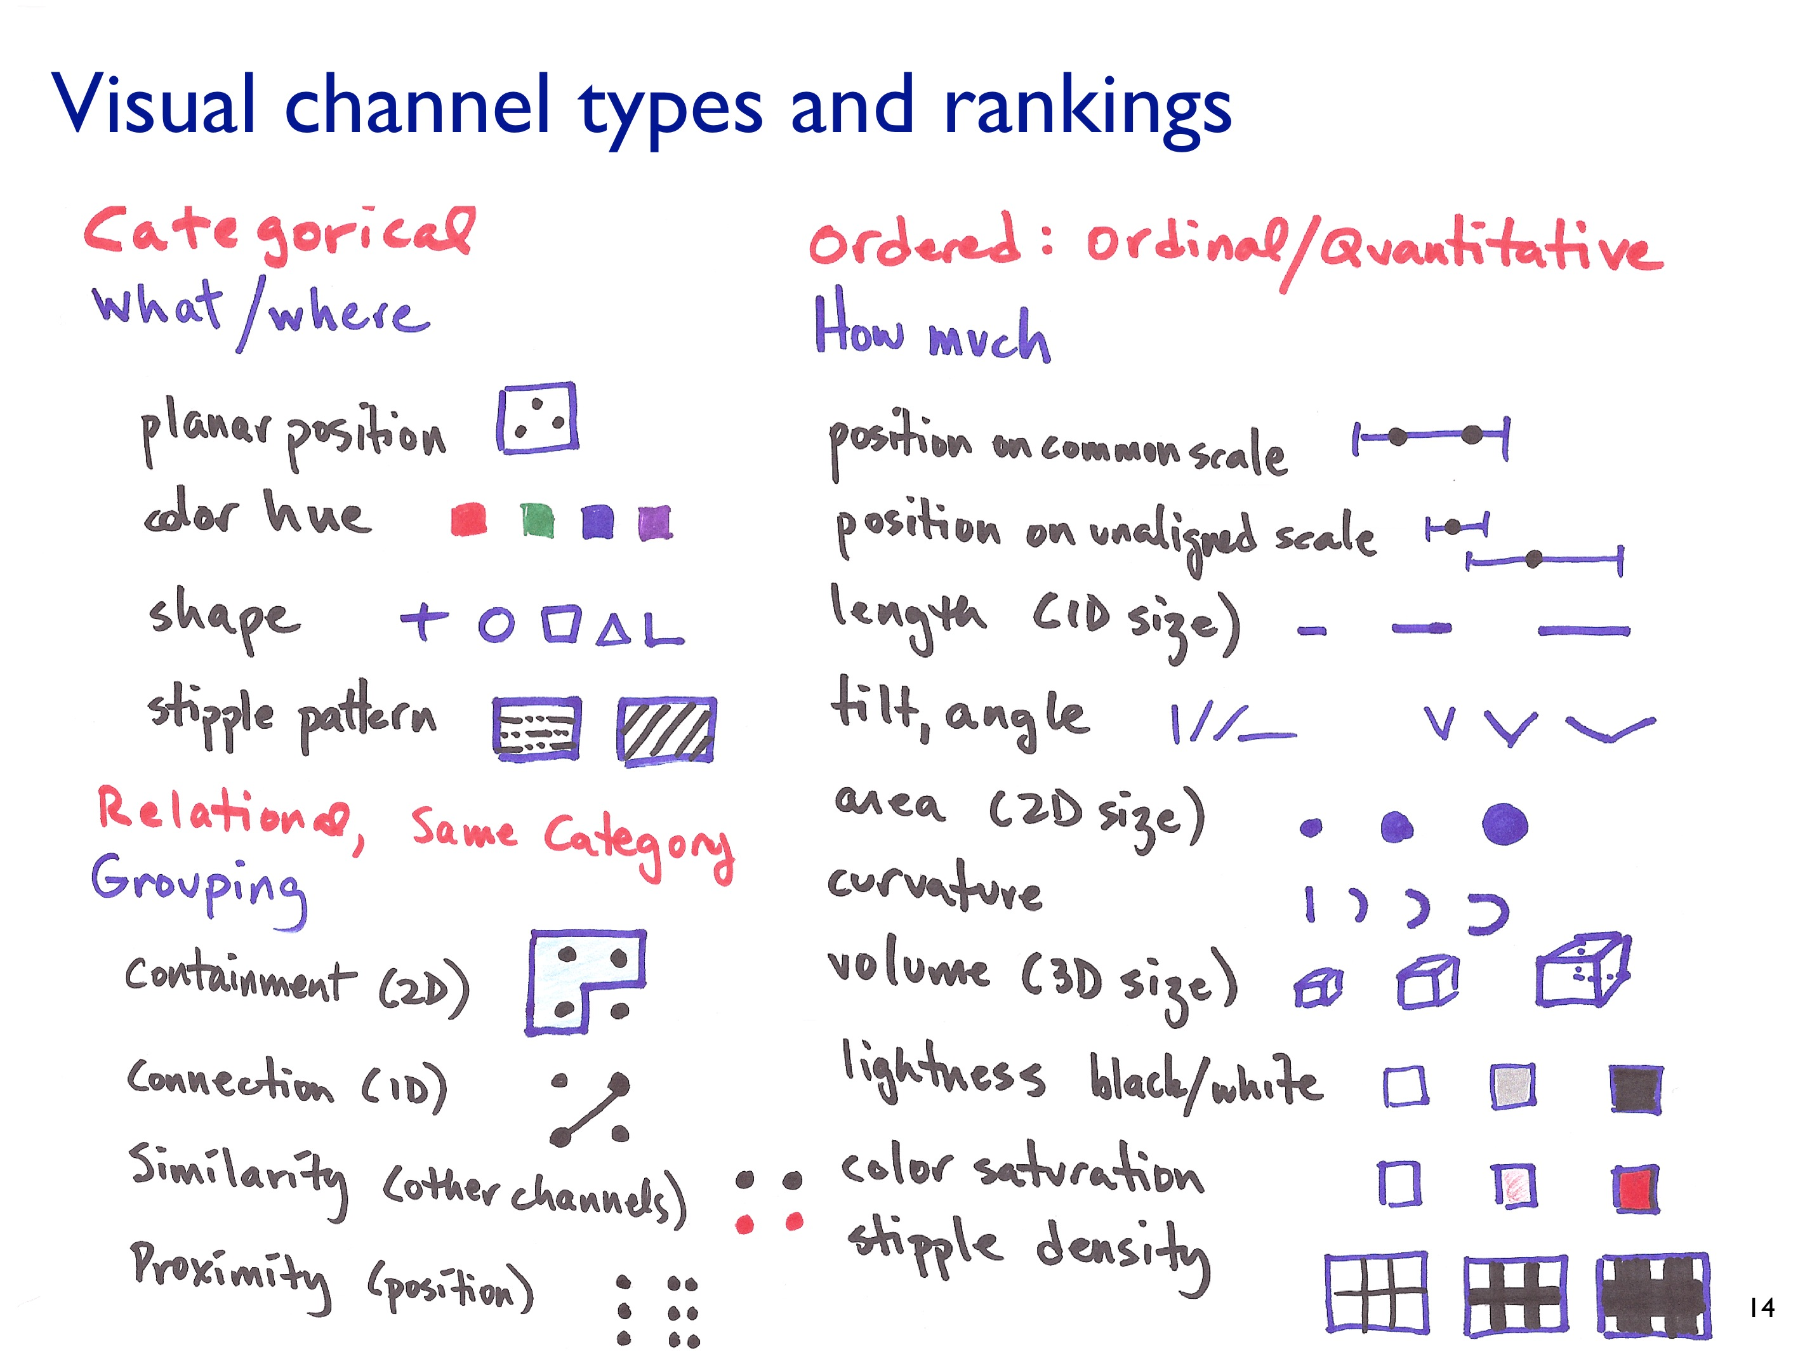

Slide 26
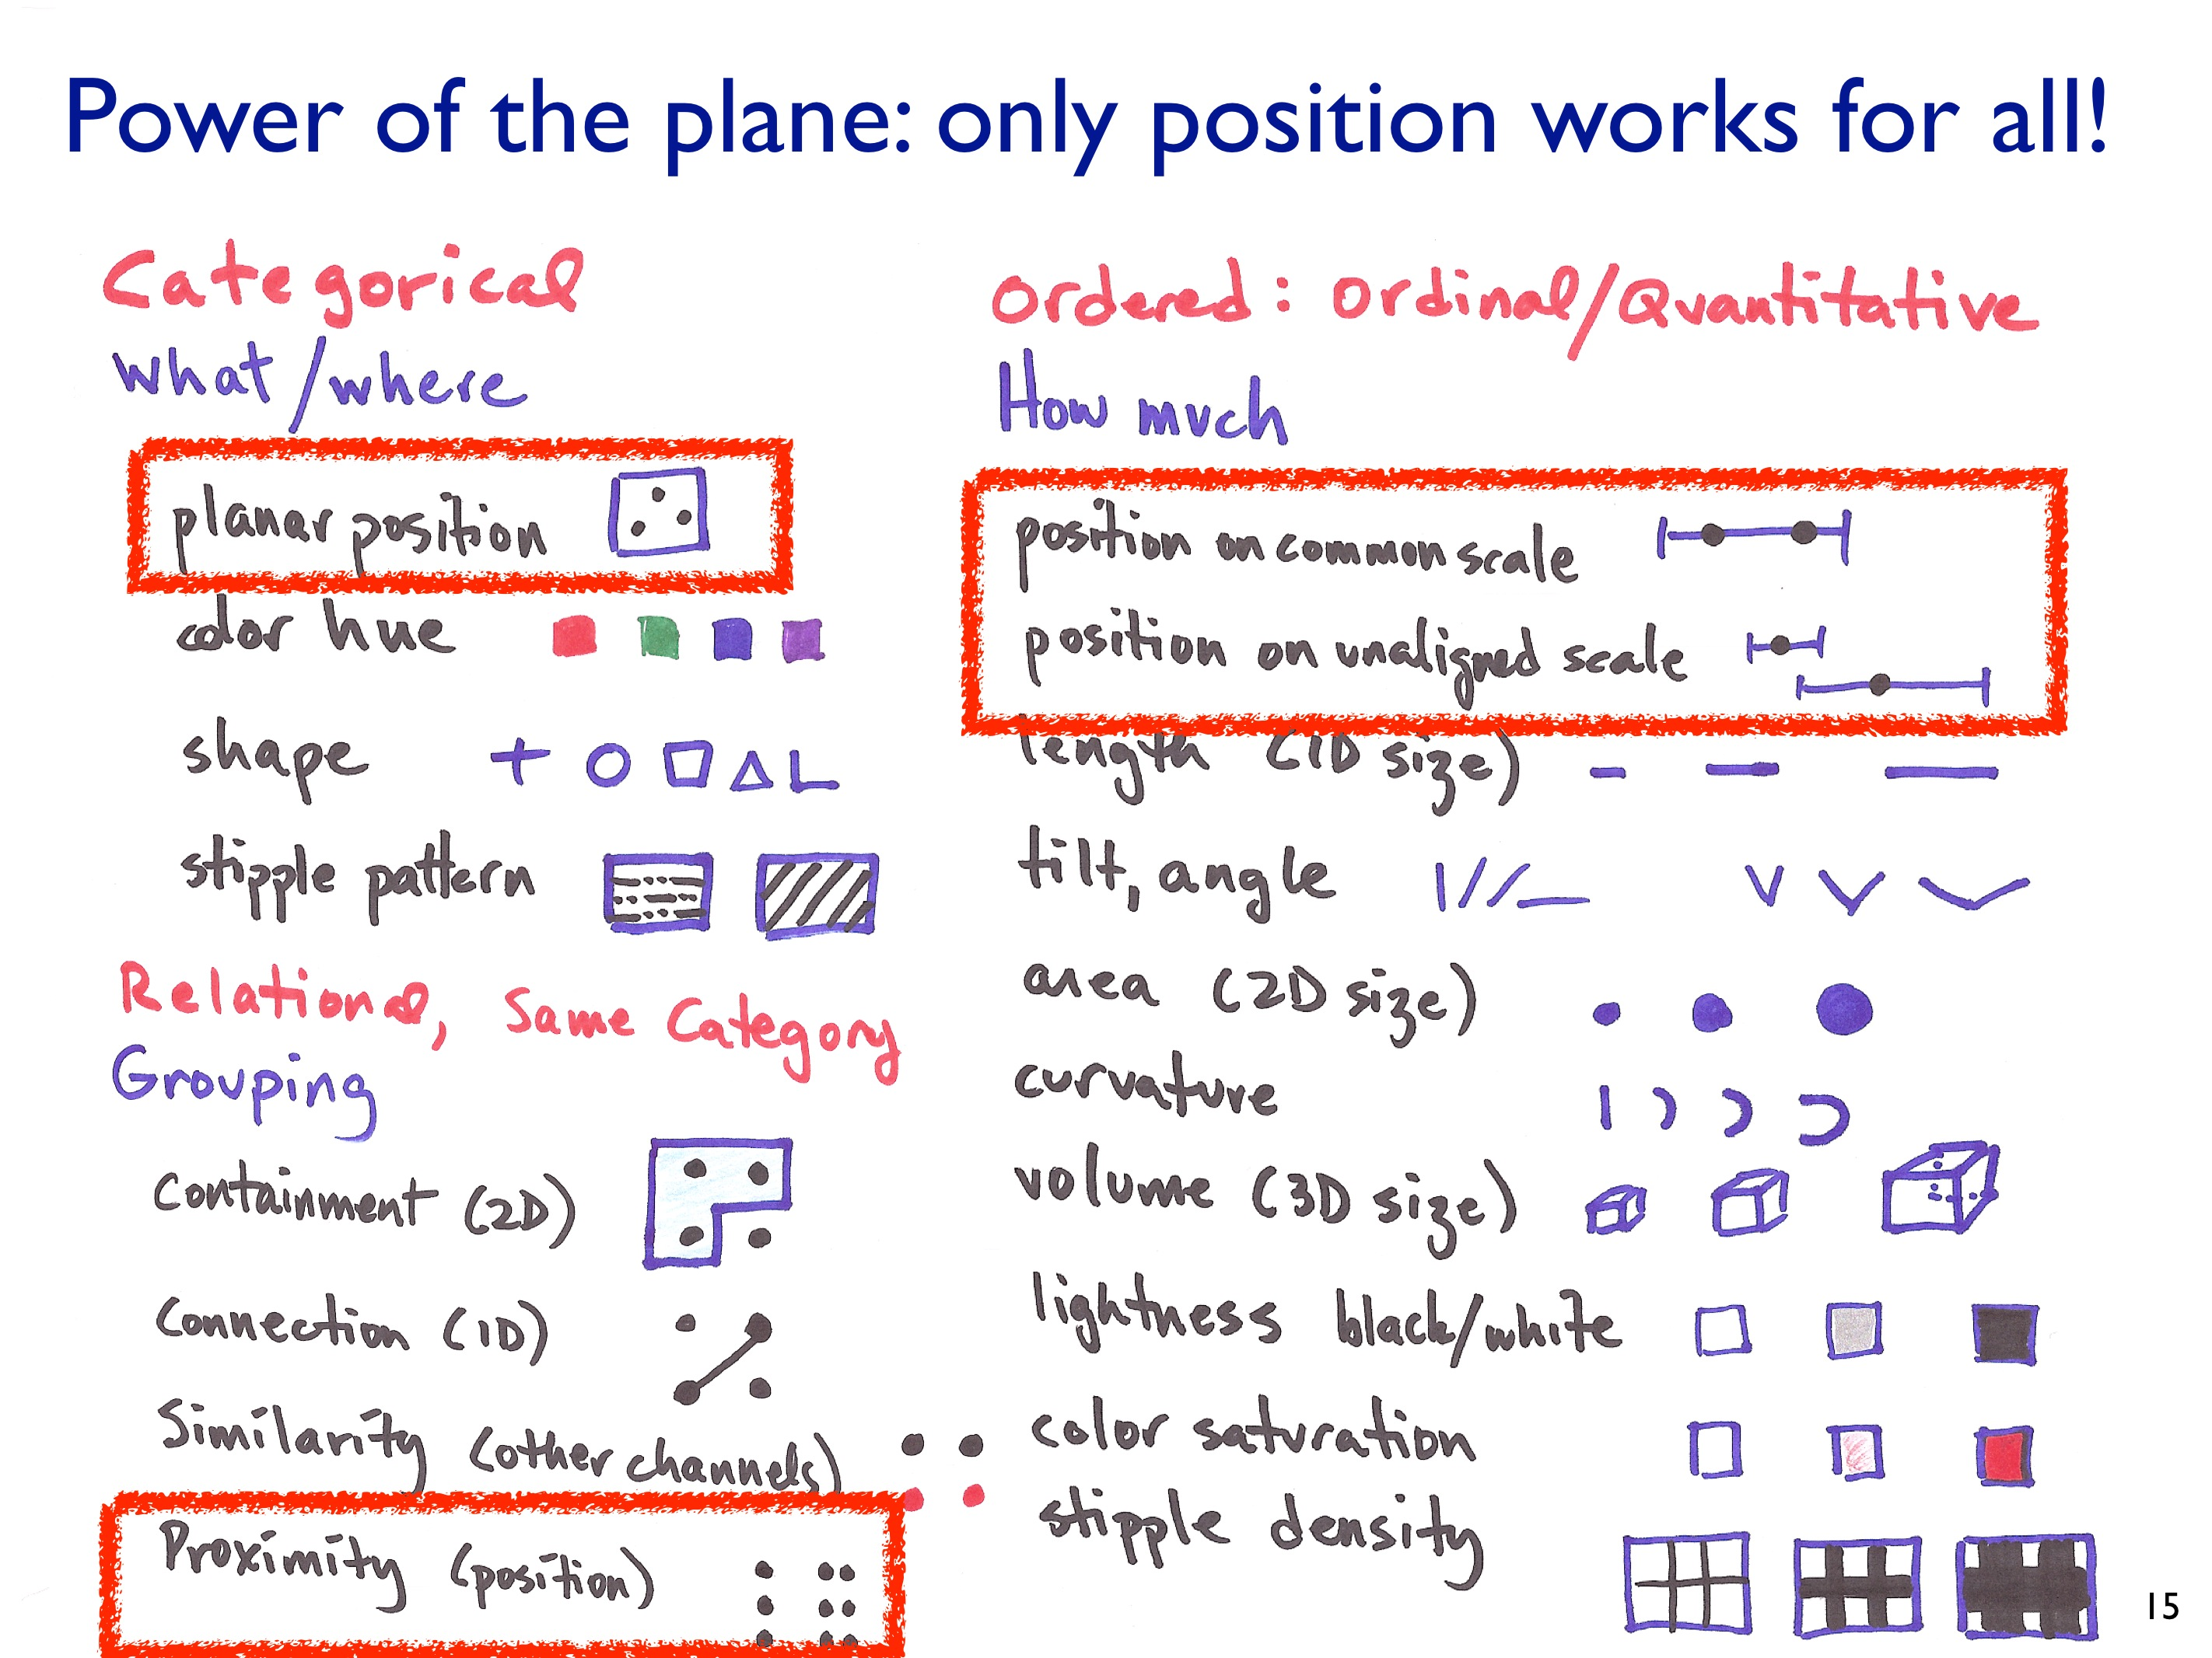

Slide 27
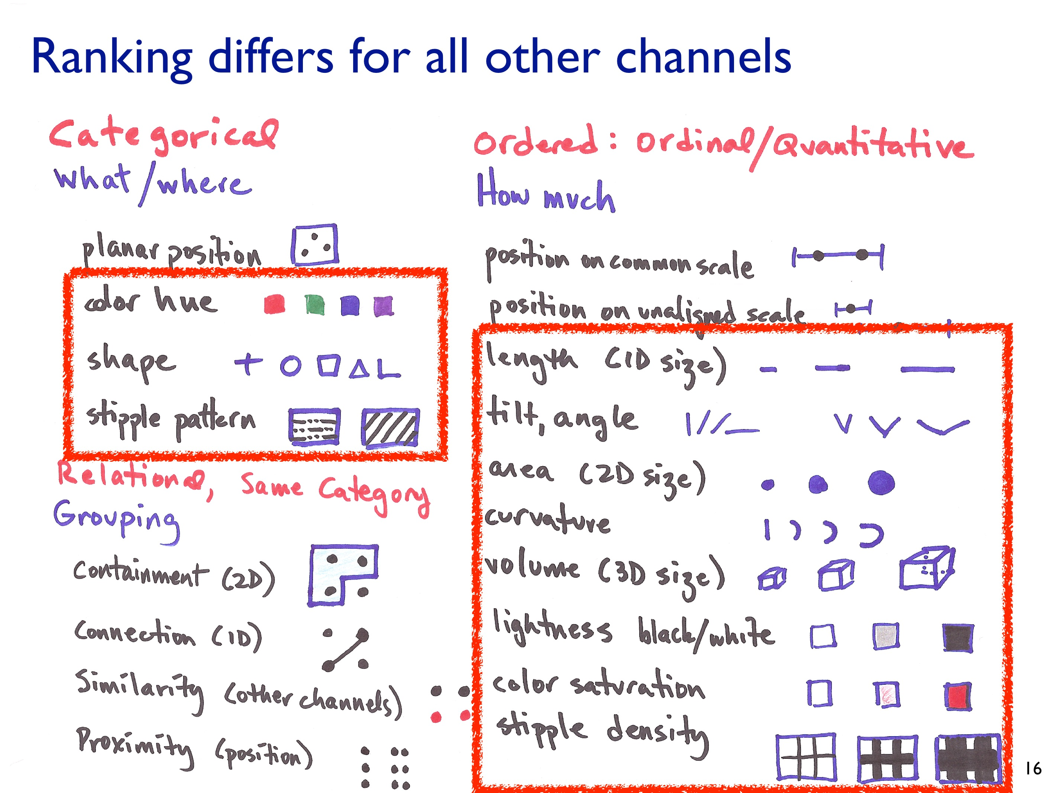

Slide 28
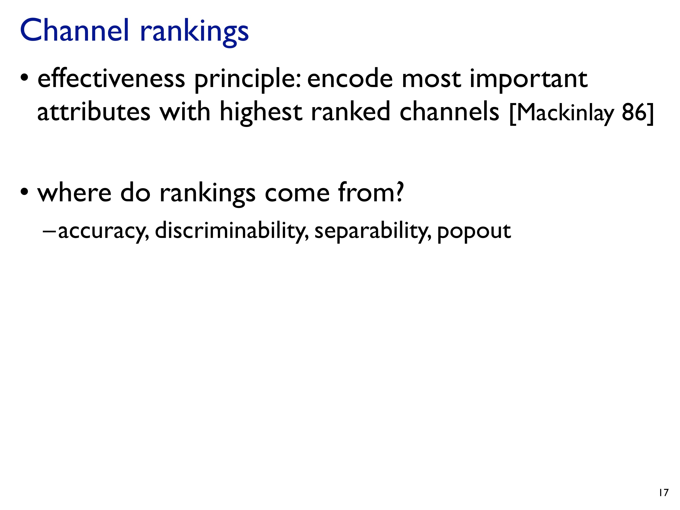

Slide 29
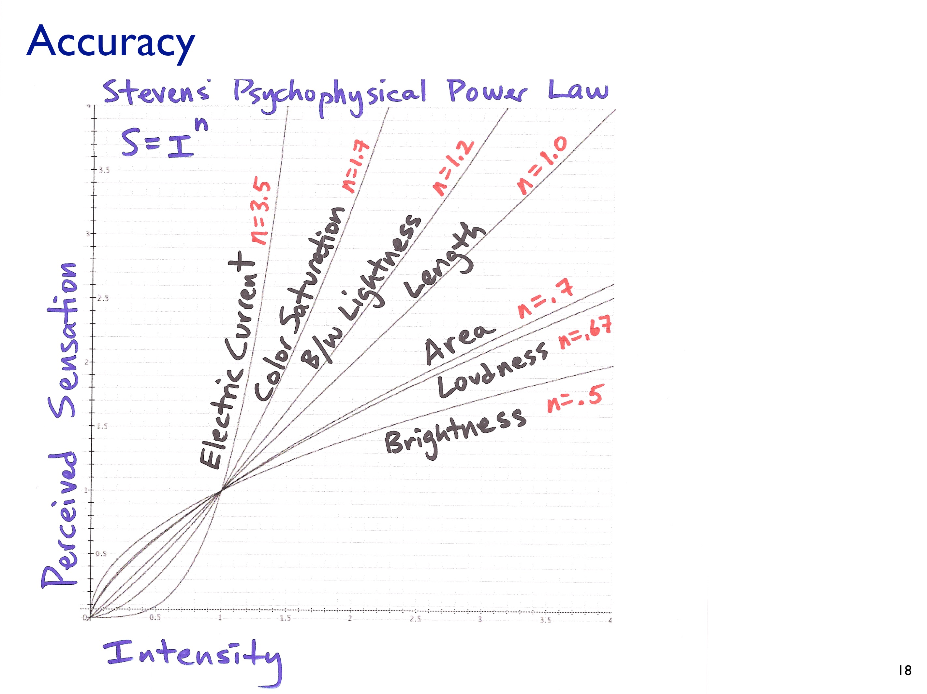

Slide 30
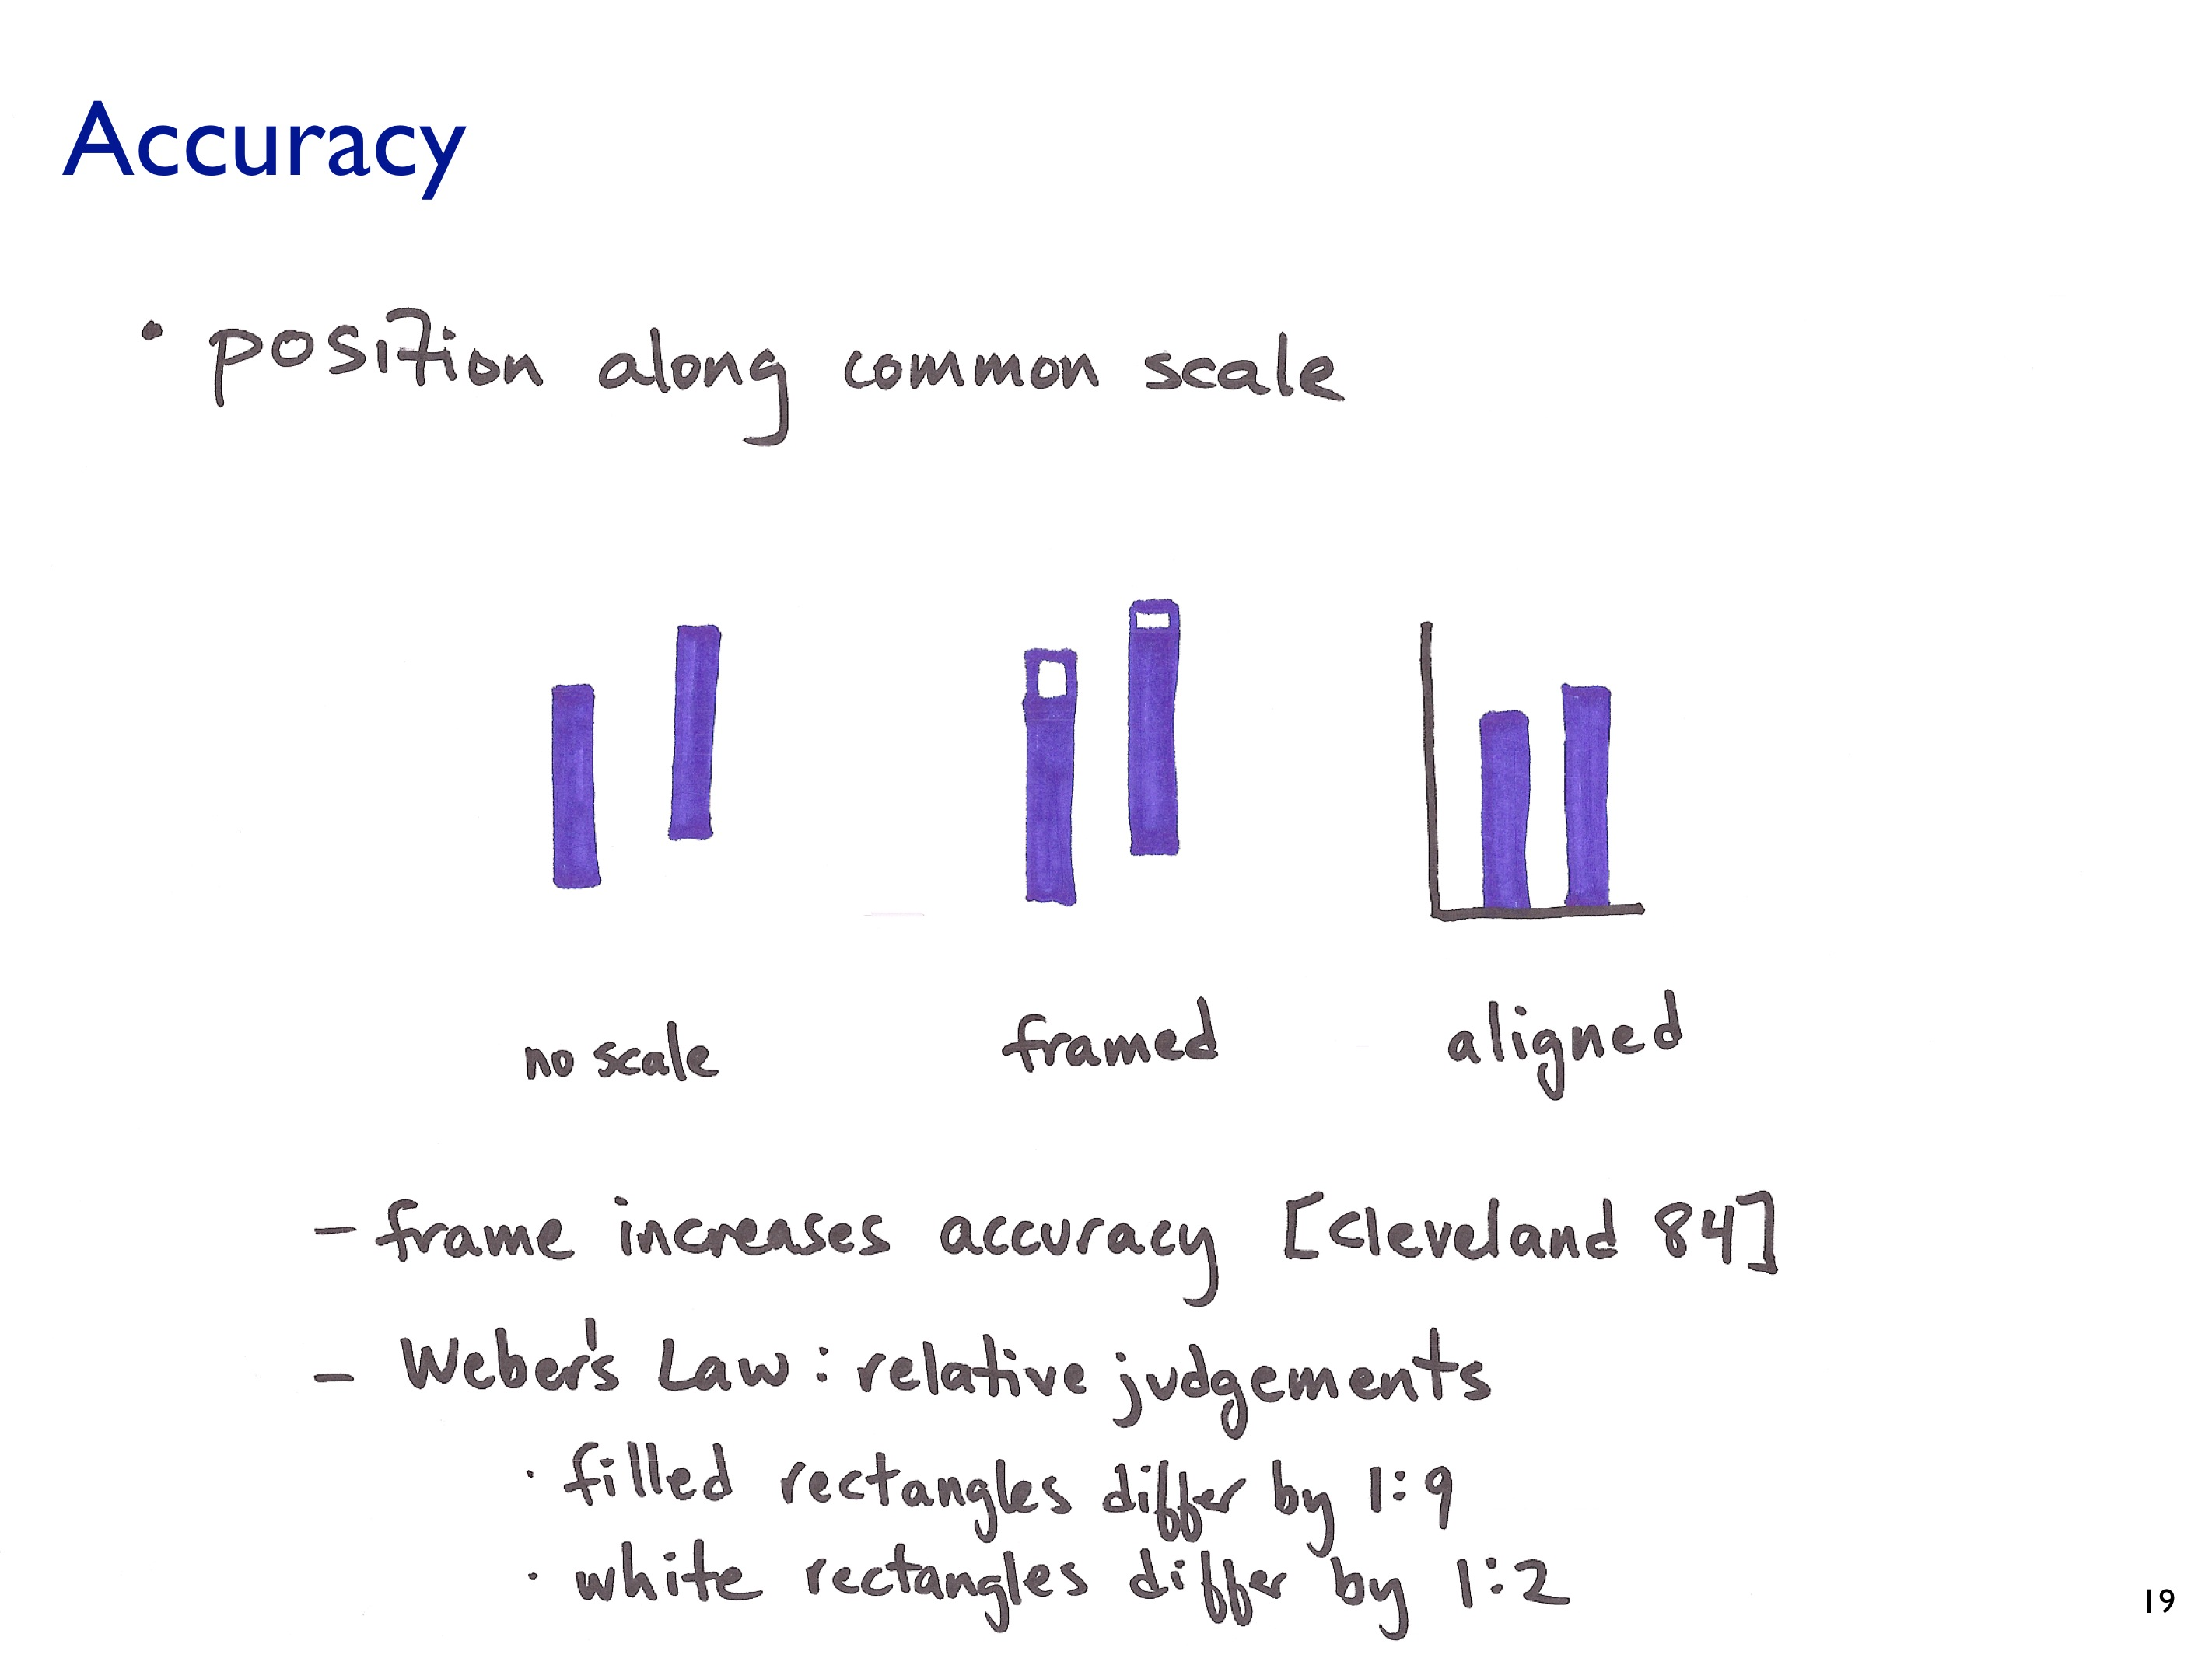

Slide 31
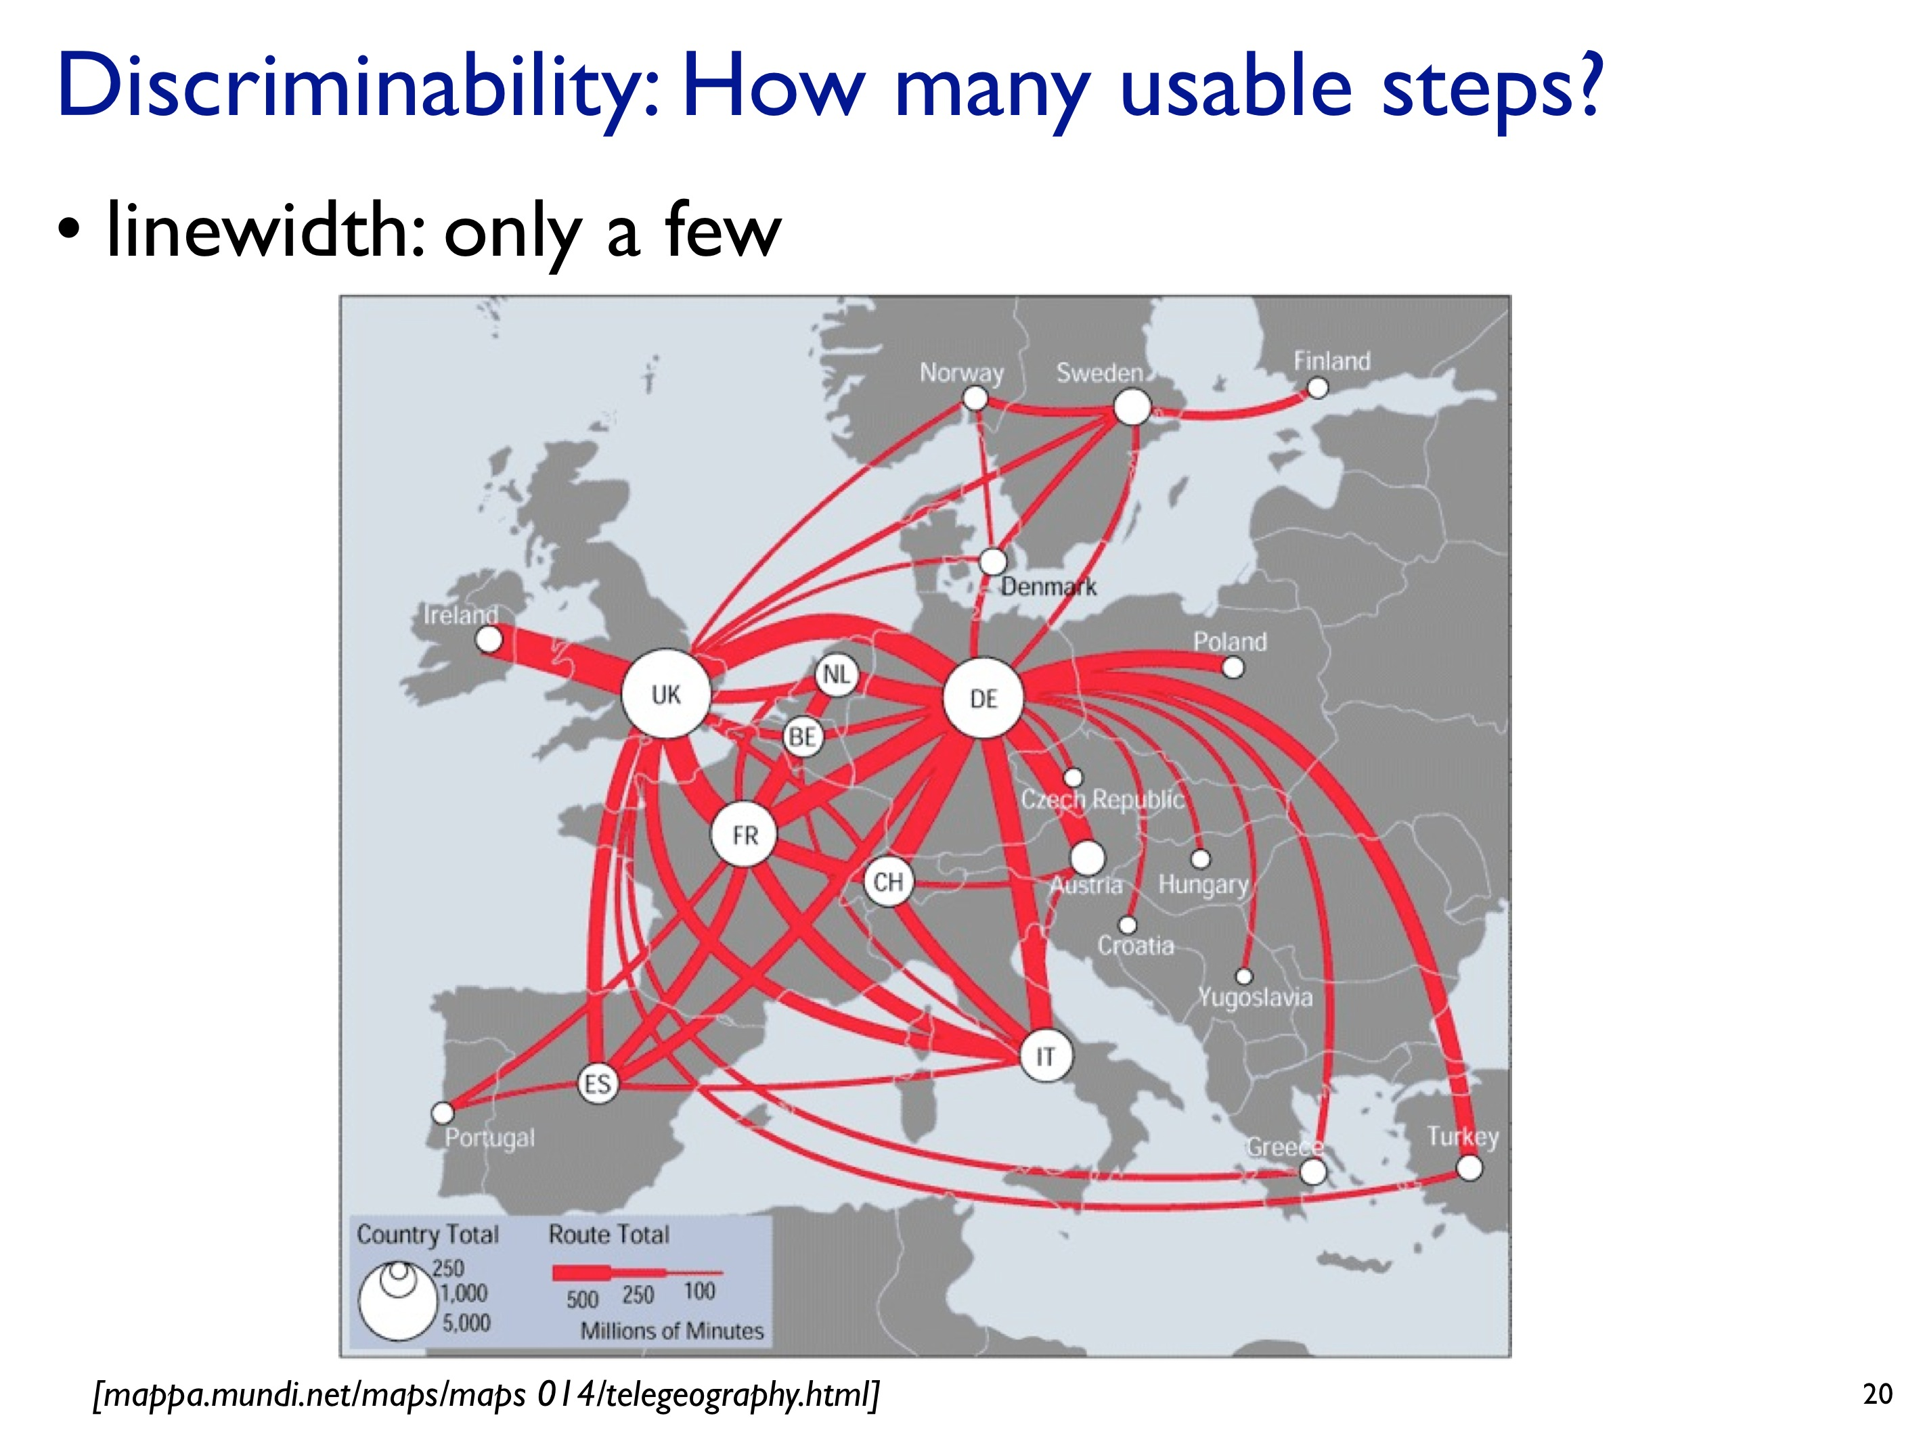

Slide 32
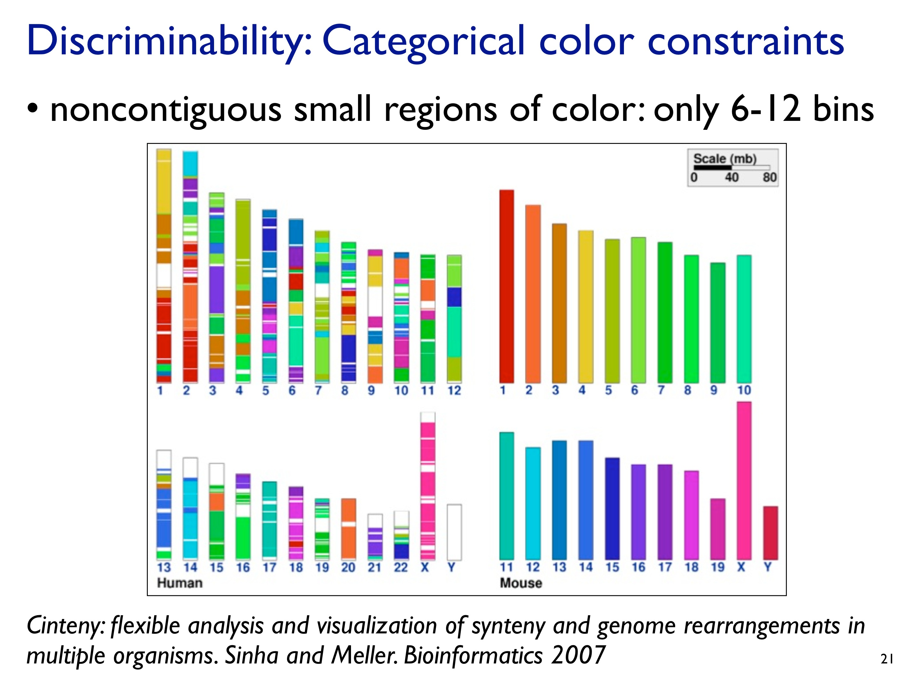

Slide 33
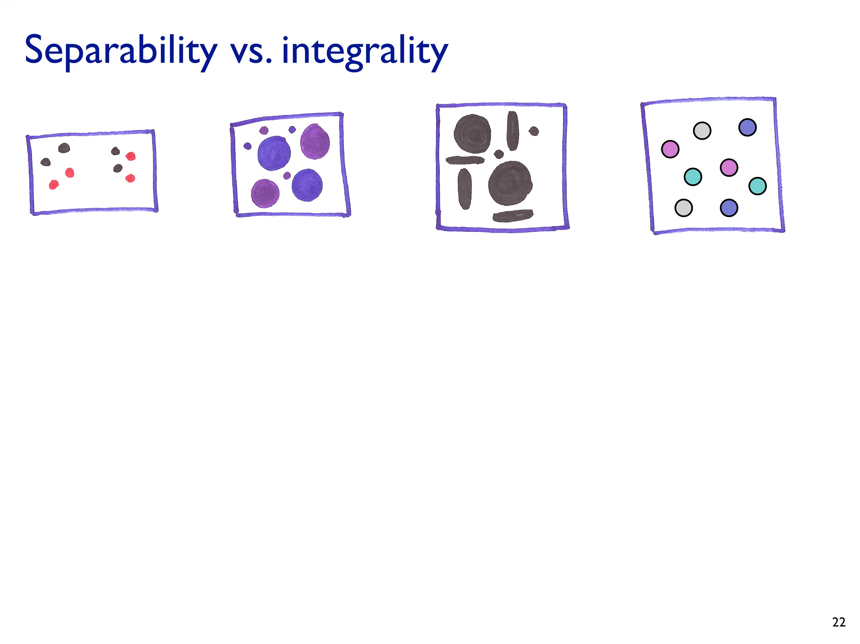

Slide 34
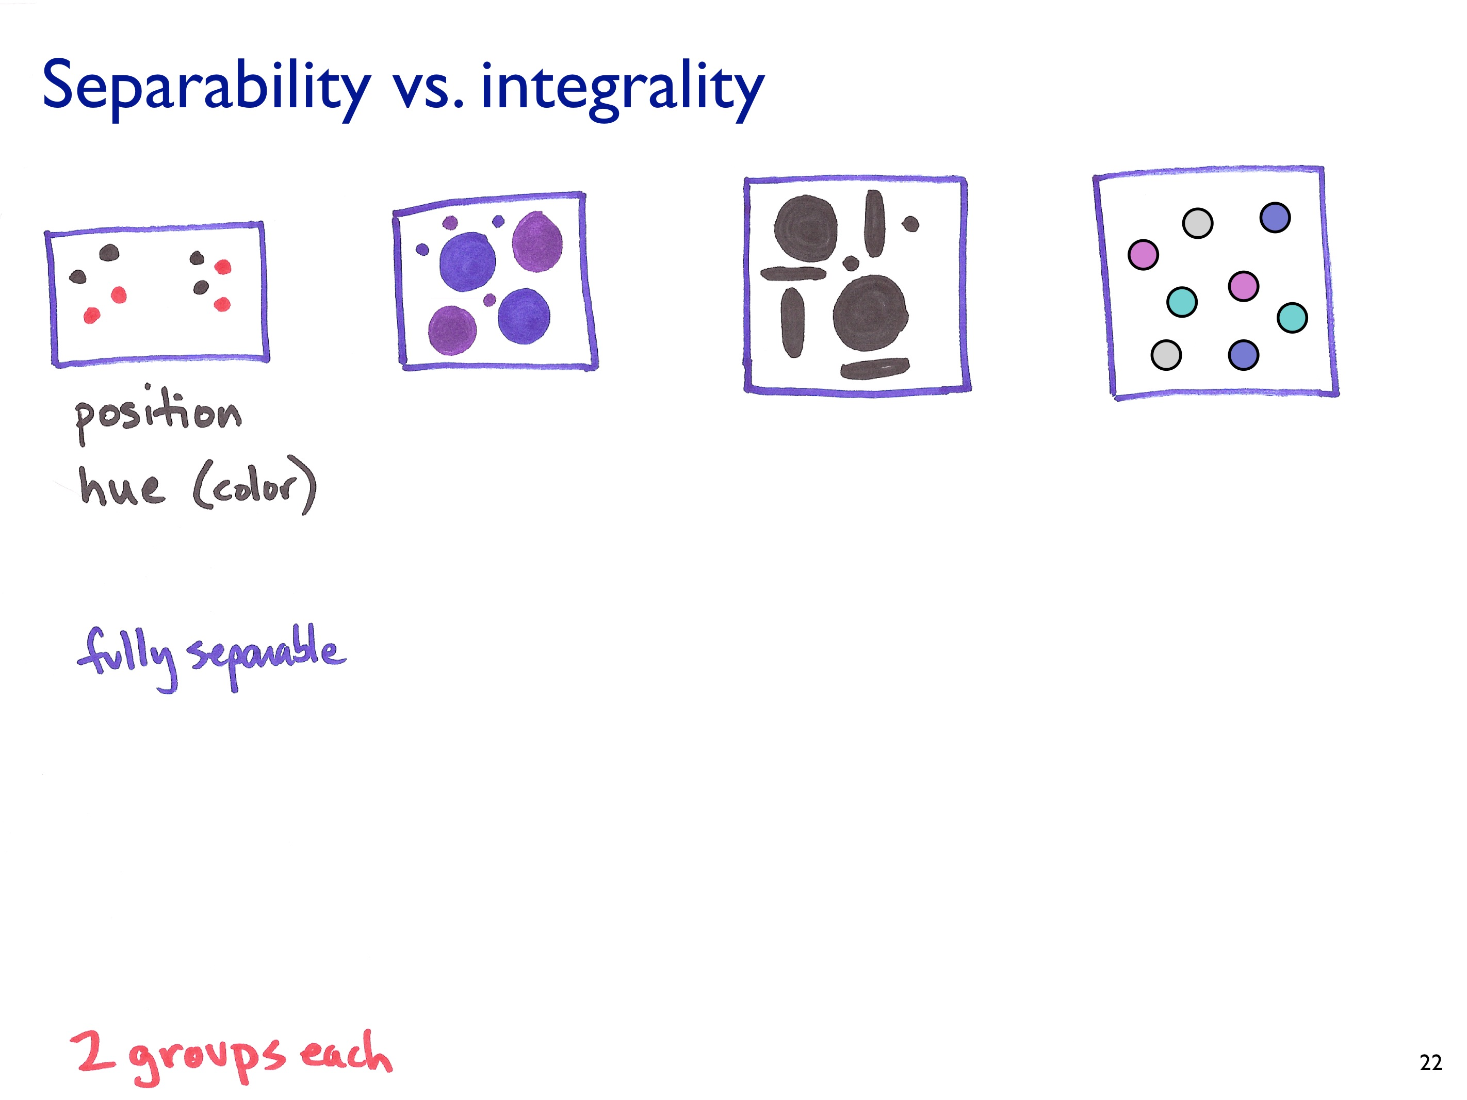

Slide 35
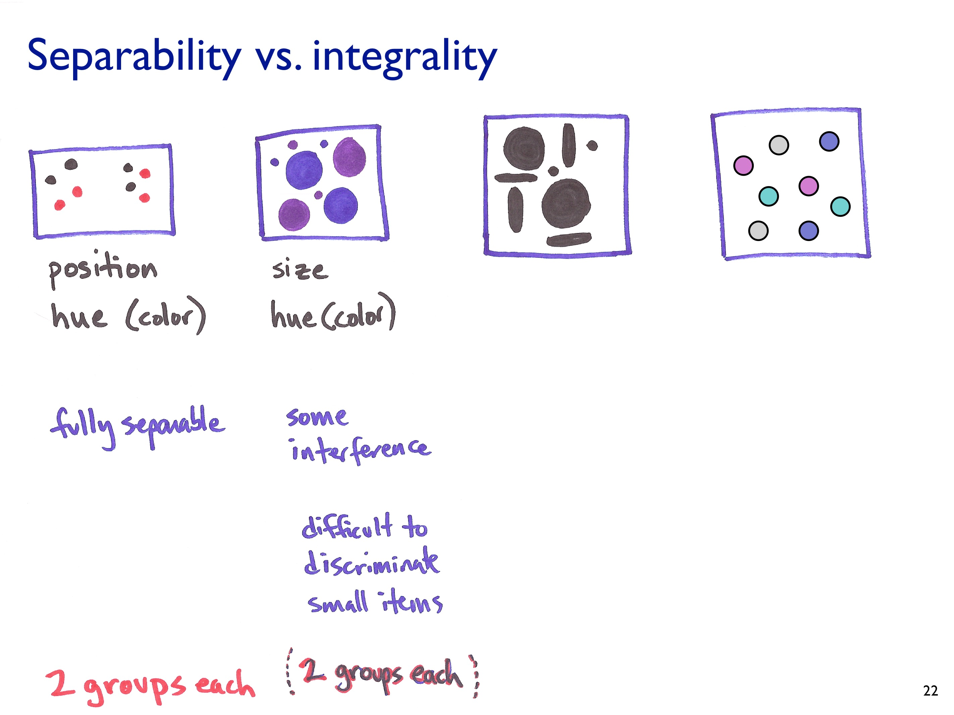

Slide 36
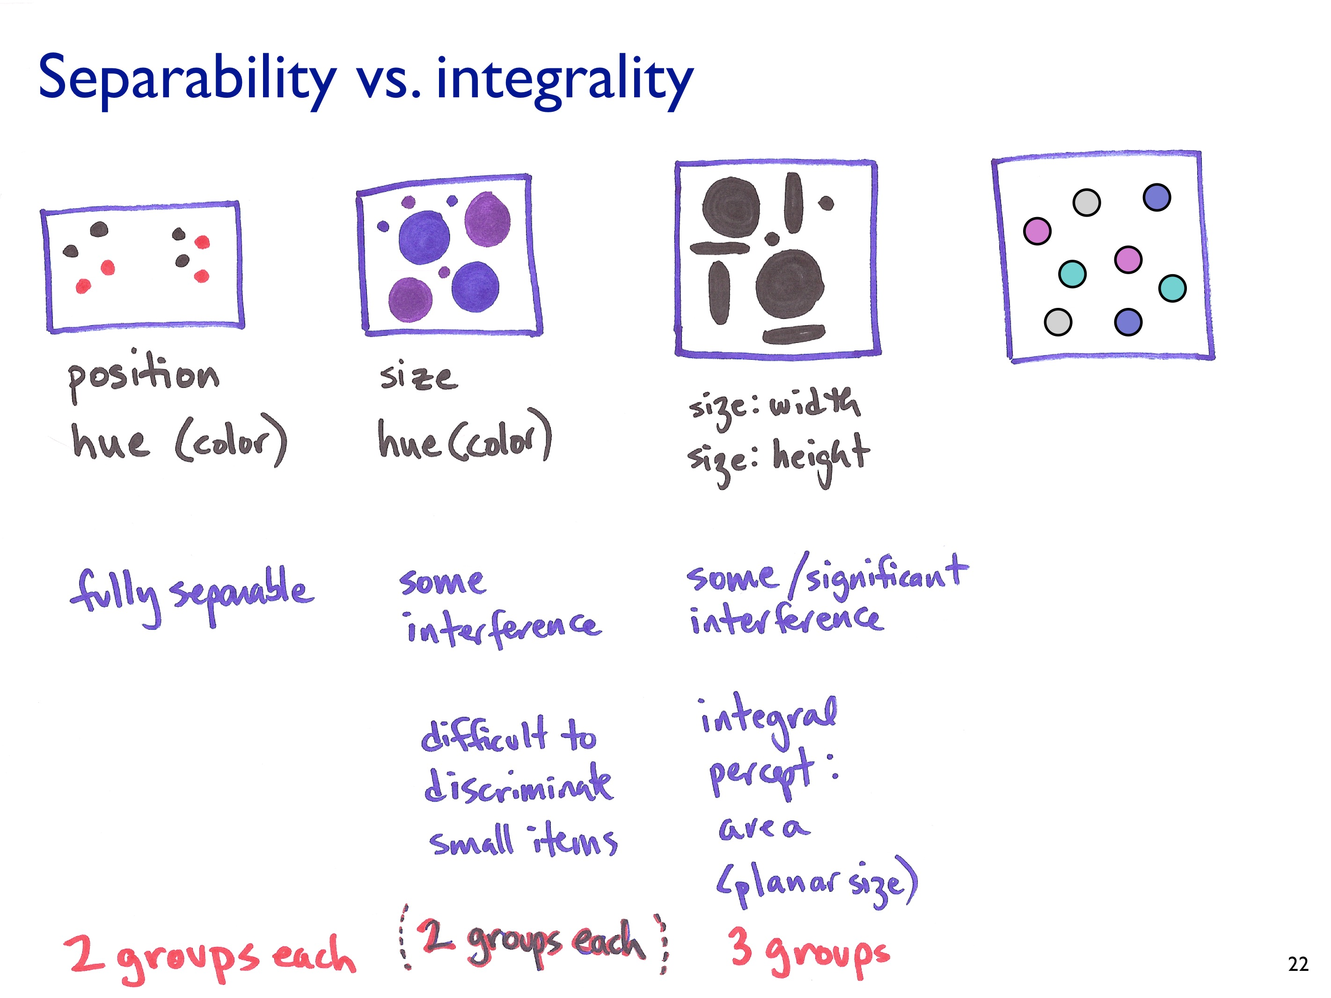

Slide 37
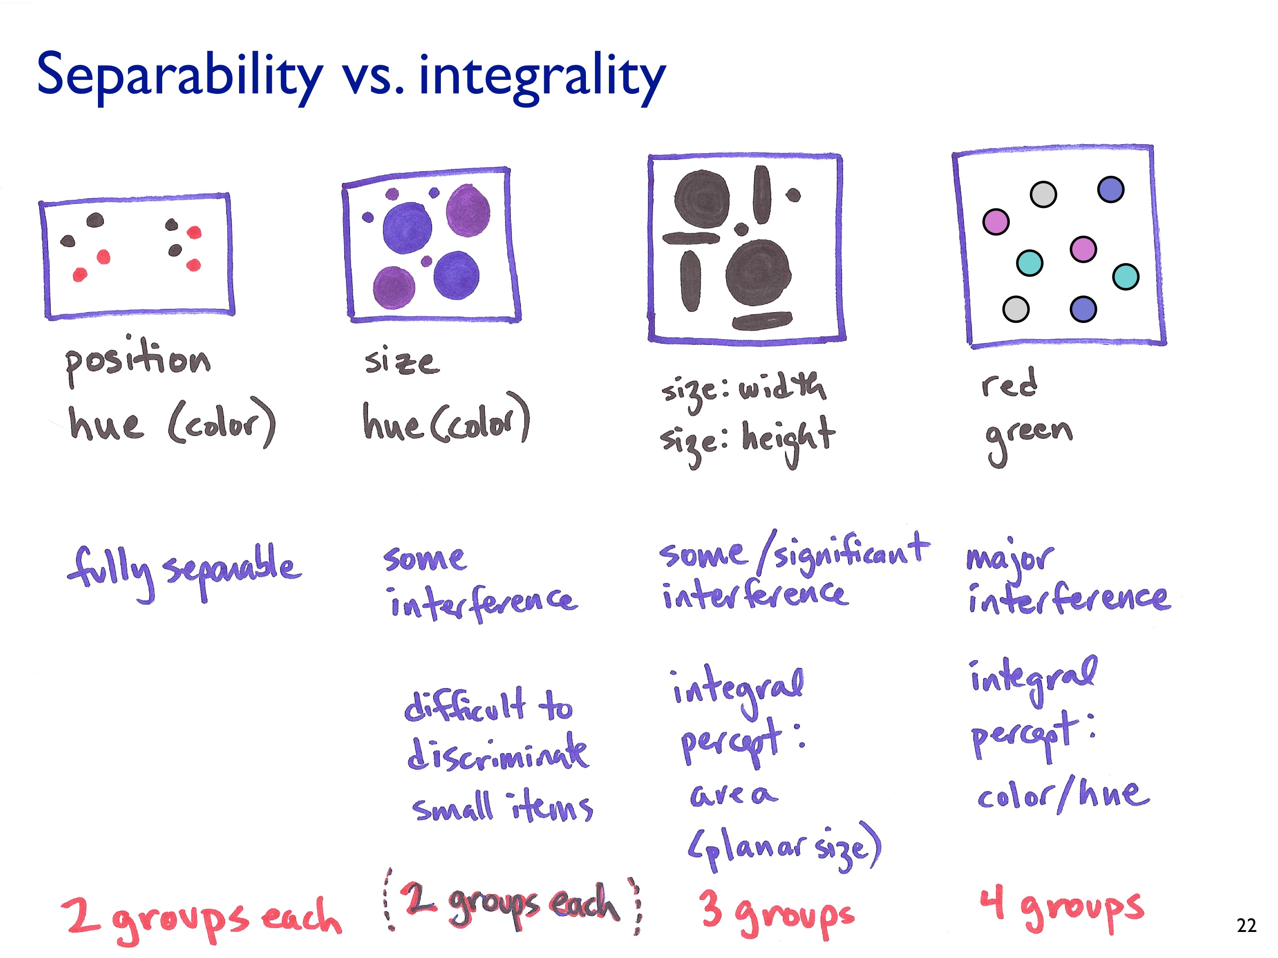

Slide 38
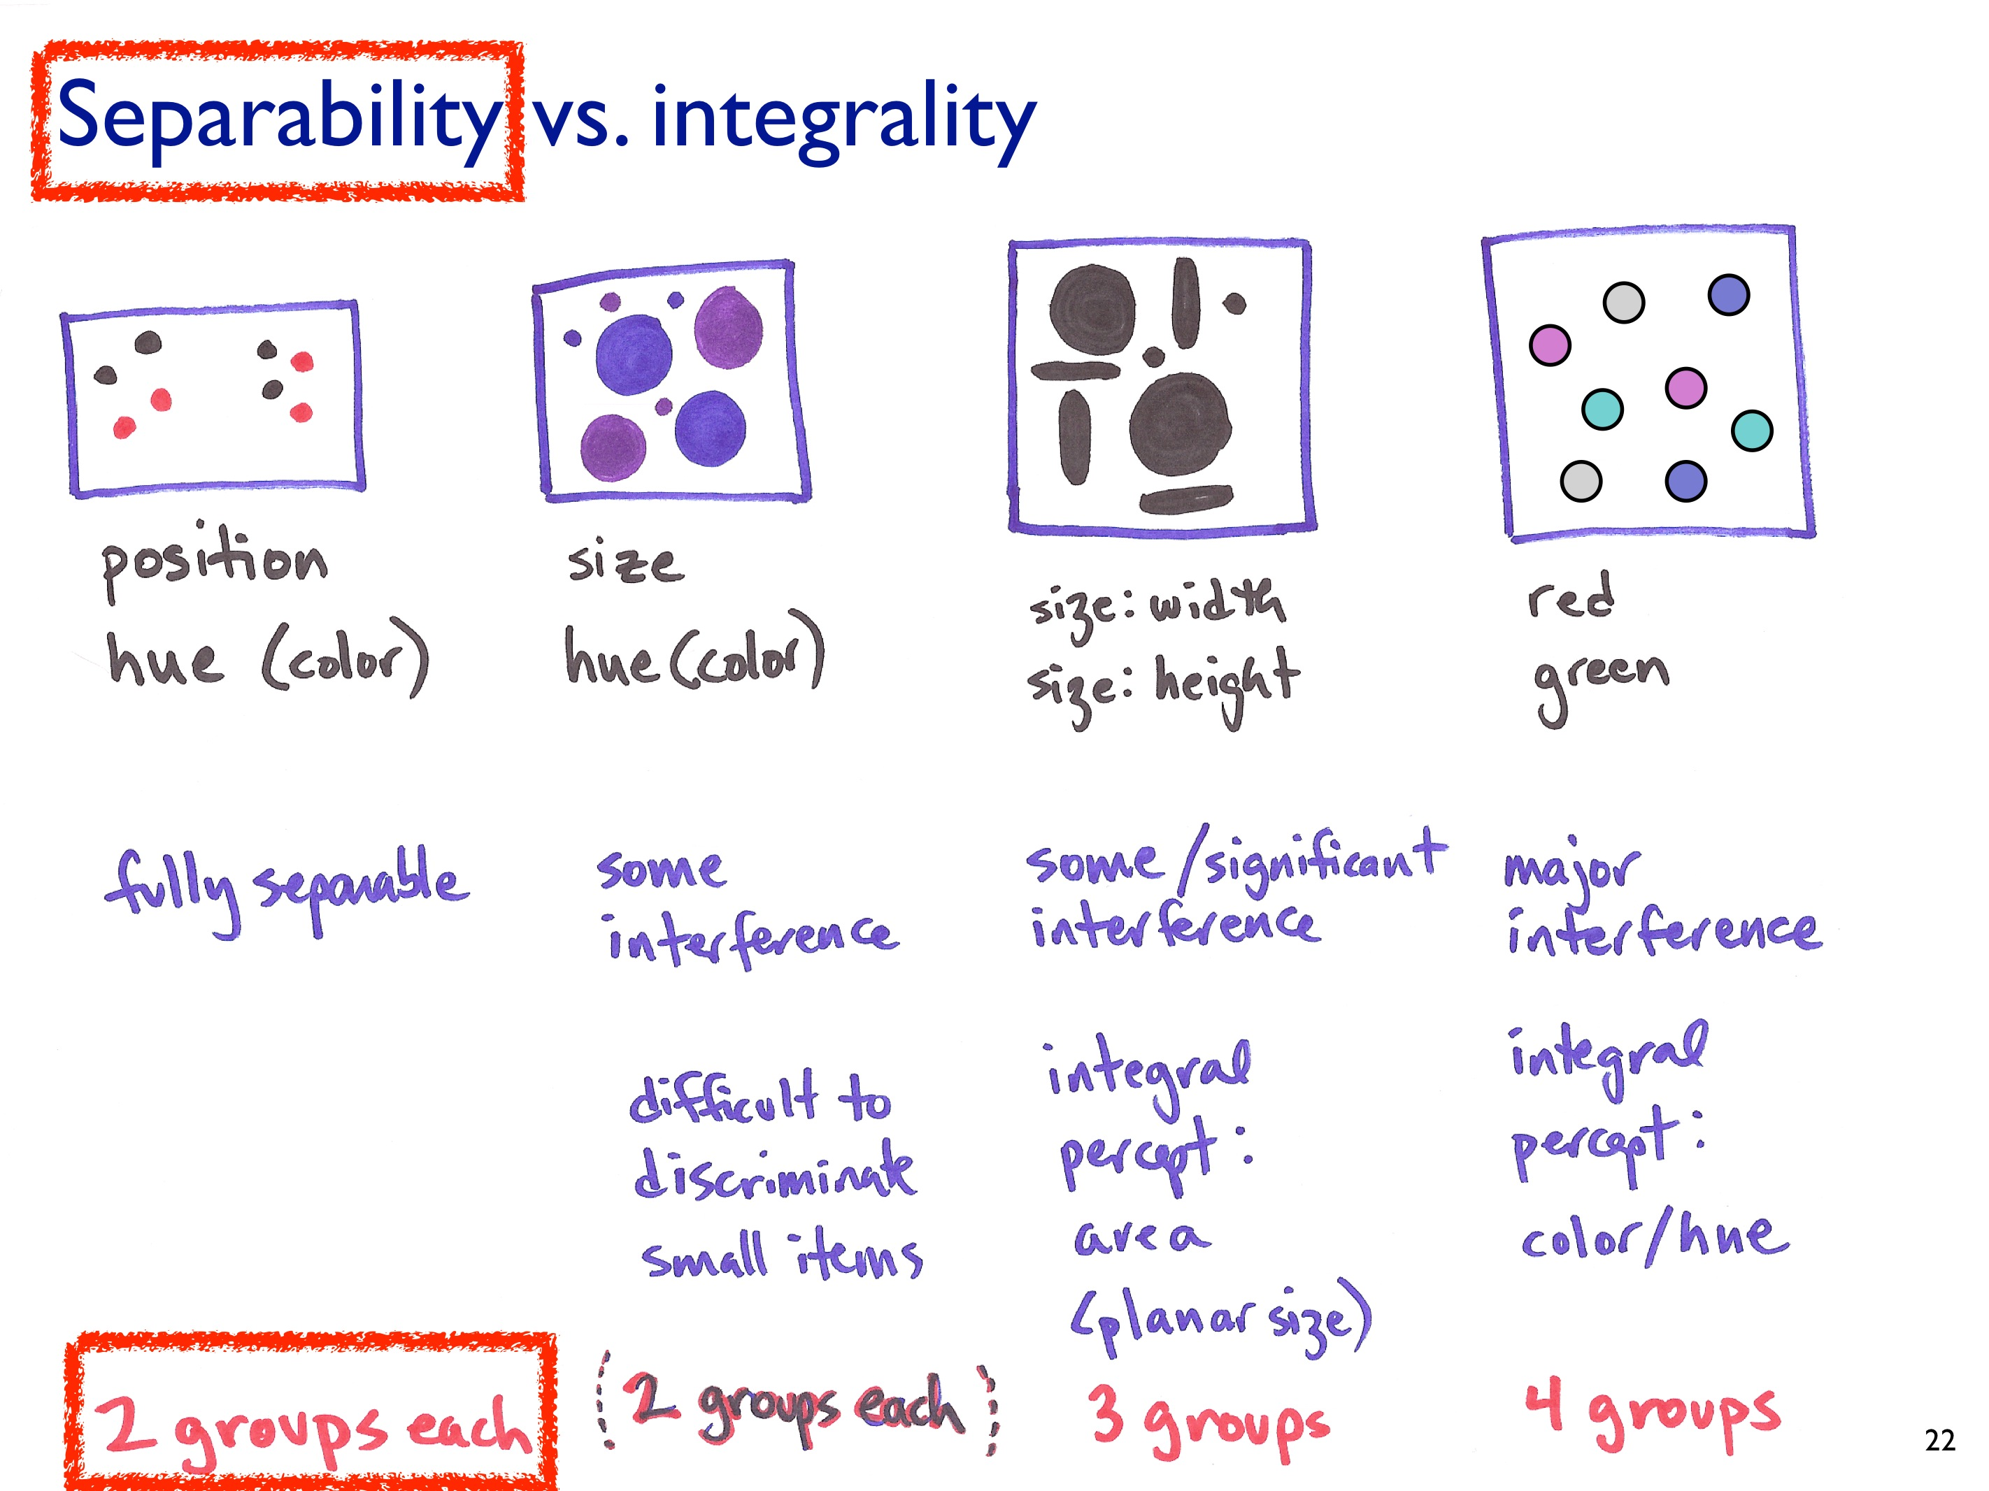

Slide 39
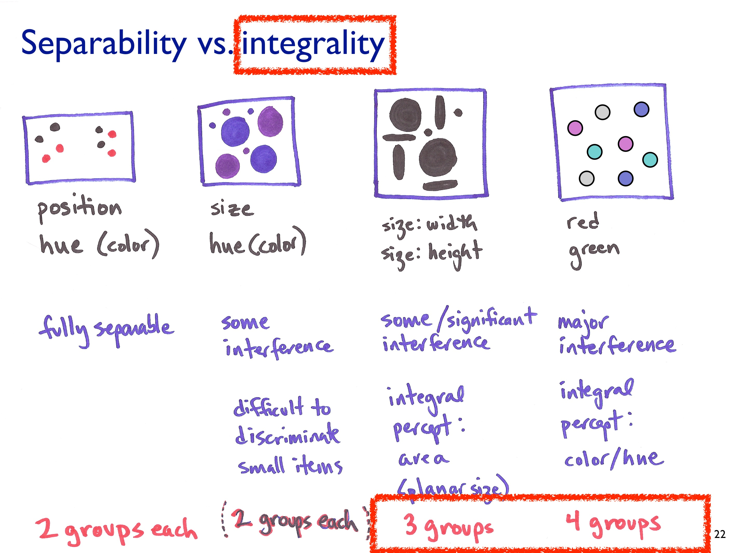

Slide 40
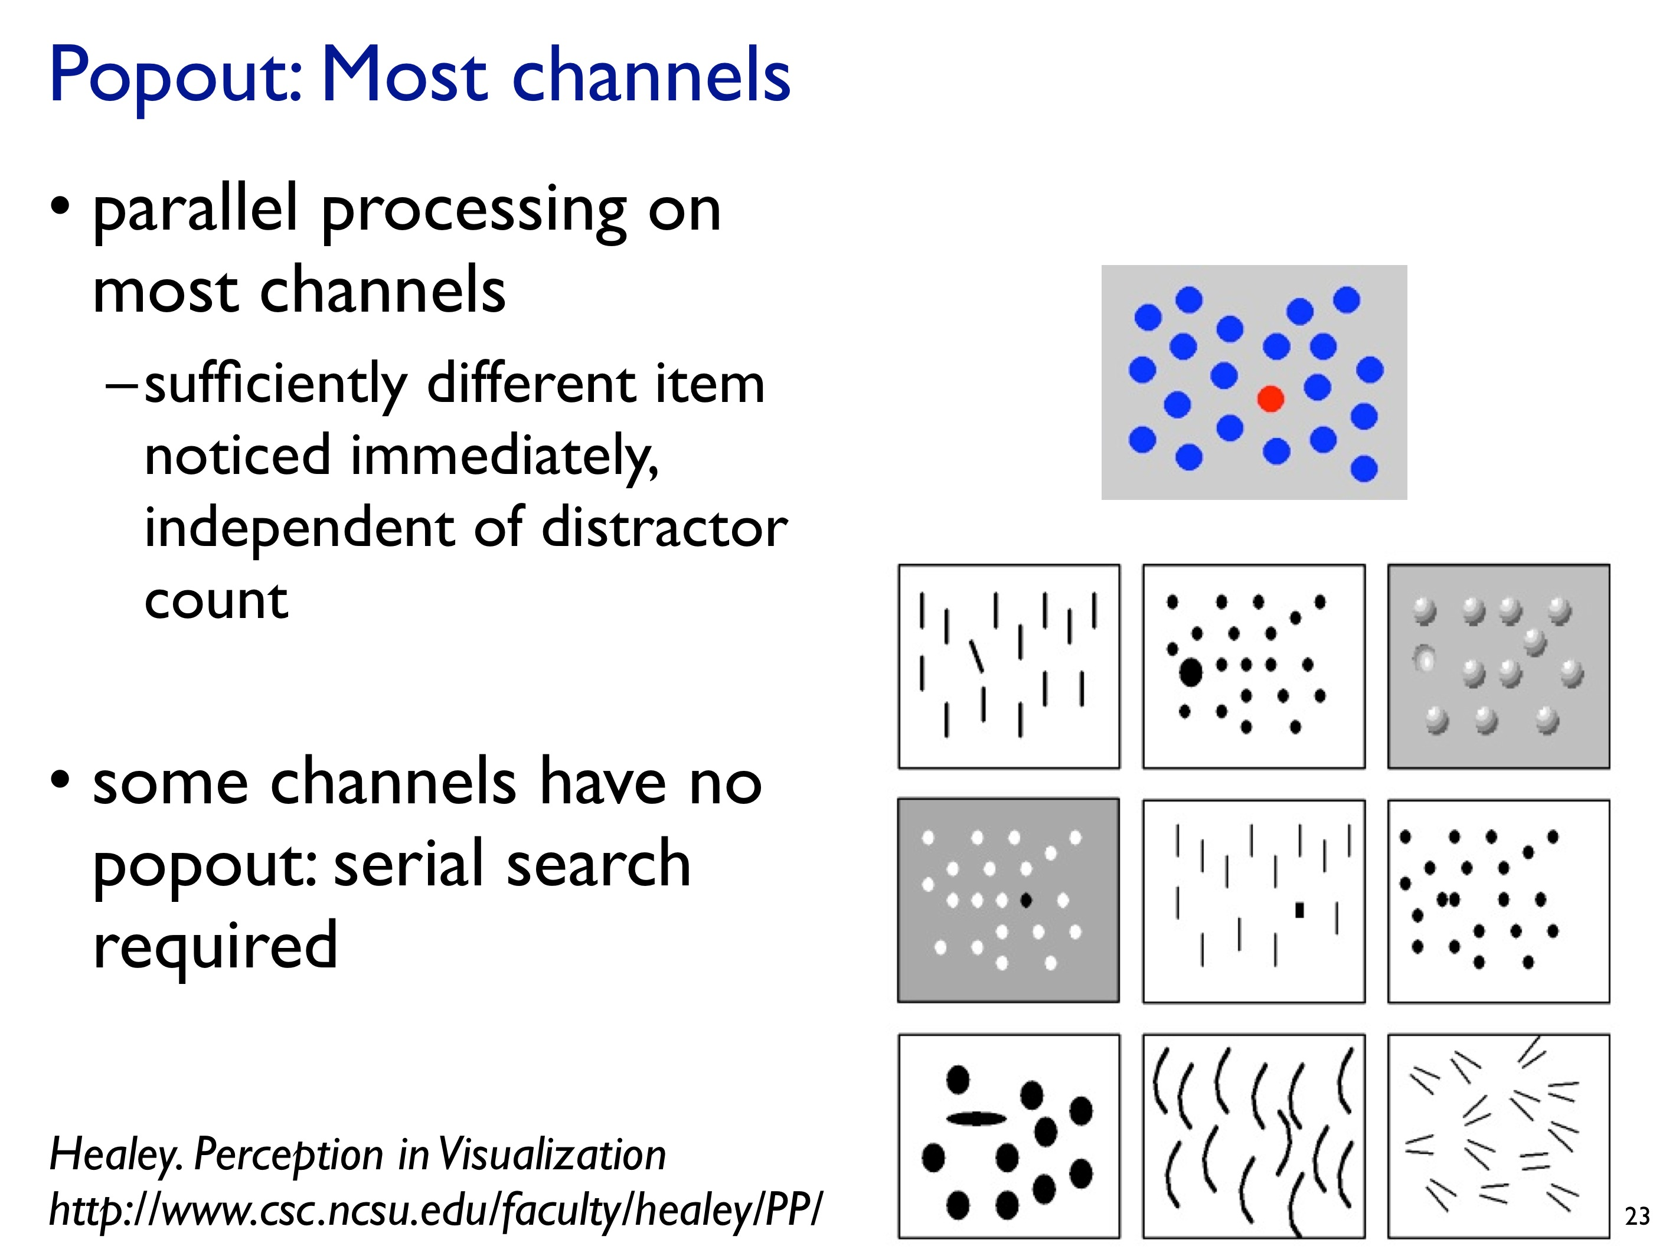

Slide 41
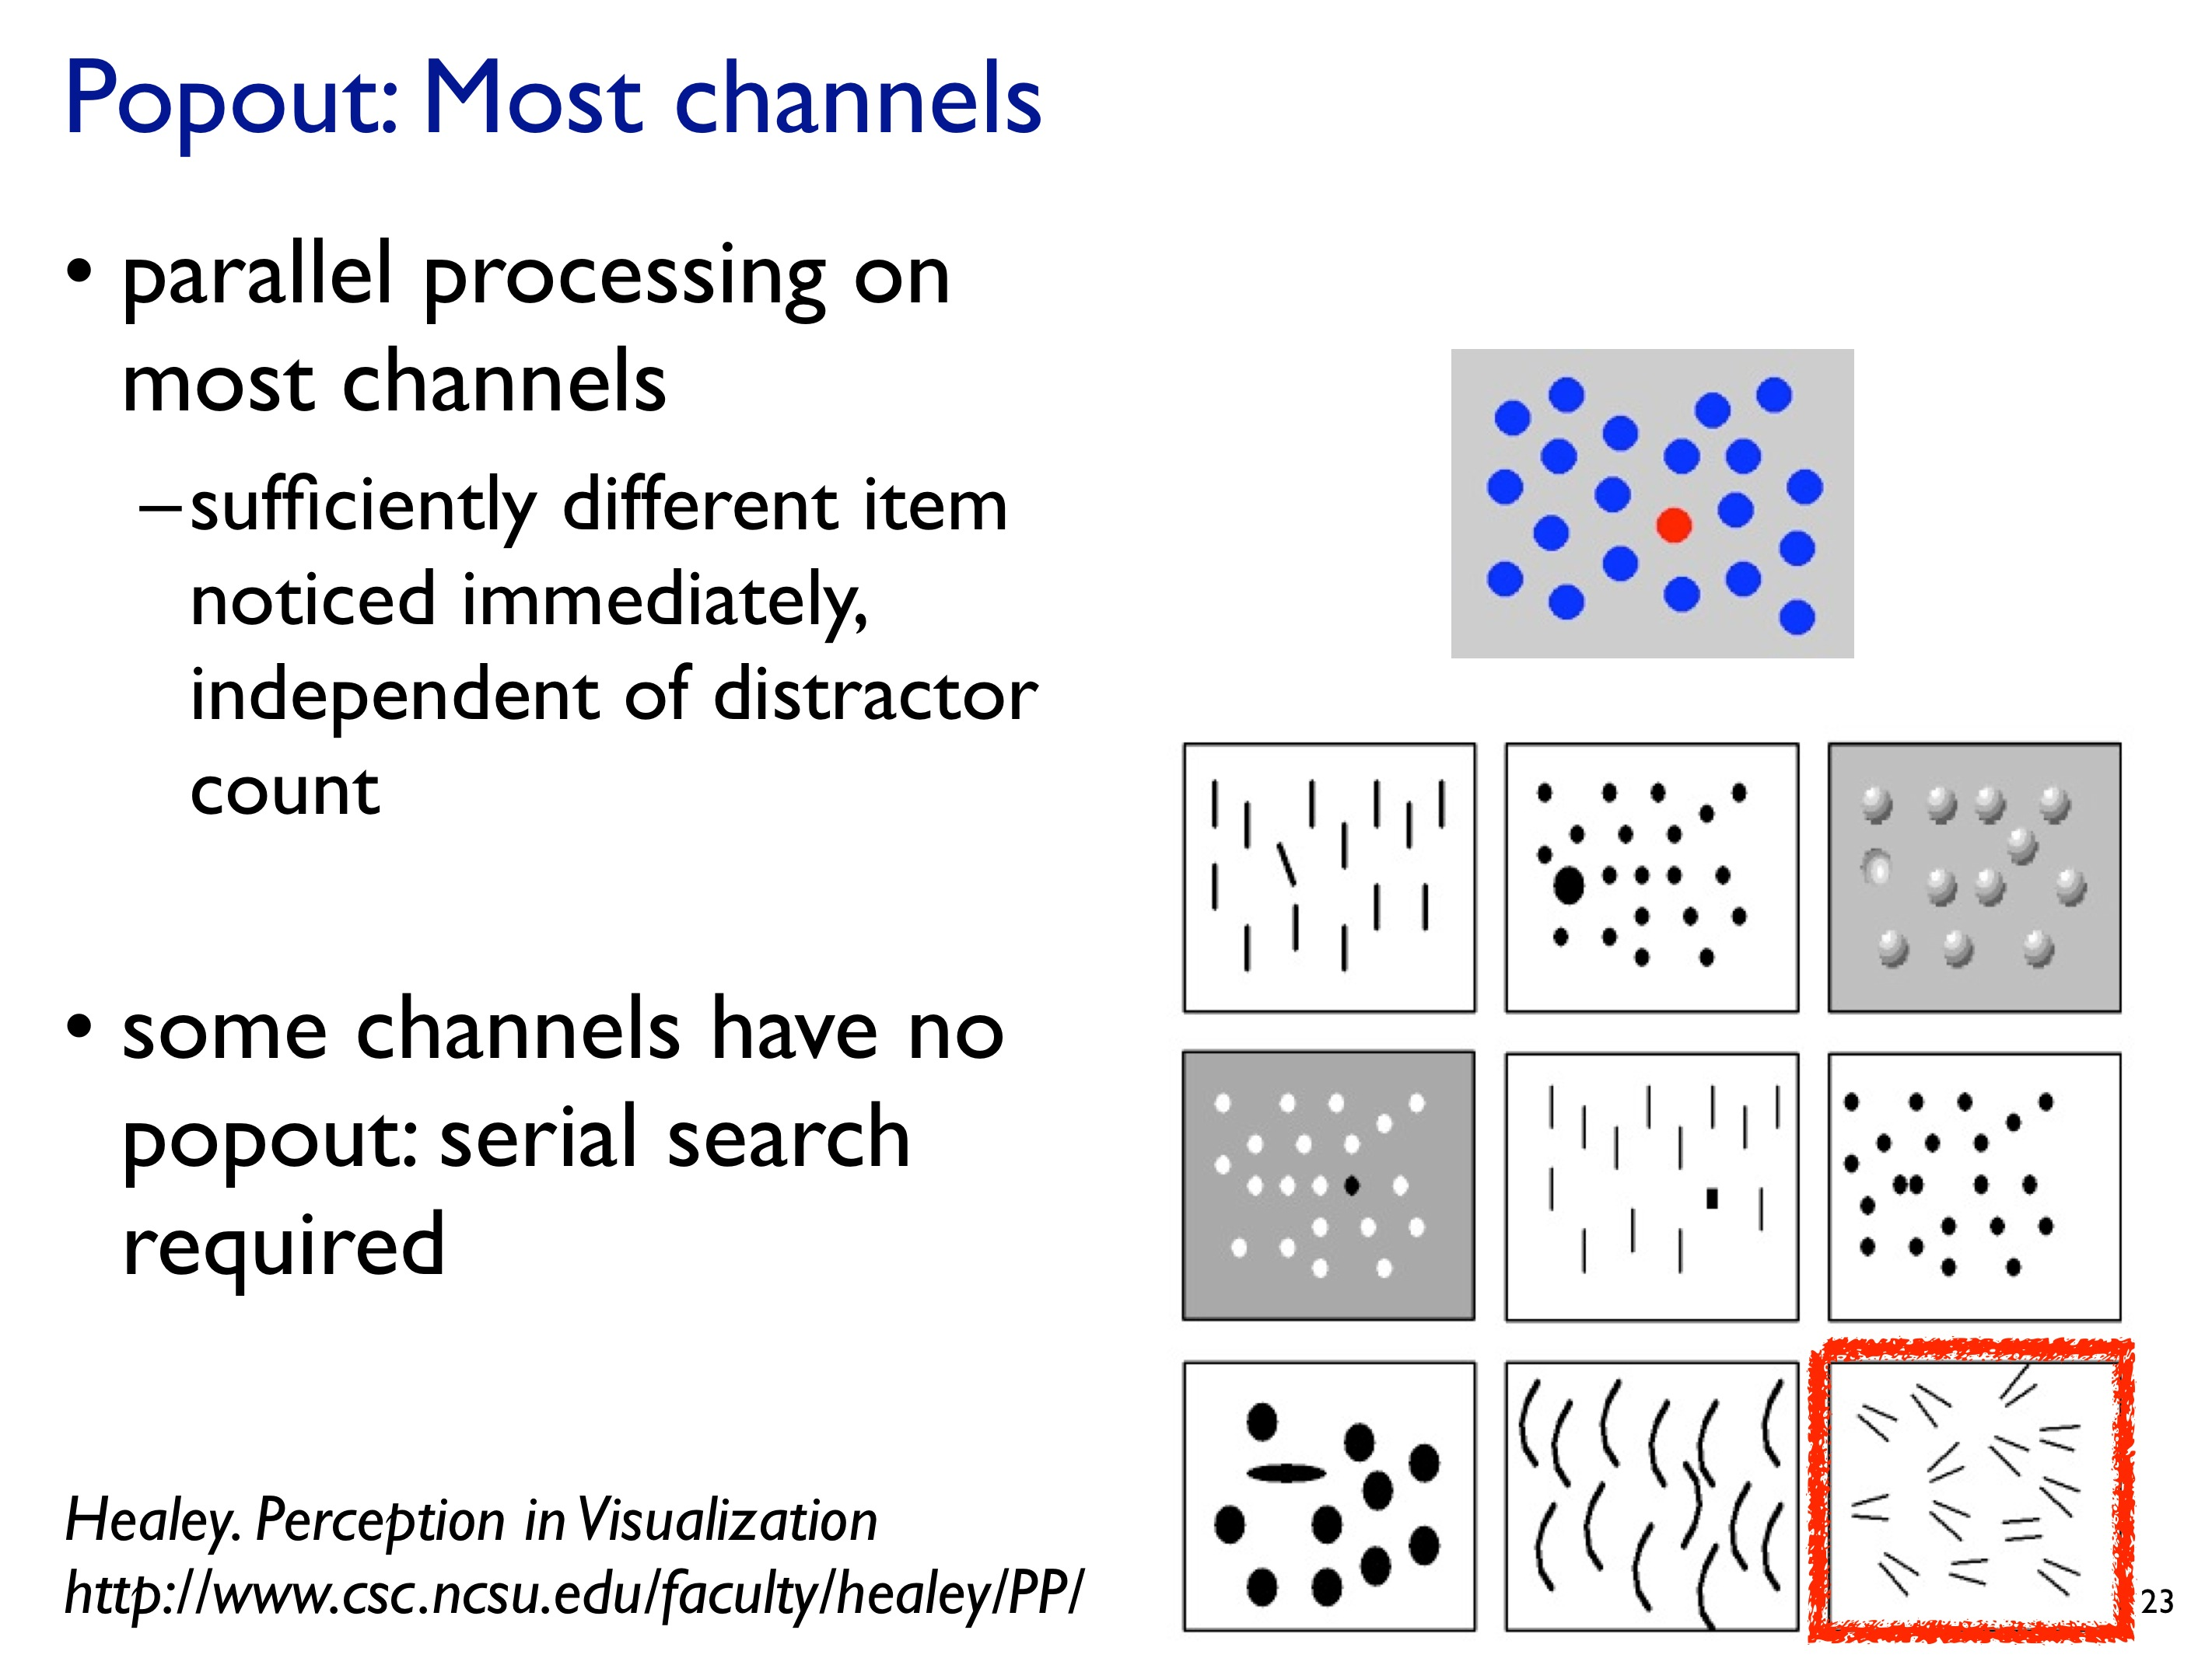

Slide 42
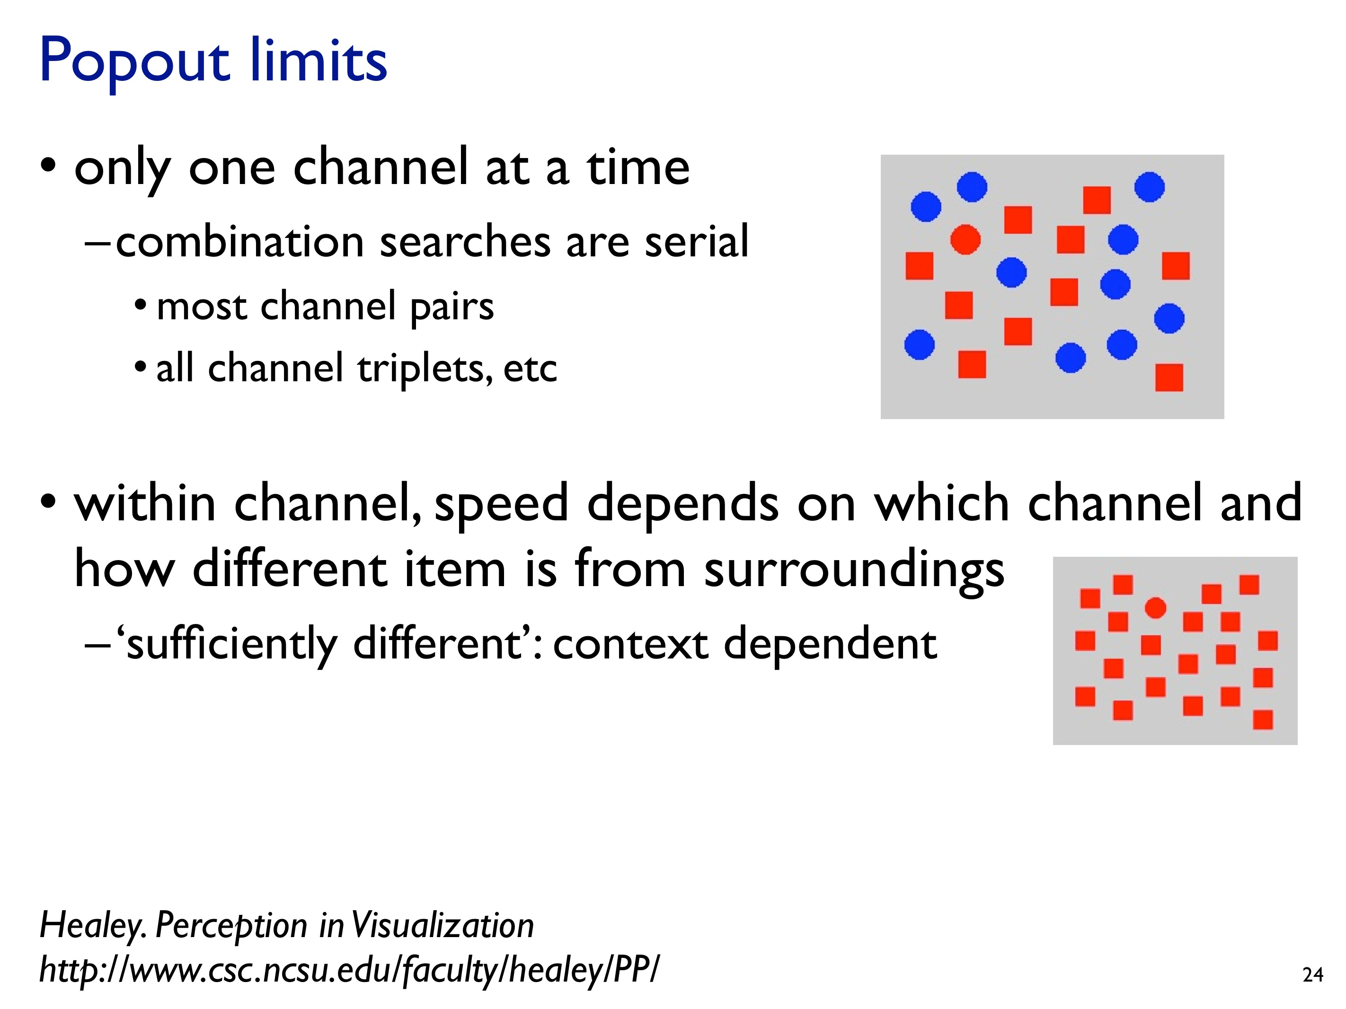

Slide 43
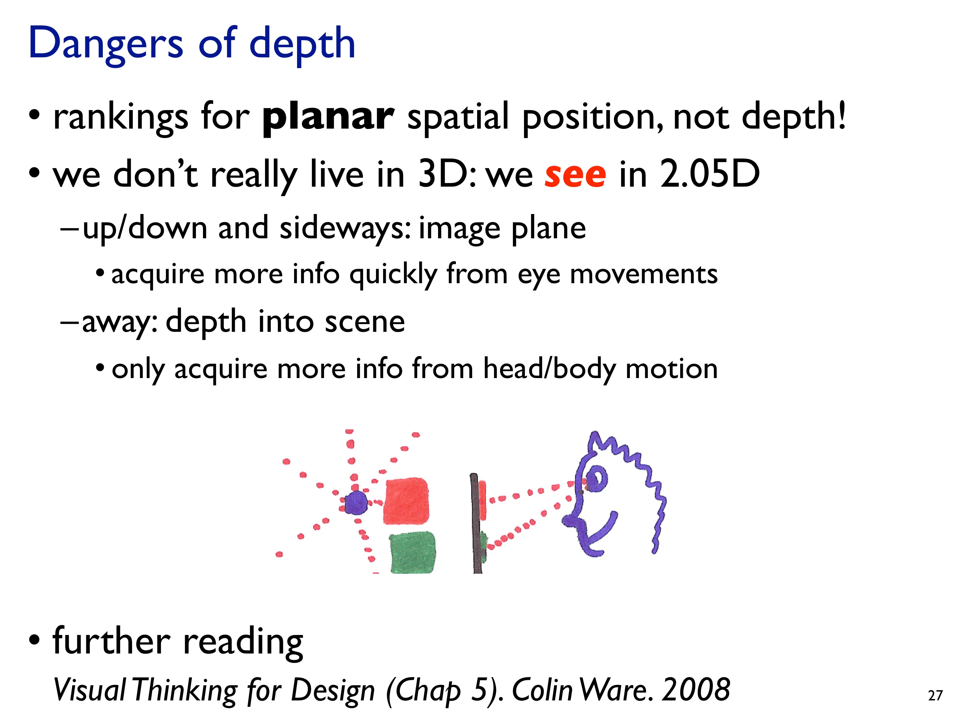

Slide 44
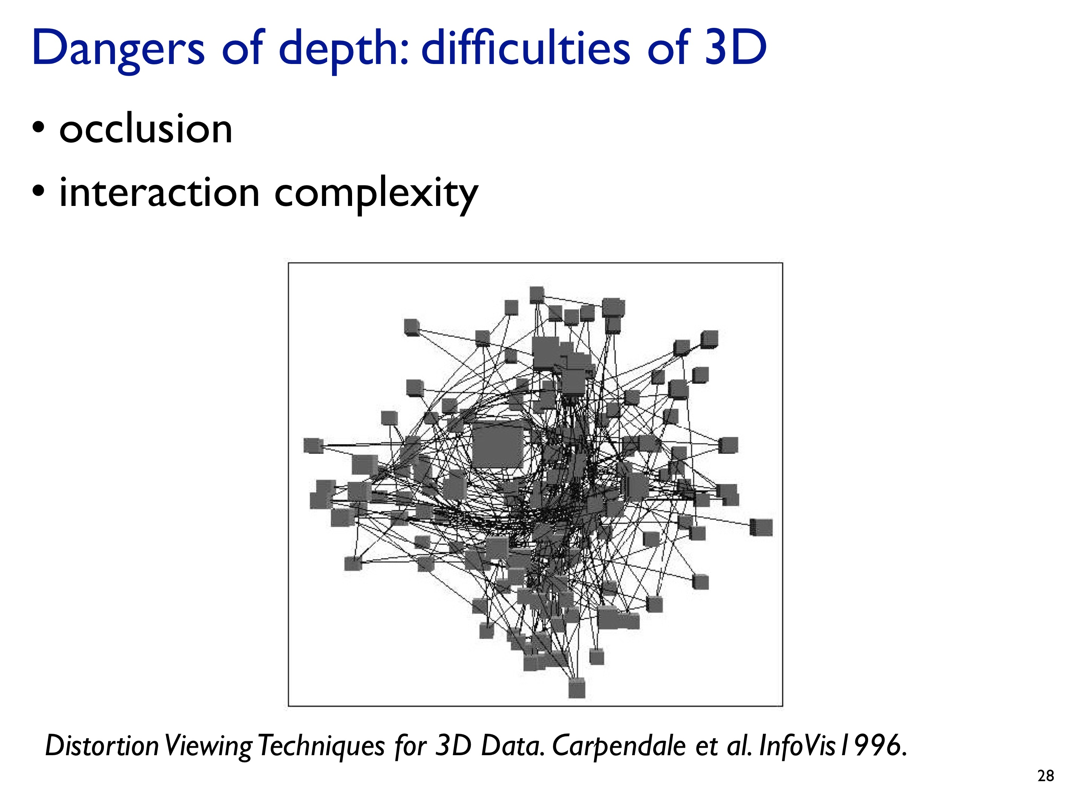

Slide 45
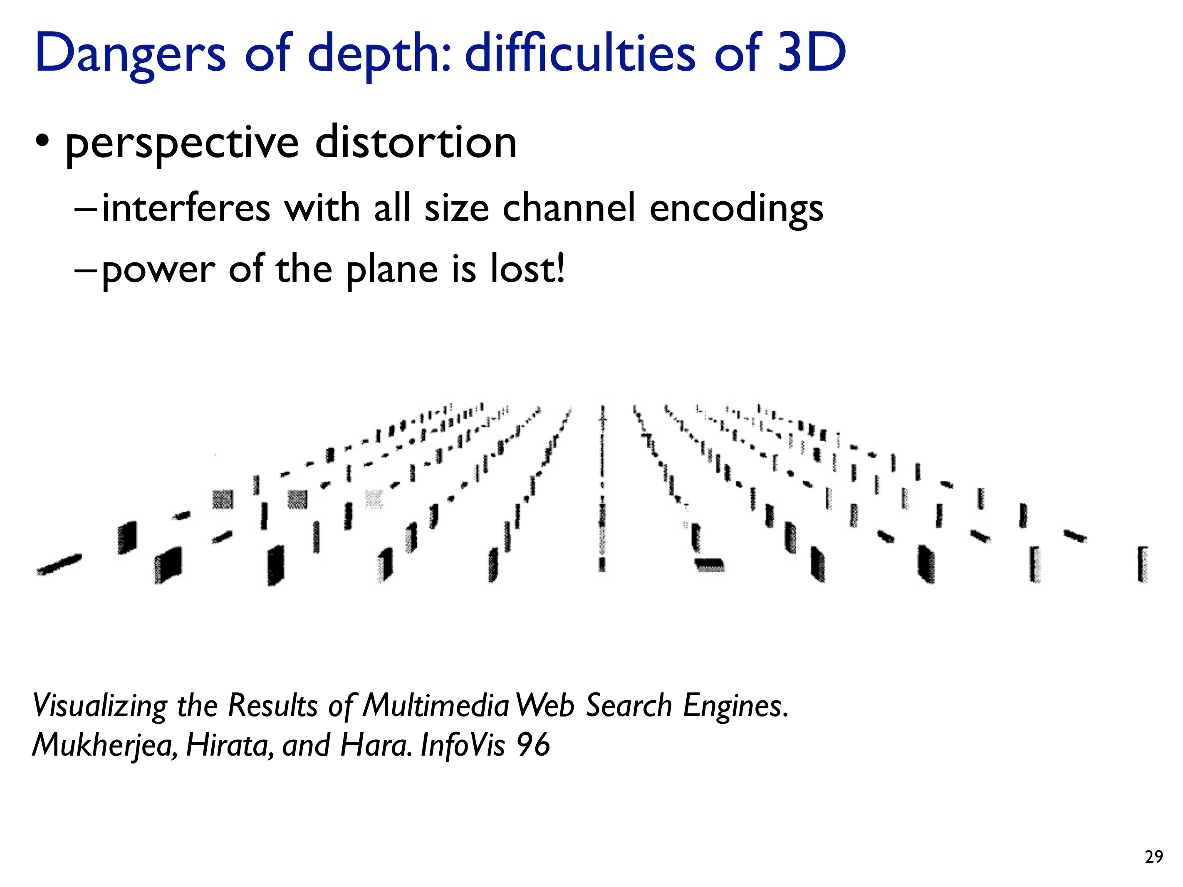

Slide 46
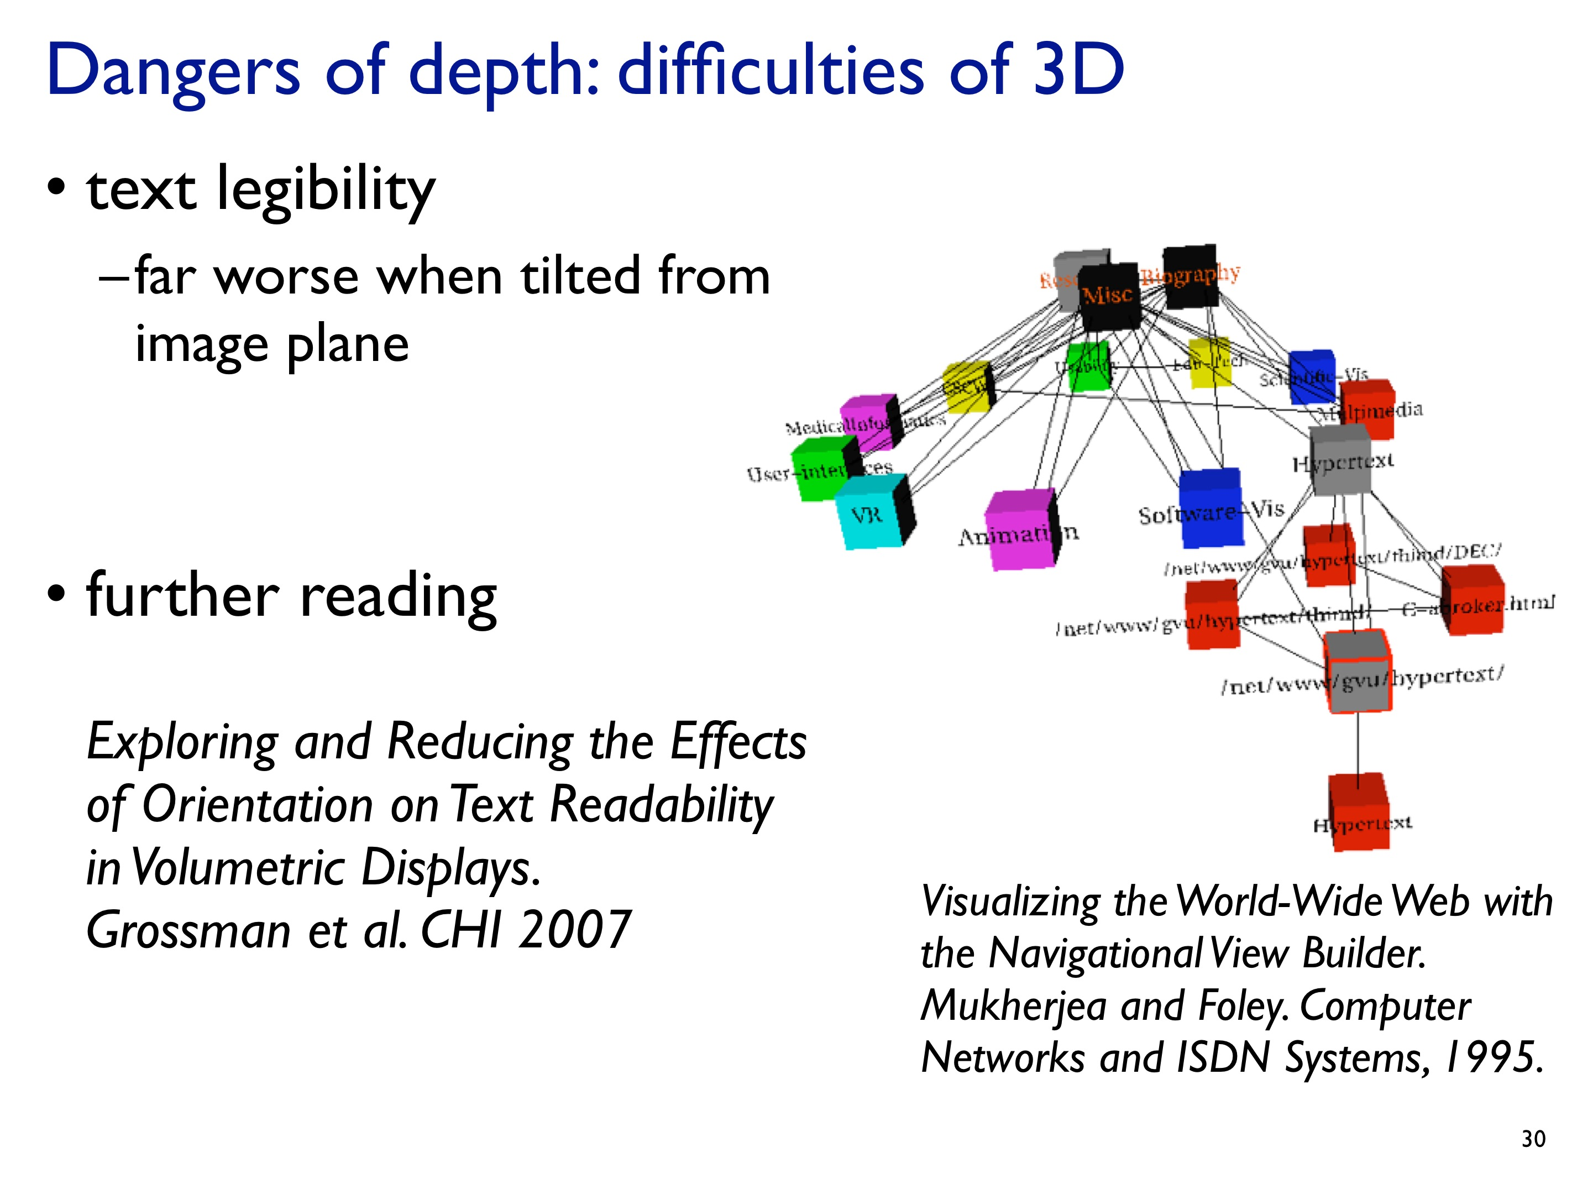

Slide 47
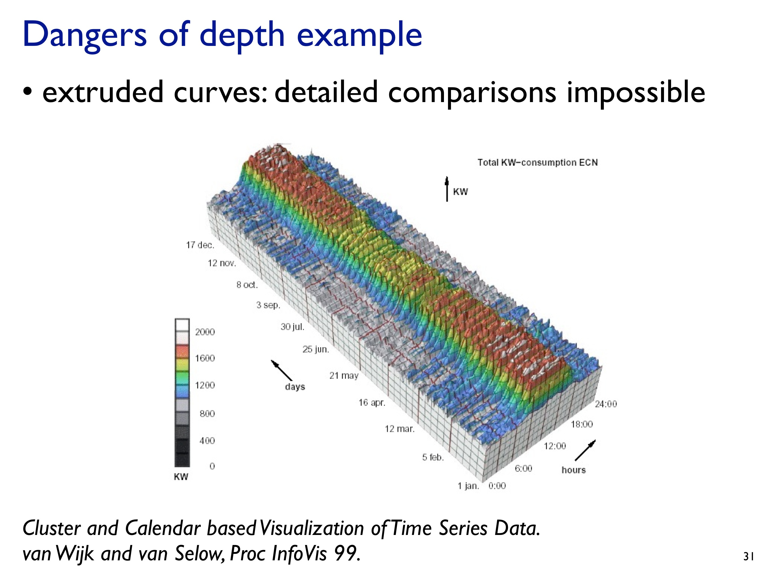

Slide 48
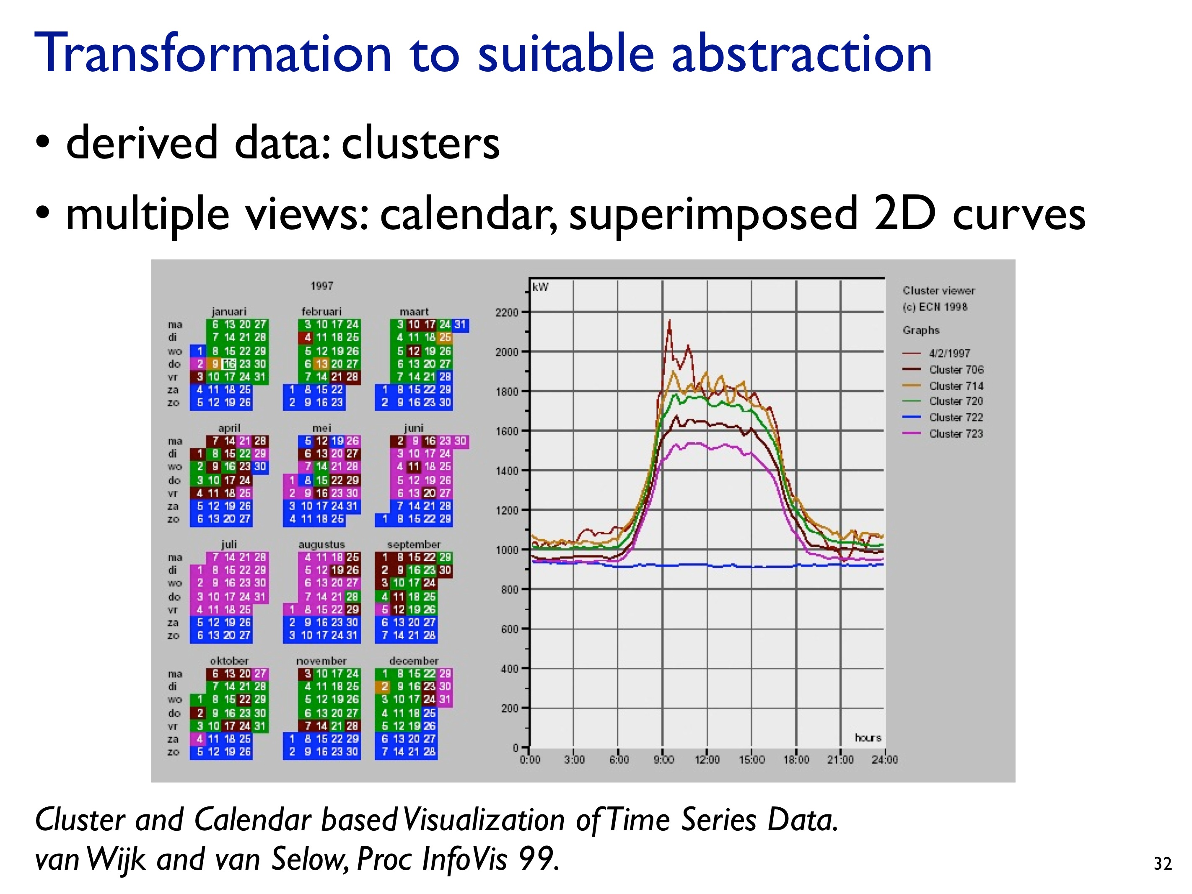

Slide 50
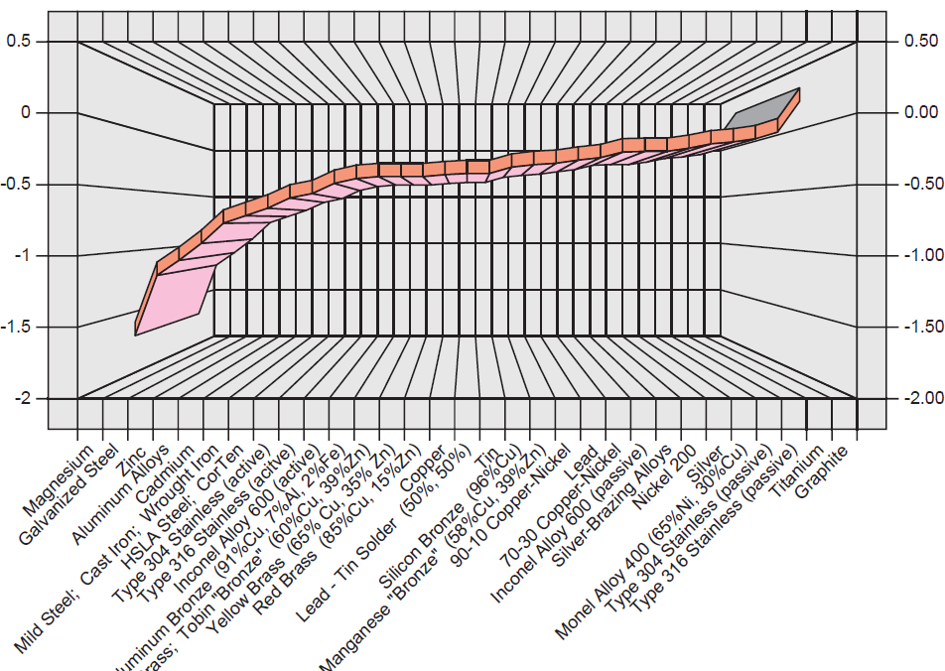
Notes:
http://www.datavis.ca/gallery/images/galvanic-3D.png
horrific use of 3D,
undesirable optical effect of the gridlines,
incorrect display of the data as a series of connected boxes,
item labels misaligned with the tick marks, and taking up far too much of the graphic display area

Slide 51
Learning Objectives
By the end of this lecture, you should be able to:
» Identify characteristics of different data types
» Understand encoding in terms of marks and visual channels
» Relate different visual channel types to data types (and effectiveness)
» Understand and apply Steven's Psychophysical Power Law
» In terms of rankings of visual channels, define and describe accuracy, discriminability, and separability vs. integrality, popouts
» Describe the dangers of using 3D in visualizations

Slide 53
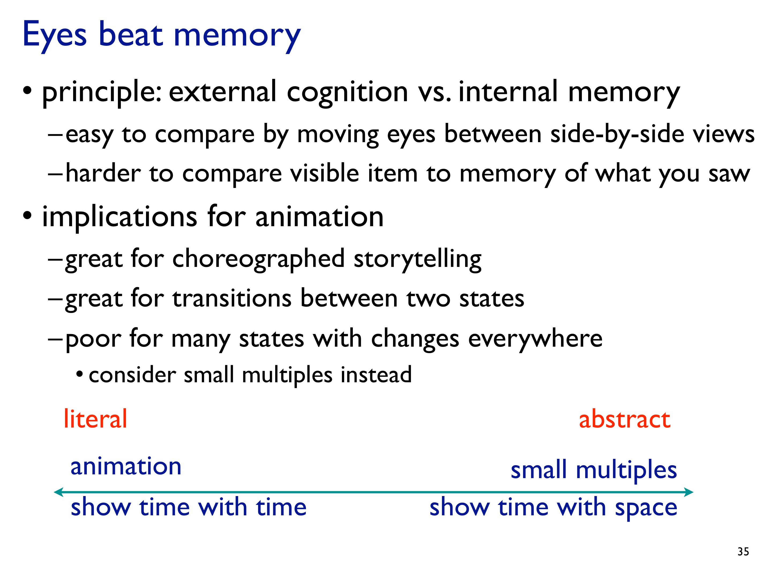

Slide 54
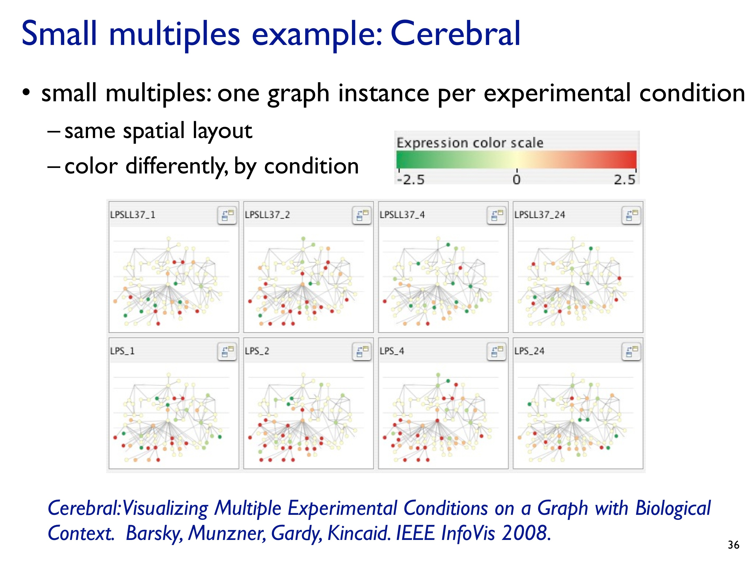

Slide 55
