Slide 1
P4: Write-Up
Write this as if it’s going to be sent to the boss of your company (boss of your boss)
What was the design problem?
What did you do for user research/what did you learn from your user research?
What is your design? What did you discard? How do you justify it?
Heuristic evaluation: what did you find; how would you iterate on the design?

Slide 2
P4: Presentation
Give this as if it’s going to be sent to the boss of your company (boss of your boss)
What was the design problem?
What did you do for user research/what did you learn from your user research?
What is your design? What did you discard? How do you justify it?
Heuristic evaluation: what did you find; how would you iterate on the design?

Slide 3
P4: Presentation
Presentations in tutorial (10 mins + 5 mins Q)
Give it a go in PowerPoint
Suggestion: practice
No need to demo (we saw that last week); give a quick tour of some highlights (say as screenshots)

Slide 4
Direct Manipulation
CPSC 481: HCI I
Fall 2012
Anthony Tang, acknowledgements to Saul Greenberg
Notes:
http://www.hpl.hp.com/techreports/96/HPL-96-152.pdf
http://www.ifs.tuwien.ac.at/~silvia/wien/vu-infovis/articles/hutchins_1985_direct-manipulation.pdf

Slide 5
Outline
Direct manipulation
What does “direct” mean?
» engagement
» distance
» semantic and articulatory distances

Slide 6
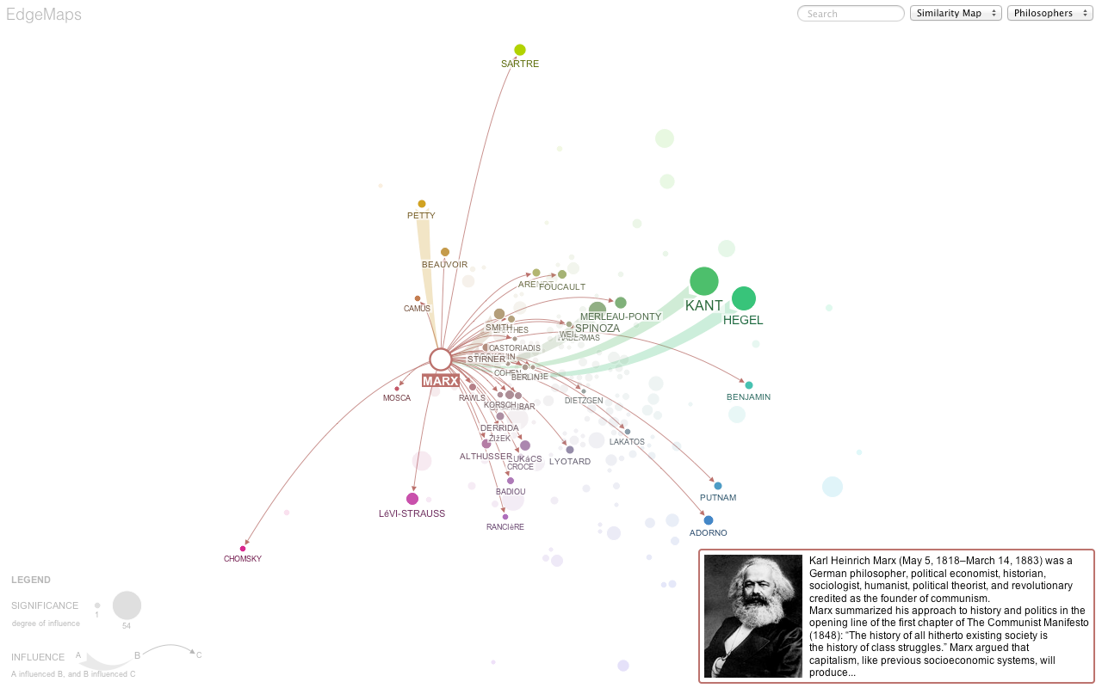
EdgeMaps
Notes:
What are some properties that make EdgeMaps interesting?
-- what are the marks that they have used?
-- what are the attributes that they have used?
-- what are some of the mappings?
How does one interact with this visualization?
-- combination of what’s known as “Multi Dimensional Scaling” and Node-edge graphs
http://mariandoerk.de/edgemaps/

Slide 7
Example: Copy command (DOS)
Copies files from one location to another. The destination defaults to the current directory.
> copy file1 [destination]
If multiple files are to be copied, the destination must be a directory, or an error will result.
> copy file1 file2 file3 [destination]
Files may be copied to devices. To send file to printer:
> copy file lpt1
To display file on screen ("console"): (alternatively: type file)
> copy file con
>
No feedback given after one of these commands; just a prompt >
Equivalent Unix command: cp

Slide 8
SQL Queries
“Which companies sell everything that WalMart sells?”
(List companies such that there does not exist an item sold by Walmart that they do not sell.)
select distinct X.name
from suppliers X
where 0 = (select count (*)
from suppliers Y
where Y.name = “WalMart” and
0 = (select count (*)
from suppliers Z
where Z.name = X.name and
Z.item = Y.item))
Notes:
Don’t scrutinize my SQL ;-)

Slide 9
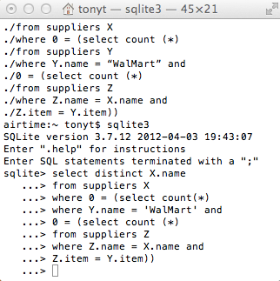
Compare and Contrast Interaction Styles
EdgeMaps
Command Line
Notes:
What makes these two things kind of different?
Directness and Engagement

Slide 10
Direct Manipulation: “the formula”
Continuous representation of the object of interest
Physical actions or labeled button presses instead of complex syntax
» copying a file:
cp foo.txt /home/tonyt
vs.
dragging file icon to my home folder
Rapid incremental reversible operations whose impact on the object of interest is immediately visible
» think about EdgeMaps
Output representation can be operated up as input

Slide 11
Direct Manipulation: benefits
Novices can learn quickly, e.g. through demonstration
Error messages are rarely needed
» actions are constrained by the interaction syntax
Users can see immediately if actions are furthering goals, and if not, they can change the direction of their activity

Slide 12
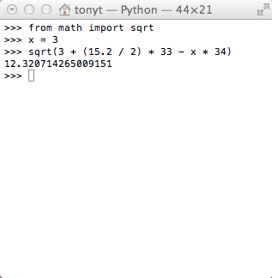
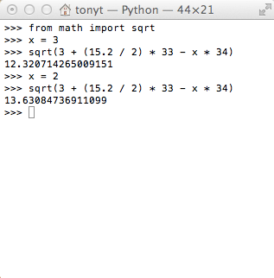
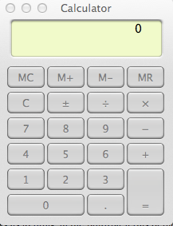
Direct Manipulation: weaknesses

Slide 13
Direct Manipulation: weaknesses
Ill-suited for abstract operations
Tedious
» manually searching a database vs. query
» or some other repeated operation
Inability to deal with variables / semantic symbols
Notes:
What about tasks for the future
With DM, user is responsible for doing everything; but some tasks are better achieved by delegating!
e.g. spell checking
repetitive actions are tedious!
Moving a mouse around the screen can be slower than pressing function keys to do same actions

Slide 14
Direct Manipulation: “direct?”
Punchline:
DIRECTNESS = ENGAGEMENT + DISTANCE
Engagement: feeling of power/control
Distance: cognitive effort to evaluate system state and communicate goals

Slide 15
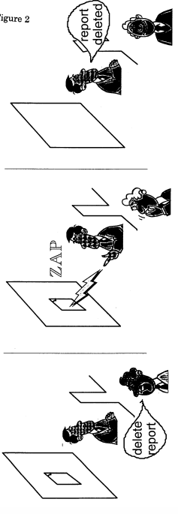
Engagement
Notes:
http://www.hpl.hp.com/techreports/96/HPL-96-152.pdf

Slide 16
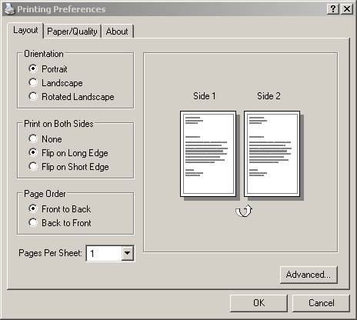
Engagement
Notes:
I hate this image. It is so hard to understand whether it’s going to do the right thing
But anyway, this is kind of like having that engagement in terms of what you would like to have done.
You are essentially telling someone else what you would like to have done, and the system lets you know whether something got done

Slide 17
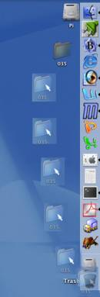
Engagement
Another way to think about this is in terms of “locus of control.”
In terms of the outcome:
Do I feel like I am in control?
Do I feel like the system is in control?

Slide 18
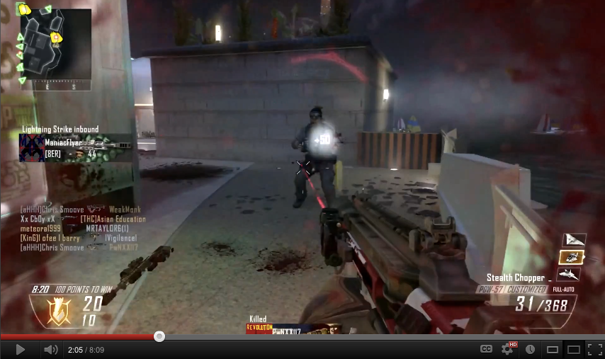
Black Ops 2

Slide 19
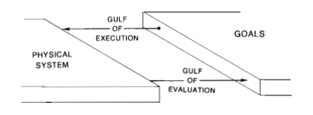
Distance and the Gulfs…
Gulf of execution: ability to express my desires/intentions to the system
Gulf of evaluation: ability to understand what system is communicating to me
Notes:
What’s important here:
It’s about a dialogue between the user and the system
It’s a TWO WAY THING
So, on the one hand, it does have a little to do with a person’s capacity: reaction, eye-hand coordination, knowledge
But it also has to do with the system’s capacity to: speak in the person’s language, efficiency, expressivity.

Slide 20
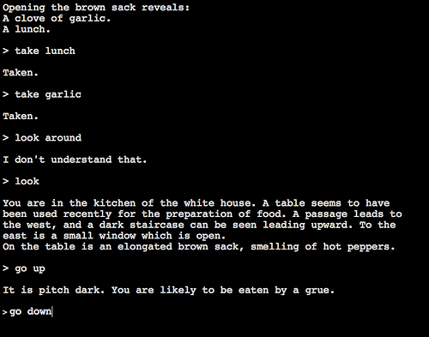
Zork

Slide 21
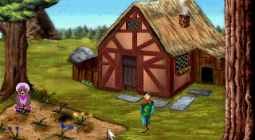
King’s Quest
Notes:
http://www.agdinteractive.com/games/kq2/about/about.html

Slide 22
Distance: communication
Semantic distance
» is it possible to say what I want to say?
» can it be said concisely?
Articulatory distance
» how difficult is it to “physically” express these meanings?
Notes:
http://www.paulgraham.com/avg.html
Semantic distance:
-- in a GUI: can I say: repeat this action multiple times?
-- in a console, …
Limits of a language. If you know multiples language
Articulatory distance: how many key presses, how much to move the mouse, etc.

Slide 23
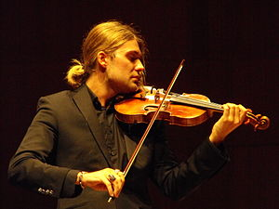
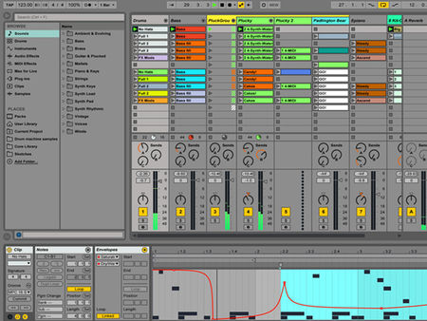
Any musicians out there?
Notes:
David Garrett
http://cdn.mos.musicradar.com/images/carouselimages/ableton-live-9-session-carousel-450-80.jpg

Slide 24
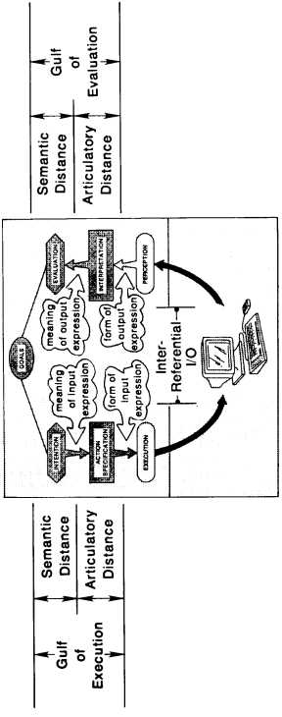
Another way of viewing interaction
Minimize gulf of execution
Minimize gulf of evaluation
Notes:
http://www.ifs.tuwien.ac.at/~silvia/wien/vu-infovis/articles/hutchins_1985_direct-manipulation.pdf
These are not always in sync with one another
How the system responds to you may not be in the same medium that you communicate with it in
For example: voice commands/number presses to have a system do something (say on the phone)
Or voice dictation
That’s why listening to voice menus is such a pain in the butt. It’s this huge gulf of evaluation and huge gulf of execution. Not allowing me to express what I want to express. Some systems: you can say a one or two word thing to trigger a particular menu.
But, isn’t it better to talk to someone often?

Slide 25
Outline
Direct manipulation
What does “direct” mean?
» engagement
» distance
» semantic and articulatory distances

