Slide 1
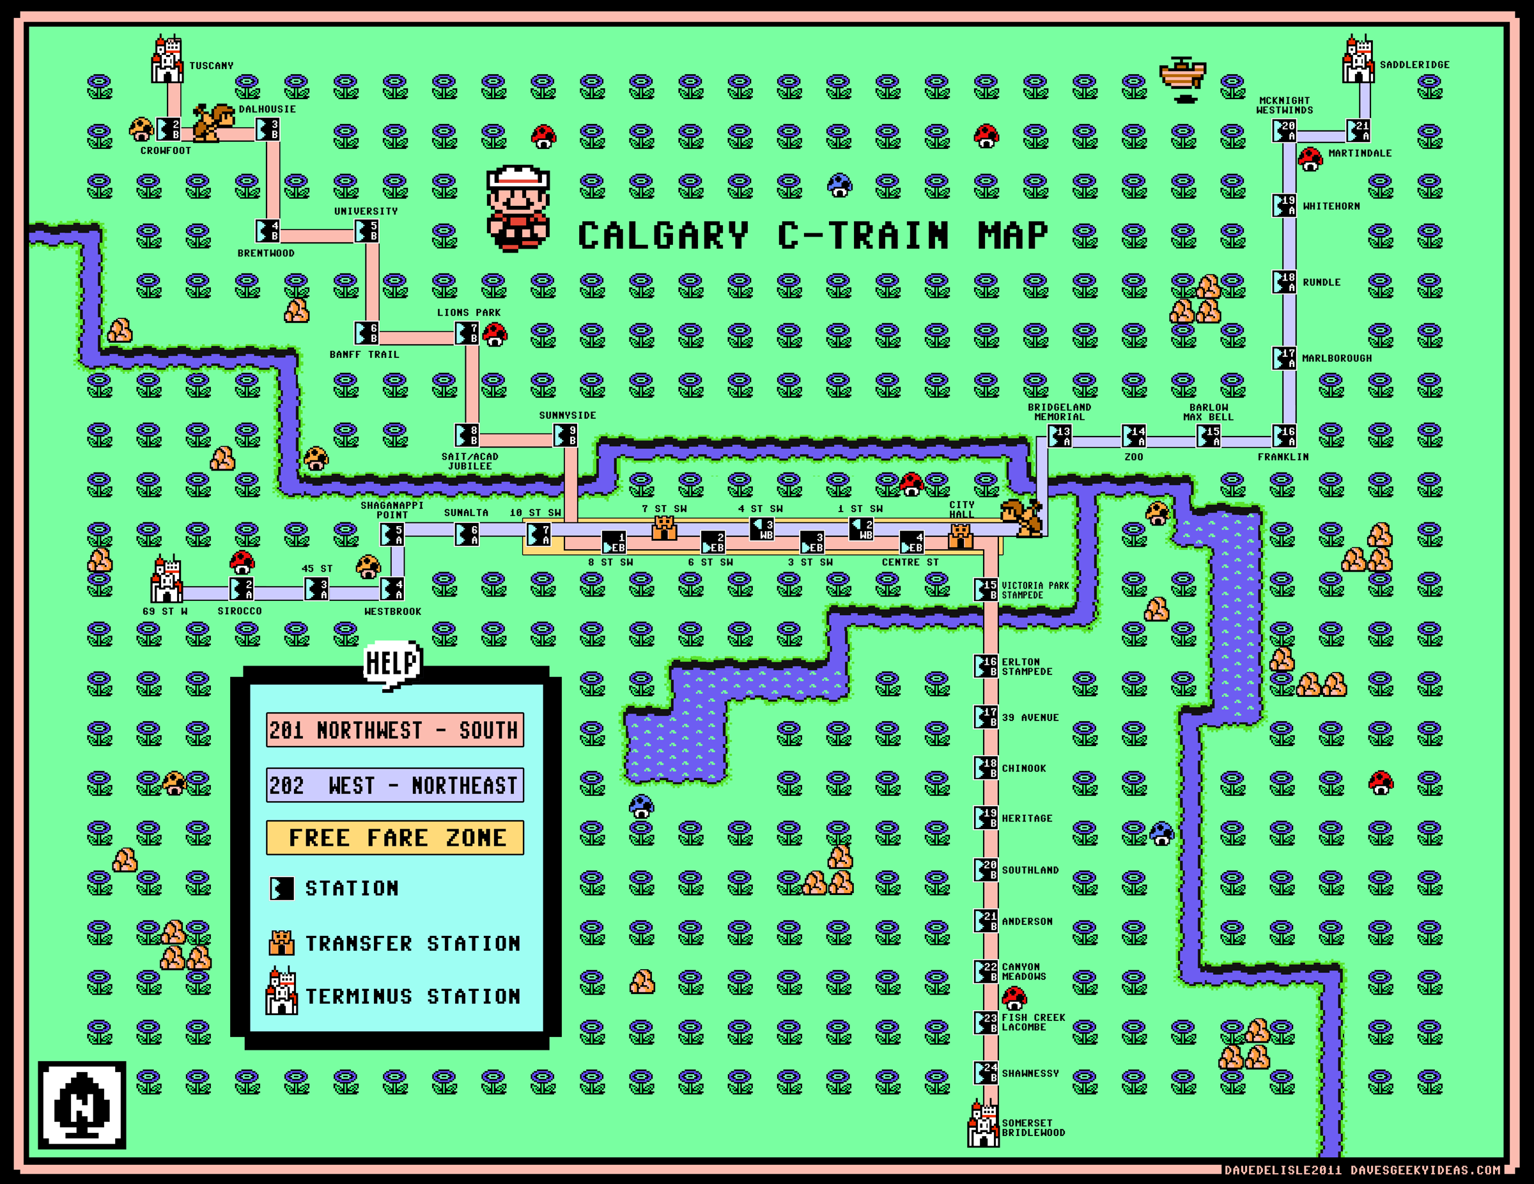
Notes:
http://originaldave77.files.wordpress.com/2011/10/super-mario-3-calgary-c-train-map-2011-2012-davesgeekyideas-wallpaper1.png

Slide 2
Information Visualization 1
CPSC 481: HCI I
Fall 2012
Anthony Tang

Slide 3
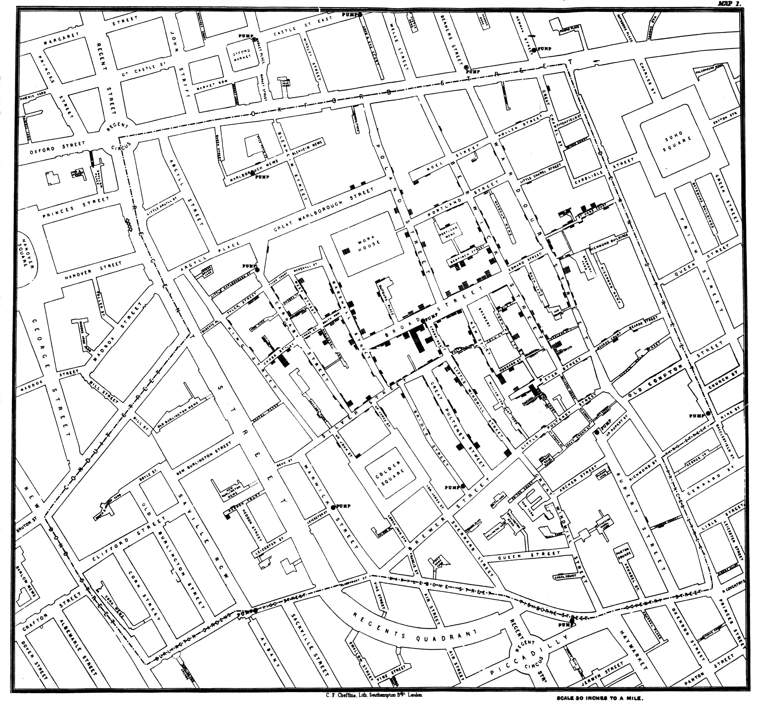
Deaths by Cholera
Dr John Snow,1854
Notes:
http://upload.wikimedia.org/wikipedia/commons/2/27/Snow-cholera-map-1.jpg

Slide 4
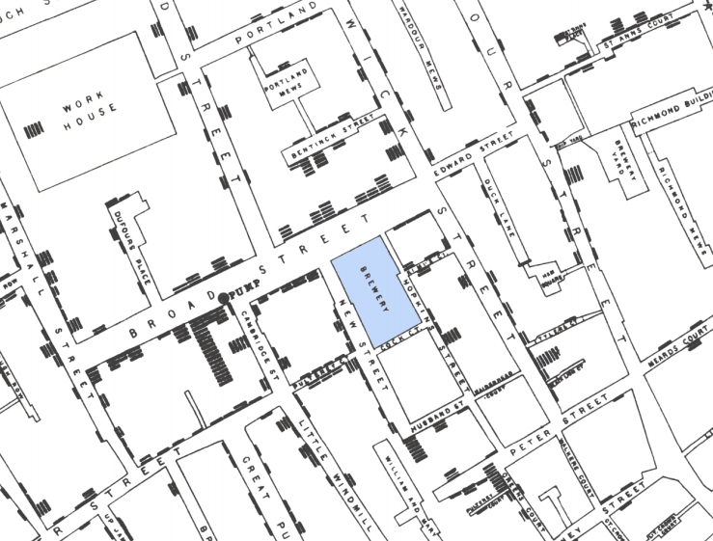
Notes:
Brewery bit is funny
Pump is the key
Dirty pump handle
This is technically a “Geo Visualization”, where data can be grounded geographically
A lot of time, data doesn’t work that way
Next time, we’ll talk about the different kinds of data, but there is a lot of data that is inherently not grounded spatially like this one

Slide 5
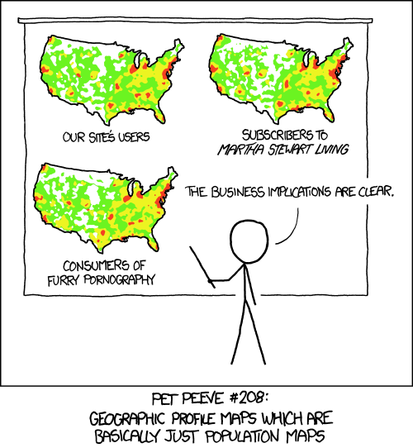
Notes:
http://xkcd.com/1138/
Causality is a tricky thing, and we need to be careful of what is representing what
These relationships may be spurious, and sometimes, they really don’t fit or make sense if we think about them

Slide 6
Edward Tufte: Graphics should reveal the data
» show the data
» not get in the way of the message
» avoid distortion
» make large data sets coherent
» encourage comparison between data
» supply both broad overview and fine detail
» serve a clear purpose
Notes:
http://www.wired.com/wired/archive/11.09/ppt2.html
http://www.edwardtufte.com/bboard/q-and-a-fetch-msg?msg_id=0001yB

Slide 7
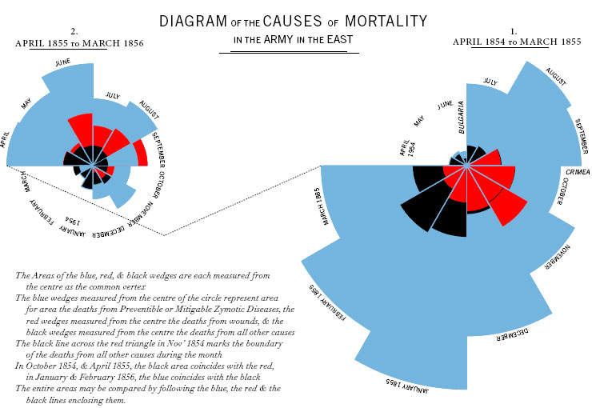
Notes:
http://guidestarinternational.files.wordpress.com/2011/08/florence-nightingale-diagram2.jpg
Florence Nightengale
Crimean war begins, and you can see the different types of death
She was able to do something starting in march 1885
» sanitation
» food quality
» cleanliness, etc.
Convinced people of what was going on, and many of these couldn’t read
The data told the story, but particularly as presented in this way
Impressive but, also, lies a bit.
Why?
Sectors are too fat

Slide 8
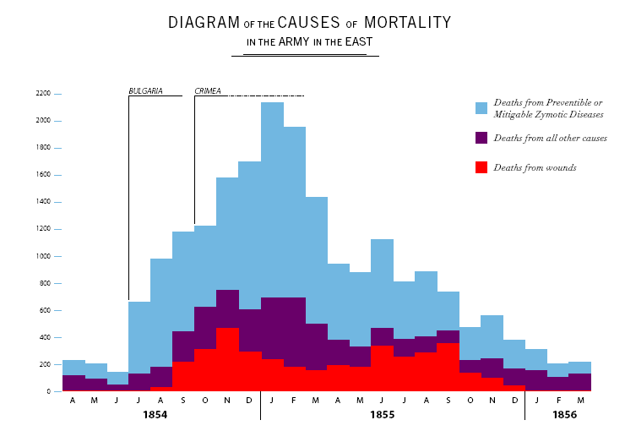
Notes:
Here’s another representation
Shows the same data.
How does this compare to the previous visualization?

Slide 9
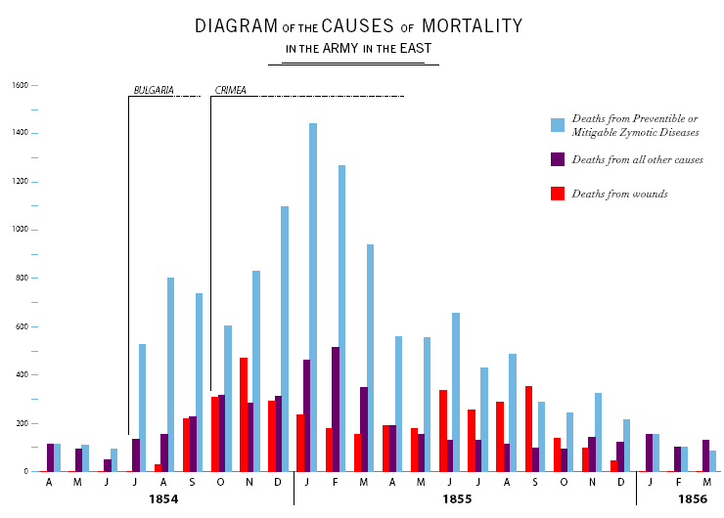
Notes:
One more time. How does this compare?
(Non-stacked allow for easier comparison across the relevant cases

Slide 10
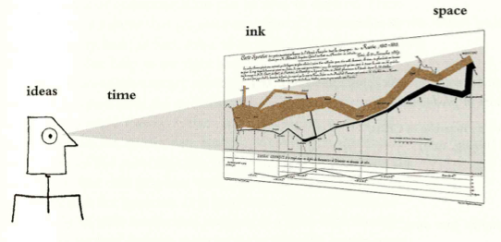
Tufte: “Graphical excellence”
That which gives the viewer the greatest number of ideas in the shortest time with the least ink in the smallest space.

Slide 11
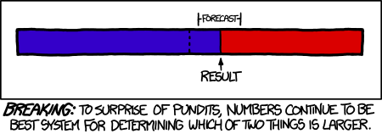
Notes:
http://xkcd.com/1131/
How we represent information needs to be useful
As I followed the US presidential election, this also frustrated me a great deal
I just couldn’t do a reasonable comparison.
All this viz allows you to do is to compare where we are to where things need to be for a particular side to win.

Slide 12
Edward Tufte's Principles
Data Densities:
Graphics are at their best when they represent very dense and rich datasets. Tufte defines data density as follows:
Data density= (no. of entries in data matrix)/(area of graphic)
Notes:
From last time…
Compactness of the visualization
Effective use of ink

Slide 13
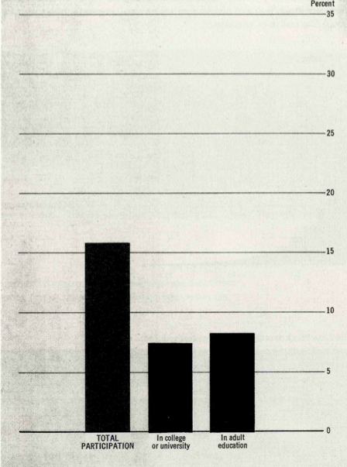

Low Data Density…

Slide 14
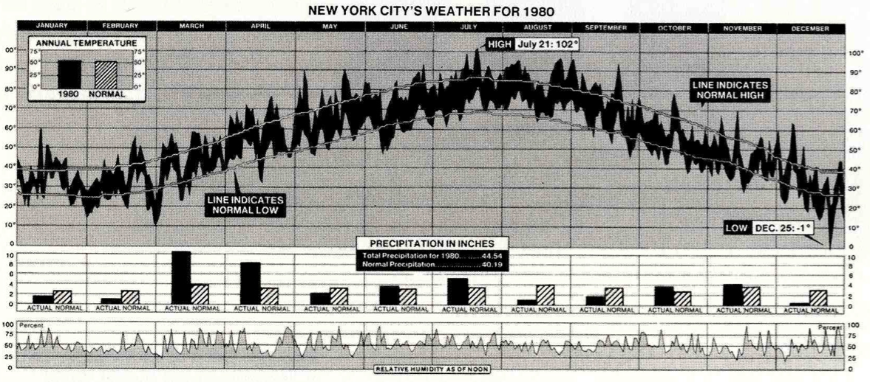
High Data Density
Think: data points per square centimeter…

Slide 15
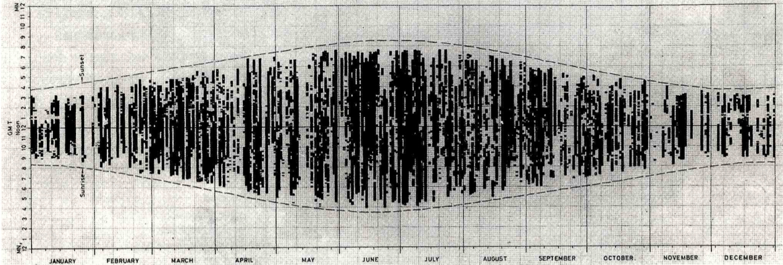
More High Data Density
Notes:
Sun observations in a year

Slide 16
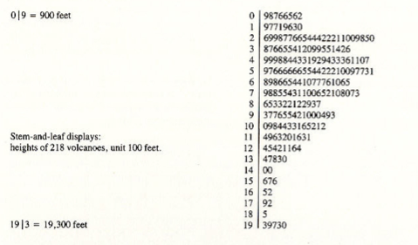
Stem-Leaf Plot
Notes:
Consider a stem-leaf plot
This is cool… the data itself doubles as a visualization because it takes up space.
The plot also allows us to see the distribution of the volcanos also

Slide 17
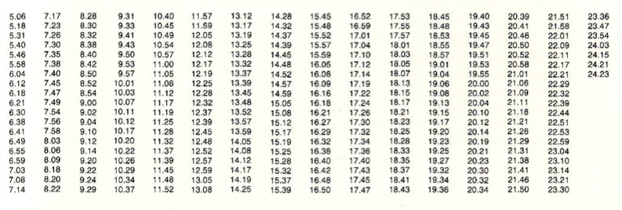
Bus/Train Times
Notes:
Lots of info here…

Slide 18
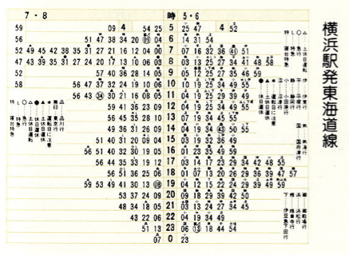
Train Times in Japan
Notes:
Efficiency in the use of ink
Left side is for trains going one way
Right side is for trains going the other way
Middle column is hour, and the times are listed
Left edge, things are kind of spurting out
This tells us a LOT of info that we actually cannot glean without careful examination of the previous representation

Slide 19
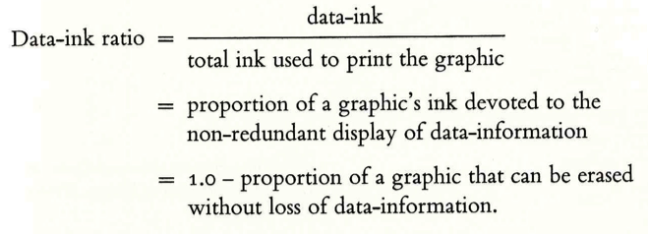
Edward Tufte Principle
Maximize data-ink ratio
Remove non-data ink within reason

Slide 20
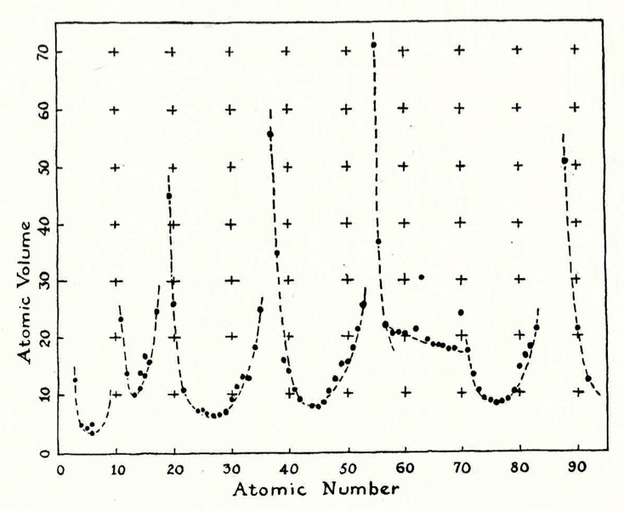

Slide 21
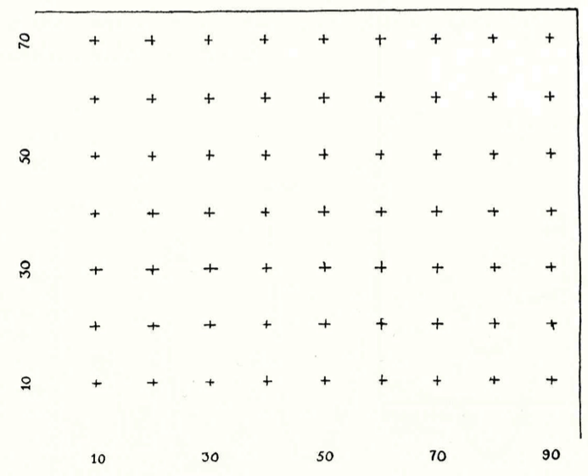
Original
Some of the non-data ink

Slide 22
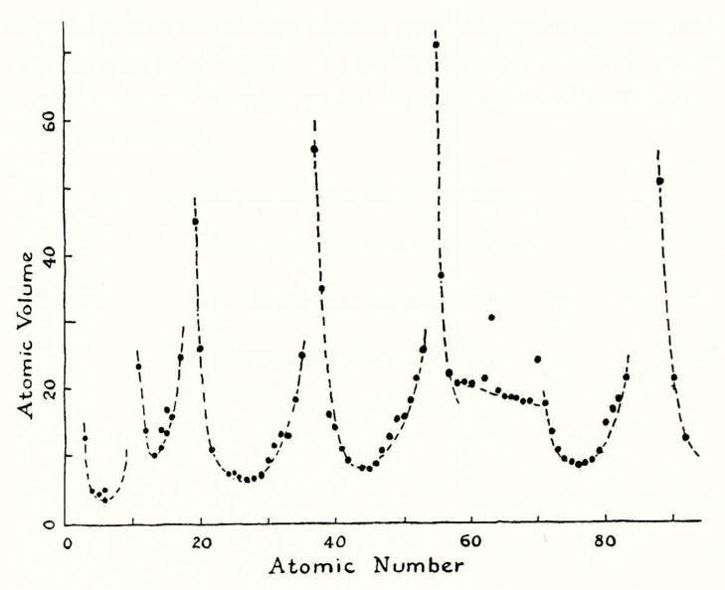
Notes:
Note– some of the stuff doesn’t follow the periodicity implication

Slide 23
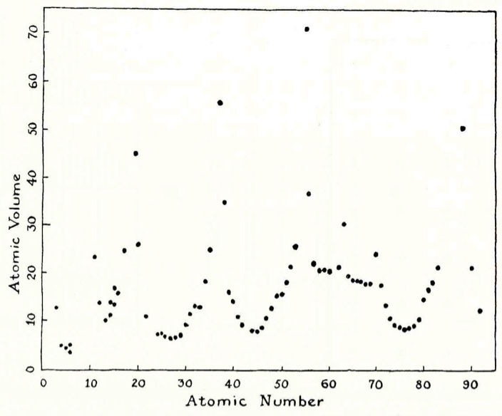
Notes:
Taking away the curves kind of removes some of the structure

Slide 24
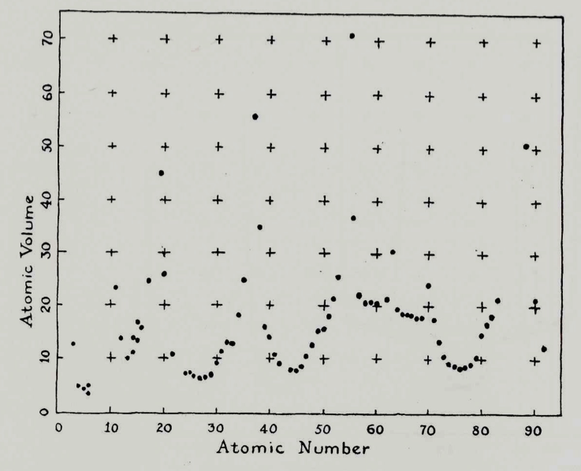
Notes:
Grid ticks are really overwhelming

Slide 25
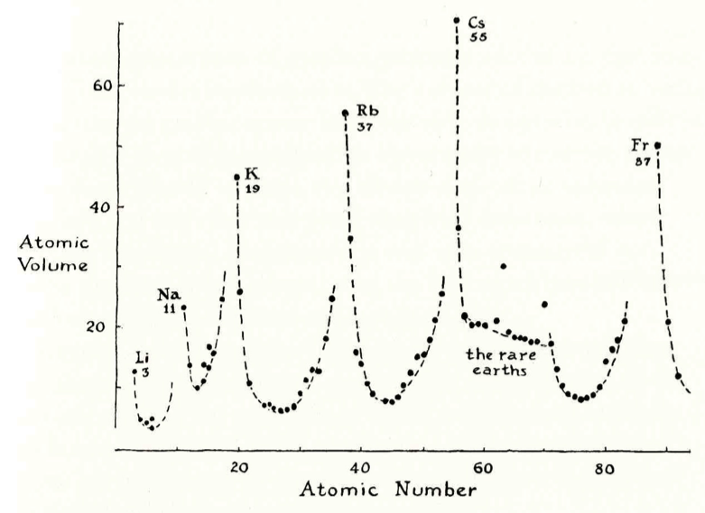
Notes:
Add in a bit of labeling to help tell the story

Slide 27
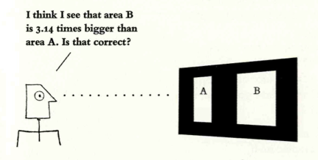
Tufte: Comparison and Small Multiples
At the heart of quantitative reasoning is a single question: compared to what?
Small multiples … visually enforcing comparisons of changes, of the differences among objects, of the scope of alternatives. For a wide range of problems in data presentation, small multiples are the best design solution.

Slide 28
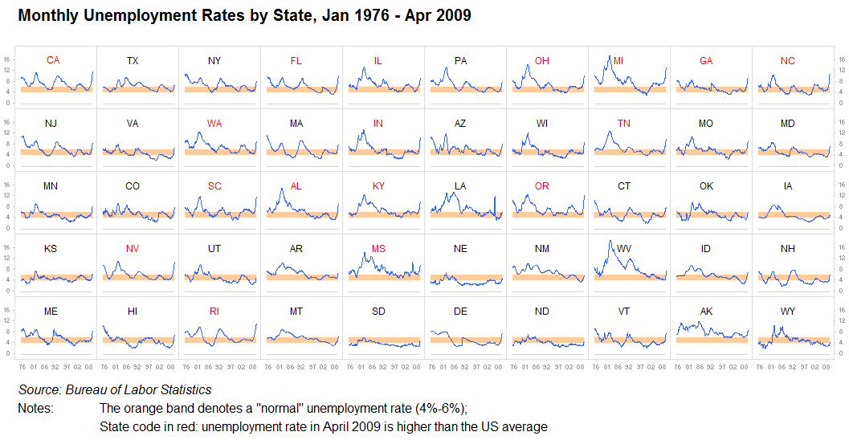
Small Multiples Illustrated

Slide 29
Small Multiples
Sets of thumbnail sized graphics on a single page that represents aspects of a single phenomenon.
Answers the “compared to what” question through repetition.
  » uses the same measures and scale
  » invites comparison
  » shows a range of options
  » on computers: overlay, rapid cycling…

Slide 30
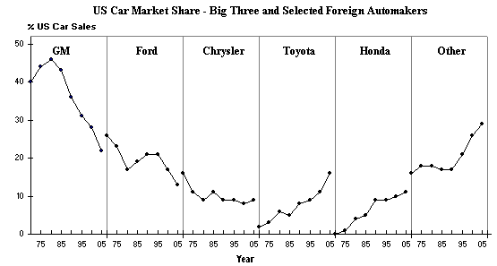
More Small Multiples

Slide 31
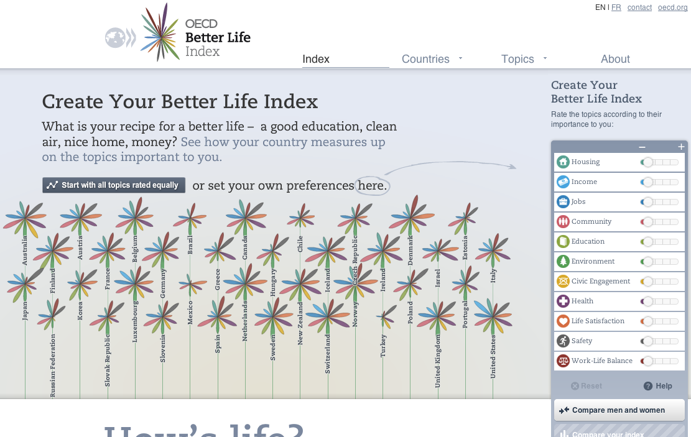
http://www.oecdbetterlifeindex.org/
Notes:
http://www.oecdbetterlifeindex.org/

Slide 32
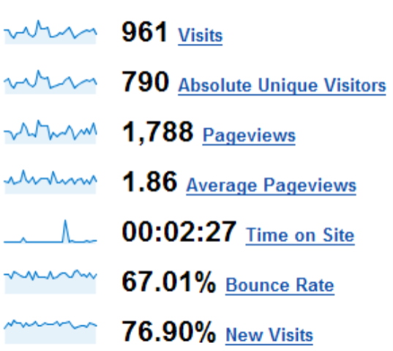
Sparklines (Tufte)
“…data-intense, design-simple, word-sized graphics…”
Sparklines
  » part of text flow
  » memorable, concise
  » located inline, same height as text

Slide 33
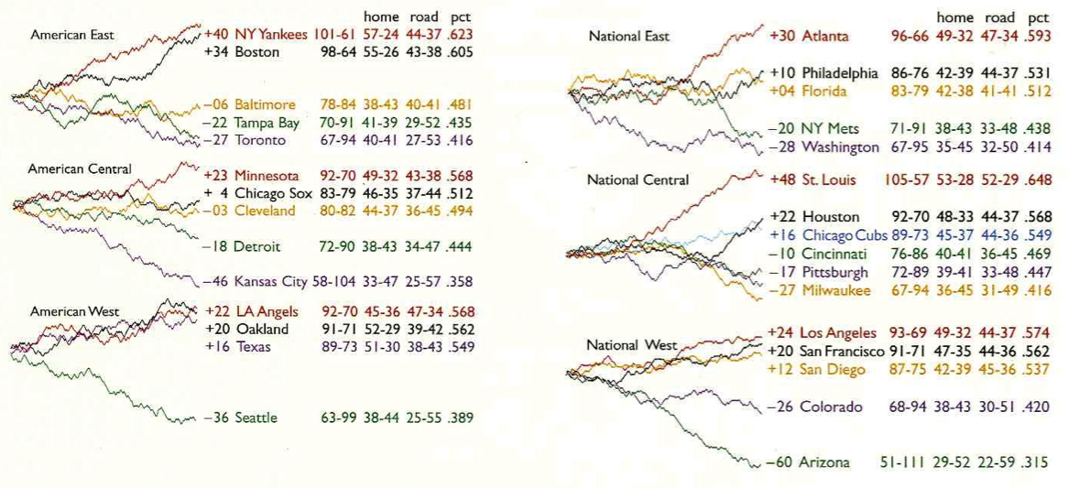

Slide 34
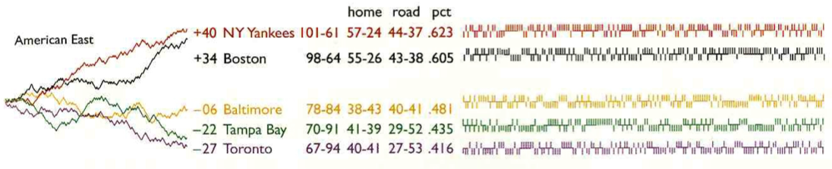

Slide 35

Interactive visualizations
Overview first, zoom and filter, then details on demand
Ben Shneiderman, Designing the User Interface 3rd Ed. 1997

Slide 36
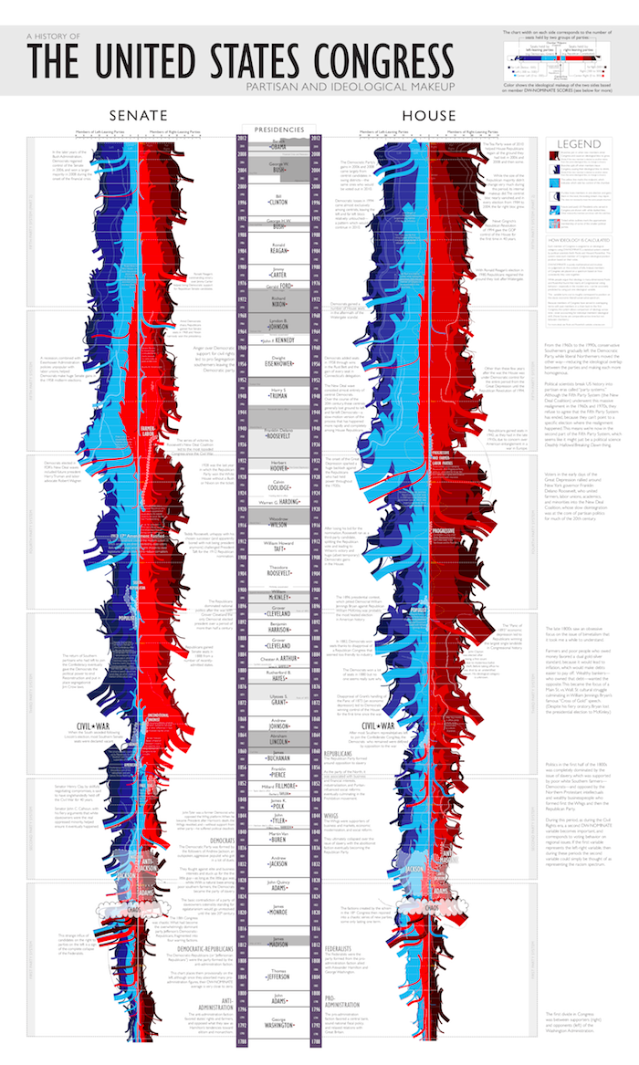
xkcd: the “shape” of US Congress
http://xkcd.com/1127/

