Slide 1
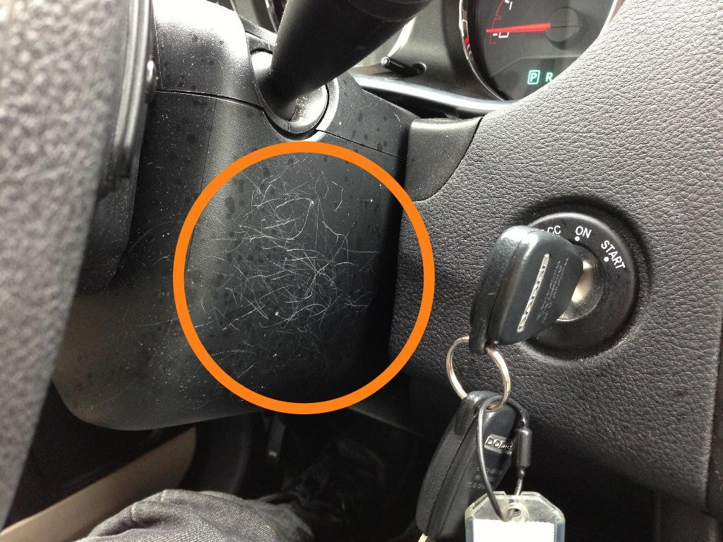
What happens when you don’t choose to follow convention…
Notes:
https://twitter.com/boagworld/status/263829079843811328/photo/1

Slide 2
Information Representation
CPSC 481: HCI I
Fall 2012
Anthony Tang

Slide 3
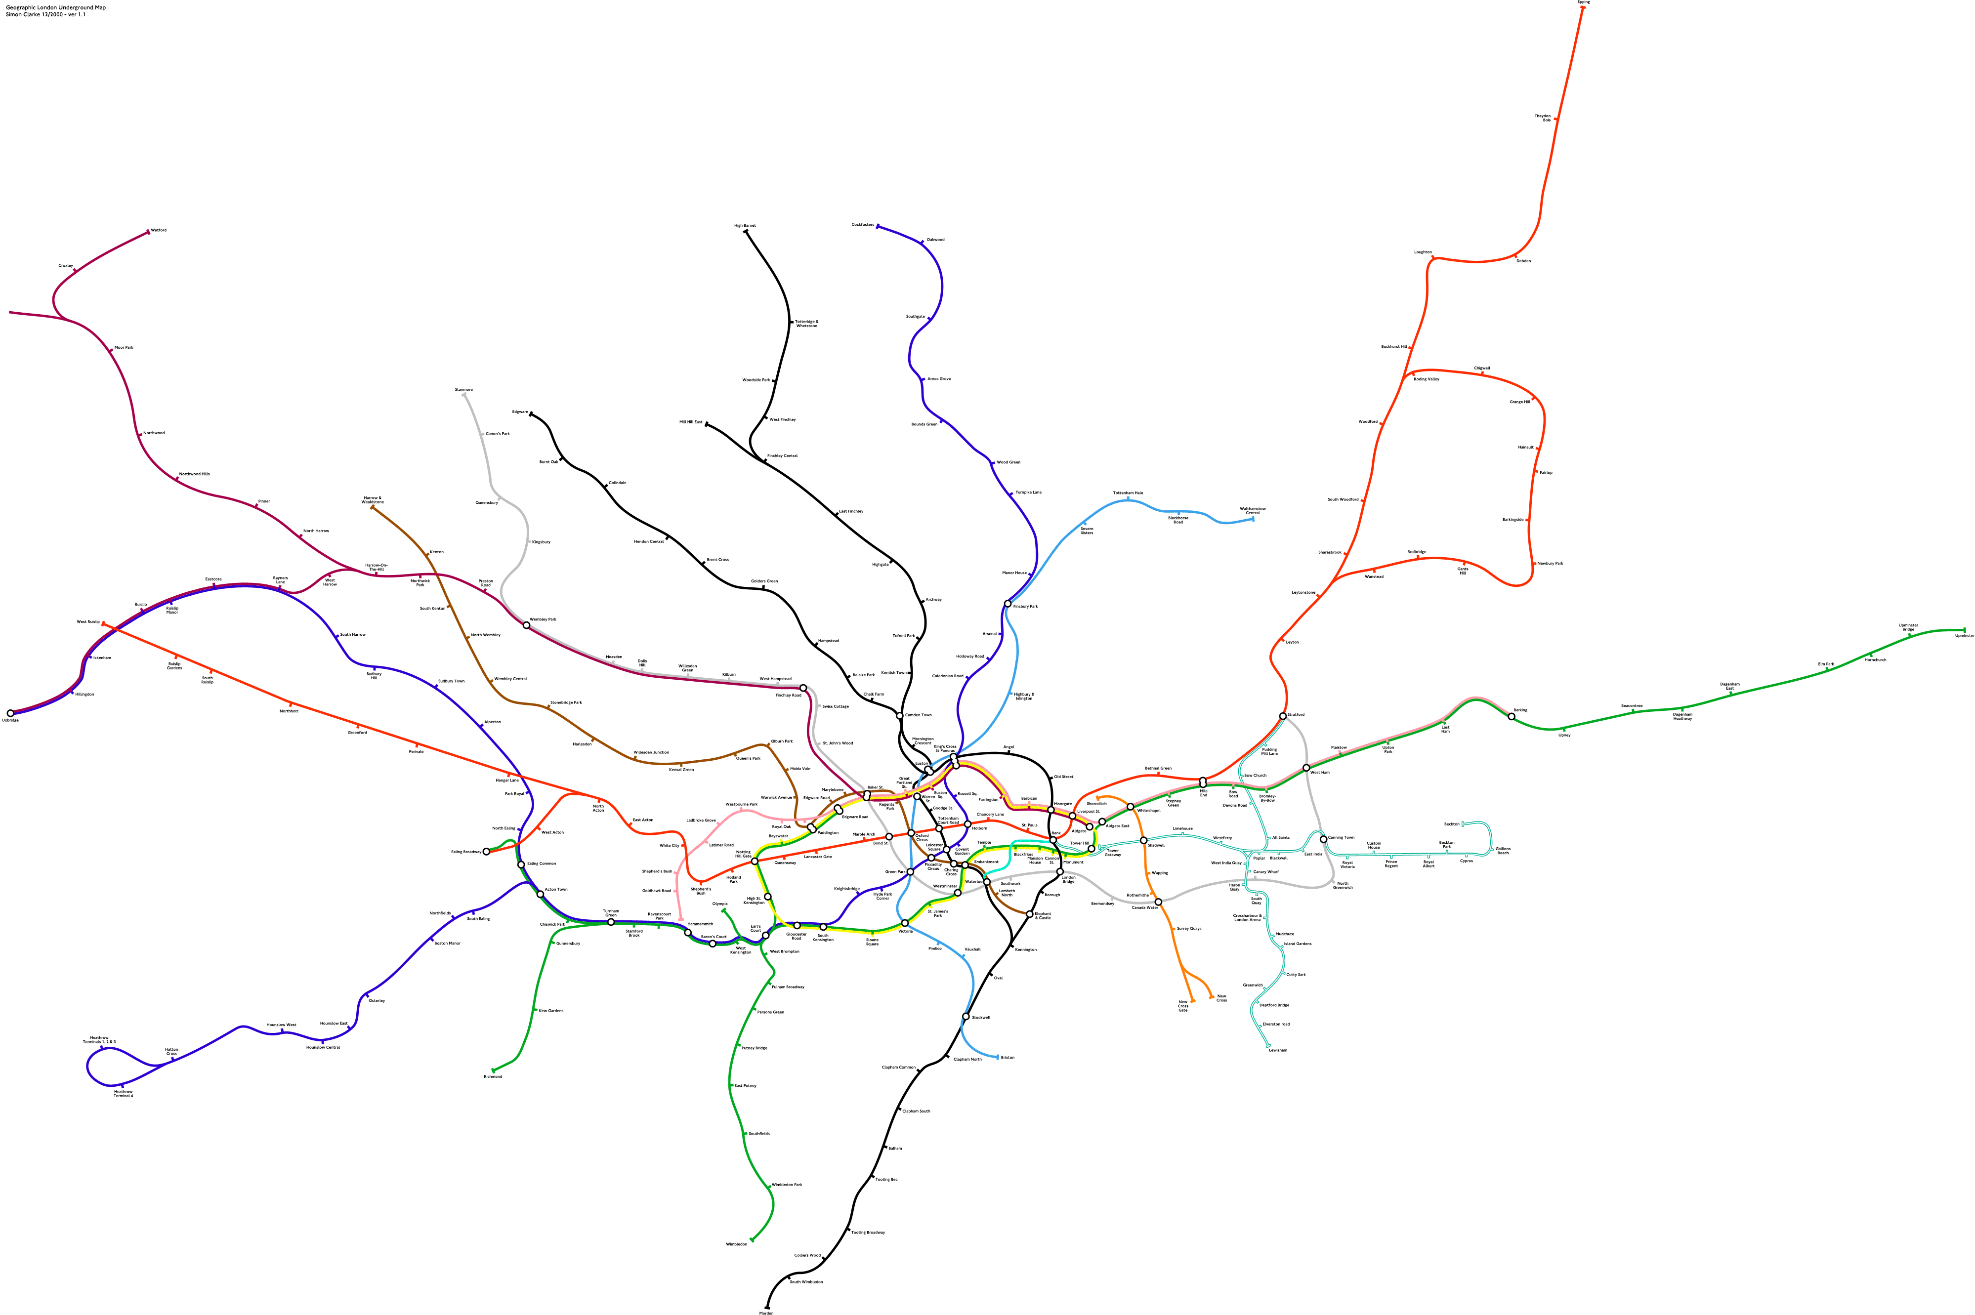
Notes:
http://i.imgur.com/Qxbza.gif
Who recognizes this? – this is the London underground tube, and all the different routes
What does it show?
What does it not show?
Heavy congestion in some parts, hard to make out things
Requires a lot of space, because london is a big place!
Unclear where lines go and intersect, and where they touch one another, etc. how to make transfers, etc.

Slide 4
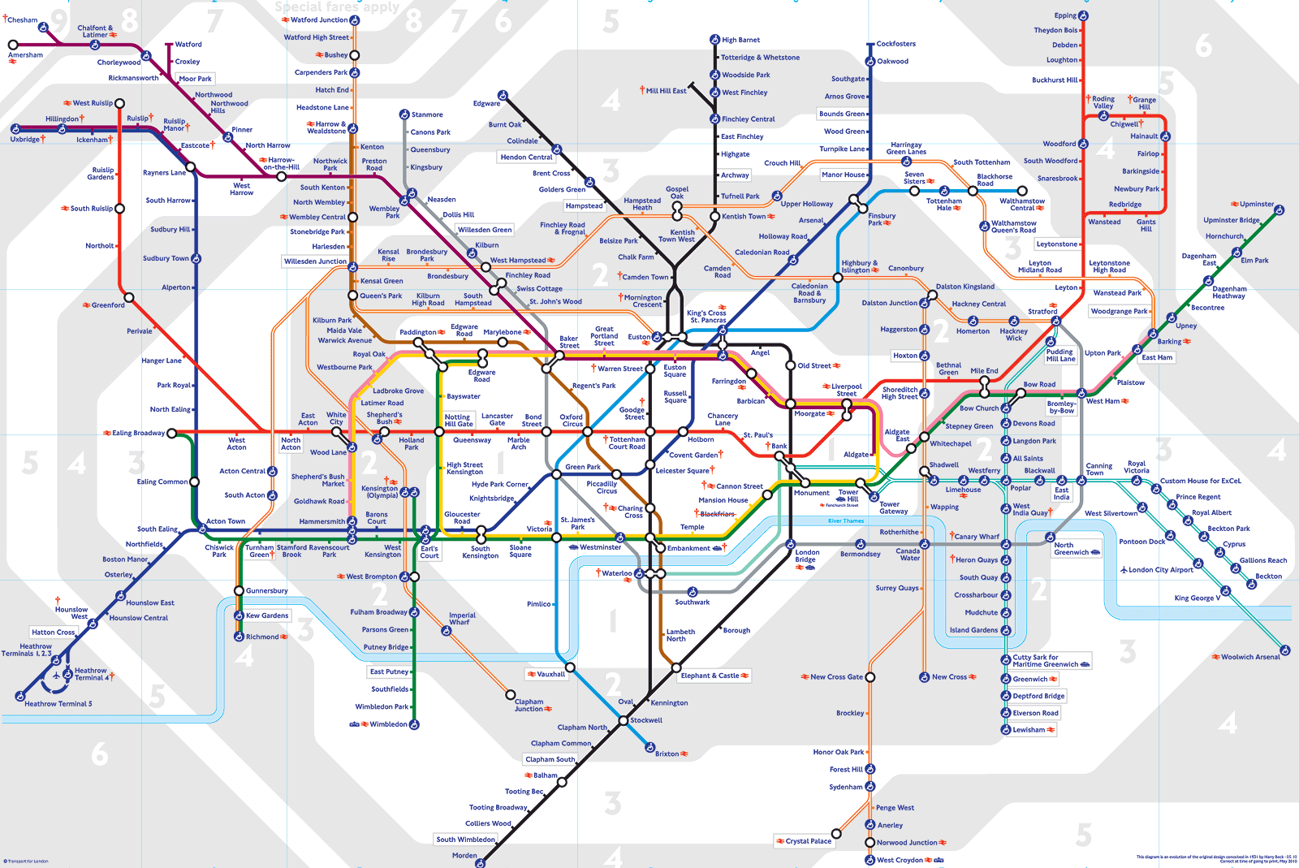
Notes:
http://www.bbc.co.uk/london/travel/downloads/tube_map.gif
Who recognizes this? [London Tube Map]
What does it show?
What does it not show?
Abstracted away many of the distances between stops
Also abstracted away some of the directions between stops
Exaggerate distance between some stops that in the downton core – for the purpose of /showing/
Means that Tony took trains between stops that were no more than five blocks away
Means also that sometimes when it looked like a transfer, Tony had to walk a few blocks underground without knowing it
Neat: overlay of the “zones” – these also give you some sense of distance
Effective for “counting stops”, which is how people give you directions. “Go to blah blah square, it’ll be x stops”

Slide 5
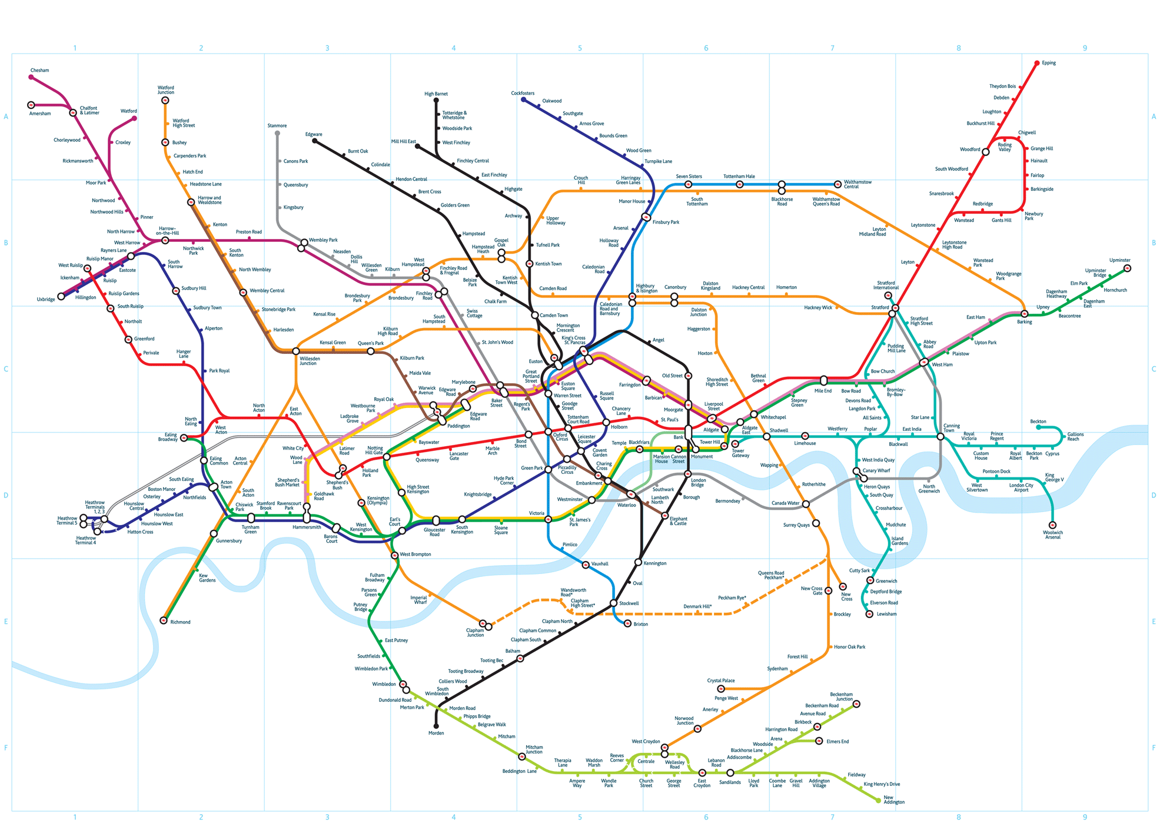
Notes:
http://www.london-tubemap.com/images/layer2.gif
Kind of a compromise version

Slide 6
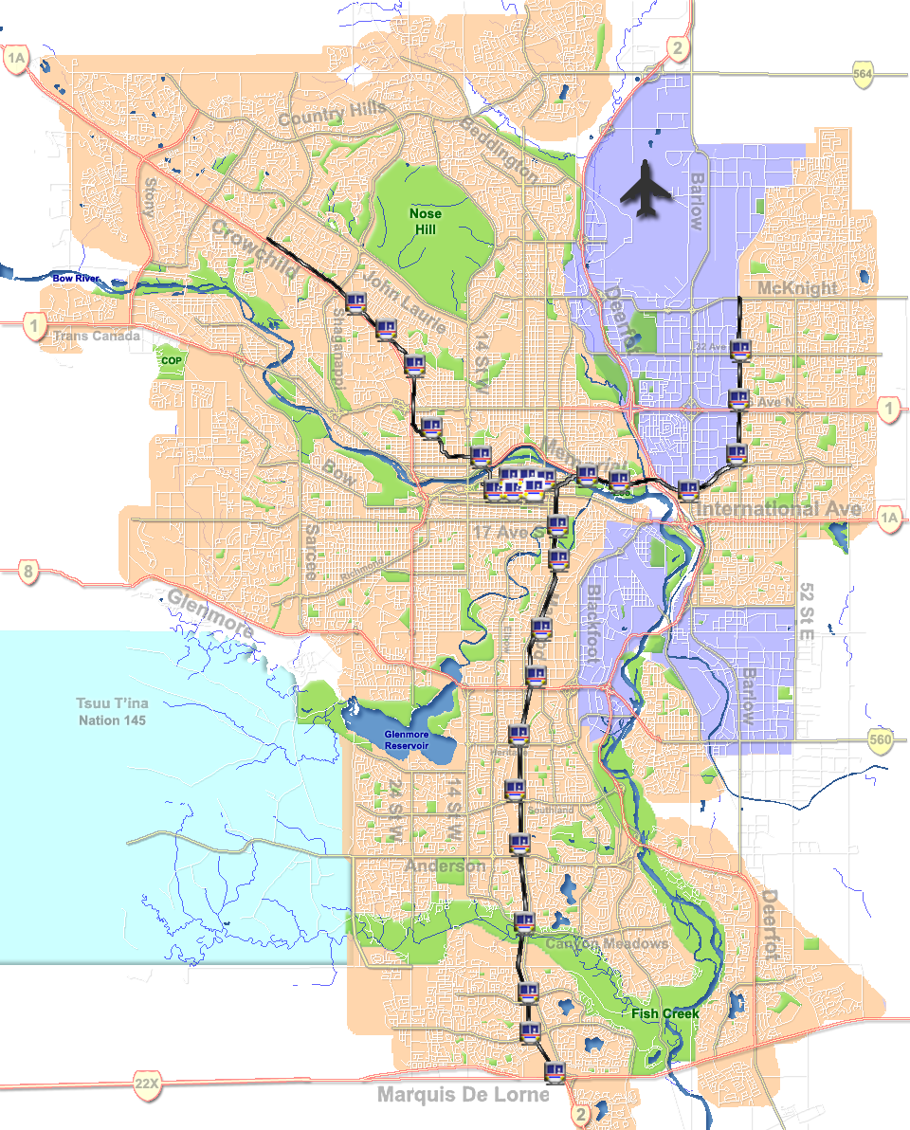
Notes:
http://upload.wikimedia.org/wikipedia/commons/9/9b/Calgary-CTrain_stations.png
You can see this more directly in something that you are familiar with

Slide 7
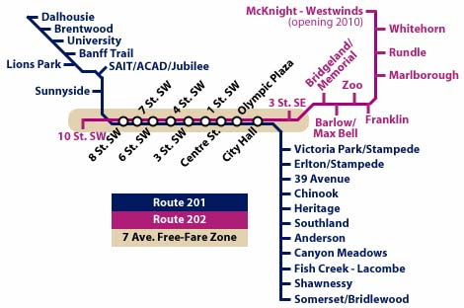

Slide 8
Punchline
Good representations…
» Show essential elements of the event/world
» Leave out irrelevant elements
» Appropriate for the person (interpretation, attention)
» Appropriate for the task

Slide 9
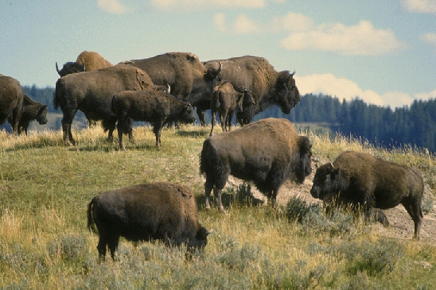

How many buffalo?
# Buffalo
# Buffalo
# Adults
# Calfs
8
4

Slide 10
What is a representation?
Representation
“Formal system or mapping by which information can be specified”
Example
decimal 34
binary 100010
roman XXXIV
Representation choices tell us something specific about the information

Slide 11
Representations
Solving a problem simply means representing it so as to make the solution transparent (Simon, 1981)
Good representations
» Allow people to find relevant information
(information may be present but hard to find)
» Allow people to compute desired conclusions
(computations may be difficult or “for free” depending on representations)

Slide 12
Let’s play a game… (1)
Let’s play a game: the game of “15.” The “pieces” for the game are the nine digits: 1, 2, 3, 4, 5, 6, 7, 8, 9. Each player takes a digit in turn. Once a digit is taken, it cannot be used by the other player. The first player to get three digits that sum to 15 wins.
Here is a sample game: Player A takes 8. Player B takes 2. Then A takes 4, and B takes 3. A takes 5.
Question: Suppose you are now to step in and play for B. What move would you make?

Slide 13
Let’s play a game… (2)
Now let’s play a different game, tic-tac-toe. Players alternately place a naught (the symbol O) or a cross (the symbol X) in one of nine spaces arranged in a rectangular array (as shown in the following illustration). Once a space has been taken, it cannot be changed by either player. The first player to get three symbols in a straight line wins. Suppose player A is X and B is O, and the game has reached the following state:

Slide 14
Let’s play a game… (3)
Remember the moves in the game of 15? A had selected 8, 4, and 5; B had selected 2 and 3:
B better select 6 this time!!
Notes:
A good representation makes all the difference here!!!

Slide 15
Which is the best flight option?
length
stop-overs
switches
different time zones
...
depart arrive
AC 117 Vancouver - Calgary 7:00 9:00
Cdn 321 Vancouver - Calgary 9:00 12:00
Cdn 355 Calgary - Montreal 13:30 19:30
AC 123 Calgary - Toronto 12:30 16:30
AC 123 Toronto - Montreal 16:45 17:30
*time zone: +1 van-cal, +2 cal-tor, mtl
Vancouver
7
9
11
13
15
17
AC 117
Cdn 321
Calgary
8
10
12
14
16
18
AC 123
Cdn 355
Toronto
Montreal
10
12
14
16
18
20
Notes:
Depending on your representation, many things come for free. Here, we can see that the slope tells us something straight up

Slide 16
When do I take my drugs?
10 - 30% error rate in taking pills, same for pillbox organizers
Inderal - 1 tablet 3 times a day Lanoxin - 1 tablet every a.m. Carafate - 1 tablet before meals and at bedtime Zantac - 1 tablet every 12 hours (twice a day) Quinag - 1 tablet 4 times a day Couma - 1 tablet a day
Breakfast Lunch Dinner Bedtime Lanoxin O Inderal O O O O Quinag O O O O Carafate O O O O Zantac O O Couma O
Breakfast Lunch Dinner Bedtime Lanoxin Inderal Inderal Inderal Inderal Quinag Quinag Quinag Quinag Carafate Carafate Carafate Carafate Zantac Zantac Couma
Adapted from Donald Norman

Slide 17
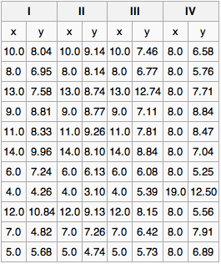
Anscombe’s Quartet
How to analyze these four data sets?
» averages
» variances
» correlation
» linear regression
Notes:
http://en.wikipedia.org/wiki/Anscombe's_quartet

Slide 18
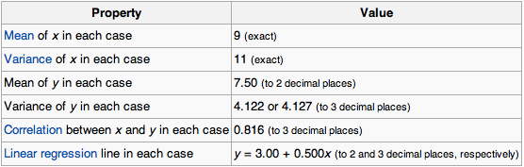
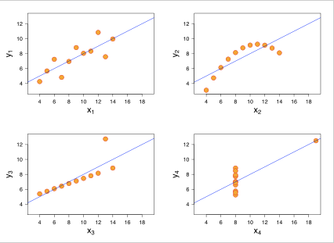
Anscombe’s Quartet
Notes:
http://en.wikipedia.org/wiki/Anscombe's_quartet
Point: a different representation of that tabular data gives us a new way to think about it, and reveals some obvious properties in the data that you would otherwise not see/think of

Slide 19
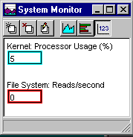
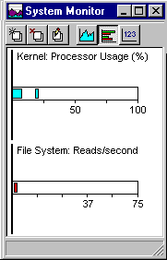
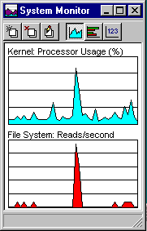
Which representation is best?
depends heavily on task
What is precise value?
How does the performance
now compared to its peak?
How does performance change over time?

Slide 20
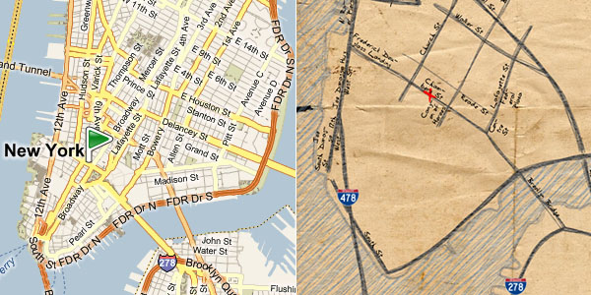
Bing Maps: Napkin Sketches
Each of these is good for different kinds of things. The napkin sketch is useful when trying to get from one place to another, and knowing which roads are the relevant ones. The regular map view is useful if you get lost! Also useful for seeing other features of the map.
Notes:
http://infosthetics.com/archives/2010/06/bing_destination_map_automatic_napkin_sketching_of_maps.html
What are each of these good for?
Depends on the task.

Slide 21
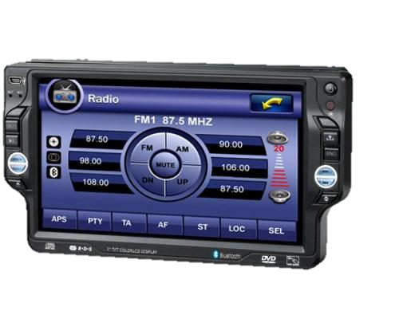
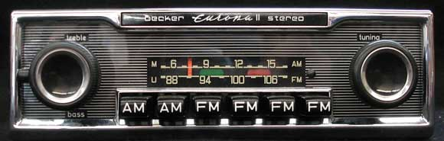
Which representation is best?
depends also on user…
What station am I listening to? What is my ability to look at the display?
Notes:
http://www.happyshoppinglife.com/car-dvd-player-1-din-car-dvd-player-c-2_13.html
http://www.blackforestllc.com/becker.html

Slide 22
Edward Tufte
PowerPoint can do harm
» changes the way we think
» changes the way we do presentations
» argues that it caused the 1988 NASA Columbia disaster
Chart junk is confusing, overly prevalent and unnecessary
Goal should be high data density
Notes:
http://www.wired.com/wired/archive/11.09/ppt2.html
http://www.edwardtufte.com/bboard/q-and-a-fetch-msg?msg_id=0001yB

Slide 23
Chart Junk does Harm…
“…the interior decoration of graphics generates a lot of ink that does not tell the viewer anything new. The purpose of decoration varies – to make the graphic appear more scientific and precise, to enliven the display, to give the designer an opportunity to exercise artistic skills. Regardless of its cause, it is all non-data-ink or redundant data-ink, and it is often chartjunk…“
Tufte, The Visual Display of Quantitative Information.

Slide 24
Chart Junk: confusing & unnecessary visual elements
Information display is not just pretty graphics
graphical re-design by amateurs on computers gives us
“fontitis,” “chart-junk,” etc.
Notes:
Chartjunk is a term for unnecessary or confusing visual elements in charts and graphs. Markings and visual elements can be called chartjunk if they are not part of the minimum set of visuals necessary to communicate the information understandably. Examples of unnecessary elements which might be called chartjunk include heavy or dark grid lines, ornamented chart axes and display frames, pictures or icons within data graphs, ornamental shading and unnecessary dimensions.
Another kind of chartjunk skews the depiction and makes it difficult to understand the real data being displayed. Examples of this type include items depicted out of scale to one another, noisy backgrounds making comparison between elements difficult in a chart or graph, and 3-D simulations in line and bar charts.
The term chartjunk was coined by Edward Tufte in his 1983 book The Visual Display of Quantitative Information. Tufte wrote: "The interior decoration of graphics generates a lot of ink that does not tell the viewer anything new. The purpose of decoration varies – to make the graphic appear more scientific and precise, to enliven the display, to give the designer an opportunity to exercise artistic skills. Regardless of its cause, it is all non-data-ink or redundant data-ink, and it is often chartjunk."

Slide 25
Chart Junk: Removing deception and simplification
70
Maintenance cost / year
65
60
55
50
45
40
35
30
25
20
15
10
5
0
Ford
GM
Pontiac
Toyota

Slide 26
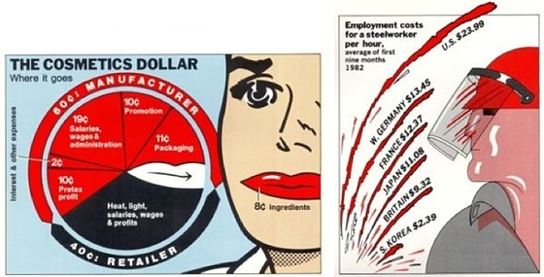
Chart Junk: Adornments don’t help us interpret the information
Notes:
http://eagereyes.org/criticism/chart-junk-considered-useful-after-all
^ interesting scientific work that disputes whether chart junk is actually useless. Kind of controversial in the scientific literature as of late, but generally, it is received wisdom that chart junk is useless

Slide 27
Data Density
Graphics are at their best when they represent very dense and rich datasets. (“Use only the ink you need to use”.)
Tufte defines data density as follows:
Data density= (no. of entries in data matrix)/(area of graphic)

Slide 28
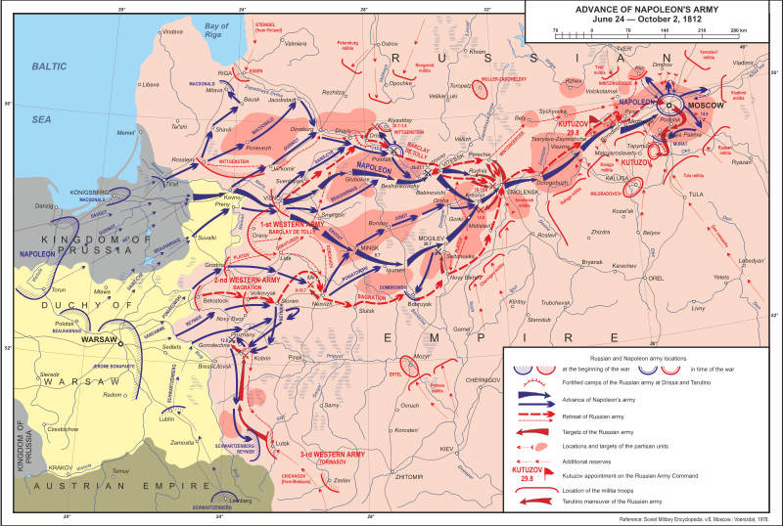
Napoleon’s march to Moscow

Slide 29
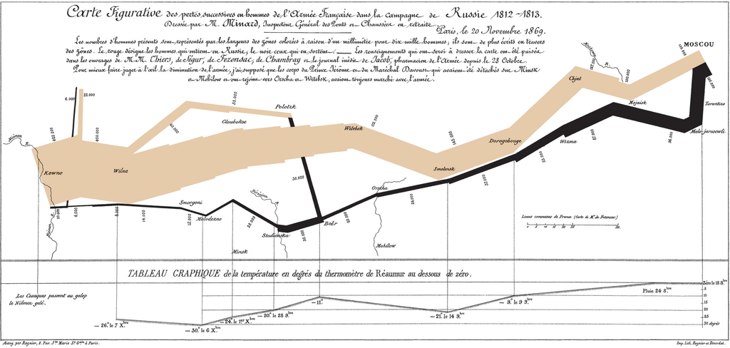
Napolean's march to Moscow (Minard)
E. Tufte “Visual Display of Quantitative Information”
Notes:
http://en.wikipedia.org/wiki/File:Minard.png
As the graph of Charles Joseph Minard, given below, shows, the Grande Armée incurred the majority of its losses during the march to Moscow during the summer and autumn. Starvation, desertion, typhus and suicide would cost the French Army more men than all the battles of the Russian invasion combined.[22] [edit]

