Slide 1
Interactive Tabletops and Surfaces 2012 - Summary
CPSC 481: HCI I
Fall 2012
Anthony Tang

Slide 2
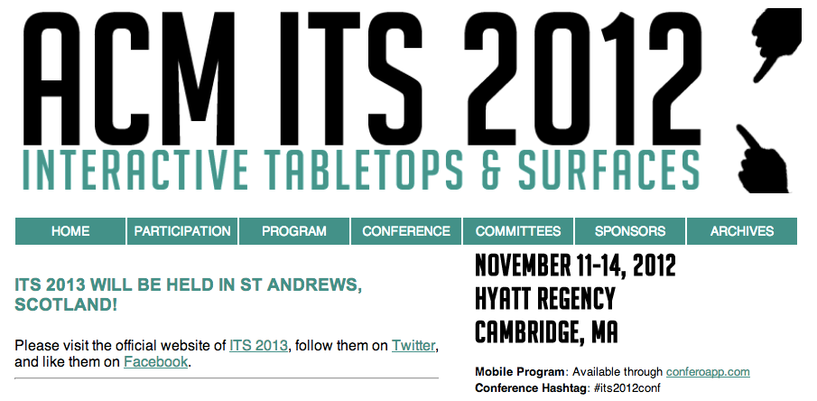
http://its2012conf.org

Slide 3
ITS 2012
Academic conference
» paper presentations
» demonstrations
» lots of discussion
Main topic area
» interactive surfaces: visual, touch, sound, etc.
» new interaction techniques
» explorations of how technology can be used
» some exploration into user needs

Slide 4
Who has used an interactive surface?
Interesting dimensions to consider
» task
» size
» input capabilities
» output capabilities
» multi-user situation | single-user situation
» public | semi-public | private/personal

Slide 5
Who has played with a digital tabletop?
Digital tabletops vs. Desktop GUI
» there is no “right side up”
» modal conventions break whe multiple users play with it
» problems of space and territory

Slide 6
HandyWidgets
Consider widgets/controls that appear as a consequence of a specific user initiated action
Notes:
What do you see here?
What is this good for?
What is the point they are trying to make?
What are the trade-offs of this design?
What are some problems?
When might it not work?

Slide 7
MobiSurf
Consider the use of multiple devices for interaction

Slide 8
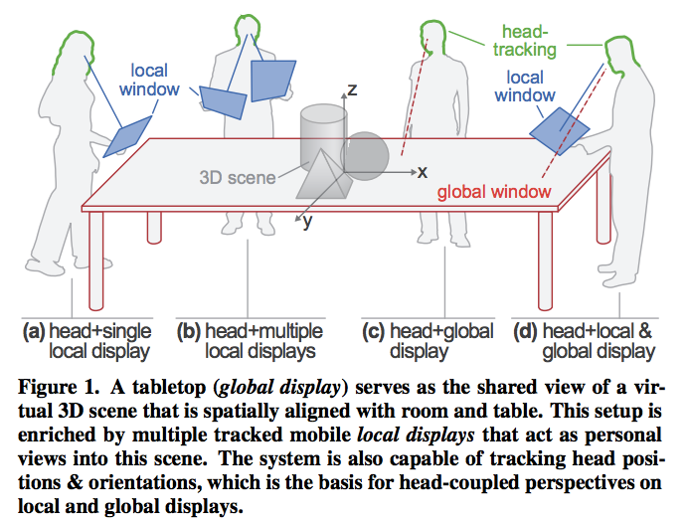
Head-Tracked Displays for 3D viewing

Slide 9
Green Touch
Consider the use of technology “in the field” for science

Slide 10
Quads
How about for learning math?

Slide 11
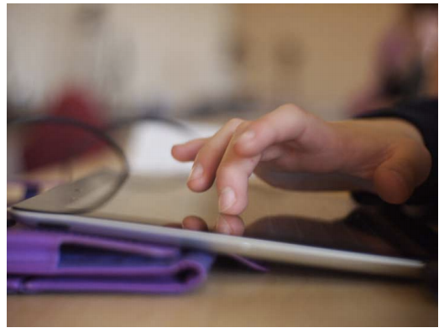
Touch Interaction for Kids
What unique challenges does designing for children bring to the table(t)?
» motor skill development
» accuracy, speed

Slide 12
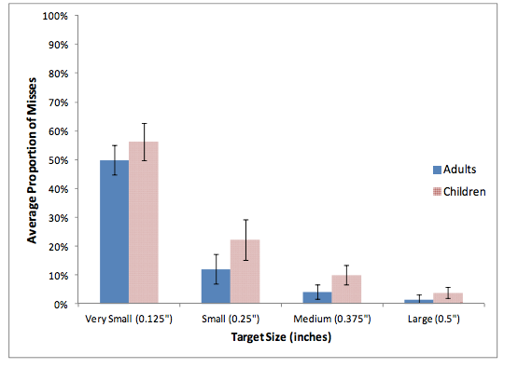
Touch Interaction for Kids

Slide 13
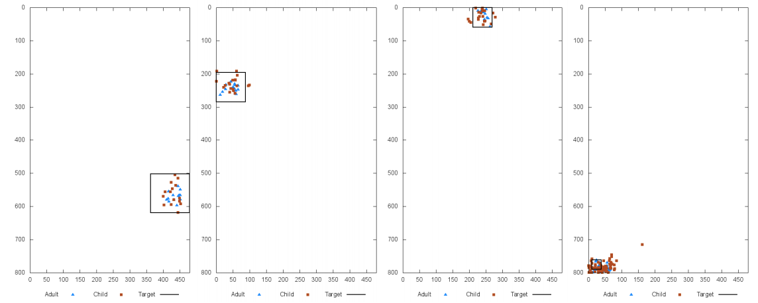
Touch Interaction for Kids
What does this tell us about the design of buttons/targets?

Slide 14
Designing a Reading Environment
What does an e-Reader do well?
What does an e-Reader do poorly?
Do you use e-Texts? Why/why not?

Slide 15
New Kinds of Surfaces…
Automatic re-writing
Water
Clothing
Sound

