Slide 1
Lessons from the Design of Everyday Things 3
CPSC 481: HCI I
Fall 2012
Anthony Tang with acknowledgements to Saul Greenberg, Ehud Sharlin, Joanna McGrenere and Karon MacLean

Slide 2
Lessons from the Design of Everyday Things
We’ve seen that a lot of things are designed poorly, be it computer interfaces, or physical objects
Formally, there is a vocabulary around these concepts that we have discussed
  » perceived affordances
  » visible constraints
  » causality
  » mapping
  » transfer effects
  » idioms & population stereotypes
  » conceptual models
  » individual differences

Slide 3

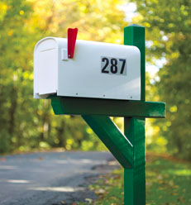
Cultural associations
Sun found their email icon problematic for some American urban dwellers who are unfamiliar with rural mail boxes.

Slide 4
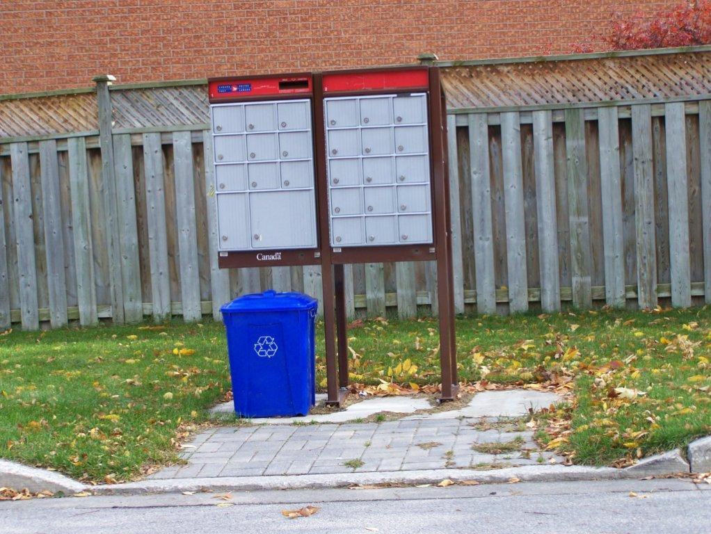
Cultural associations
Sun found their email icon problematic for some American urban dwellers who are unfamiliar with rural mail boxes.

Slide 5


Idioms and Population Stereotypes
Interface idioms:
  ‘standard’ interface features we learnt, use and remember
Idioms may define arbitrary behaviours
  red means danger
  green means safe
Population stereotypes: Idioms vary in different cultures
  Light switches
    America: down is off
    Britain: down is on
  Faucets
    America: anti-clockwise on
    Britain: anti-clockwise off
Notes:
An expression that has a separate figurative meaning from its literal meaning, and is based on common understanding and common use

Slide 6
Conceptual Models
People have mental models (or conceptual models) of how things work
What do we construct these models from?
  Affordances
  Causality
  Constraints
  Mappings
  Positive Transfer
  Population stereotypes/cultural standards
  Instructions
  Interactions (including with other people)

Slide 7
Conceptual Models
Models allow us to mentally simulate device operation
Models may be wrong, especially if attributes are misleading
Designers control the system image, which contribute to the formation of users’ mental model

Slide 8
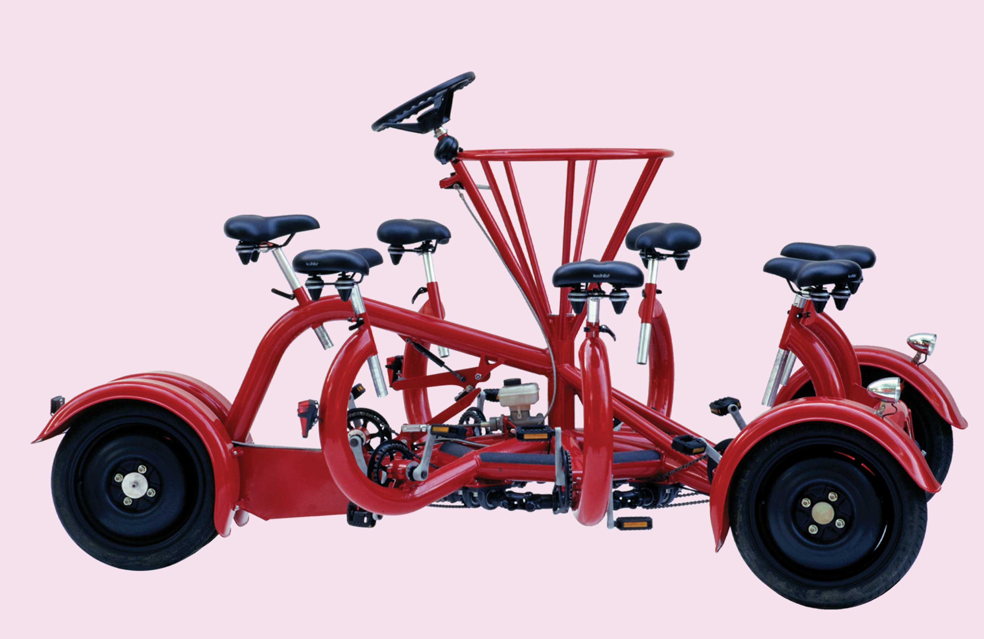
Our conceptual model of a bike isn’t as good as we think it is, but it’s good enough to recognize this as a bike!
Notes:
http://www.conferencebike.com/
Will this work?
Why seven seats?
How does the drive train work? Which wheels steer this thing?
Our conceptual model of a bike isnt’ as good as we think it is, but it’s good enough to recognize this as a bike!

Slide 9

Conceptual models of simple machines
Affordances
  » holes for something to be inserted
Constraints
  » big hole for seeral fingers, small hole for thumb
Mapping
  » holes-for-fingers suggested / constrained by appearance
Positive transfer & cultural idioms
  » learned when young; constant mechanism
Conceptual model
  » physical object implies how the operating parts work
A reasonable conceptual model can be formed by just looking at, and perhaps holding the object.
» you don’t understand everything, but do some things anyway: why big blade down?
» model’s not perfect: what about the “glide” style of cutting?

Slide 10

Conceptual models of more complex devices
Affordances
  » space to put your hand under it
  » often stops before you are done, but how do you continue?
Constraints and mapping unknown
  » how to control temperature? (you can’t)
Transfer of training
  » weak/no transfer from manual faucet
Conceptual model
  » must be taught / learned; often varies between models
Notes:
Consider how much complex this gets when interacting with devices that have more complex functions (your computer, mobile phones)

Slide 11
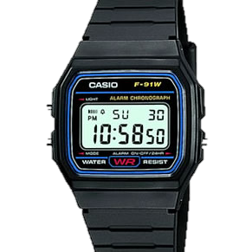
Conceptual models of more complex devices
Affordances
  » four buttons to push, but not clear what they will do
Constraints and mapping unknown
  » no visible relation between buttons, possible actions and end result
Transfer of training
  » little relation to analog watches
Cultural idioms
  » somewhat standardized corecontrols and functions, but still highly variable
Conceptual model
  » must be taught
Notes:
Consider how much complex this gets when interacting with devices that have more complex functions (your computer, mobile phones)

Slide 12
Conceptual Models
"In interacting with the environment, with others, and with the artifacts of technology, people form internal, mental models of themselves and of the things with which they are interacting.
These models provide predictive and explanatory power for understanding the interaction."
- Don Norman

Slide 13
Conceptual Models vs. Conceptual Design
Conceptual models: something the user has (or forms)
  » users see and understand the system through mental models
  » users rely on mental models during usage
Conceptual design: something the designer does
  » defining the intended mental model (hiding the technology of the system)
  » designing a suitable system image (applying appropriate design guidelines)

Slide 14
Conceptual Design
A designer’s role is to provide a meaningful, useful system image so that a user’s model matches the design model
User’s model
Design model
User
Designer
System Image
System
Notes:
Why is there no arrow between the user and the designer?
Why is there a double arrow between the user and system image?

Slide 15
Some models…
Design model: what a designer intends to convey
System image: what the user “sees” – the UI, documentation, labels, etc.
User’s model: the user’s mental model developed by the user through interaction with the system
  » i.e. a belief system about the system model

Slide 16
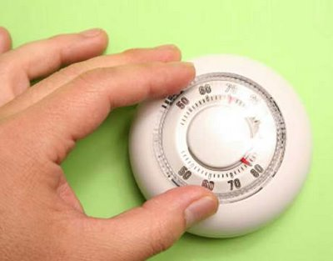
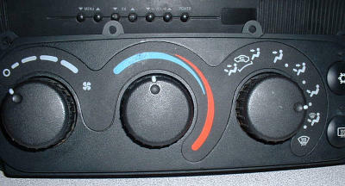
Mismatches between user’s model and system model
Sometimes a poor model is fostered deliberately (consider a fridge or the heating system in a house vs. the heating/cooling system in a car)
Notes:
http://www.nachi.org/images10/thermostat.jpg
http://www.carmedix.net/static/images/content/auto-service-heating-and-air-conditioning.jpg

Slide 17
Mismatches between user’s model and system model
Sometimes, it’s a representation problem
  » document sizes measured in bytes, not pages or words
  » dates may be in non-standard formats
  » error messages may use system specific codes

Slide 18
Acquiring Mental Models
During system usage:
  » user’s own activity leads to a mental model
  » explanatory theory, developed by the user
  » often used to predict the future behaviour of the system
Observing others use the system:
  » casual observation of others working
  » asking someone else to “do this for me”
  » formal training
Reading about a system:
  » documentation, help screens, “for dummies” books
This is done by the user (not the designer)

Slide 19
Mental models are “runnable”
Includes a notion of causality: “doing this will result in this”
Used for explanation
» to understand why the system responds as it does
Used for prediction
» to select an appropriate action in a given situation

Slide 20
Types of Mental Models
Structural: an image of what the system is
  » descriptive of what the system is
  » user may need additional knowledge to actually use it
  » often more powerful/flexible, though harder to use
  » road map: may show a particular type of information, but isn’t customized to your particular use of that information
Functional: action-based; describes how it is used
  » prescriptive; specific; step-by-step
  » does not assume global or system knowledge
  » easier to use, but not helpful for problem-solving or dealing with the unexpected
  » google directions: great when everything’s there; not so great when the road is closed

Slide 21
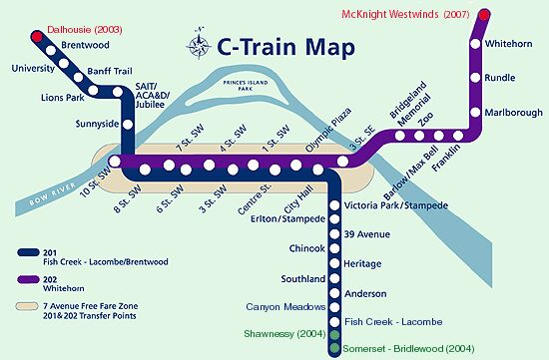
Structural Models » “what the system is”
Maps and schematics
Notes:
• provide a specific view of the system; “use as needed”
• different views: street, bus, bike maps of same region are
customized to drivers, bus riders and bikers. All are structural
models.

Slide 22
Structural Models » “what the system is”
Object-action models
  » users think in terms of concrete or abstract objects
  » system supports actions on the objects
What are some programs that you think of as “objects that act”, or that we can act on objects?
Unix: files are objects, commands act on them, etc.
Notes:
• provide a specific view of the system; “use as needed”
• different views: street, bus, bike maps of same region are
customized to drivers, bus riders and bikers. All are structural
models.

Slide 23
Paper by 53
Notes:
http://vimeo.com/37254322

Slide 24
Structural Models » “what the system is”
Analogies/metaphors
  » a new system (closely) resembles an old system
  » (usually) intent is to help transfer existing system knowledge
  » e.g. desktop metaphor; spreadsheets
Notes:
• provide a specific view of the system; “use as needed”
• different views: street, bus, bike maps of same region are
customized to drivers, bus riders and bikers. All are structural
models.

Slide 25
Functional Models » “how the system is used”
Many kinds of user manuals and step-by-step and “howto” guides
  » U of C’s “job aids”
  » http://www.ucalgary.ca/hr/system/files/JOR%20Initiator%20Guide%20-%20Project.pdf

Slide 26
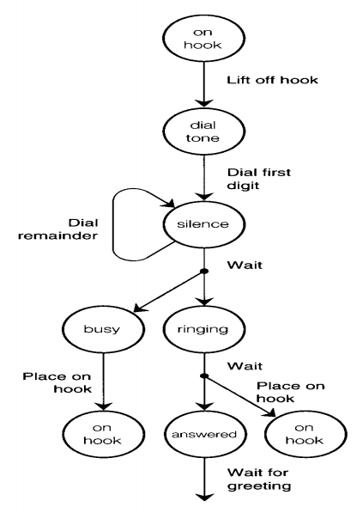
Functional Models » “how the system is used”
State transition model
  » how most of us think of how phones work (what you see on the right is a representation of that model)
  » changes in state need to be visible, otherwise, this kind of model doesn’t form

Slide 27
Functional Models » “how the system is used”
Functional “mapping” models
  » users learn a sequence of actions to accomplish tasks
  » mappings need to be “rote-learned”; often arbitrary
  » hand-held calculator maps “math” to key presses; keyboard shortcuts

Slide 28
System Image
Designers control what the users see (i.e. the system image). That’s it.
  » choose a system image to foster a good mental model
Some interfaces actually display the system!
  » all objects and actions may be visible at all times
  » e.g. automobile dashboard (system image) that is literal—this is your car!*
Some principles:
  » currency (up-to-date-ness) is important
  » consistency (contributes to learnability)

Slide 29
Where a simple model might be better (to hide system complexity)
Many systems have messy low-level details
  » irrelevant to a user’s activity
  » full functionality may not be required
Example: MS Word has hundreds (thousands?) of commands
  » most users only use a small subset of these
  » users can hide complexity through customization
  » IT admins can provide macro capabilities (bundling low-level commands into a single concept) → ‘submit’ program
  » wizards allow a user to “do what’s right”, skipping details

Slide 30
Hiding System Complexity
Water faucet
  » the system has independent hot & cold
  » system image provides variable temperature
  » some taps allow separate temperature and volume control
  » both “hot & cold” and “temperature & volume” are 2 degrees of freedom
Audio-video conferencing link
  » real system model has four independent channels
  » users may consider standard ways of combining these:
  glance – two way video only
  office share – two way audio and video
  phone – two way audio only

Slide 31
Lessons from the Design of Everyday Things
We’ve seen that a lot of things are designed poorly, be it computer interfaces, or physical objects
Formally, there is a vocabulary around these concepts that we have discussed
  » perceived affordances
  » visible constraints
  » causality
  » mapping
  » transfer effects
  » idioms & population stereotypes
  » conceptual models
  » individual differences

