Slide 1
Lessons from the Design of Everyday Things 2
CPSC 481: HCI I
Fall 2012
Anthony Tang with acknowledgements to Saul Greenberg and Ehud Sharlin

Slide 2
Lessons from the Design of Everyday Things
We’ve seen that a lot of things are designed poorly, be it computer interfaces, or physical objects
Formally, there is a vocabulary around these concepts that we have discussed
  » perceived affordances
  » visible constraints
  » causality
  » mapping
  » transfer effects
  » idioms & population stereotypes
  » conceptual models
  » individual differences

Slide 3
Transfer Effects
People transfer their learning/expectations of similar objects to current objects
  » positive transfer: previous learnings applies to new situation
  » negative transfer: previous learnings conflicts with the new situation

Slide 4
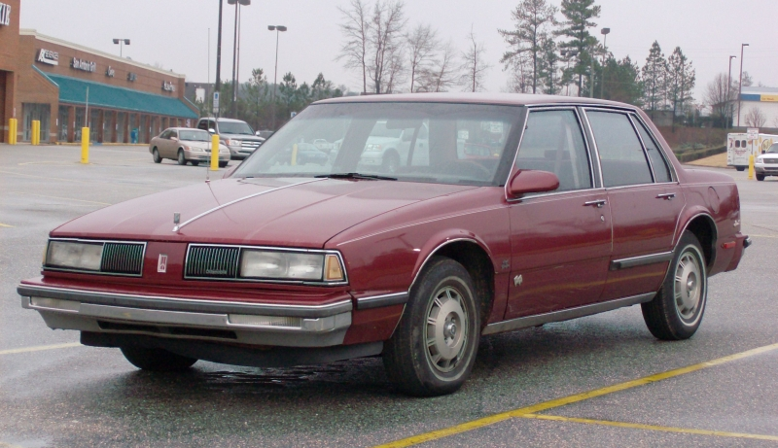
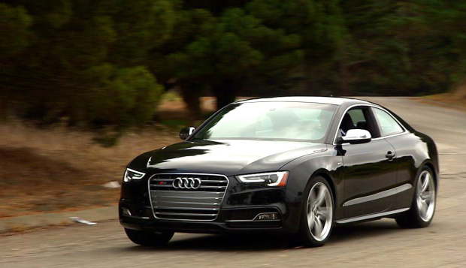
Transfer Effects in Real Life…

Slide 5
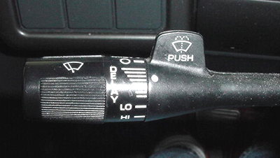
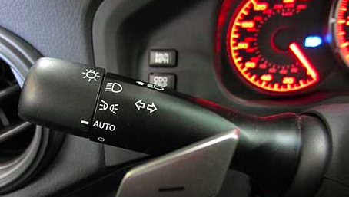
Transfer Effects in Real Life…
Notes:
Wipers always went on

Slide 6
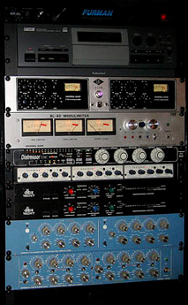
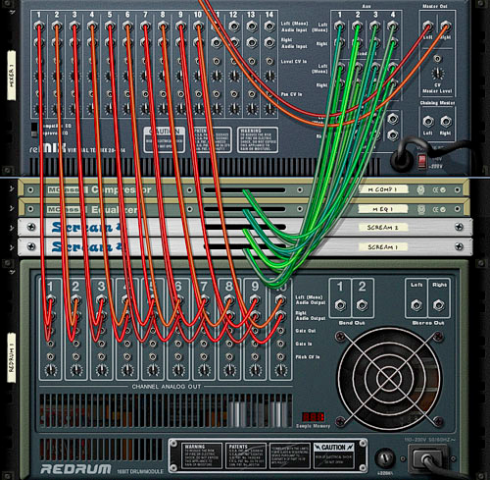
Transfer Effects for GUIs
Real life
Reason
Notes:
http://www.releasetime.de/test-propellerhead-reason-4/
http://tightmixblog.com/wp-content/uploads/2007/11/audio-rack-units.jpg
Kenneth

Slide 7
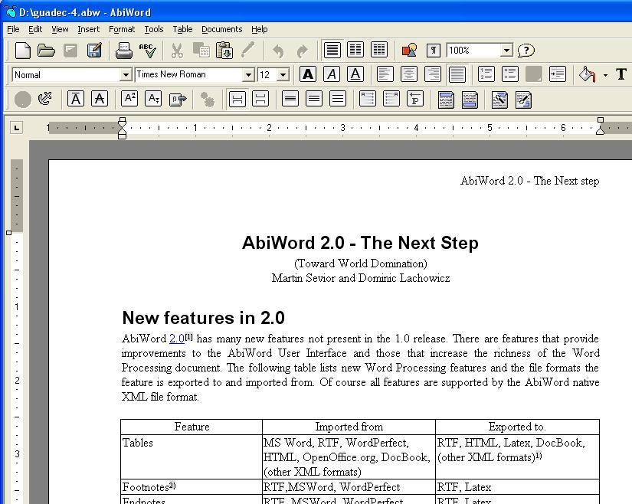
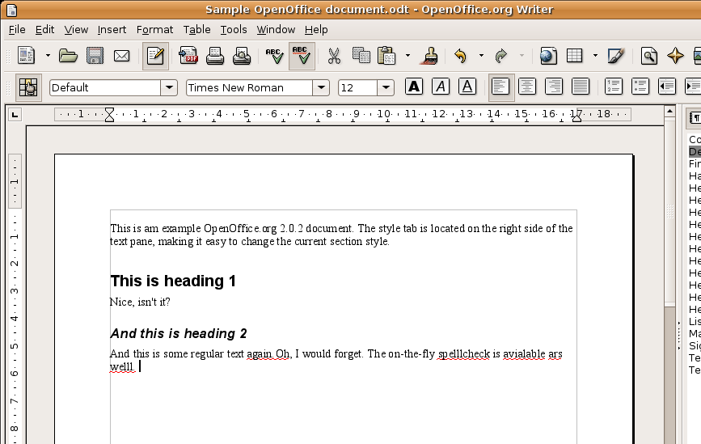
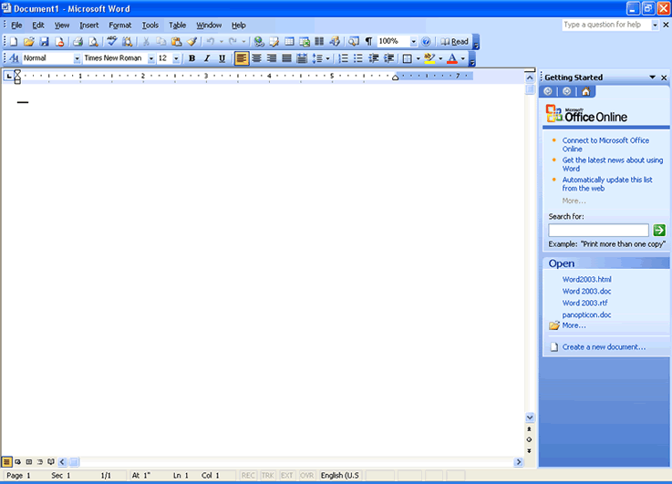
Transfer Effects in GUIs
AbiWord
OpenOffice
MS Word

Slide 8
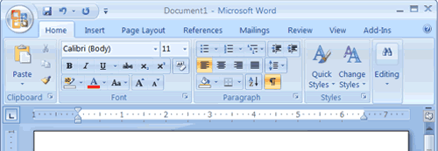
Transfer Effects in GUIs
MS Word 2003
MS Word 2007

Slide 9
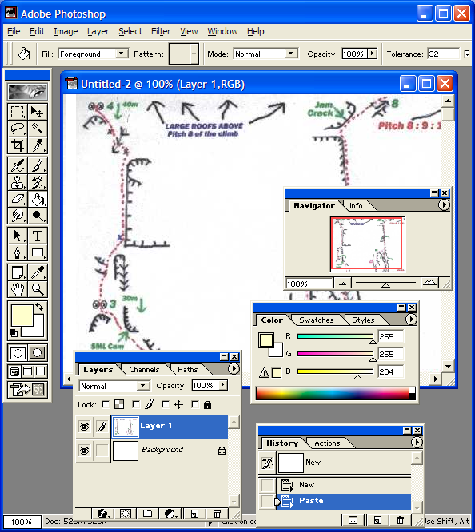
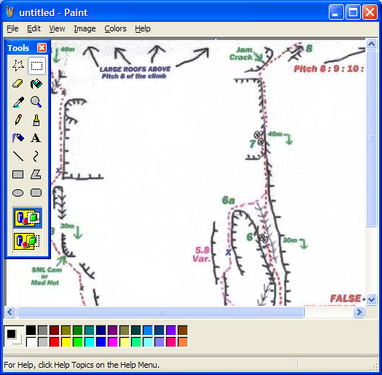
Transfer Effects in GUIs
How does knowing MSPaint
help you in Photoshop?
  e.g. rectangular control…

Slide 10
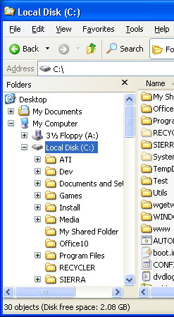
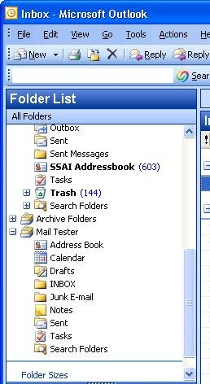
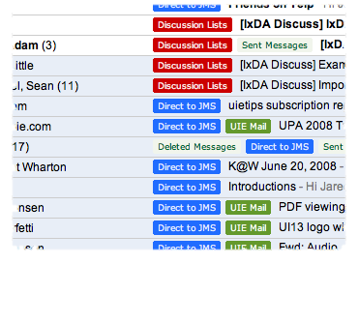
Transfer Effects in GUIs
What do each of these designs afford?

Slide 11
Transfer Effects
People transfer their learning/expectations of similar objects to current objects
  » positive transfer: previous learnings applies to new situation
  » negative transfer: previous learnings conflicts with the new situation

Slide 12
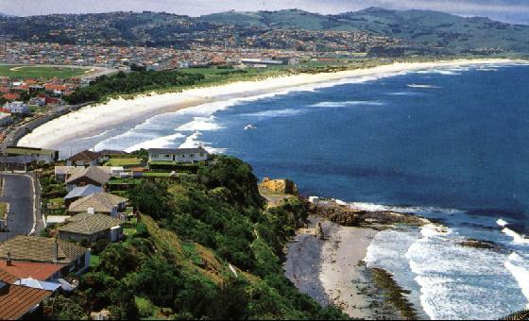
How you almost had another 481 prof…
Notes:
Dunedin, NZ

Slide 13

How you almost had another 481 prof…
Notes:
Dunedin, NZ

Slide 14
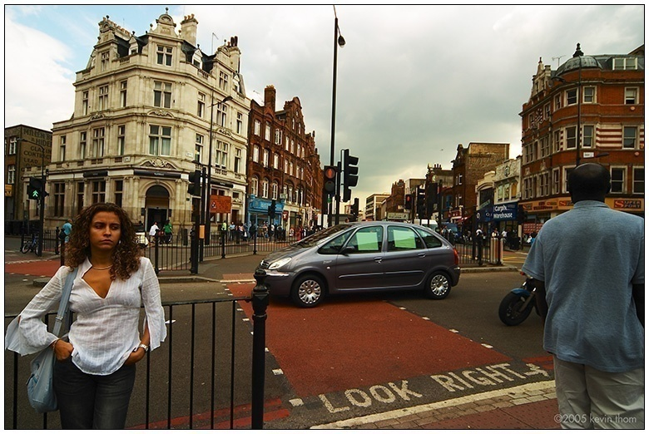
Look Right!

Slide 15

How you almost had another 481 prof…

Slide 16
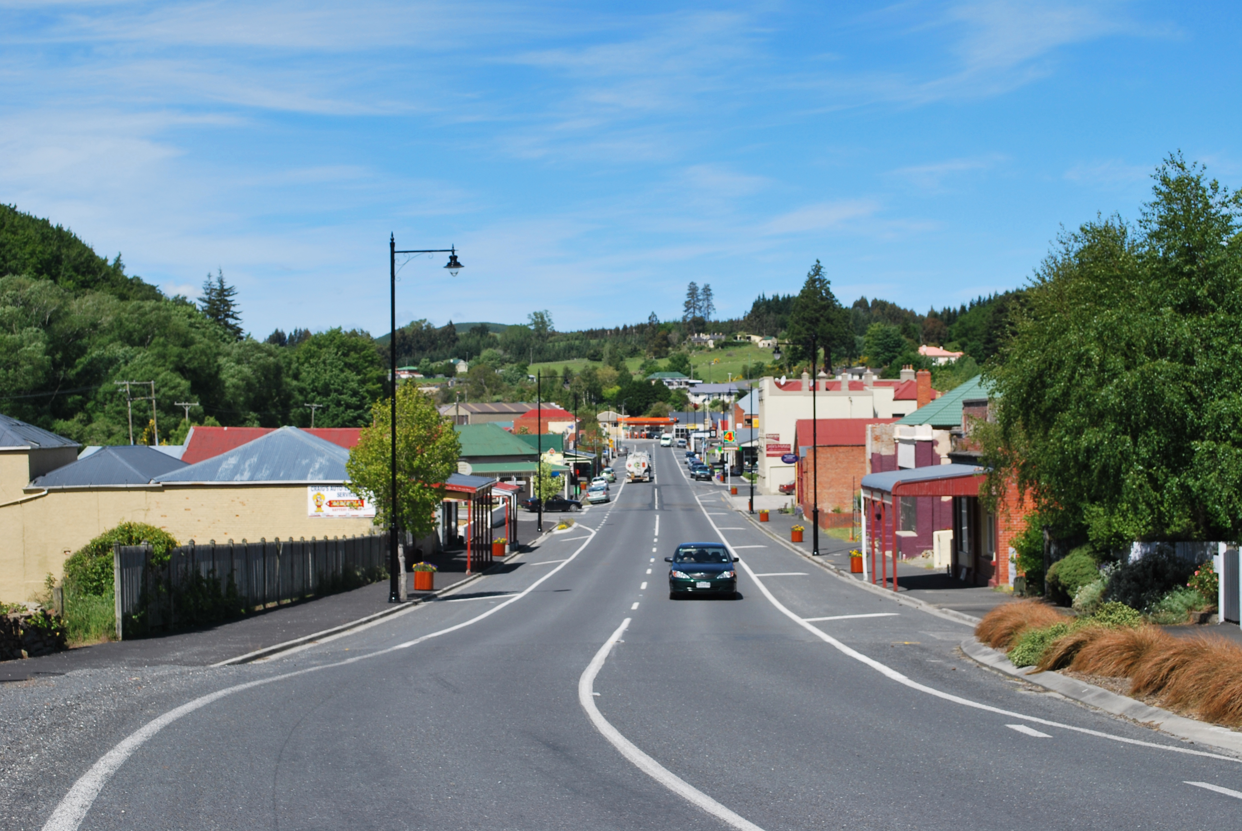
How you almost had another 481 prof…

Slide 17


Idioms and Population Stereotypes
Interface idioms:
  ‘standard’ interface features we learnt, use and remember
Idioms may define arbitrary behaviours
  red means danger
  green means safe
Population stereotypes: Idioms vary in different cultures
  Light switches
    America: down is off
    Britain: down is on
  Faucets
    America: anti-clockwise on
    Britain: anti-clockwise off
Notes:
An expression that has a separate figurative meaning from its literal meaning, and is based on common understanding and common use

Slide 18
Idioms and Population Stereotypes
Ignoring/changing idioms?
  home handyman
    light switches installed upside down
  calculators vs. phone number pads
    which did computer keypads follow and why?

Slide 19
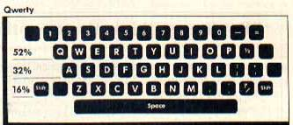
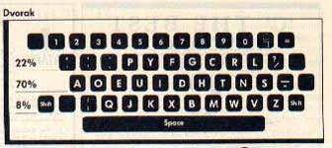
Idioms and Population Stereotypes
Difficulty of changing stereotypes
  Qwerty keyboard: designed to prevent jamming of keyboard
  Dvorak keyboard (’30s): provably faster to use

Slide 20
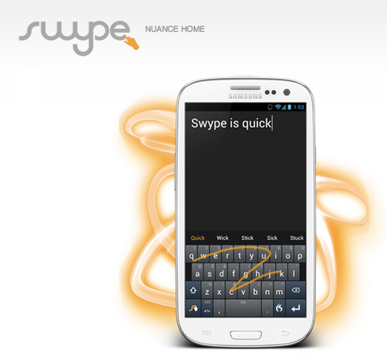
Notes:
http://www.youtube.com/watch?v=SJ-RAefCG_c
http://www.youtube.com/watch?v=Wjg3vwDoFhc&feature=player_embedded

Slide 21
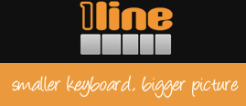

Slide 22

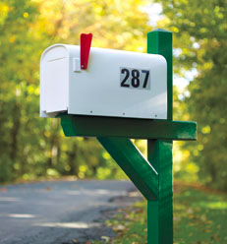
Cultural associations
Sun found their email icon problematic for some American urban dwellers who are unfamiliar with rural mail boxes.

Slide 23
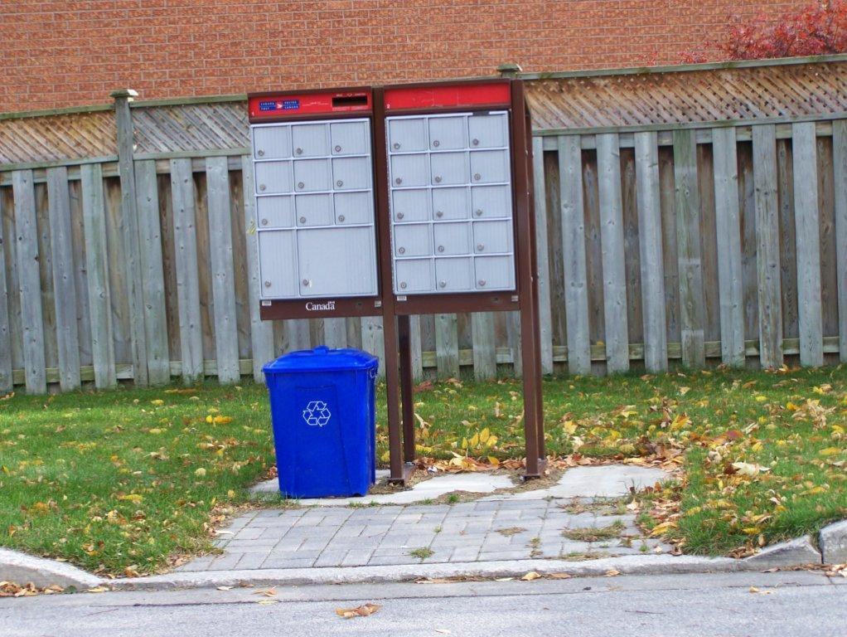
Cultural associations
Sun found their email icon problematic for some American urban dwellers who are unfamiliar with rural mail boxes.

Slide 24
Idioms and Population Stereotypes
Interface idioms:
  ‘standard’ interface features we learnt, use and remember
Idioms may define arbitrary behaviours
  red means danger
  green means safe
Population stereotypes: Idioms vary in different cultures
  Light switches
    America: down is off
    Britain: down is on
  Faucets
    America: anti-clockwise on
    Britain: anti-clockwise off
Notes:
An expression that has a separate figurative meaning from its literal meaning, and is based on common understanding and common use

Slide 25
Conceptual Models
People have mental (or conceptual) models of how things work
What do we construct these models from?
  Affordances
  Causality
  Constraints
  Mappings
  Positive Transfer
  Population stereotypes/cultural standards
  Instructions
  Interactions (including with other people)

Slide 26
Conceptual Models
Models may be wrong, especially if attributes are misleading
Models allow us to mentally simulate device operation
Designers only have control over the system image

Slide 27
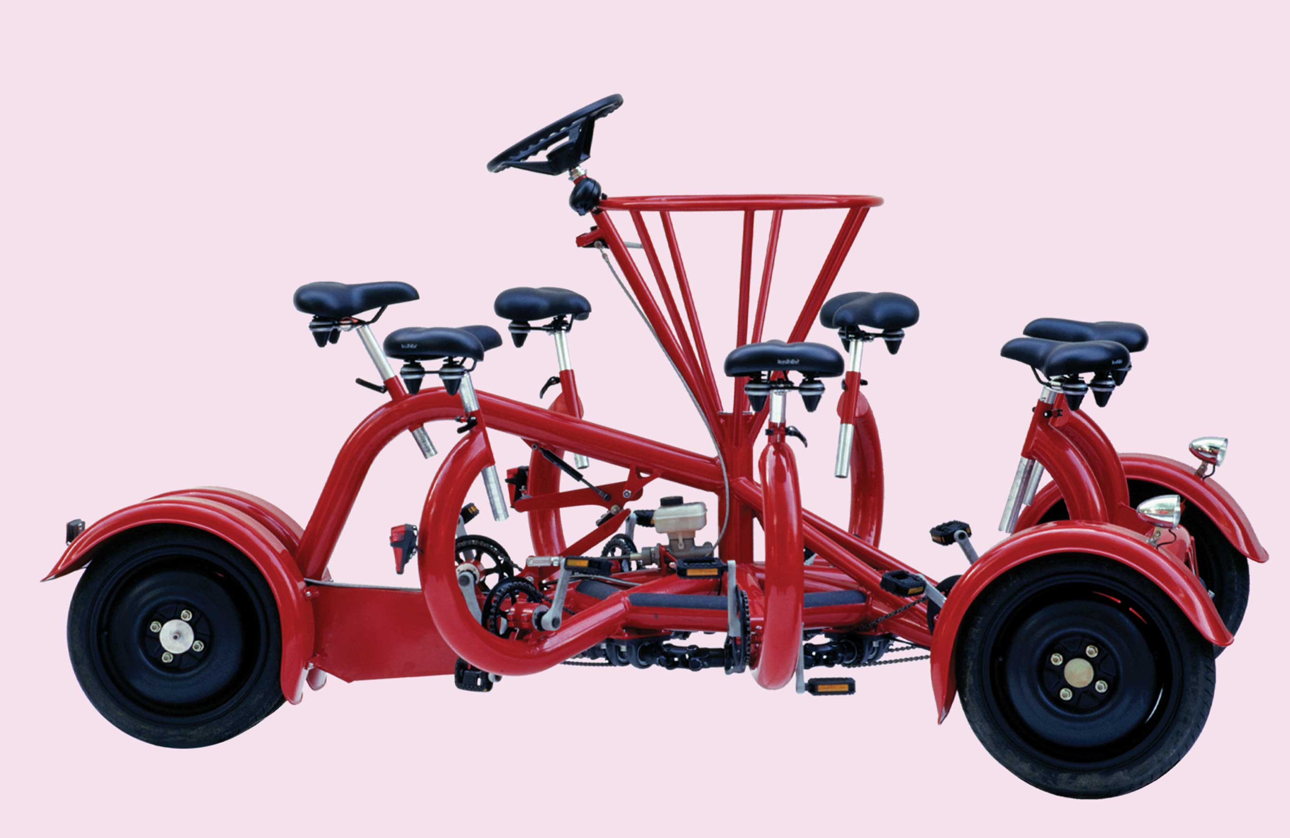
Our conceptual model of a bike isn’t as good as we think it is, but it’s good enough to recognize this as a bike!
Notes:
http://www.conferencebike.com/
Will this work?
Why seven seats?
How does the drive train work? Which wheels steer this thing?
Our conceptual model of a bike isnt’ as good as we think it is, but it’s good enough to recognize this as a bike!

Slide 28

Conceptual models of simple machines
Affordances
  » holes for something to be inserted
Constraints
  » big hole for seeral fingers, small hole for thumb
Mapping
  » holes-for-fingers suggested / constrained by appearance
Positive transfer & cultural idioms
  » learned when young; constant mechanism
Conceptual model
  » physical object implies how the operating parts work
A reasonable conceptual model can be formed by just looking at, and perhaps holding the object.
» you don’t understand everything, but do some things anyway: why big blade down?
» model’s not perfect: what about the “glide” style of cutting?

Slide 29
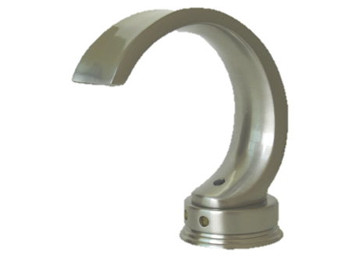
Conceptual models of more complex devices
Affordances
  » space to put your hand under it
  » often stops before you are done, but how do you continue?
Constraints and mapping unknown
  » how to control temperature? (you can’t)
Transfer of training
  » weak/no transfer from manual faucet
Conceptual model
  » must be taught / learned; often varies between models
Notes:
Consider how much complex this gets when interacting with devices that have more complex functions (your computer, mobile phones)

Slide 30
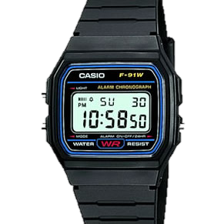
Conceptual models of more complex devices
Affordances
  » four buttons to push, but not clear what they will do
Constraints and mapping unknown
  » no visible relation between buttons, possible actions and end result
Transfer of training
  » little relation to analog watches
Cultural idioms
  » somewhat standardized corecontrols and functions, but still highly variable
Conceptual model
  » must be taught
Notes:
Consider how much complex this gets when interacting with devices that have more complex functions (your computer, mobile phones)

Slide 31
Conceptual Models
"In interacting with the environment, with others, and with the artifacts of technology, people form internal, mental models of themselves and of the things with which they are interacting.
These models provide predictive and explanatory power for understanding the interaction."
- Don Norman

Slide 32
Conceptual Models vs. Conceptual Design
Conceptual models: something the user has (or forms)
  » users see and understand the system through mental models
  » users rely on mental models during usage
Conceptual design: something the designer does
  » defining the intended mental model (hiding the technology of the system)
  » designing a suitable system image (applying appropriate design guidelines)

Slide 33
Conceptual Design
Designer’s role is to provide a meaningful, useful system image a user’s model matches the design model
User’s model
Design model
User
Designer
System Image
System model
Notes:
Why is there no arrow between the user and the designer?
Why is there a double arrow between the user and system image?

Slide 34
Some models…
Design model: what a designer intends to convey
System model: some representation of how the system really works
System image: what the user “sees” – the UI, documentation, labels, etc.
User’s model: the user’s mdental model developed by the user through interaction with the system
  » i.e. a belief system about the system model

Slide 35
Mismatches between user’s model and system model
Sometimes a poor model is fostered deliberately (consider a fridge or the heating system in a house)
Sometimes, it’s a representation problem
  » document sizes measured in bytes, not pages or words
  » dates may be in non-standard formats
  » error messages may use system specific codes

Slide 36
Next time…
More on conceptual models…

