Slide 1
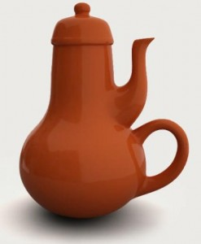
Notes:
http://brazenthoughts.com/2012/06/the-tao-of-usefulness/

Slide 2
Pathological Designs
CPSC 481: HCI I
Fall 2012
Anthony Tang with acknowledgements to Saul Greenberg and Ehud Sharlin
Notes:
While computer design has its own idiosyncrasies, we can learn a tremendous amount by looking at the design of everyday things. We start with bad design, which make us realize that the problems and errors people face when dealing with even simple technology are usually a result of design failure. We then move to understanding visual design principles that help us analyze bad design and create good designs.

Slide 3
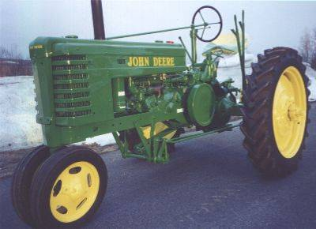
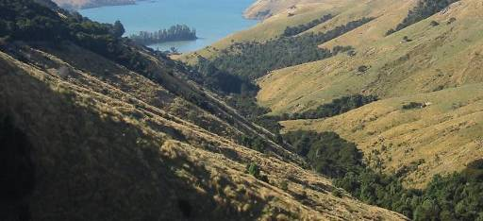

Slide 4
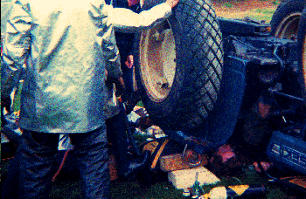
National AG Safety Database
“tractor upsets cause more fatalities than other farm accidents”
“injuries often include a broken or crushed pelvis”
“Human error”

Slide 5
Re-examination…
high center
of gravity
narrow front
wheel base
Terrain
  » unsurfaced and rough
  » hilly
Farmer
  » works long hours
  » works quickly

Slide 6
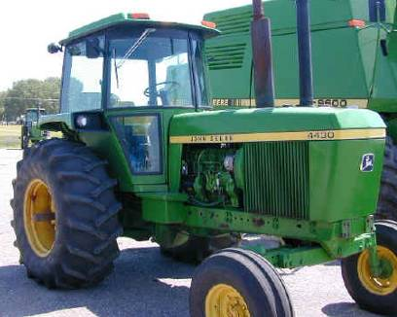
human error or design error?
accidents less frequent as modern designs have
  roll cage
  low center of gravity
  wider wheel bases

Slide 7
So what does this tell us?
Lesson 1
  » many failures of human-machine systems are the result of designs that don’t recognize people’s capabilities and fallibilities
  » this leads to apparent machine misuse and human error
Lesson 2
  » good design always accounts for human capabilities
So, consider the following:
  » given examples of ‘human error’, critique them for possible ‘design errors’
  » propose designs that limit/remove these errors
Notes:
There are a lot of reasons why we often blame human error.
It allows us to sleep better at night: “that wouldn’t happen to me”
It frees the company from blame
BUT THIS IS THE WRONG WAY TO THINK ABOUT THINGS!!

Slide 8
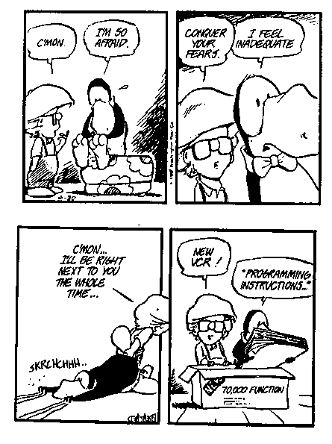
Psychopathology of Everyday Things
How many of you can program or use all aspects of your
  » digital watch
  » PVR
  » sewing machine
  » washer and dryer
  » microwave
  » home theatre
  » cell phone
  » …
Notes:
The engineer who founded DEC confessed at the annual meeting that he can’t figure out how to heat a cup of coffee in the company’s microwave oven

Slide 9
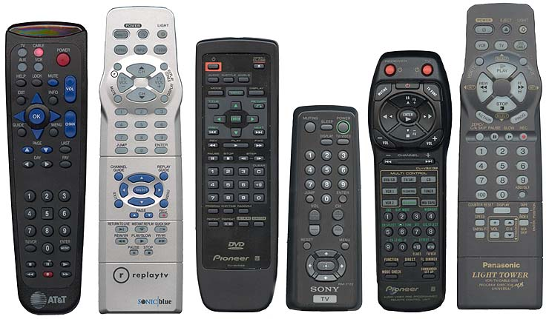

Remote Controls
cable box digital video recorder DVD television audio amplifier VCR
six remote controls required to operate a modest home theater
Notes:
You’ve seen this image before. I asked you to press the pause button quickly.
Just scanning these quickly, which could you find it on easiest?
What makes the TiVo one easy to find?
Big, distinct (CRAP), visually distinct.
Also, the WAY you hold it would lend itself to clicking there. Think about how the weight is distributed on these bad boys

Slide 10
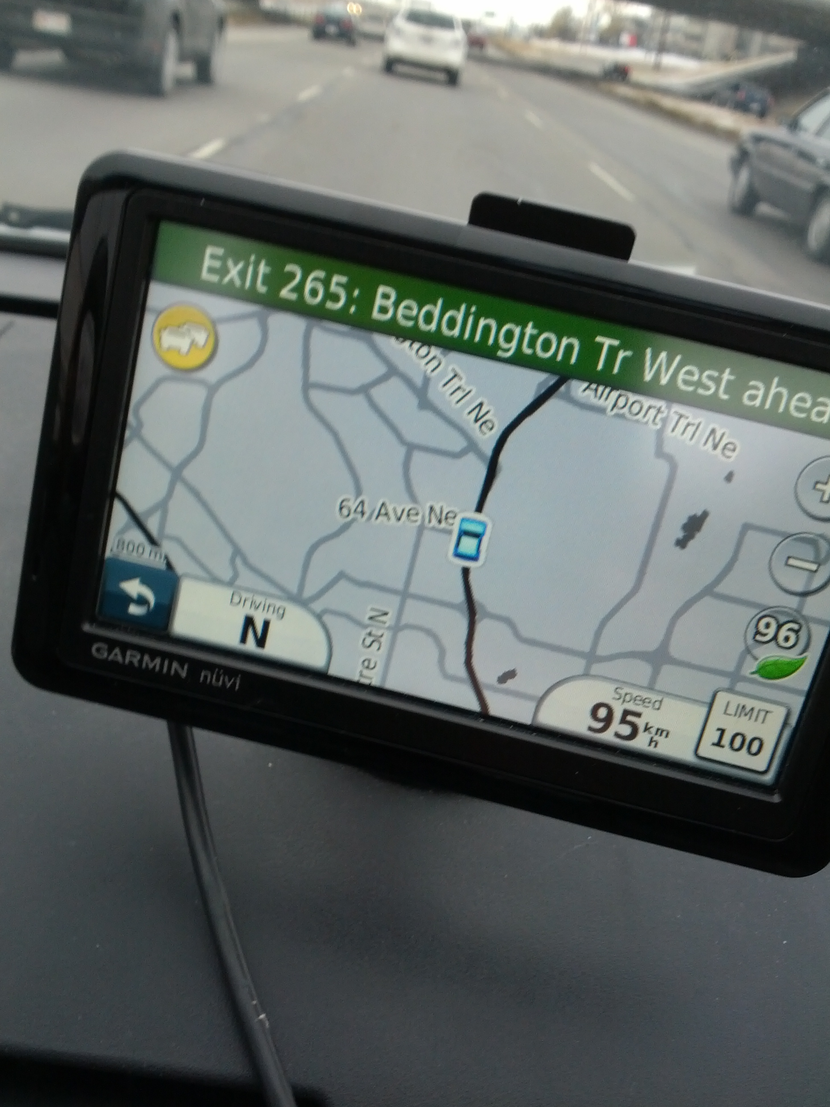
I hate my GPS
Notes:
So, suddenly, my device tells me there’s traffic ahead.
I glance over at my GPS, and suddenly, everything is ugly. It’s this grey nasty thing.
So, I click the yellow button (which is the traffic indicator)
Oops. It’s locked. Can’t be used while driving.

Slide 11
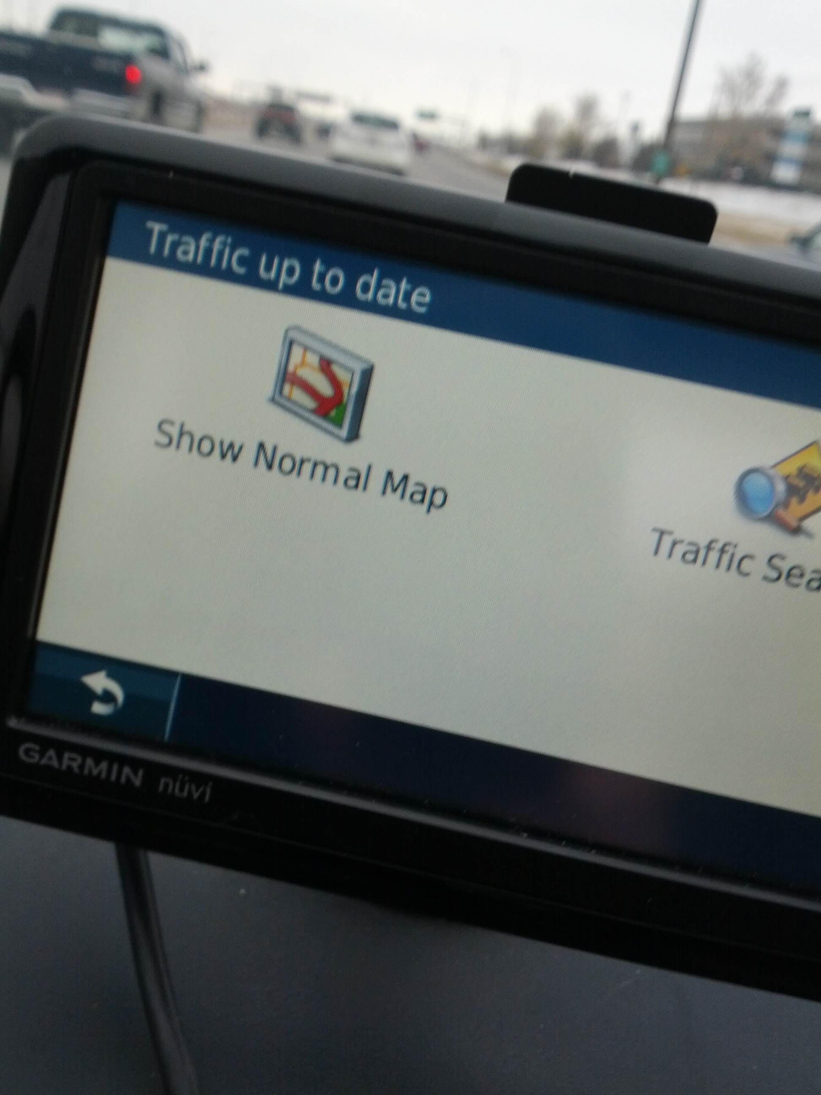
I hate my GPS
Notes:
What the… I was in the traffic mode already?

Slide 12
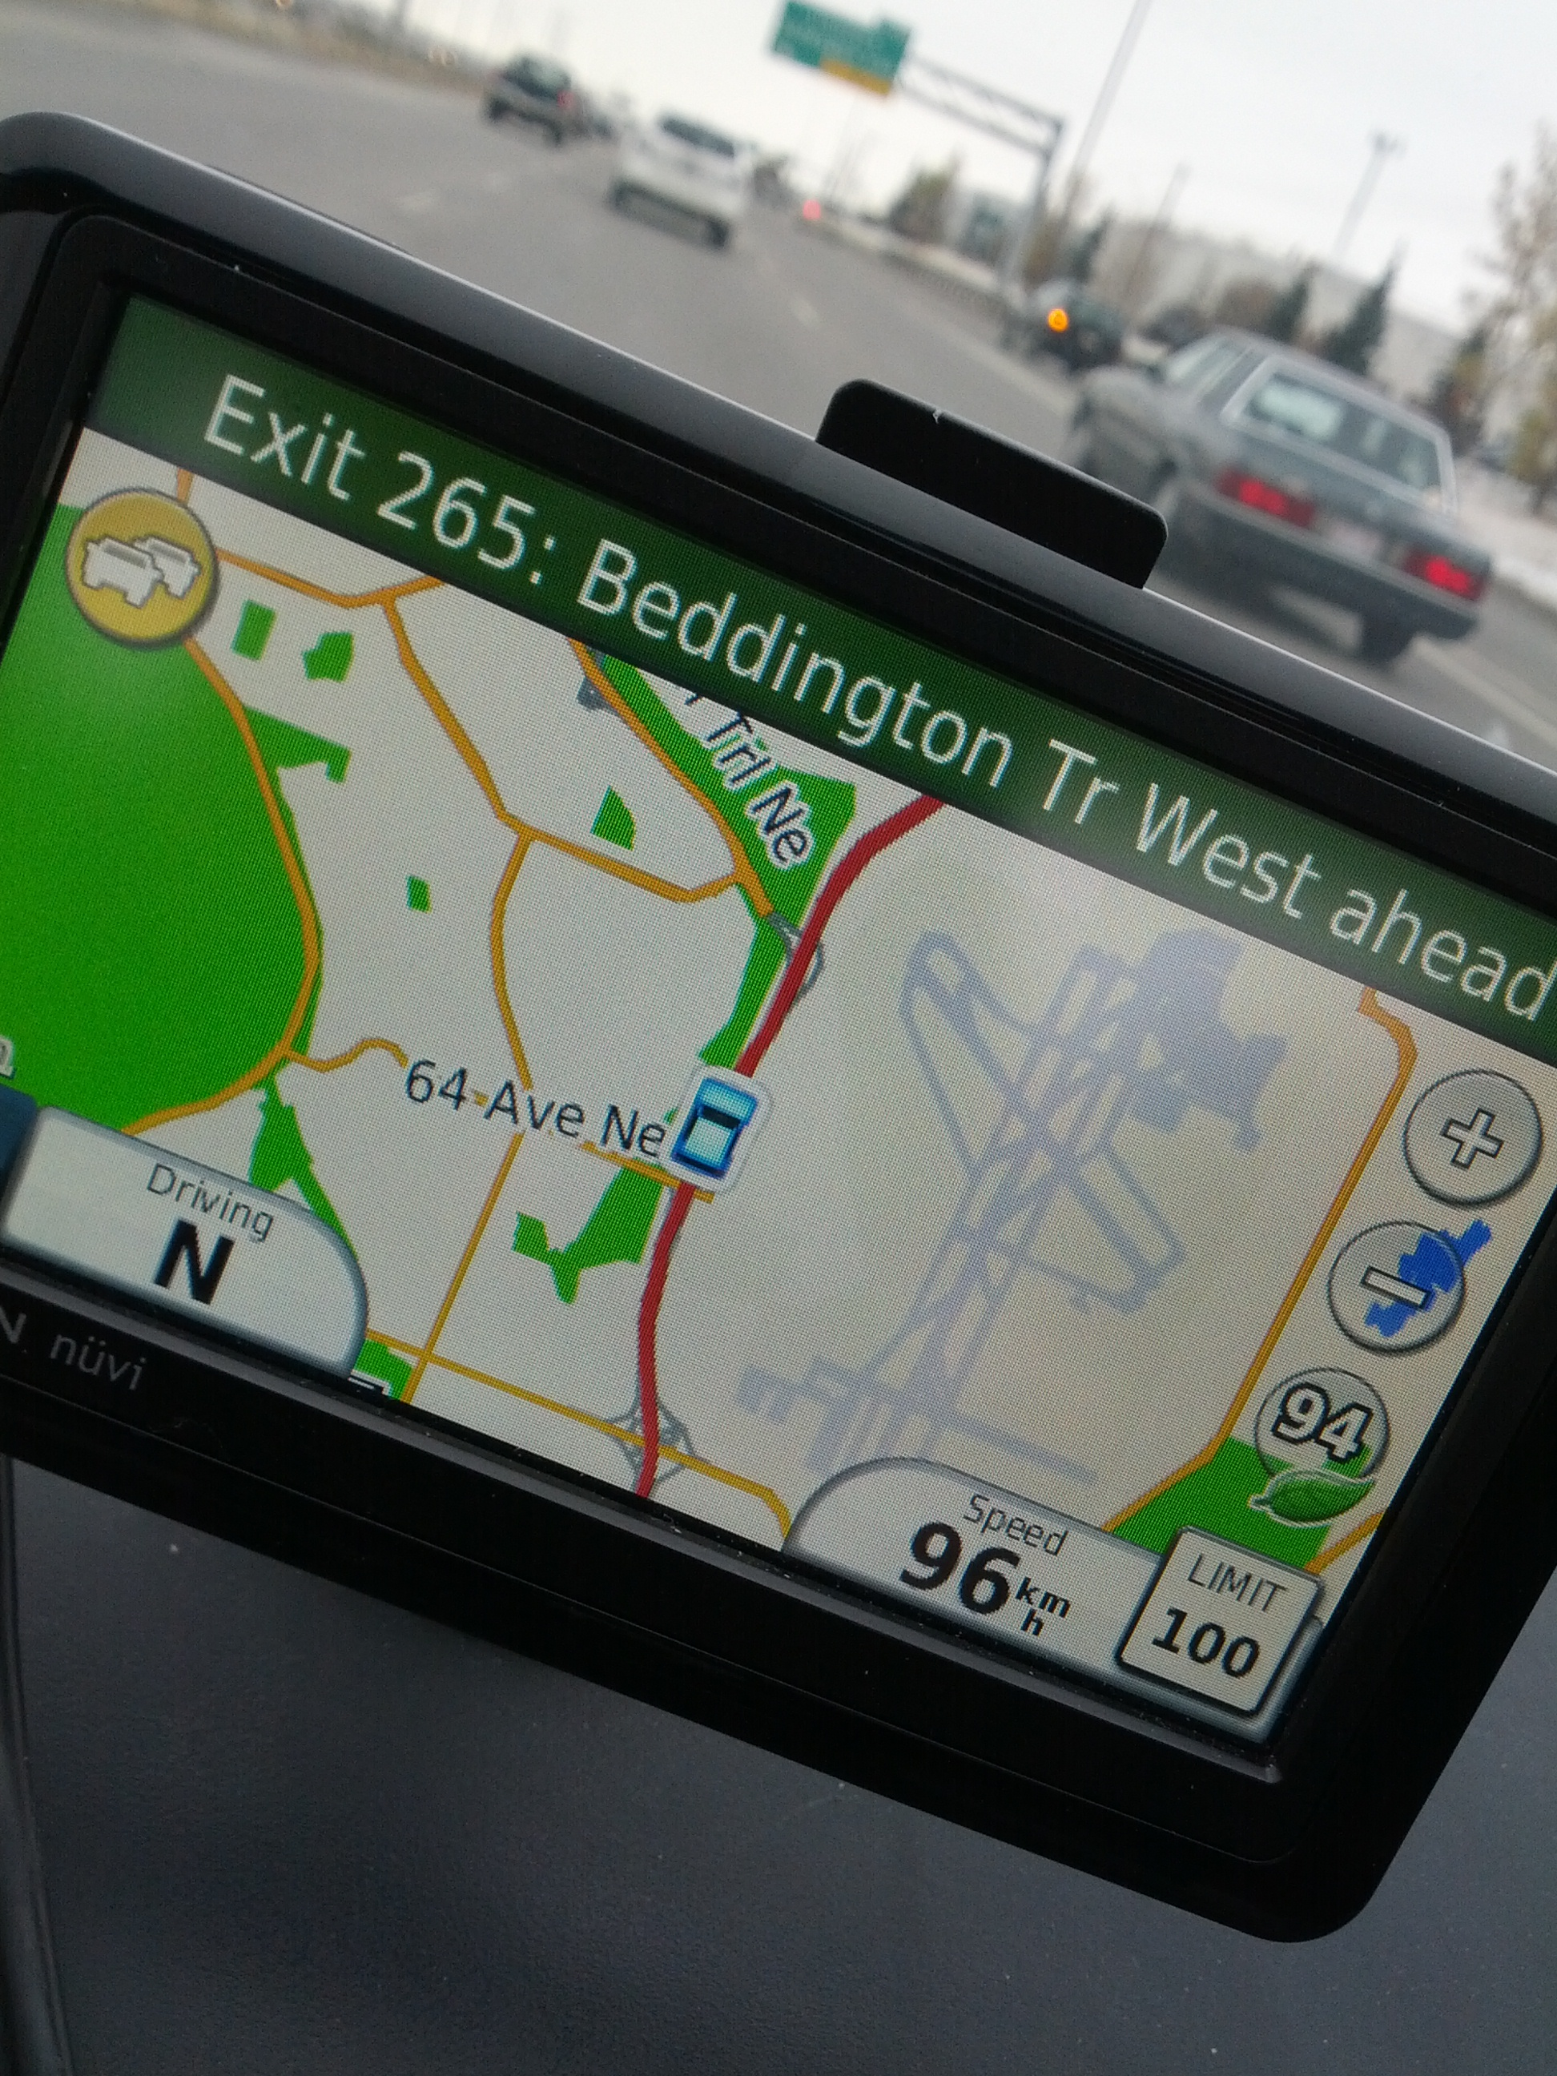
I hate my GPS
Notes:
Okay, whatever… here I am again.
Wait, where’s the traffic exactly?

Slide 13
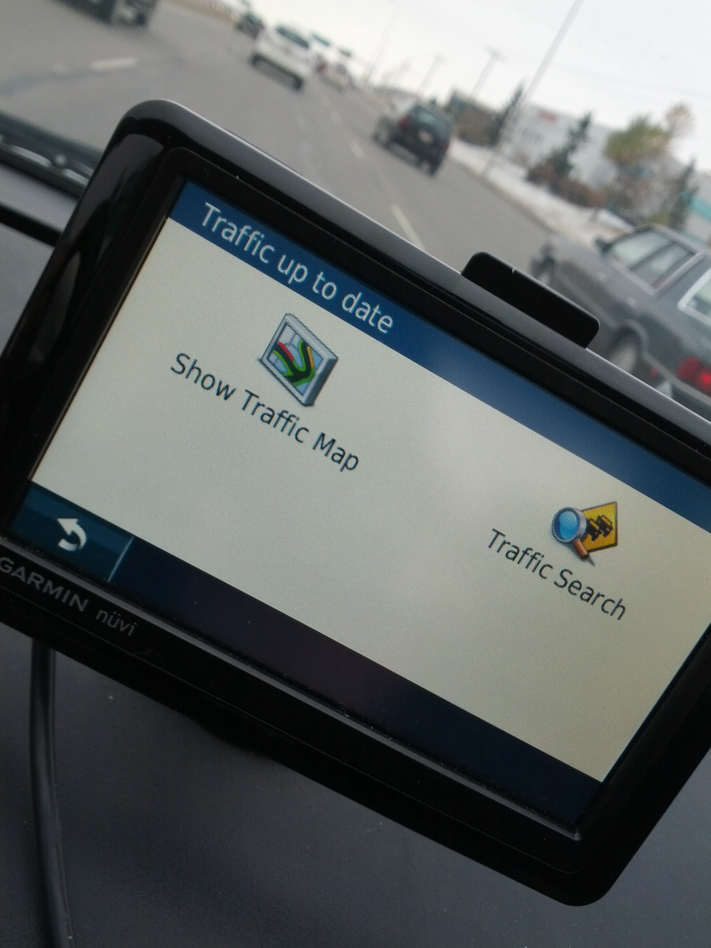
I hate my GPS
Notes:
Uh… those two screens look basically the exact same.
I’m DRIVING for goodness sake. I don’t have time to read a one word difference

Slide 14
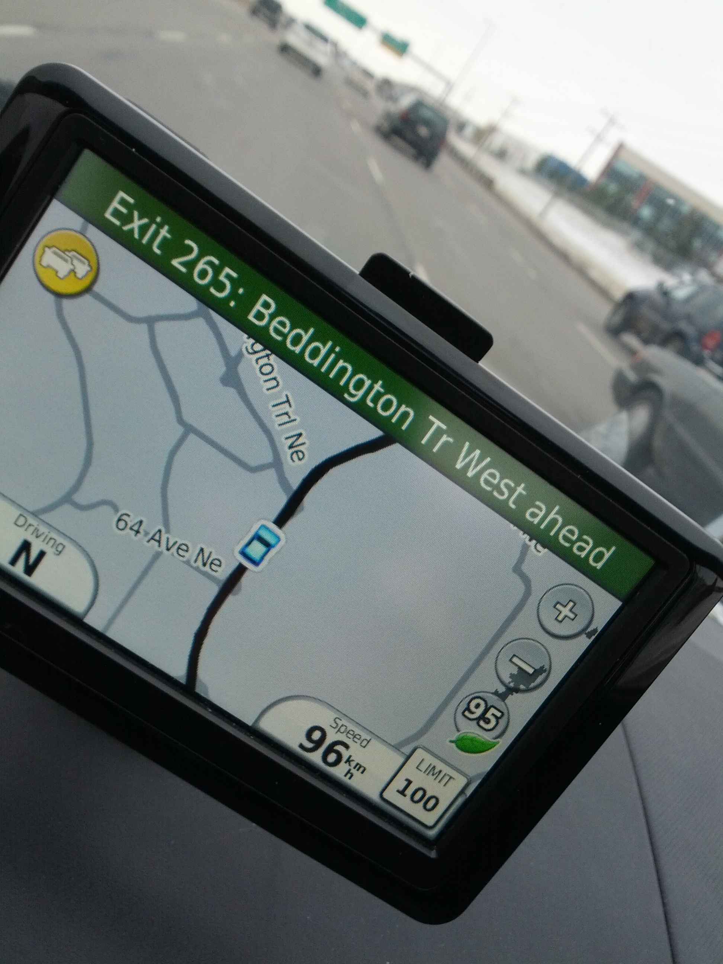
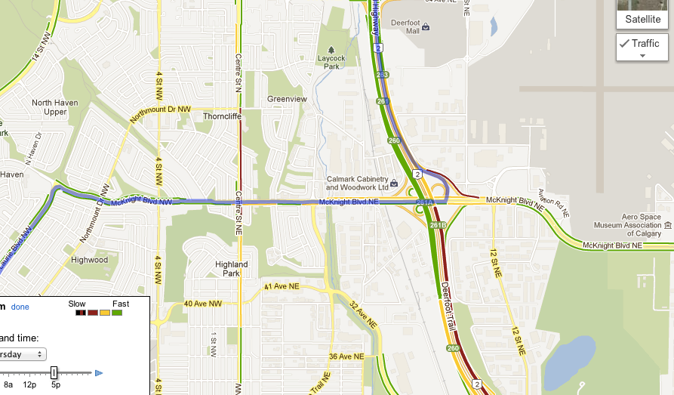
I hate my GPS
Notes:
Back at this useless screen.
WHERE IS MY TRAFFIC!?
I can see the traffic ahead – totally useless on the timing there
Why does it have to be a different mode? Lots of people have integrated maps already
If I have to switch, why does the screen not be more distinctive?
Finally, what the hell happens if I’m in a mode that doesn’t allow me to touch the screen?

Slide 15
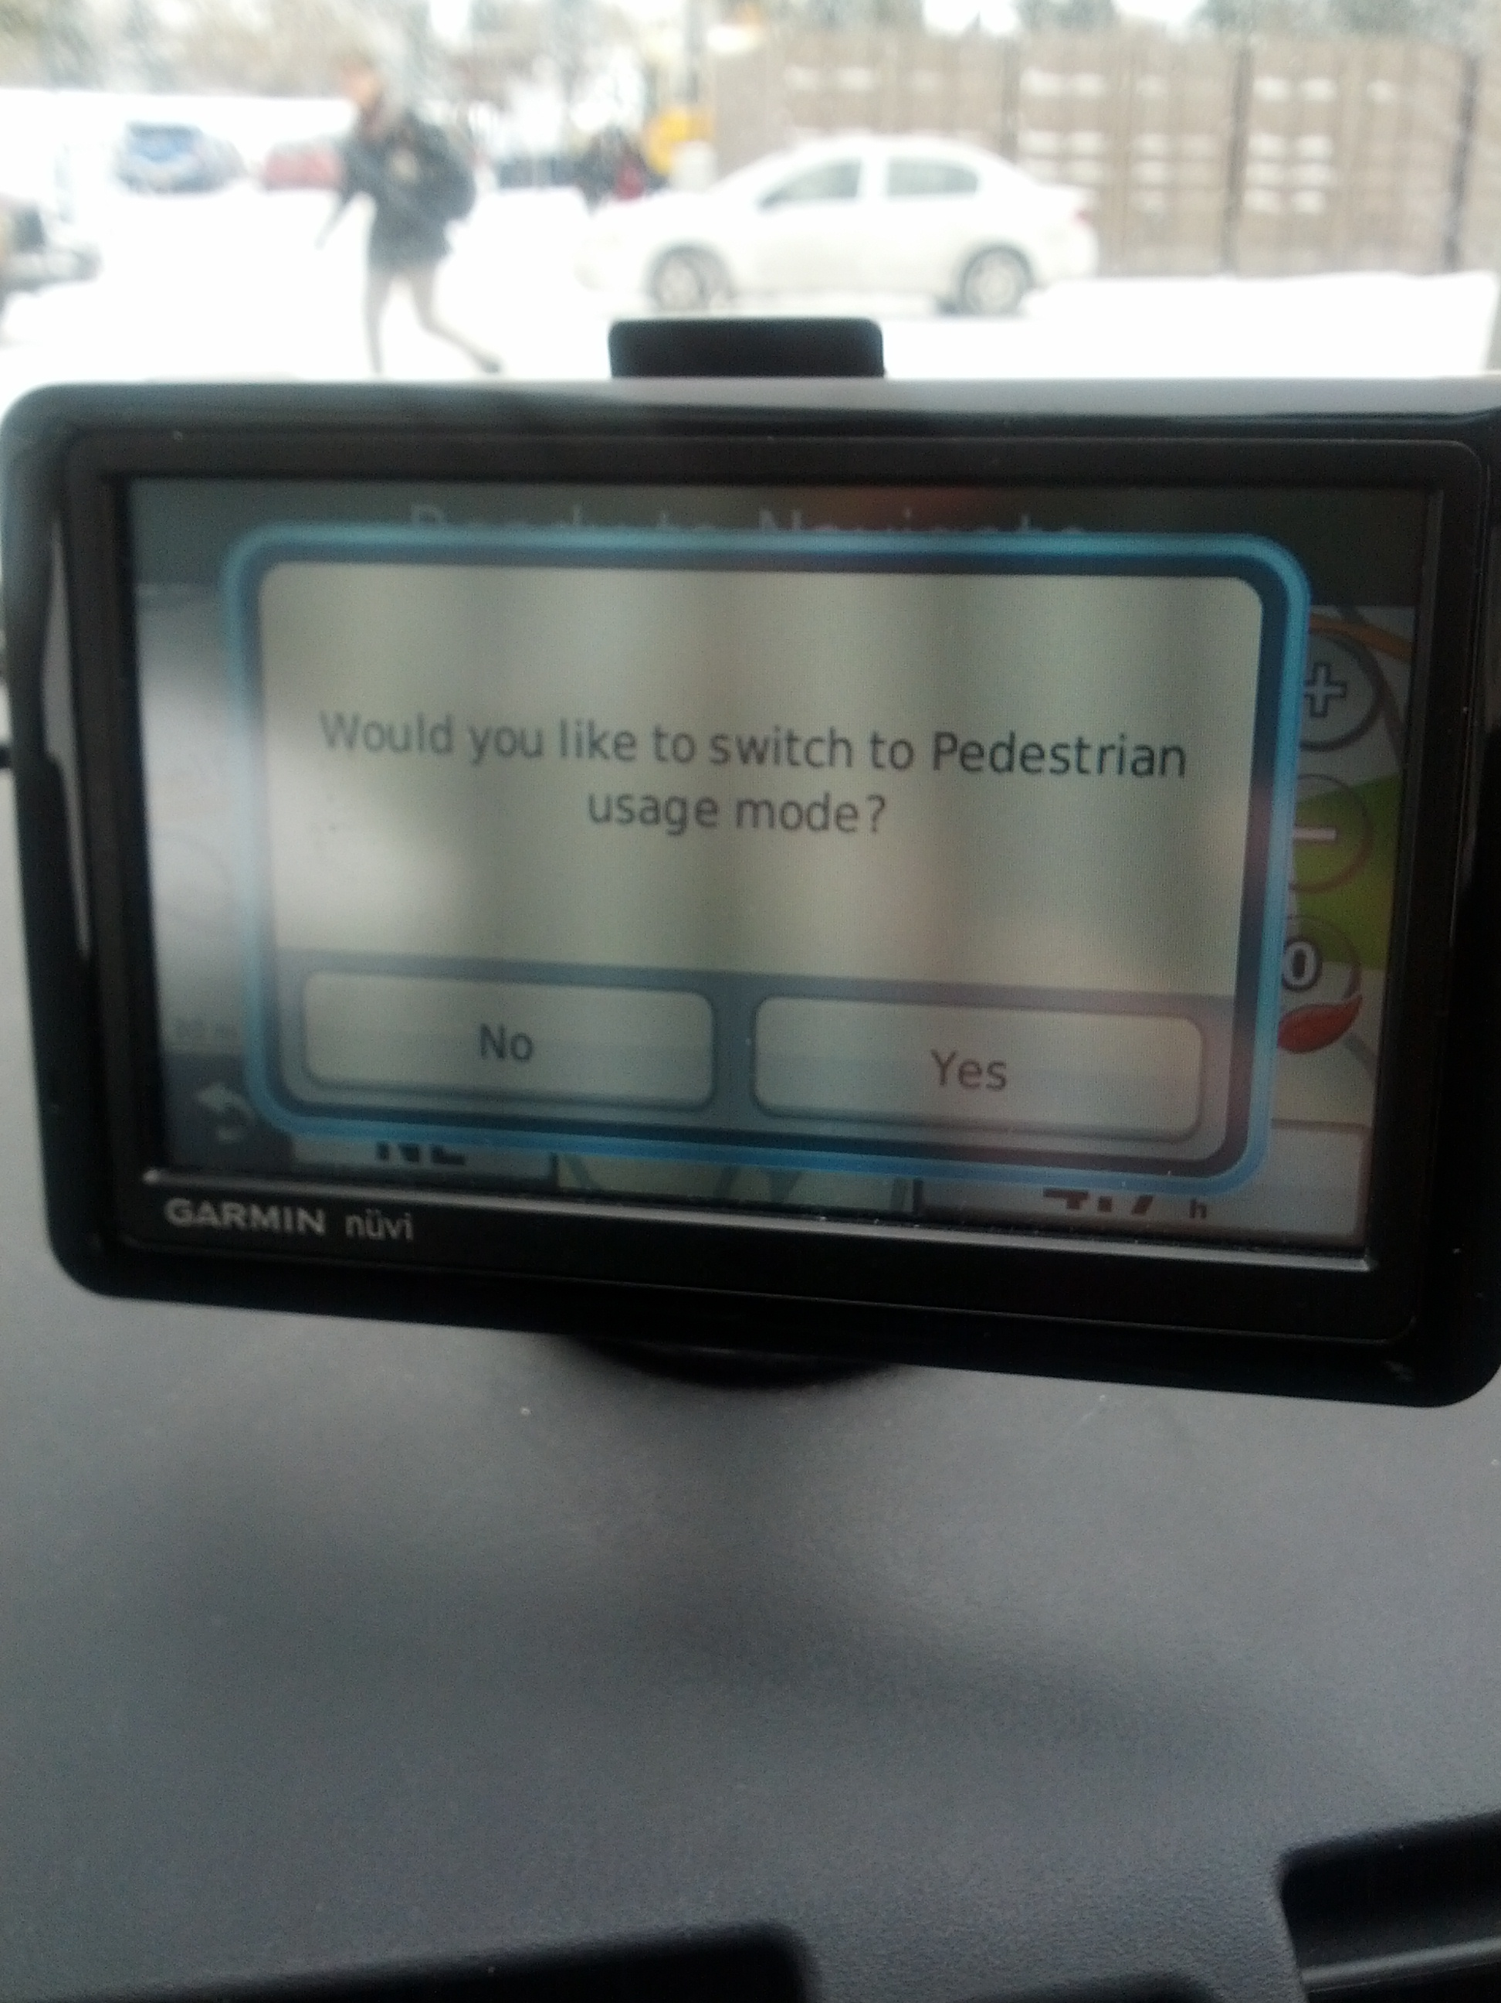
I hate my GPS
Notes:
Yes, there’s traffic, but seriously?!!

Slide 16
Pathological design: slide projector
Remote control from Leitz slide projector
  How do you forward/reverse?
Instruction manual:
  short press: slide change forward
  long press: slide change backward

Slide 17
Pathological design: PHONES
Modern telephone systems
  standard number pad
  two additional buttons * and #
Problem
  many hidden functions
  operations and outcome completely invisible
    *72+number = call forward
      can I remember that combination?
      if I enter it, how do I know it caught?
      how can I remember if my phone is still forwarded?
    Ok, I’ll read the manual
      but what does call park mean? what's a link?
      where is that manual anyway?

Slide 18
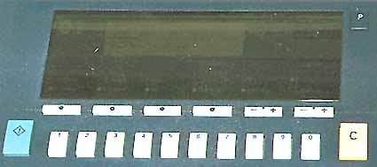
Pathological design: photocopiers
You want to make 15 copies, sorted and stapled.
You type in “1” then “5”, and then you press “C” to start the copying.
What happens next?
The photocopier makes the copies correctly
The copier settings are cleared, and no copies are made.
Notes:
http://www.baddesigns.com/copier.html

Slide 19
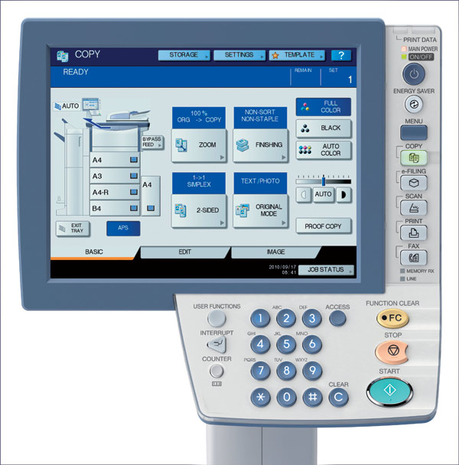
Pathological design: photocopiers
Better?
Safely:
» most functions never get used
» most buttons are never touched
Notes:
http://www.clubcopying.co.uk/toshiba-office/photocopiers/mfd-colourprinters/estudio5540c/

Slide 20
Getting serious about design
World War II
  complex machines (airplanes, submarines...)
    taxed people’s sensorimotor abilities to control them
    frequent (often fatal) errors occurred even after high training
  example airplane errors:
    if booster pump fails, turn on fuel valve within 3 seconds
      test shows it took ~five seconds to actually do
    Spitfire: narrow wheel base
      easy to do violent ground loops which breaks undercarriage
    Altimeter gauges difficult to read
      caused crashes when pilots believe they are at a certain altitude
Result
  human factors became critically important
Slide ideas from David Hill

Slide 21
What’s the altitude?
  Early days (< 1000’):
    only one needle needed
0
9
1
  As ceilings increased over 1000’
    small needle added
8
2
  As they increased beyond 10,000’
    box indicated 10,000’ increment through color change
7
3
6
4
5
< 10,000’
> 10,000’
Slide ideas from David Hill

Slide 22
Tape altimeter
Human factors test showed:
  eliminated reading errors
  was faster to read
But not in standard use! Why?
14000
900
000
15000
100
200
16000
300
reference
line
400
17000
500
18000
600
independent
movement
Slide ideas from David Hill

Slide 23
Harvard Airplane (World War II)
Undercarriage crashes
  pilots landed without dropping undercarriage!
  undercarriage warning horn
    sounds if wheels up and power low (landing condition)
Stalls
  plane airspeed drops too low to maintain lift
  if occurs just before landing, will crash
Training
  deliberately stall and recover
  but sometimes similar to landing with undercarriage up
    horn sounds, annoyance
  installed “undercarriage horn cut-out button”
Oops! Now why did
I do that?
Slide ideas from David Hill

Slide 24
The Harvard Control Panel
U/C horn
cut-out
button
Problem #1: Conditioned response
  stall -> push button; therefore stimulus nullified
Slide ideas from David Hill

Slide 25
The Harvard Control Panel
The T-33 Control Panel
U/C horn
cut-out
button
Tip-tank
jettison
button
Problem #2: Negative transfer
  T-33’s: tip-tank jettison button in same location
Slide ideas from David Hill

Slide 26
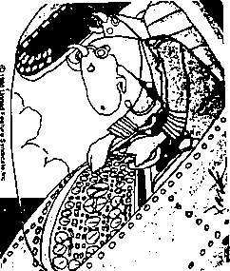
Darn these hooves! I hit the wrong switch again!
Who designs these instrument panels, raccoons?

Slide 27
Motorway Communication System
Britain 1976
  Motorway communication system operated 40% of its highways
  police controlled it in real time to
    change lane signs, direction signs, speed limits, etc
  On December 10th, police failed to change the
  speed limit signs when fog descended
    34 vehicles crashed
    3 people killed
    11 people injured and trapped in their vehicles
    motorway closed for 6.5 hours
Slide ideas from David Hill

Slide 28
Some quotes
Police (at inquest)
  “The system did not accept the instruction”
Dept of Transport (after examining computer logs)
  “There is no evidence of technical failure”
System designers
  after emphasizing that they have no responsibility for the system
    “We supplied it over 5 years ago and have never been called
    to look at that problem”
The Coroner’s court
  judged it as "operator error"
    the police operator:
    “failed to follow written instructions for entering the relevant data”
Where have we heard this before?
Not me!

Slide 29
Example problems
cryptic input codes
  XR300/1: change (X) sign 300 on highway M5 (R) to code 1
  i.e. change particular sign to indicate fog condition
no feedback
  operator entered command, no visible effect of system response
cryptic error messages
  “Error code 7”
teletype machine was old, text illegible
  people could not see what they typed or system’s reply
operator overloaded with other chores
  also handled radio and telephone traffic

Slide 30
The single key press
from InfoWorld, Dec ’86
  “London—
  An inexperienced computer operator pressed the wrong key on a terminal in early December, causing chaos at the London Stock Exchange. The error at [the stockbrokers office] led to systems staff working through the night in an attempt to cure the problem”

Slide 31
More powerful key presses
from Science magazine
  In 1988, the Soviet Union’s Phobos 1 satellite was lost on its way to Mars, when it went into a tumble from which it never recovered.
  “not long after the launch, a ground controller omitted a single letter in a series of digital commands sent to the spacecraft. And by malignant bad luck, that omission caused the code to be mistranslated in such a way as to trigger the [ROM] test sequence [that was intended to be used only during checkout of the spacecraft on the ground]”

Slide 32
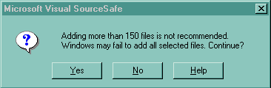
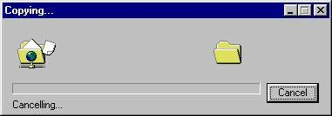
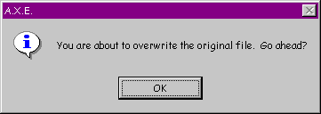

Inane Dialog Boxes
Umm, thanks for the warning,
but what should I do?
What happens when you
cancel a cancelled operation?
Do I have any choice in this?
Uhhh… I give up on this one
Some of these interfaces were posted on Interface Hall of Shame

Slide 33
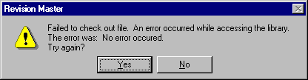

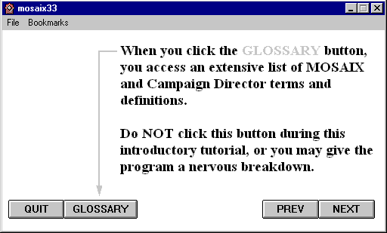
Inane Dialog Boxes
These are too good not to show
Some of these interfaces were posted on Interface Hall of Shame

Slide 34
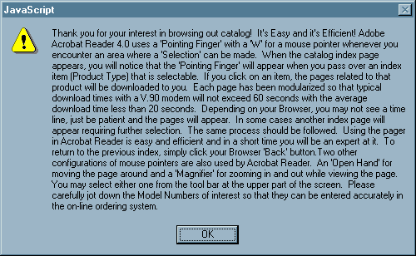
Inane Dialog Boxes
Midwest Microwave's online catalog
Some of these interfaces were posted on Interface Hall of Shame

Slide 35
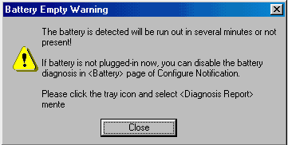
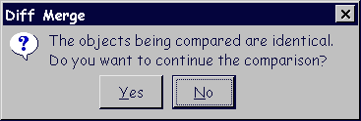
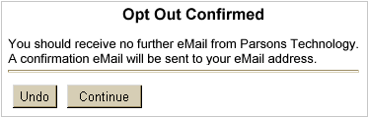
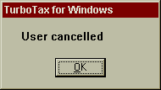
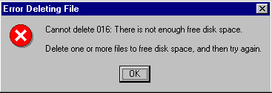
Inane Dialog Boxes
ClearCase, source-code control Rational Software
Some of these interfaces were posted on Interface Hall of Shame

Slide 36


Bad hosting company system

Slide 37
Why should you care?
Past
  manufacturers had little incentive to emphasize usability
  customers have no experience until after they buy the product
  early technology adaptors were ‘resilient’
    willing to put up with annoyances
  consequences of bad design typically small (annoyances)
Slide idea from Jacob Nielsen Alertbox March 15, 2004

Slide 38
Why should you care?
Today: Usability sells
  product reviews emphasize usability (e.g., Consumer Reports)
  customers have used related products, and can often download trial versions (including competitors)
  today’s users are impatient and intolerant of bad design
consequences of bad design now large
  costly errors in serious systems (e.g., financial institutes)
  widespread effects (e.g., incorrect billing, failures)
  life-critical systems (medical, air traffic control)
  safety (in-car navigation systems)

Slide 39
Why should you care?
Professionalism
  software engineers are designers
  we are ultimately responsible for the products we build
  a history of ‘hack’ designs does not excuse our responsibilities
Compared to civil engineers
  What would happen to an engineer who built a bridge where people fell off of it into the river (because the guard rails were too low), and where accidents were high (because the bridge was too narrow)?
  We would call this incompetence.
  The same standard should apply to software engineers.

