Slide 1
Models of Conversation
CPSC 599.81
Anthony Tang

Slide 2
Punchlines
Designing for groups is challenging
Evaluating systems for groups can be challenging
Systems are embedded with our values, and our assumptions about how people (should/will) interact

Slide 3
Agenda
Questions about components?
Group assignments for tutorials
» code, write, speak
Conversation & Cognoter
A look ahead

Slide 4
Course components
Meaningful participation in discussion is the key
» online participation (twice a week: once with your thoughts; a second with your revised thoughts) – 15%
» in-class participation – 15%

Slide 5
Course components
Assignments: you will build four whiteboard systems
» three will be “replication”, where you build a whiteboard based on a tutorial that others have shown in class (individual assignments) –add some personal flare to these
» one will be a tutorial that you construct with a small group of four (both an online tutorial, and an in-class tutorial)

Slide 6
Course components
Project theme: play
» involve collaborative play – one that involves interaction with others in a meaningful way that progresses the state of interaction (more on this next week)
» can be a study, or a system

Slide 7
Group Assignment
I need three groups. You need several skill sets in each group: technical, writing, and speaking.
Vote:
» Tony-assigned groups?
» Self-selected groups?

Slide 8
Conversation and Cognoter
Q: How can we design team room technologies to support brainstorming?
Q: What does our understanding of conversation tell us about the challenges people faced when using Cognoter?

Slide 9
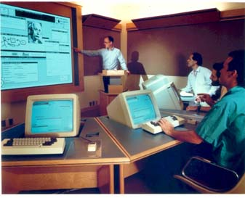
cognoter in colab
supporting presentation preparation
separation to 3 processes: brainstorming, organizing, evaluation

Slide 10
questions
how would you use cognoter?
how similar are your meetings with those in the video?
what does brainstorming look like?
Notes:
What does brainstorming look like?
What is production blocking?
How does Cognoter work?
What problem did it aim to solve?

Slide 11
More questions
What is the method they use to evaluate this system?
What makes the evaluation of this collaborative system difficult?

Slide 12
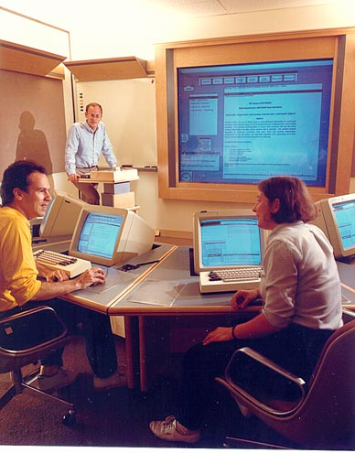
design for conversation: lessons from cognoter
models of conversation to explain what they saw: interactive vs. parcel-post
cognoter problems observed:
users wanted to see more
users couldn’t resolve deictic references

Slide 13
Questions
What are some problems that they faced?
» what is a deictic reference?

Slide 14
interactive model of conversation
“conversation is a highly coordinated activity in which meaning is attained and affirmed using a number of mechanisms that have context dependent functions” (pp192)
elementary: “the green thing on bookshelf”
try marker: “so when I’m talking about this thing (try marker), you know what I’m talking about”
mid-course corrections

Slide 15
Interactive model of conversation
Listener plays an active role in each “turn”
Conversation is context-dependent
Both speaker and listener have mutual responsibility

Slide 16
some lessons from prior work
two types of actions involving whiteboards: those that involve production of objects, and those that involve use of (references to) those objects (Suchman 1988)
writing/recording takes time, so people manage that timing in the real world (Tang 1989)

Slide 17
some specific lessons from cognoter
separation b/n speech and text creation
loss of acknowledgements
unpredictable delay
private editing causes problems

Slide 18
Reflect
How do they assume people work with one another?
How do the ideas here square with your own understanding of conversation?
How does this play out over BBM/SMS/IM?
What effect does latency play in collaboration?

Slide 19
Punchlines
Designing for groups is challenging
Evaluating systems for groups can be challenging
Systems are embedded with our values, and our assumptions about how people (should/will) interact

Slide 20
A Look Ahead
Wednesday: basic networking, and touching on the architectures of the four toolkits
Monday: what is the nature of collaborative play within the context of health?
Notes:
How the internet works – hopefully, this is review

