Slide 1
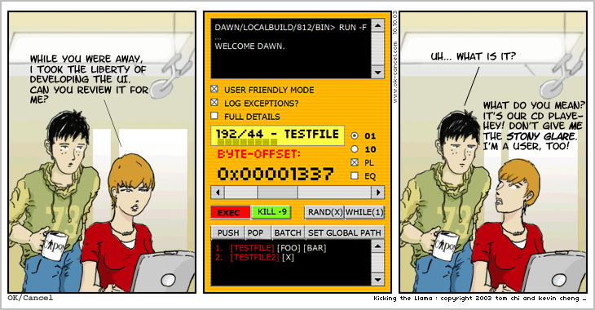
Everyone’s a designer…
Notes:
http://okcancel.com/comic/4.html

Slide 2
Heuristic Evaluation
CPSC 481: HCI I
Fall 2012
Anthony Tang with acknowledgements to Robert C Miller, James Landay, Saul Greenberg and Ehud Sharlin

Slide 3
wget
GNU Wget is a free software package for retrieving files using HTTP, HTTPS and FTP, the most widely-used Internet protocols. It is a non-interactive commandline tool, so it may easily be called from scripts, cron jobs, terminals without X-Windows support, etc.
GNU Wget has many features to make retrieving large files or mirroring entire web or FTP sites easy, including:
  Can resume aborted downloads, using REST and RANGE
  Can use filename wild cards and recursively mirror directories
  NLS-based message files for many different languages
  Optionally converts absolute links in downloaded documents to relative, so that downloaded documents may link to each other locally
  …
Notes:
Open up wget, show that it has a lot of options

Slide 4
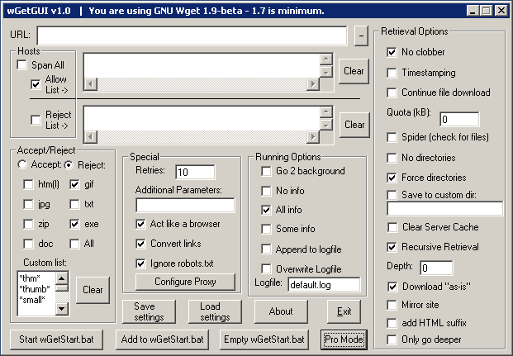
wGetGUI v1.0
Notes:
http://www.jensroesner.de/wgetgui/
Would you run a study on this?
What are you hoping to find?
What would you do?
What’s wrong with this?!!

Slide 5
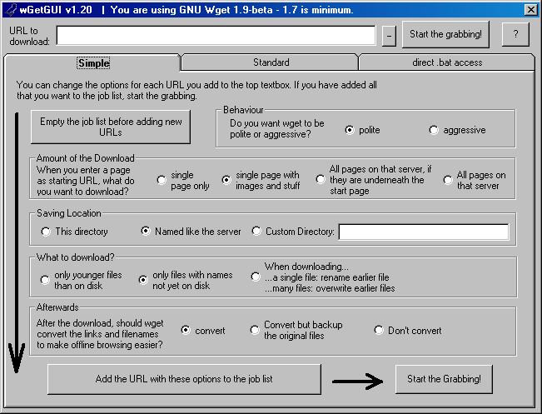
wGetGUI v1.2
Notes:
Does this improve things?

Slide 6
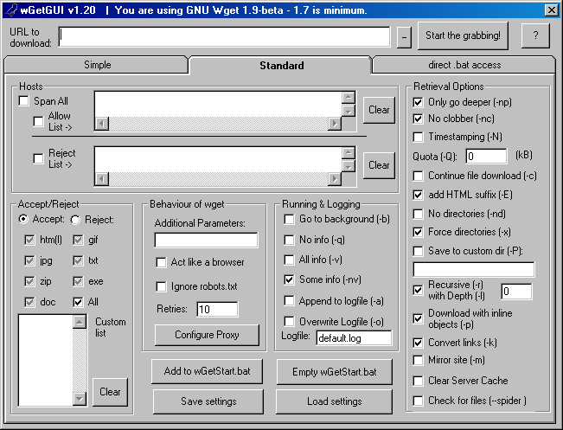

Slide 7
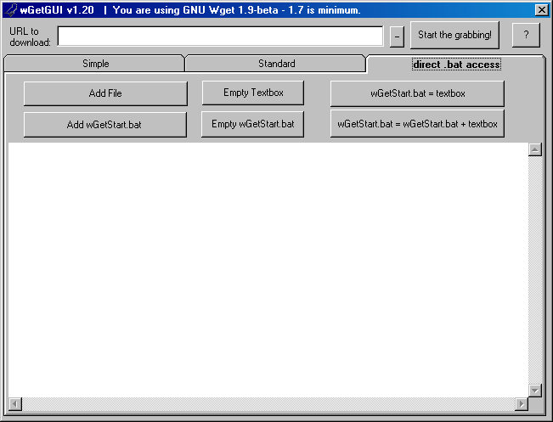

Slide 8
So…
We probably don’t need to run a usability study on this design, because intuitively, we see that there are “things that are wrong” with the current design.
How can we formalize this idea of “using our intuition” so that it is more systematic, and less haphazard?

Slide 9
Heuristic Evaluation
Systematic inspection of an interface design to see if an interface complies with a set of usability heuristics, or usability guidelines.
Generally:
  » 3-5 inspectors (usability engineers, end users, experts…)
  » inspect interface in isolation (~1-2 hr for simple interfaces)
  » results are aggregated afterwards
    single evaluator catches ~35% usability problems
    5 evaluators catch ~75%
Notes:
Caveat: designing your interface according to these design principles/heuristics also allows you to avoid common design pitfalls.
Designers eventually “ingrain” these ideas in their design, but problems still arise. You’ll see how
You can do this on working UI or on sketches

Slide 10
define: heuristic
a heuristic is a rule of thumb—a principle that is a shortcut for solving a problem or making decisions
  » never chase after a bus, another one is coming…
  » stuck in traffic: car in the lane next to me passed me → that lane must be moving faster
not always right/true, but cognitive shortcuts

Slide 11
Design Heuristics
Broad usability statements that can guide a developer’s design efforts
Derived from common design problems across many systems
Several researchers and practitioners have developed different sets of heuristics (e.g. domain specific)

Slide 12
Heuristic Evaluation: Advantages
Minimalist approach
  » a few guidelines identify many common usability problems
  » easily remembered, easily applied with modest effort
“Discount” usability engineering
  » end users not required
  » cheap and fast
  » can be done by usability experts as well as end users
  » provides common evaluation template (to evaluate across systems)

Slide 13
Heuristic Evaluation: Disadvantages
Principles are general
  » not a simple checklist
  » subtleties involved in use
  » you may actually have the wrong design altogether – e.g. who downloads webpages any more?

Slide 14
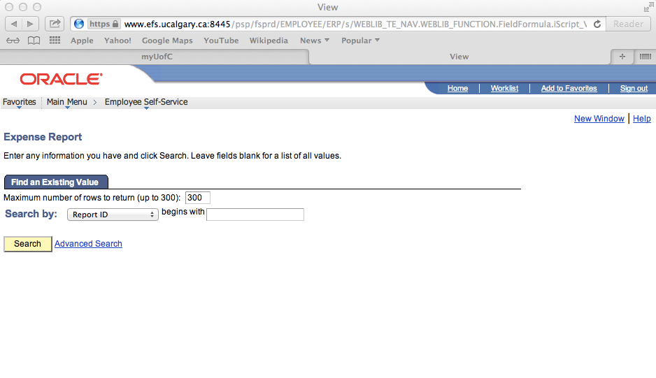

Slide 15
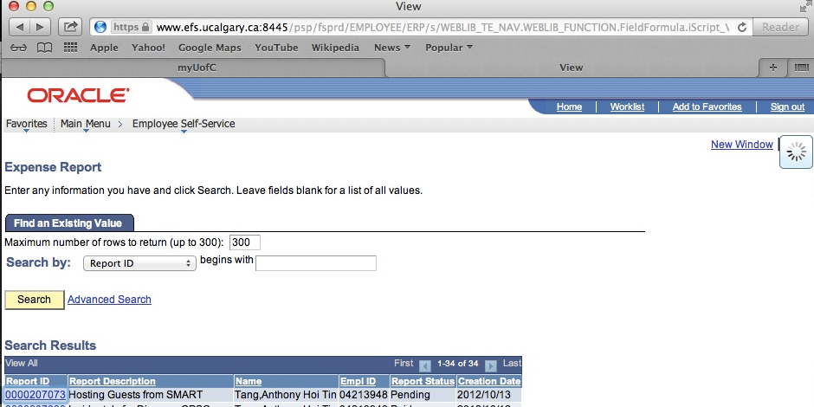

Slide 16
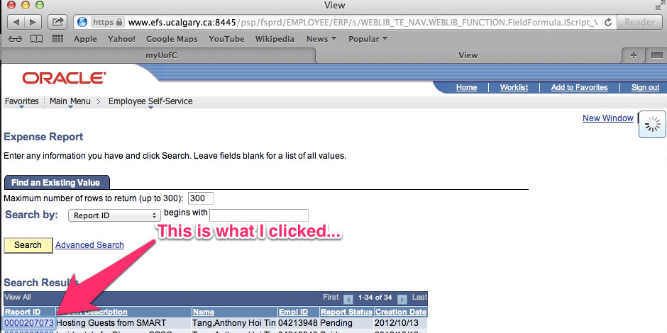

Slide 17
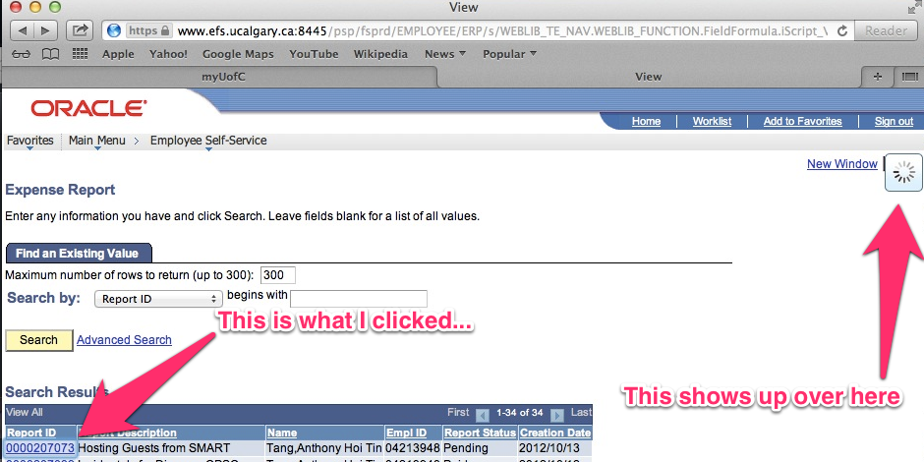

Slide 18
1 Visibility of System Status
Keep users informed about what is going on
Feedback should be appropriate (from the perspective of the user)
Feedback should be timely

Slide 19

1 Visibility of System Status
searching database for matches
example: pay attention to response time
  0.1 sec: no special indicators needed, why?
  1.0 sec: user tends to lose track of data
  10 sec: max. duration if user to stay focused on action
  for longer delays, use percent-done progress bars

Slide 20
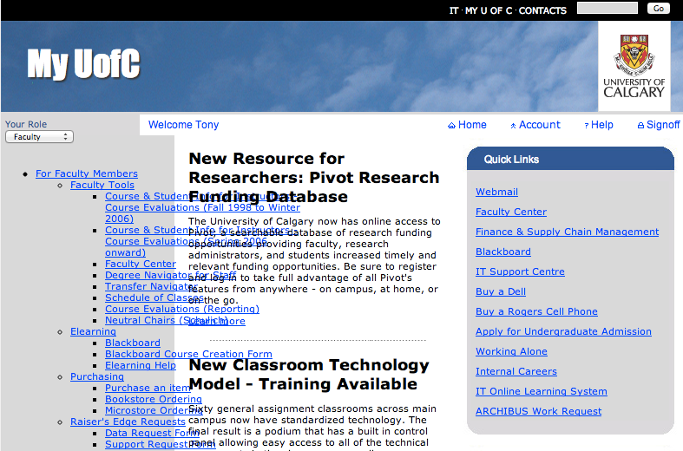

Slide 21
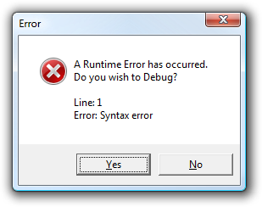

Slide 22


Slide 23
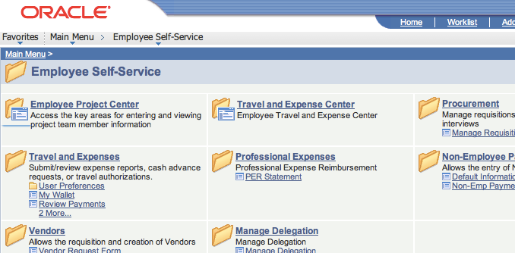

Slide 24
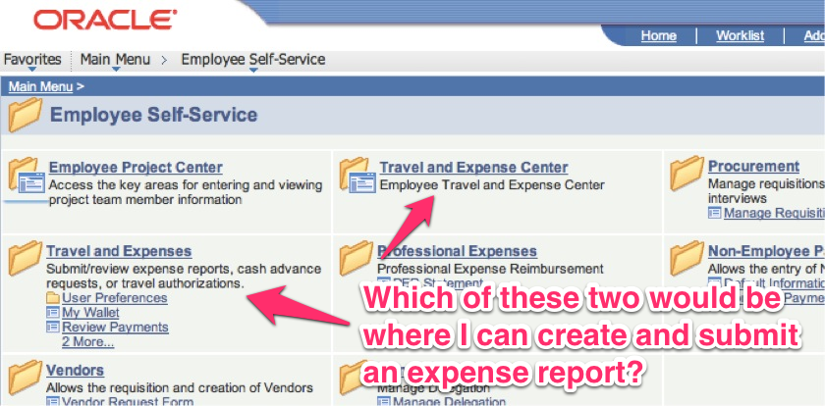

Slide 25
2 Match between system and real-world
System should speak the user’s language, with words, phrases and concepts familiar to the user, rather than system oriented terms.
Follow real-world conventions: information should appear in natural and logical order based on user’s expectations.
Remove modes.

Slide 26

2 Match between system and real-world
Bad example: Mac desktop
  Dragging disk to trash should delete it, not eject it?!

Slide 27
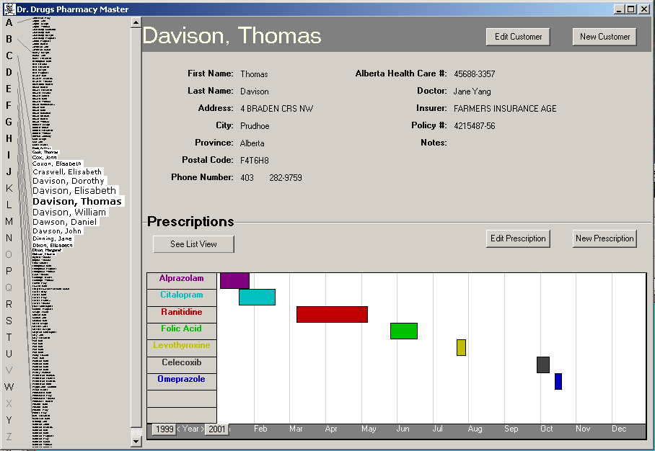
Good: information all in the same place, fisheye menu
Good: stable interface
By previous 481 student (with permission)

Slide 28
Good: information all in the same place, fisheye menu
Good: stable interface
By previous 481 student (with permission)

Slide 29
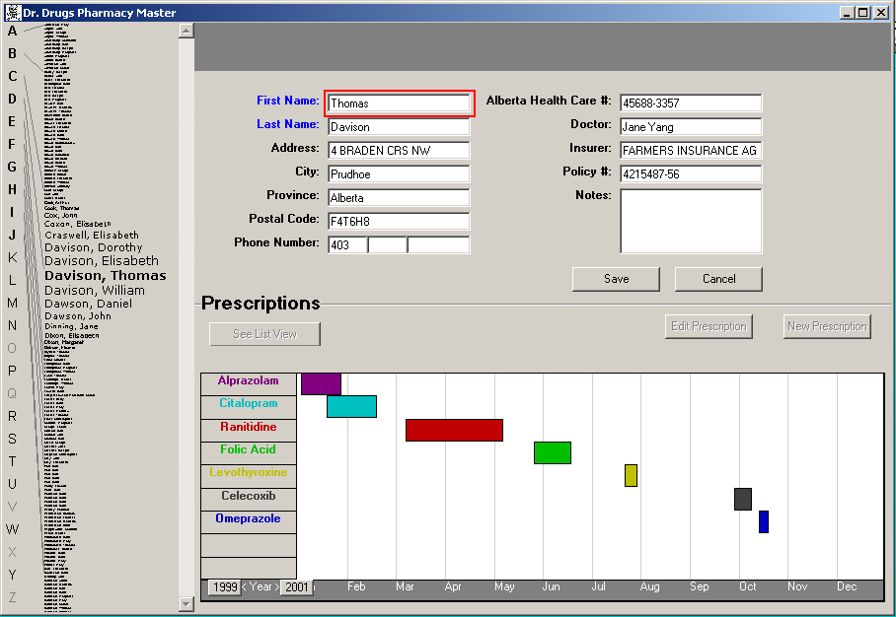
Good: information all in the same place, fisheye menu
Bad: special edit mode
By previous 481 student (with permission)

Slide 30
By previous 481 student (with permission)

Slide 31
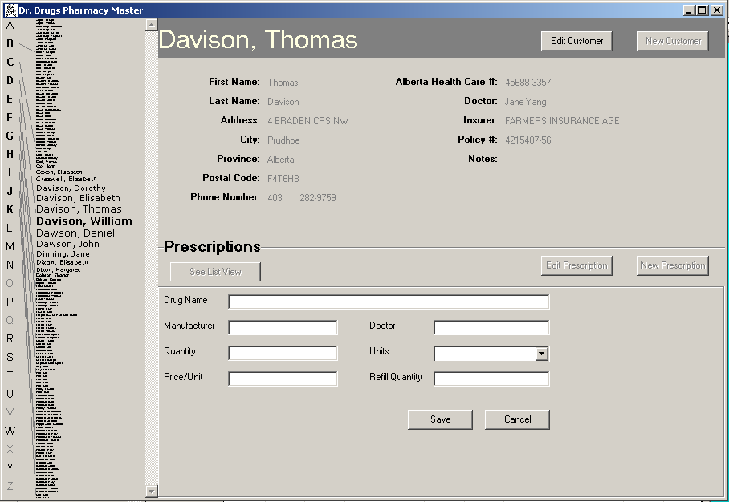
By previous 481 student (with permission)

Slide 32
Good: Stable parts of the window
Bad: Prescriptions separate from graphics
By previous 481 student (with permission)

Slide 33
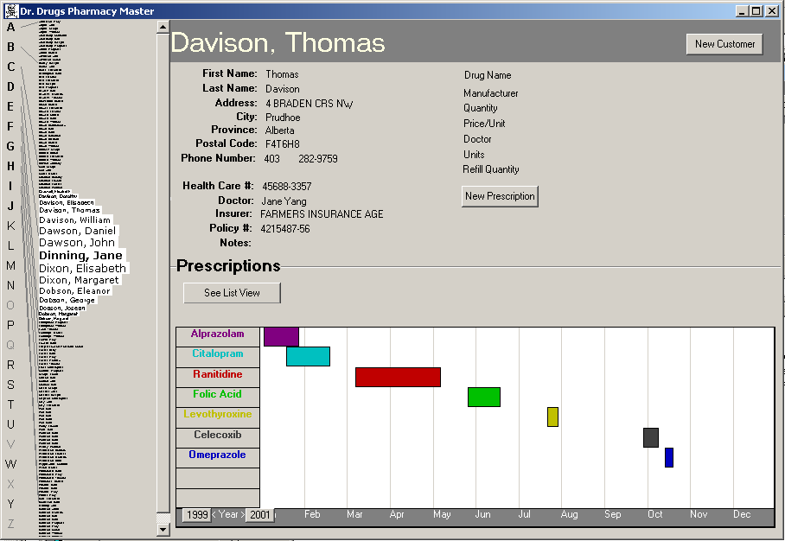
collapsed onto
one screen
Click to get info
Double click to edit
(mode buttons gone)
Add Undo
By previous 481 students (with permission)

Slide 34
2 Match between system and real-world
System should speak the user’s language, with words, phrases and concepts familiar to the user, rather than system oriented terms.
Follow real-world conventions: information should appear in natural and logical order based on user’s expectations.
Remove modes.

Slide 35
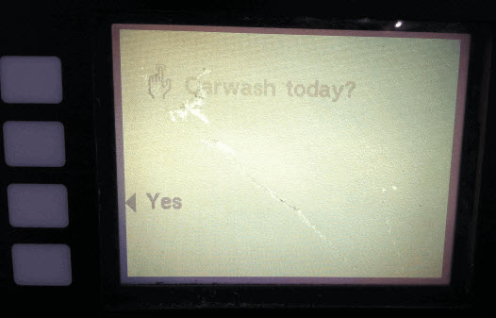
Notes:
http://thedailywtf.com/Articles/Numerically-Nonnumeric.aspx

Slide 36
3 User Control and Freedom
Users should be provided with clearly marked “emergency exits” to leave unwanted states.
Support undo and redo.

Slide 37
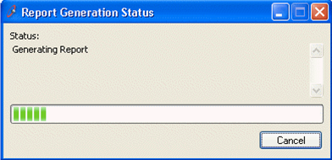
3 User Control and Freedom
Learning by exploring
Dealing with errors
User is sentient, computer is not
Long actions should be cancelable
Notes:
Good interfaces are explorable. One way users learn is by exploring: poking around an interface, trying things out. An interface should encourage this kind of exploration, not only by making things more visible, but also by making the consequences of errors less severe. For example, users navigating around a 3D world or a complex web site can easily get lost; give them an easy, obvious way to get back to some “home”, or default view. Users should be able to explore the interface without fear of being trapped in a corner.

Slide 38
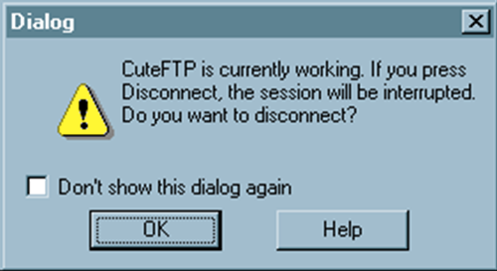
3 User Control and Freedom
All dialogues should have a cancel button
Notes:
The simplest kind of user control is a veto — the ability to cancel an operation, even if it was something they asked for. Users should not be trapped by the interface. Long operations should not only have a progress bar, but a Cancel button too. Likewise, every dialog box should have a Cancel button. Where is it in this CuteFTP dialog box on the bottom? As a user of this dialog, would you feel like you’re in control?

Slide 39
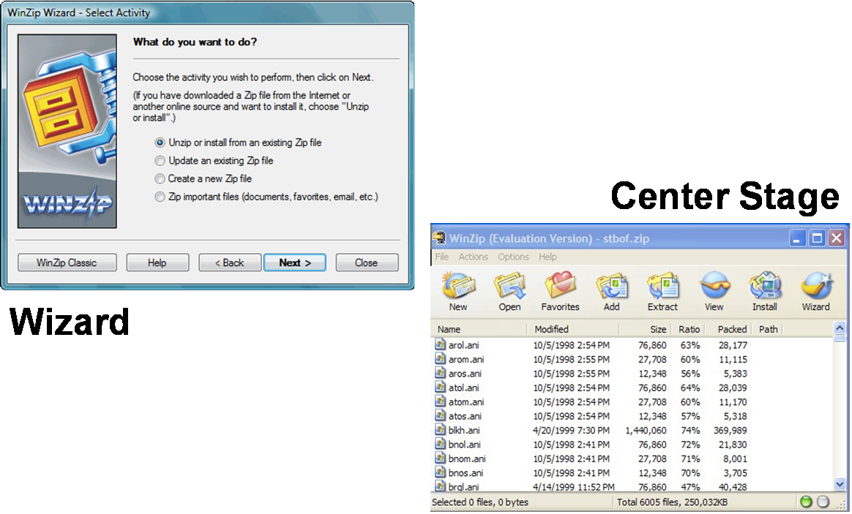
3 User Control and Freedom
Notes:
Let’s look a little further at who controls the dialog between the user and the system. (Here, dialog means the general pattern of back-and-forth communication between the user and the interface, as if the user and the system are having a conversation. A dialog box is a specific kind of window, a design pattern used in a dialog. We often say dialog as a shorthand for dialog box, but hopefully the distinction will be obvious from context.) We’ll contrast two patterns. The wizard design pattern is a familiar pattern for improving the learnability of a complex interaction, by structuring it as a step-by-step process, with each step in a dialog. Wizards are the conventional pattern for software installation. In a wizard, the system controls the dialog — it dictates the steps, the ordering of the steps, and what it asks for at each step. Imagine a travel agent who’s asking you a series of questions, and refuses to listen to what you say if it’s not relevant to the question they asked. That’s a wizard. Contrast that with the center stage pattern, which lays out data objects in the main section of the window, and gives the user a set of tools for operating on the objects. In this case, the user controls the dialog, deciding which objects to select and which tools to pick up. Wizards clearly restrict the user’s freedom, but for complex, infrequently-done tasks (like installation), the tradeoff is often worth it. Note, however, that a good wizard has two key features: a Back button (for backing out of errors) and a Cancel button (for vetoing the operation entirely). So even though the wizard pattern puts the system in control of the details, the user still has supervisory control.

