Slide 1
Usability Testing 3
CPSC 481: HCI I
Fall 2012
Anthony Tang

Slide 2
Experimental Validity
External validity » realism
  Across situations
  Across people
Internal validity » integrity
  Confound
  Selection bias
  Learning effects
  Priming
  Experimenter bias

Slide 3
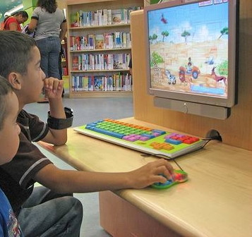
Imagine this test…
You design two computer games for children, and bring it to a school to test.
The first 10 students that complete their homework are sent to your testing office for the first game.
The next 10 students that complete their homework are sent to play the second game.

Slide 4
Imagine this test…
You design two computer games for children, and bring it to a school to test.
The first 10 students that complete their homework are sent to your testing office for the first game.
They find the game easy to play.

Slide 5
Internal Validity » Selection Bias
Systematic, non-random sampling of the population distorts your ability to generalize from the results.
Notes:
http://c.suite101.com/files/styles/article_full/public/000/105/000105936.jpg

Slide 6
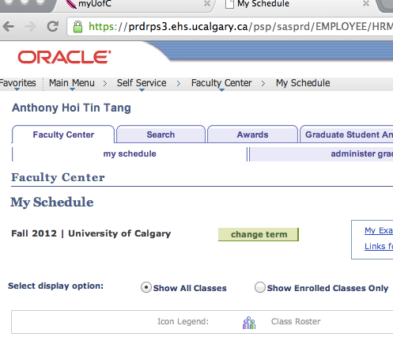
Imagine this test…
You have designed two new interfaces for PeopleSoft. You recruit students to test your interface.
For each participant, you give them your least favourite interface first to complete the task, and then you give them your favourite interface second.

Slide 7
Internal Validity » Learning | Fatigue Effects
Experience gained from using the first interface (to conceptual model) affects how they think about and use the second interface.
Too much testing means participants get tired of testing.
Mix it up: for some participants, A then B; for others, B then A.

Slide 8
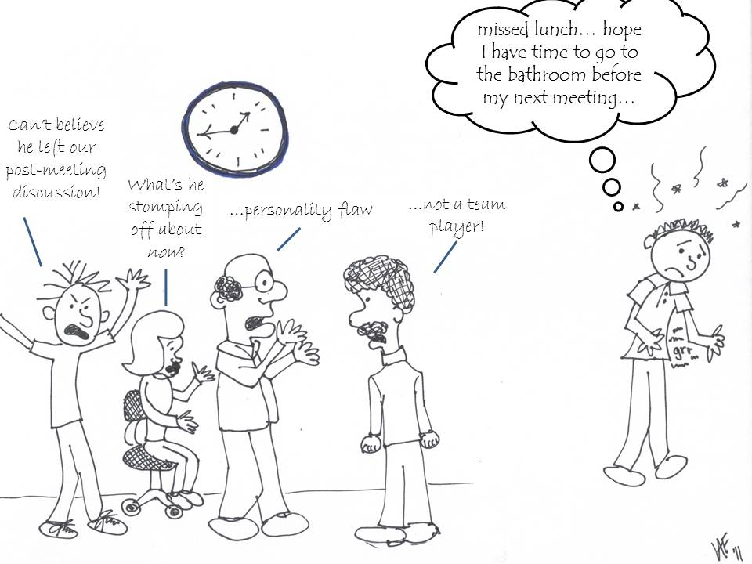
Internal Validity » Experimenter Bias
Notes:
http://blog.lib.umn.edu/paldr001/myblog/2011/12/

Slide 9
Internal Validity » Demand Characteristics
If participants know what your hypothesis is, they will actively try to be “good participants” and help you.

Slide 10
Ways to overcome some of these problems…
“Double-blind” experiment
  » neither participant nor experimenter know the hypothesis
Active deception
  » tell participants you’re expecting the opposite of what you expect

Slide 11
Ways to overcome some of these problems…
Randomized assignment to conditions
  » reduces systematic assignment biases
Randomized ordering of conditions
  » normalizes the effect of order/learning/fatigue
Large sample size
  » reduces effect of “randomness”

Slide 12
Experimental Validity
External validity » realism
  confidence that results applies to real situations
Internal validity » integrity
  confidence in our explanation of experimental results

Slide 13
Recording Observations
We risk forgetting, missing, or misinterpreting events if we do not record user actions for later analysis.
Lots of different methods for doing this with various pros and cons:
  » paper and pencil (2nd observer helps)
  » audio recording
  » video recording
  » system recording (user actions w/ system, user actions)
Notes:
This is in the wrong slot. Should be in slide deck 14
– paper and pencil
• primitive but cheap
• observer records events, comments, and interpretations
• hard to get detail (writing is slow)
• 2nd
observer helps…
– audio recording
• good for recording think aloud talk
• hard to tie into on-screen user actions
– video recording
• can see and hear what a user is doing
• one camera for screen, rear view mirror useful…
• initially intrusive

Slide 14
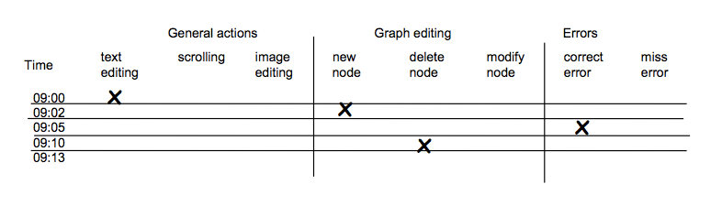
Coding sheet example…
Tracking a person’s use of an editor…

Slide 15
WhatUsersDo video
Notes:
http://www.youtube.com/watch?v=HAiJCPWMGss

Slide 16
Usability Testing: Providing Feedback
Based on your list of issues, provide a small handful of suggestions on how to address the issue
Depending on the part of the design cycle you are in (early, middle, late), these should be bigger or smaller suggestions
Provide video “proof” of people encountering issues
ITERATE ON THE DESIGN!!?!?!?
Sample final report:
  http://www.utexas.edu/learn/usability/report.html
Notes:
http://www.utexas.edu/learn/usability/report.html

Slide 17
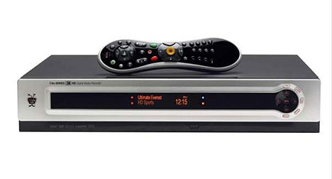
Tivo: Weekly Usability Tests (12 weeks)
Already have a DVR? vs. Want step-by-step instructions?
Notes:
http://www.useit.com/alertbox/weekly-usability-tests.html
Website usability
Remote testing (across the country)
1-1 testing – stakeholders : “good for team to see frustration users’ faces rather than to simply listen to testers tell them about it on the phone”
Actionalbe results: new approach to content
-- originally: voice and personality (bring out attributes of brand)
-- feedback: “I hate reading fluff”
-- redesign: small chunks of text, deeper links, more detailed information inline links
“Already have a DVR?” – for people looking for HOWTOS
-- hard to find
-- “Want step-by-step instructions” seemed to work better (remember: what is their goal) → language of the user rather than the language of the designer
Words and phrases really matter

Slide 18
Research Example » EdgeLens
Notes:
http://innovis.cpsc.ucalgary.ca/innovis/uploads/Publications/Publications/EdgeLens-finalversion.pdf
http://innovis.cpsc.ucalgary.ca/innovis/uploads/Research/EdgeLens/EdgeLens.avi

Slide 19
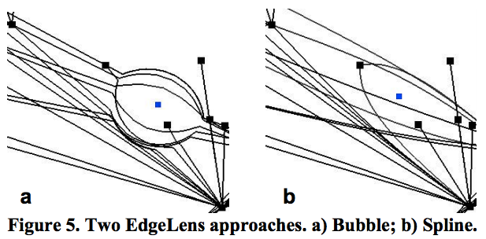
EdgeLens » Usability Study

Slide 20
EdgeLens » Usability Study Details
16 participants (8 males, 8 females)
Route finding task (varying difficulty)
  » Canadian cities, varying number of hops req
Collecting
  » path
  » certainty of correctness
  » time to complete task
  » preference
  » comments

Slide 21
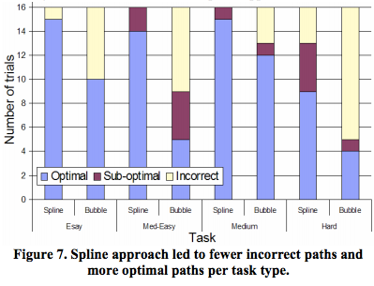
EdgeLens Test » Results

Slide 22
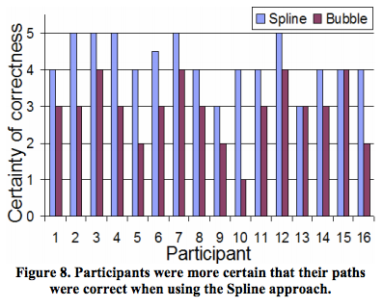
EdgeLens Test » Results

Slide 23
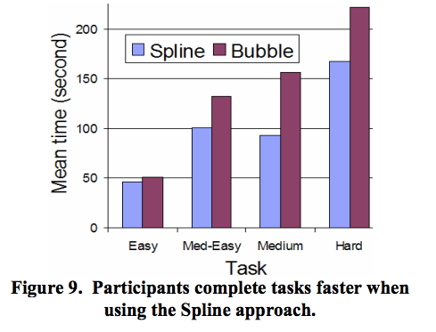
EdgeLens Test » Results

Slide 24
Usability Tests: HOWTO
Determine goals of usability test
Determine testing timeframe
Determine target audience & recruitment plan
Develop testing plan
  What are the most important things you want to know? (top 10)
  Conceptual model extraction
  Provide non-leading questions
  Simple/realistic scenarios
  Prepare any written materials (audience-specific, if necessary)
Run a pilot study
Run your test with real participants
Notes:
Also, testing location and context

Slide 25
When should I use a usability test?
Any time.
Early:
  Exploring potential possible designs
Late:
  Close to end stage to determine possible showstoppers
After:
  Investigate reported problems
Notes:
My emphasis: earlier
It’s cheaper, but still possible to do it late
You can figure out what needs to be fixed for next time around, or determine what kind of documentation is required/information for support people

