Slide 1
Need volunteer with high self-esteem
Notes:
Think-aloud protocol with the overhead projector

Slide 2
Usability Testing 2
CPSC 481: HCI I
Fall 2012
Anthony Tang

Slide 3
Think-aloud protocol
As participants complete a task, you ask them to report
» what they are thinking
» what they are feeling
» rationale for their actions and decisions
Idea: rather than interpret their actions/lack of action, you can actually understand why they are doing what they are doing

Slide 4
Think-aloud protocol
What’s weird:
People are not normally used to saying things out loud as they work.
They may also be embarassed to say things out loud.

Slide 5
Co-discovery Learning prototcol
Main idea: remove the awkwardness of think-aloud
Two people sit down to complete tasks
Only one person is allowed to touch the interface
Monitor their conversation
Variation: use a semi-knowledgable “coach” and a novice (only the novice gets to touch the design)

Slide 6
Conceptual Model Extraction
Show the design, but don’t say how it works
Ask the user to explain
» function of each element
» how they would perform a particular task

Slide 7
Conceptual Model Extraction
Initial conceptual model (before they use it)
Formative conceptual model (after they’ve used it)
Good for: eliciting a user’s understanding before and after use
Bad for: understanding exploration and learning

Slide 8
Variations on Usability Tests
How well do people learn the interface?
Does the interface work with people’s actual real-life interactions?
How well does this interface work when people are busy with other things?
How well does this interface work with only a few seconds of interaction at a time?

Slide 9
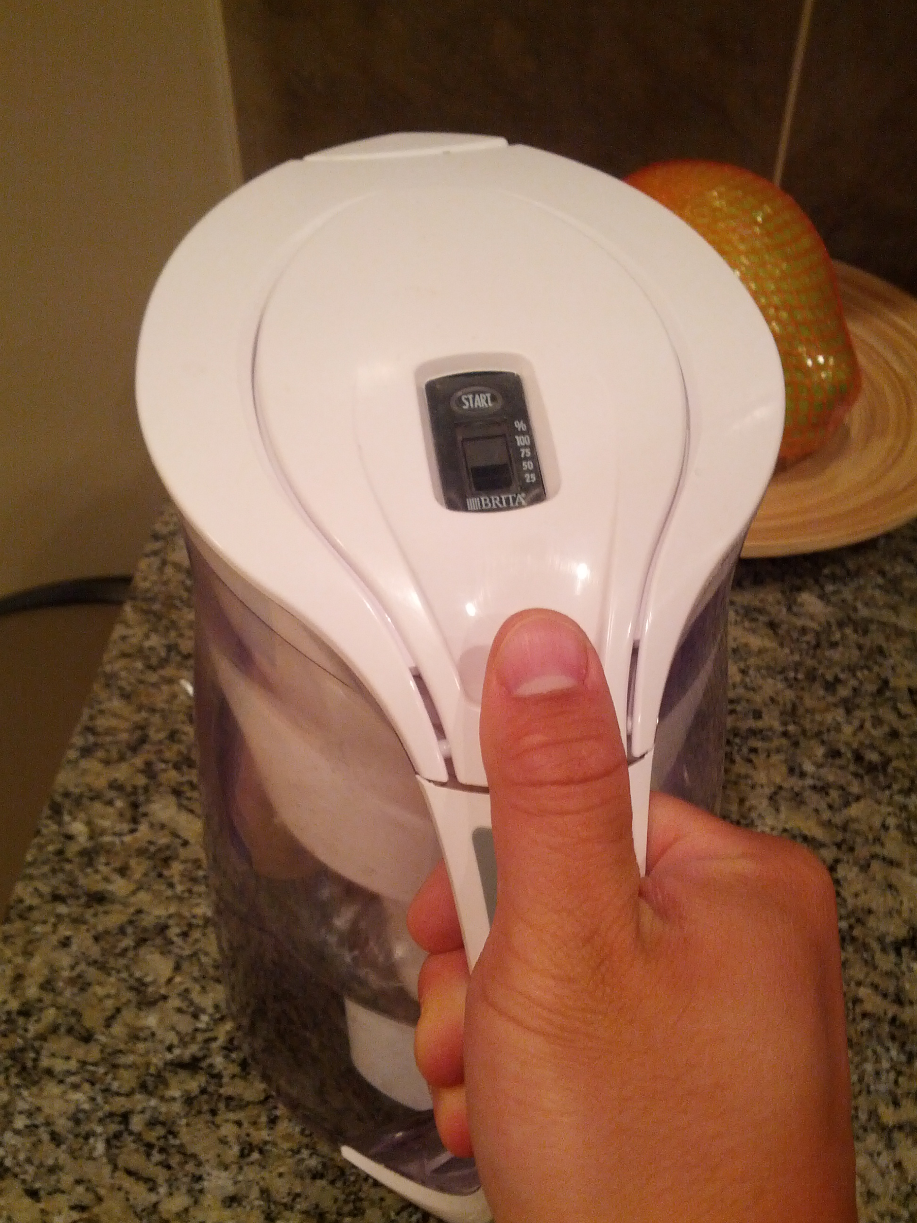

Slide 10
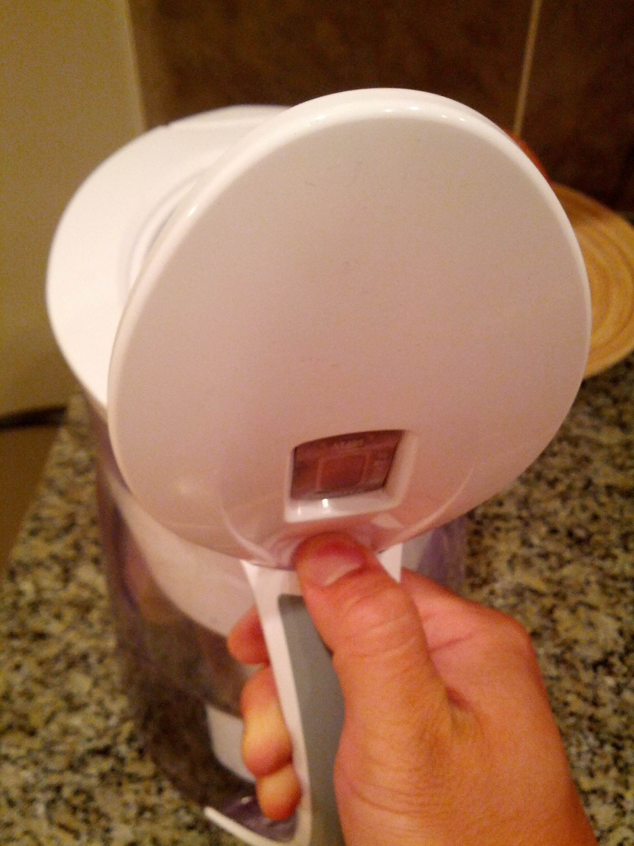

Slide 11
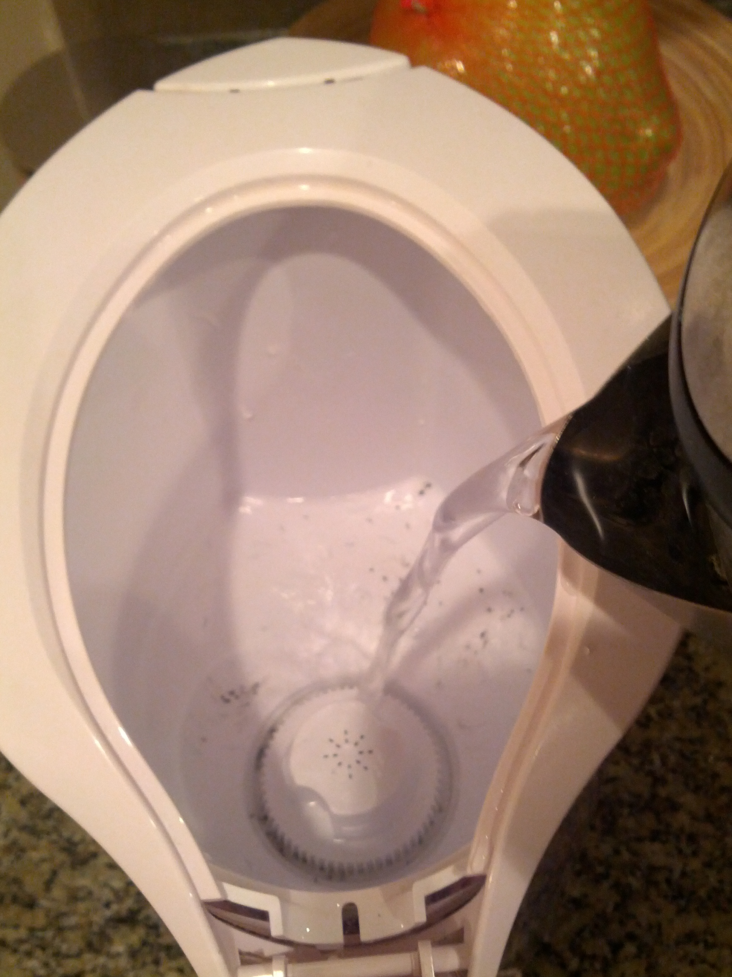

Slide 12
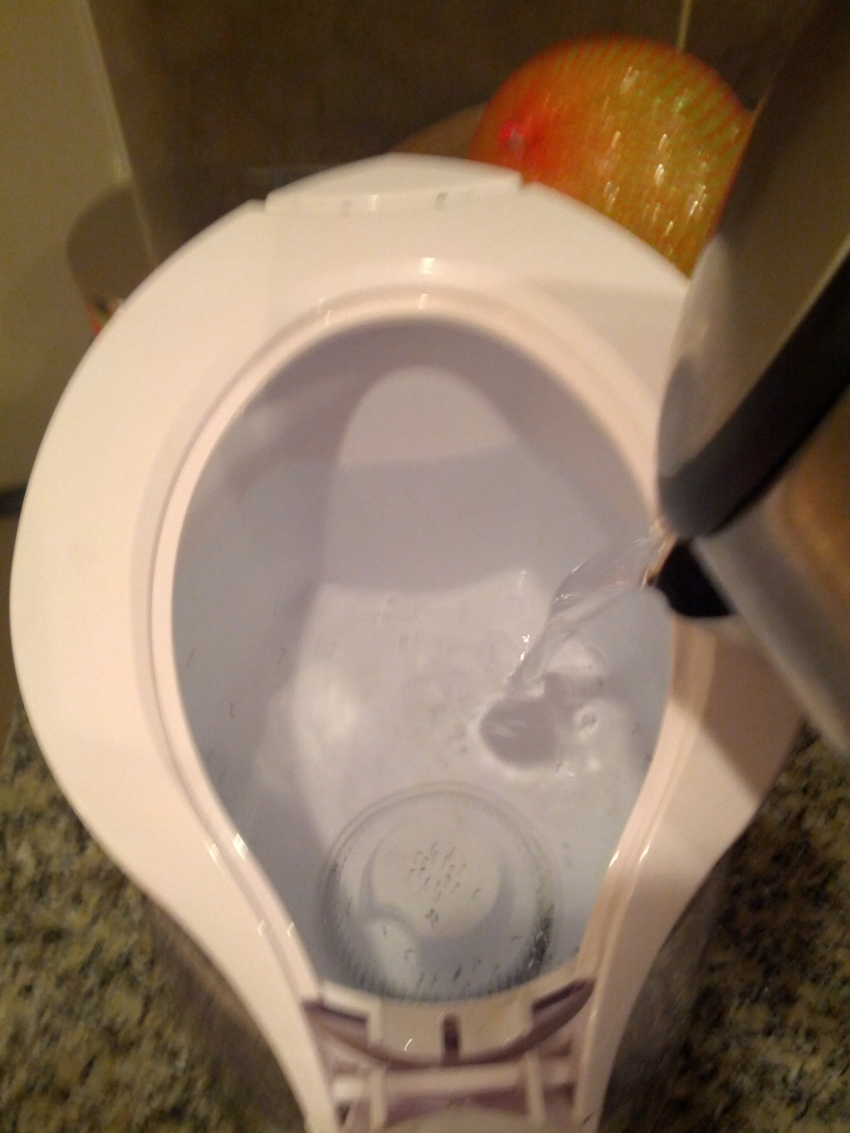

Slide 13
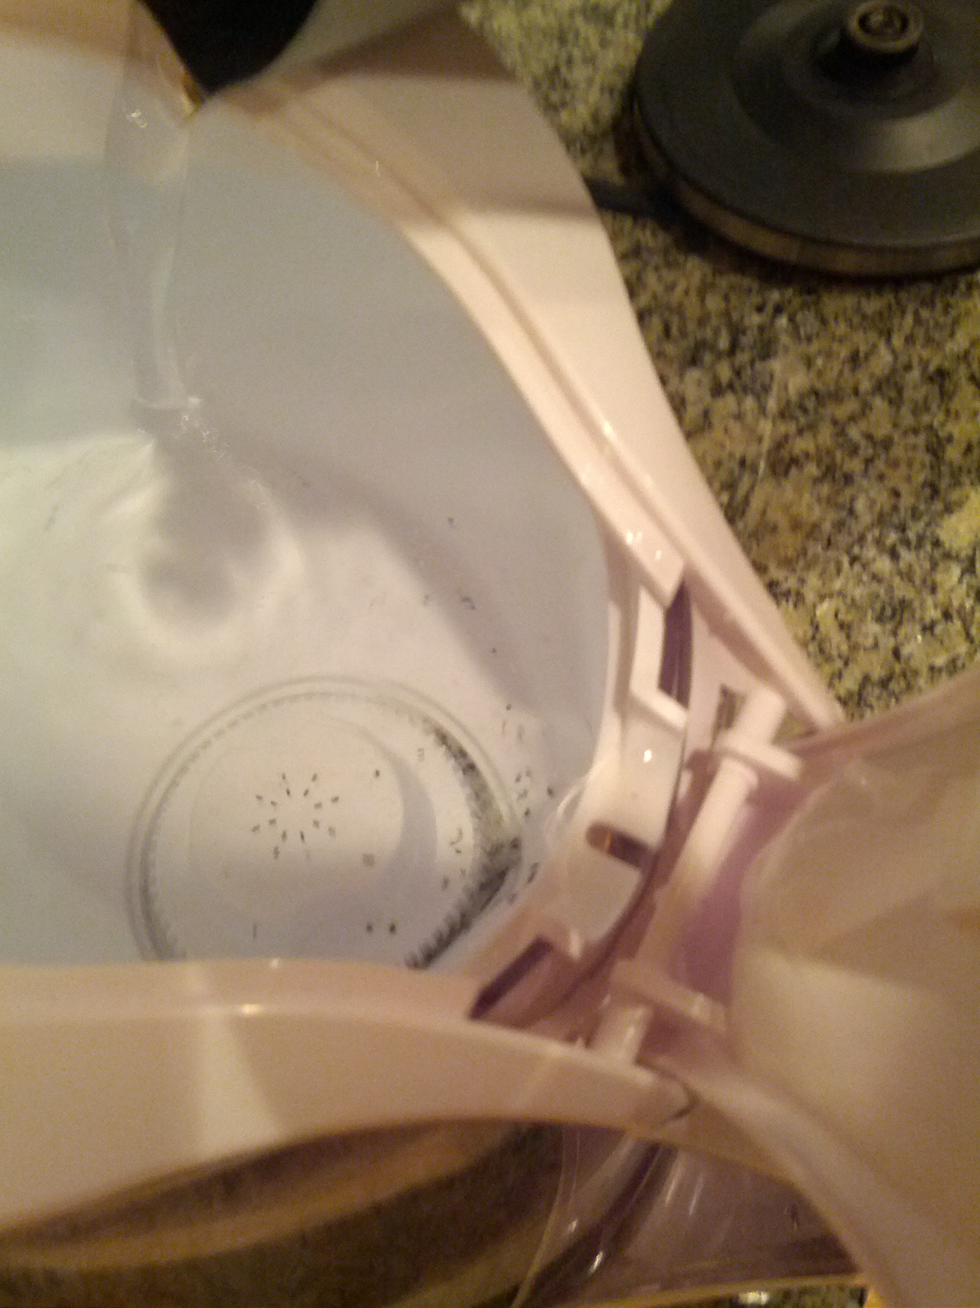
SPILLAGE!!!

Slide 14
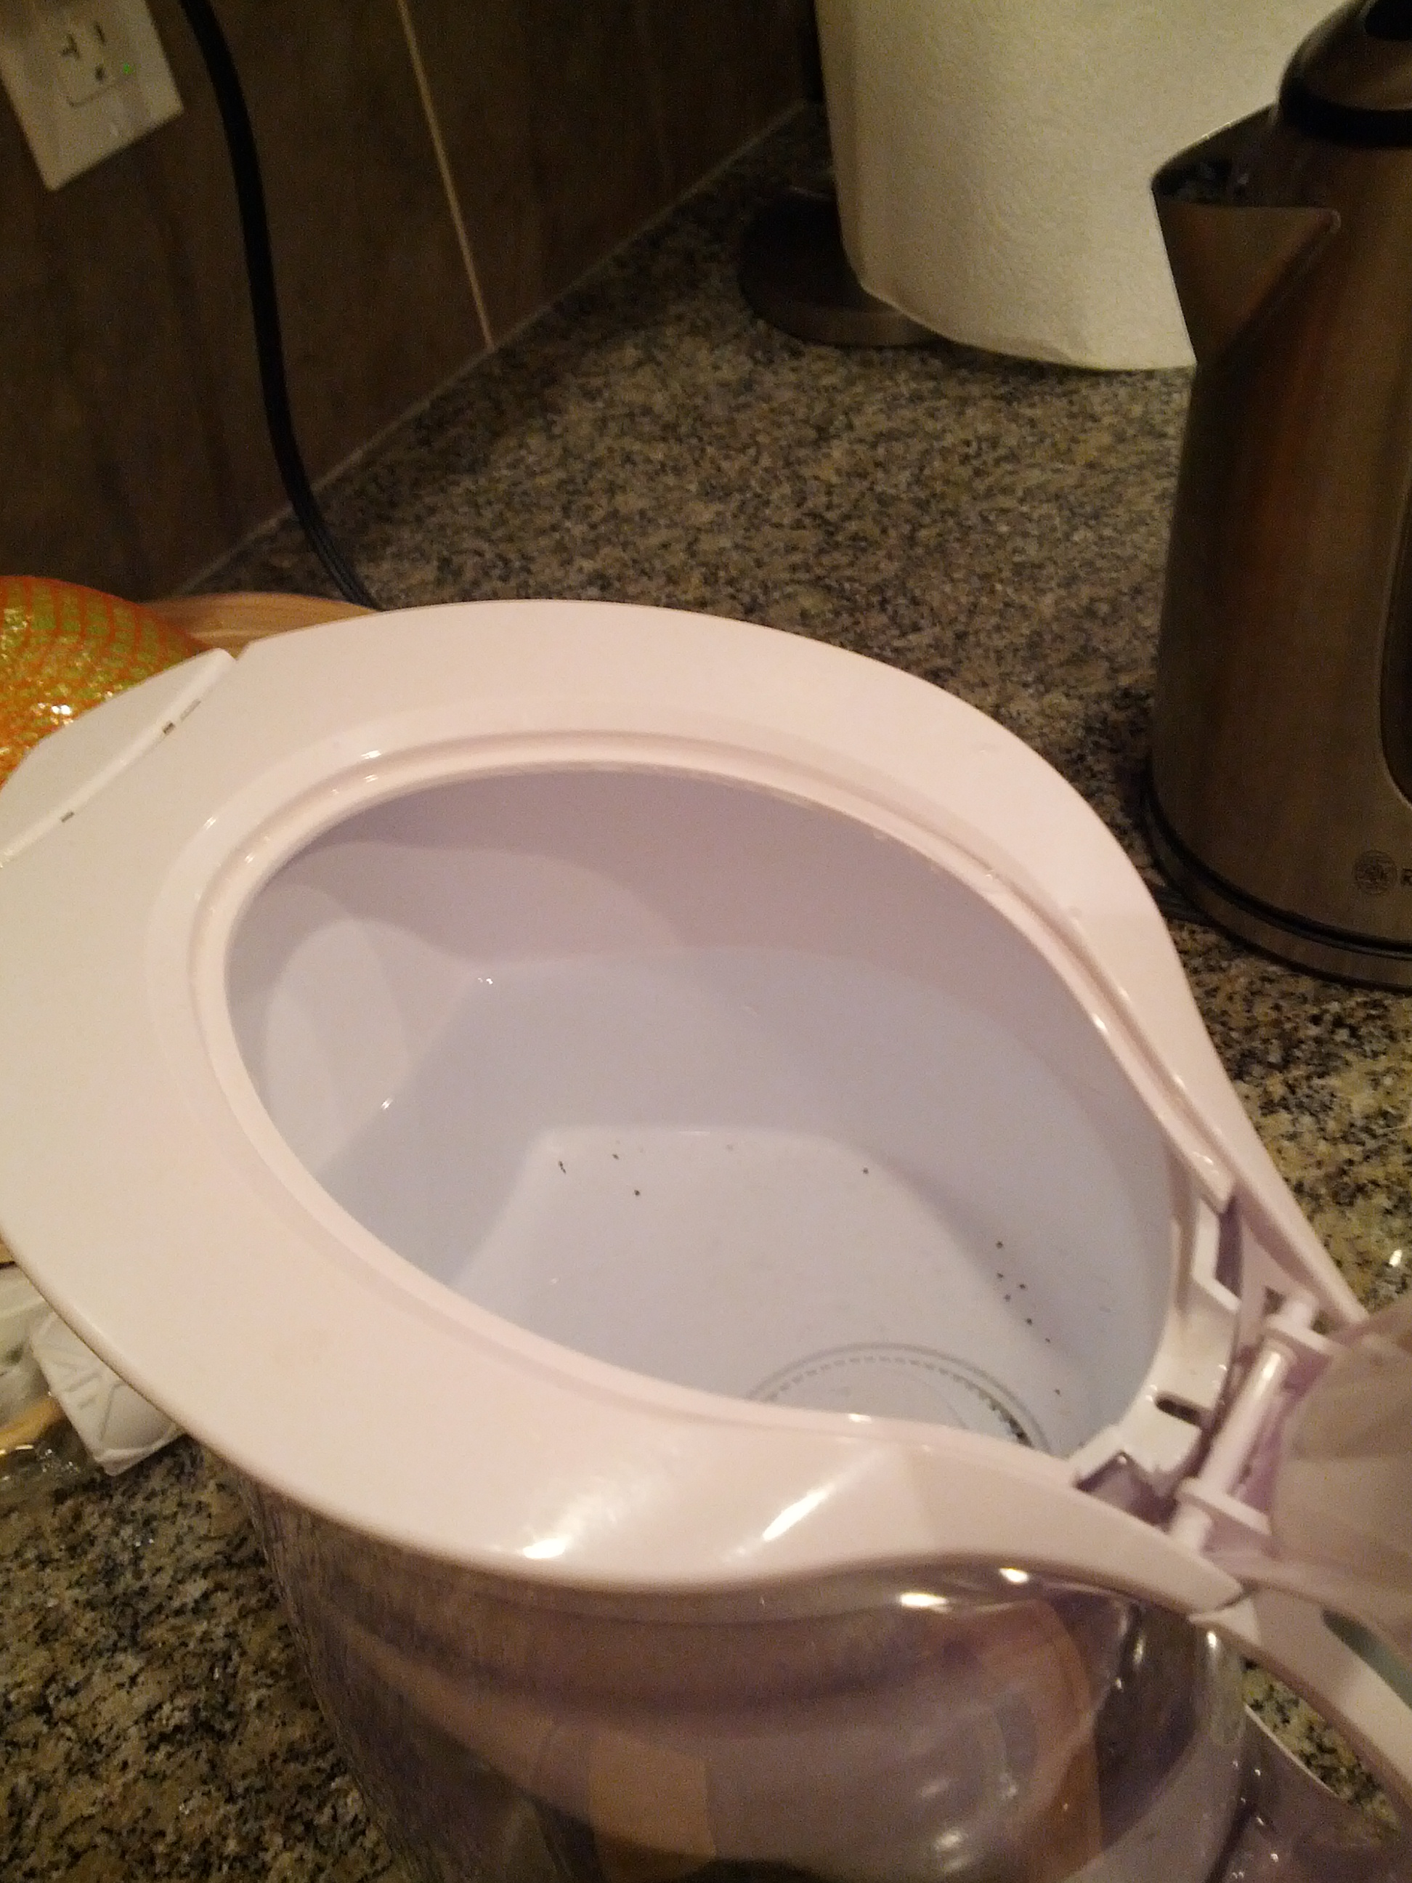
“Pour more!”
SPILLAGE!!!

Slide 15
Experimental Validity
External validity » realism
Across situations
Across people
Internal validity » integrity
Confound
Selection bias
Learning effects
Priming
Experimenter bias

Slide 16
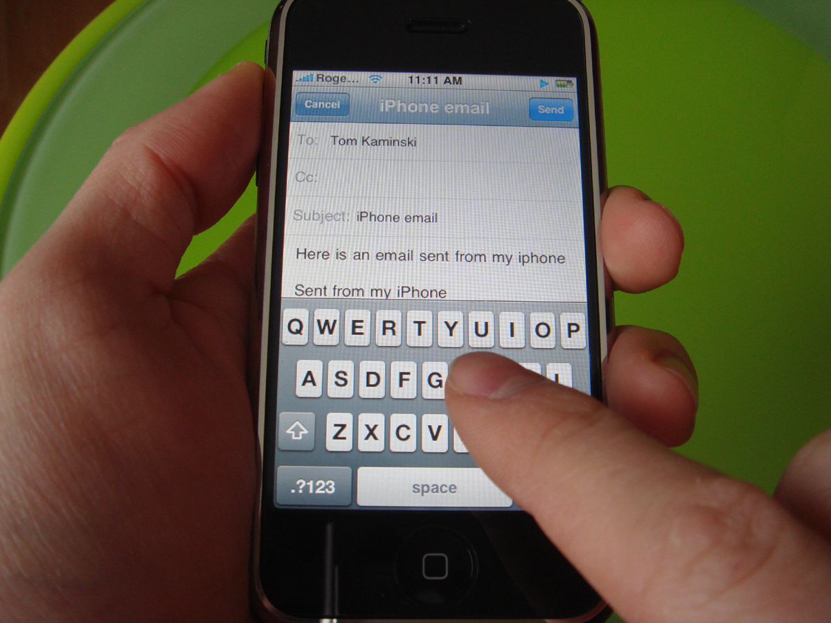
Imagine this test…
Design a typing interface for use while driving cars.
Bring people into the lab, put them at a desk.
Ask them to write an email, and time how long it takes.
Notes:
http://crackberry.com/files/u3/roundrobin/iphone/iphone6.jpg
At least one hand needed to drive!
What about attention and distractedness?
How will the device be held?

Slide 17
External Validity » Across Situations
Does the test situation match the situation that the design will be used in?
Does it match at least in critical ways?
What are aspects that are different?
Artificiality

Slide 18
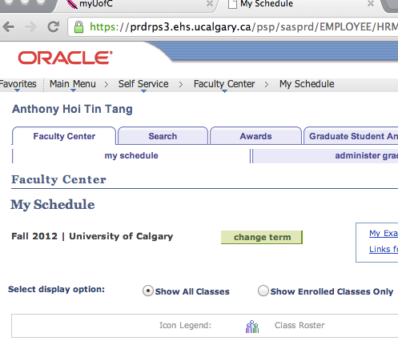
Imagine this test…
Recruiting developers of PeopleSoft, ask them to register for courses.
Because they can register for their courses within 5 minutes, the interface is deemed usable.

Slide 19
External Validity » Across People
Are test subjects representative of the target user population?
Is it a randomly selected group, or are there constraints on how the group is selected that may affect test results?
Generalizability across a population.

Slide 20

Imagine this test…
You are designing a colour scheme for your interface, and recruit participants for the entire day. For morning participants, you use interface A; for afternoon participants, you use interface B.
Morning participants seem to have no problems with the interface, but participants take a lot more time to complete the task
Notes:
http://3.bp.blogspot.com/-d3Z2sX-Dv60/UDFDEUwe4pI/AAAAAAAAIM4/Dj8dMzS9jfI/s1600/2012+08+family+room+office+area9.jpg

Slide 21
Internal Validity » Confound
When you are testing something, and changing one aspect of the test (i.e. a variable), if something else changes along with that variable, then you have a confound.
This means that you cannot tell what is causing the difference.
E.g. When you do not eat cereal in the morning, you are fine, but if you do, then you get sick. You conclude that you are allergic to cereal.

