Slide 1
Midterm Recap
Marks are posted on http://piazza.com
Originally 49 pts, changed to 46 pts + 3 pts bonus
If your student number is not listed, I think it’s because you didn’t write an exam—please let me know if you don’t see your number there!
Average: 38; Median: 39
To review your exam: meet me in my office hours (Mondays, after class)

Slide 2
Usability Testing
CPSC 481: HCI I
Fall 2012
Anthony Tang

Slide 3
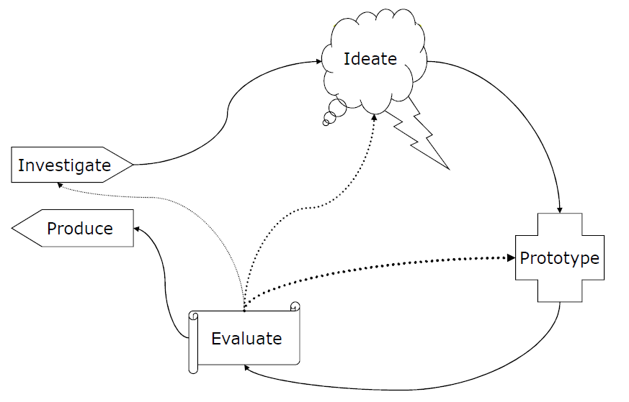
User Centered Design Cycle
Discover problems
Assess progress
Determine next steps

Slide 4
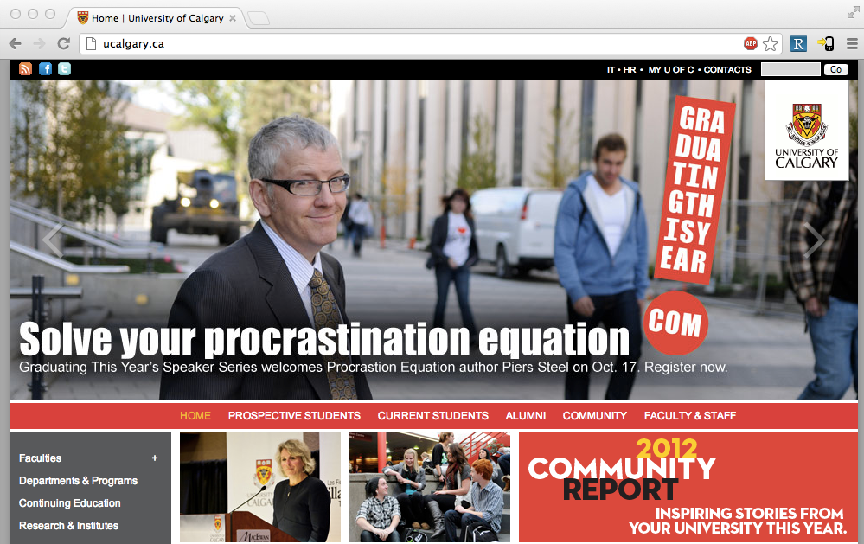
Notes:
Let’s suppose you were part of the design team for ucalgary.ca
What now? You have a design
What will you evaluate?
How will you evaluate this?

Slide 5
Within an organizational context
Reviews with stakeholders
Usually, fairly cursory as a presentation / part of a meeting
General flow, look/layout/feel
Useful for: getting people on board
Tests with users
See whether it actually works with real people
Looking for the problems that people encounter
In organizations w/ poor design: part of “quality assurance” (aka “testing”)
Reviews with stakeholders
Usually, fairly cursory as a presentation / part of a meeting
General flow, look/layout/feel
Useful for: getting people on board
Tests with users
See whether it actually works with real people
Looking for the problems that people encounter
In organizations w/ poor design: part of “quality assurance” (aka “testing”)

Slide 6
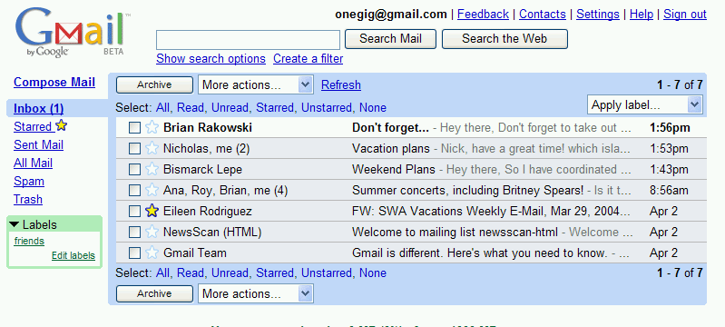
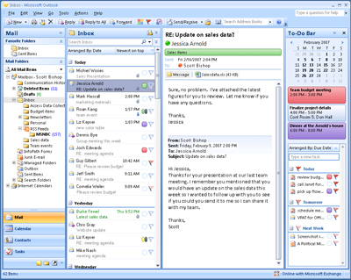
Which is better?
Notes:
Which of these would be easier to use?

Slide 7
Usability Test
A usability test is a “formal” method for evaluating whether a design is learnable, efficient, memorable, can reduce errors, and meets users’ expectations.
Users are not being evaluated
The design is being evaluated
Notes:
This is an important point—that users are not the ones being evaluated. Although we recruit them, and ask them to complete tasks for us, and we watch them fail, the key is that what we are evaluating Is whether the design is making it something that they can do

Slide 8

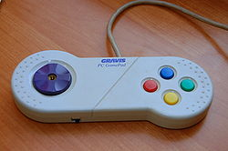
Learnable, memorable, but inefficient
Notes:
Easy to learn, but less task coverage (and perhaps inefficient)

Slide 9
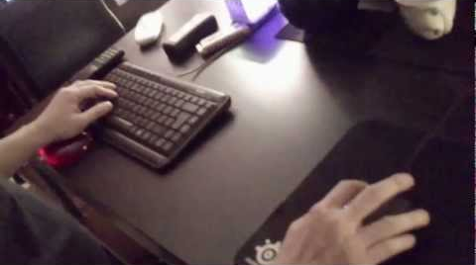
Difficult to learn, but efficient
Mouse left
Mouse right
W
A
D
S
Notes:
Difficult to learn, but efficient

Slide 10
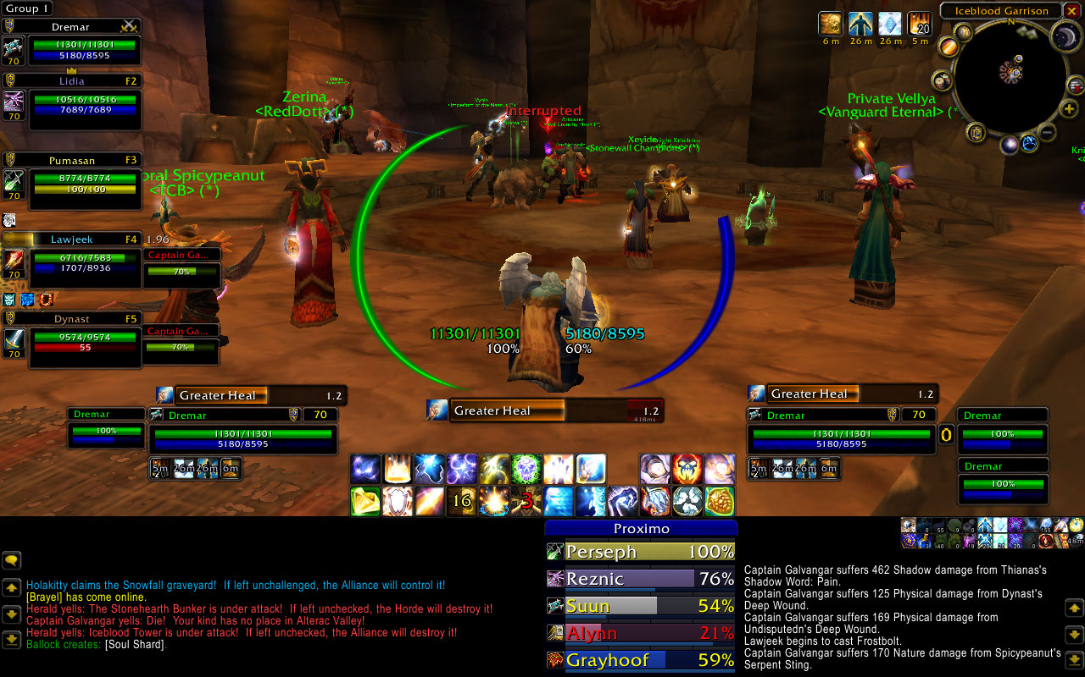
Difficult to learn, efficient? Reduces errors? Satisfaction?
Notes:
Crazy to look at, difficult to learn, but efficient

Slide 11
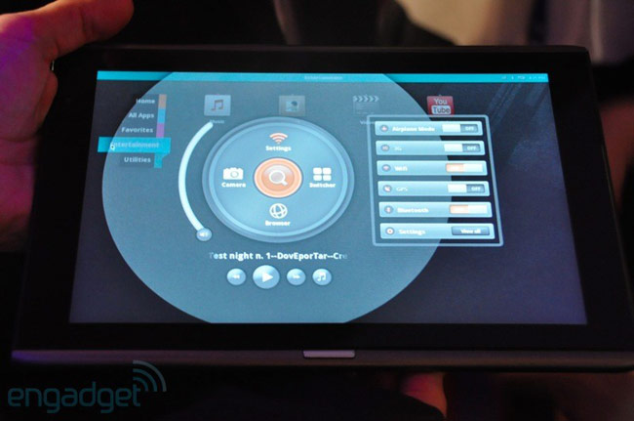
Interfaces with less well-known elements…
Notes:
http://droid-n.com/wp-content/uploads/2011/06/wpid-acer-m500-circular-ui.jpg
Can they learn this interface if they’ve never seen it before? Are there familiar elements? Is it using the language they expect?

Slide 12
Usability Test: Essentially…
Bring in real users
Have them complete tasks with your design, while you watch with your entire team
Use a think-aloud protocol, so you can “hear what they are thinking”
Measure
Task completion, task time
Satisfaction, problem points, etc.
Identify problems (major ones | minor ones)
Provide design suggestions to design/engineering team
Iterate on the design, repeat

Slide 13
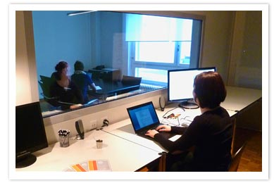
Testing Environments…
Notes:
http://lynnewatanabe.wordpress.com/2011/08/24/could-usability-testing-of-websites-help-non-profits-heck-yeah/
http://www.telono.com/en/lelab/fixed-lab
http://www.clockwork.net/blog/2009/11/04/291/our_usability_lab_keepin_it_simple
http://www.experiencelabstudios.com/studio_small.html

Slide 14
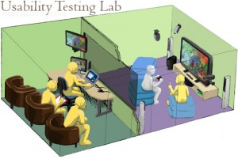
Testing Environments…
Notes:
http://lynnewatanabe.wordpress.com/2011/08/24/could-usability-testing-of-websites-help-non-profits-heck-yeah/

Slide 15
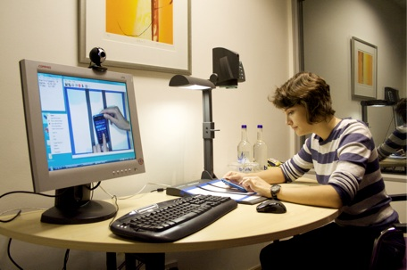
Testing Environments…
Notes:
http://lynnewatanabe.wordpress.com/2011/08/24/could-usability-testing-of-websites-help-non-profits-heck-yeah/

Slide 16
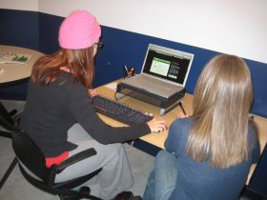
Testing Environments…
Notes:
http://lynnewatanabe.wordpress.com/2011/08/24/could-usability-testing-of-websites-help-non-profits-heck-yeah/

Slide 17
Testing Environments…
Best environment depends on pragmatic considerations, as well as what you’re looking for
Do you want your whole team to be able to view?
Do you want to be able to review a test?
Are interruptions important?
Repeat use systems, or one-time use systems?

Slide 18
Things you care about in a usability test
Learnability/Discoverability: How easy is it for users to accomplish basic tasks the first time they encounter the design?
Efficiency: Once users have learned the design, how quickly can they perform the tasks?
Memorability: When users return to a design after a period of not using it, how easily can they reestablish proficiency?
Errors: How many errors do users make, where are these errors occuring, and how easy is it to recover from these errors?
Satisfaction: How pleasant is it to use?
Notes:
http://www.useit.com/alertbox/20030825.html
Some of these require “repeat visits”, and so may not always be practical

Slide 19
Corel Paper Prototype Test
Notes:
http://www.youtube.com/watch?v=ppnRQD06ggY
What is striking about this video?
Site settings -> use of terminology
Notions of mental models, and how design can push one or another
You can evaluate some things just with paper prototypes!
What are they evaluating here? (flow)
What can you not evaluate with a paper prototype?

Slide 20
Think-Aloud Protocol
As participants complete a task, you ask them to report
» what they are thinking
» what they are feeling
» rationale for their actions and decisions
Idea: rather than interpret their actions/lack of action, you can actually understand why they are doing what they are doing

Slide 21
Usability Tasks: IKEA Example
“Find a bookcase”
Search for “bookcase.”
“You have 200+ books in your fiction collection, currently strewn around your living room. Find a way to organize them.”
Clicking on catalogues looking for a storage solution
Searches (a few) were for “shelves” and “storage systems”
Notes:
http://www.uie.com/events/roadshow/know_your_users/articles/usability_testing_mistakes/

Slide 22
Usability Tasks
Again, depends a lot on what you’re looking for
Specific: does a task flow work?
Broad: does your language match the user’s mental model/language?
Consider “the context of use”
What would someone need to do with your tool?
Under what circumstances would they be in? (relaxed vs. under pressure; non-interrupted vs. interrupted constantly)
etc.

Slide 23
Usability Tasks: Netflix.com
“Rate a few movies”
“It’s a Friday night, and you’re looking for a movie to watch. What do you do?”
“You’re about to watch `Batman 3’, but want to watch the first two, first. How do you do this?”
“You want to watch Batman 1 through Netflix in your living room with your xbox. How do you set that up?”
“What do you think about the site?”

Slide 24
Usability Testing Metrics
Performance
Task success, time on task, errors, efficiency
Issue Metrics
Identify issue, issue severity
Behavioural
Observe verbal behaviour, issue severity
Self-reported
Ease, satisfaction, clarity, comprehension, etc.
Notes:
These are things you can really drill down on, and consider carefully

Slide 25
Usability Testing: Users
Who?
Depends on your needs
Goal: get the people that will be using it, or people that represent those that will be using it
How many?
Considerable debate in the community. Rule of thumb: ~5

Slide 26
Usability Tests: How many users?
Main argument: If you have 15 people, it’s better to test three designs with 5 users each, rather than one design with 15 people. ➔ Pragmatics, bang for buck
Notes:
Nielsen & Landaurer (1993)
http://heb.freeshell.org/ie662/lecture7small.pdf
Only equation in the class
Rationale: you learn almost right away what is working well and what isn’t. if the first three people can’t login, you’re probably better off fixing the login page, rather than testing another 12 people on it
Most usability tests will help show you obvious problems, and those are the ones you want to get rid of right away

Slide 27
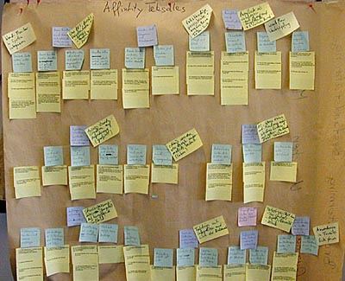
Making sense of your data
Affinity diagrams
Notes:
http://www.baran-systems.com/Products/Affinity%20Diagram%20for%20Excel/index_concept.htm
You’re doing this type of thing this week in tutorial. The main idea is to cluster ideas and observations so that you can make sense of what’s going on

Slide 28
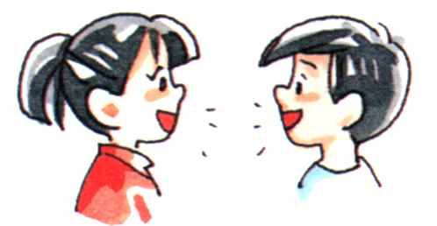
Making sense of your data
Discussion with others who watched with you
Notes:
http://www.how-to-kiss.us/get-to-know-someone.html
Part of affinity diagramming.

Slide 29
Making sense of your data
Look for:
Big obvious problems
Error trends
Trends in comments
Group issues in terms of severity/priority
1: must fix/brick wall
2: should fix/okay to wait
3: okay as is/could be improved
Notes:
http://www.how-to-kiss.us/get-to-know-someone.html

Slide 30
Usability Testing: Providing Feedback
Based on your list of issues, provide a small handful of suggestions on how to address the issue
Depending on the part of the design cycle you are in (early, middle, late), these should be bigger or smaller suggestions
Provide video “proof” of people encountering issues
ITERATE ON THE DESIGN!!?!?!?
Sample final report:
http://www.utexas.edu/learn/usability/report.html
Notes:
http://www.utexas.edu/learn/usability/report.html

Slide 31
WhatUsersDo video
Notes:
http://www.youtube.com/watch?v=HAiJCPWMGss

Slide 32
Usability Tests: HOWTO
Determine goals of usability test
Determine testing timeframe
Determine target audience & recruitment plan
Develop testing plan
What are the most important things you want to know? (top 10)
Conceptual model extraction
Provide non-leading questions
Simple/realistic scenarios
Prepare any written materials (audience-specific, if necessary)
Run a pilot study
Run your test with real participants
Notes:
Also, testing location and context

Slide 33
When should I use a usability test?
Any time.
Early:
Exploring potential possible designs
Late:
Close to end stage to determine possible showstoppers
After:
Investigate reported problems
Notes:
My emphasis: earlier
It’s cheaper, but still possible to do it late
You can figure out what needs to be fixed for next time around, or determine what kind of documentation is required/information for support people

Slide 34
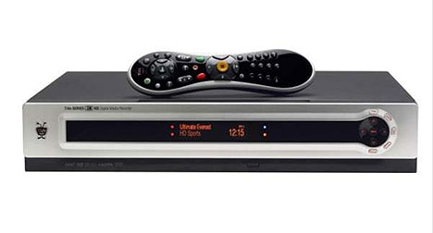
Tivo: Weekly Usability Tests (12 weeks)
Already have a DVR? vs. Want step-by-step instructions?
Notes:
http://www.useit.com/alertbox/weekly-usability-tests.html
Website usability
Remote testing (across the country)
1-1 testing – stakeholders : “good for team to see frustration users’ faces rather than to simply listen to testers tell them about it on the phone”
Actionalbe results: new approach to content
-- originally: voice and personality (bring out attributes of brand)
-- feedback: “I hate reading fluff”
-- redesign: small chunks of text, deeper links, more detailed information inline links
“Already have a DVR?” – for people looking for HOWTOS
-- hard to find
-- “Want step-by-step instructions” seemed to work better (remember: what is their goal) → language of the user rather than the language of the designer
Words and phrases really matter

