Slide 1
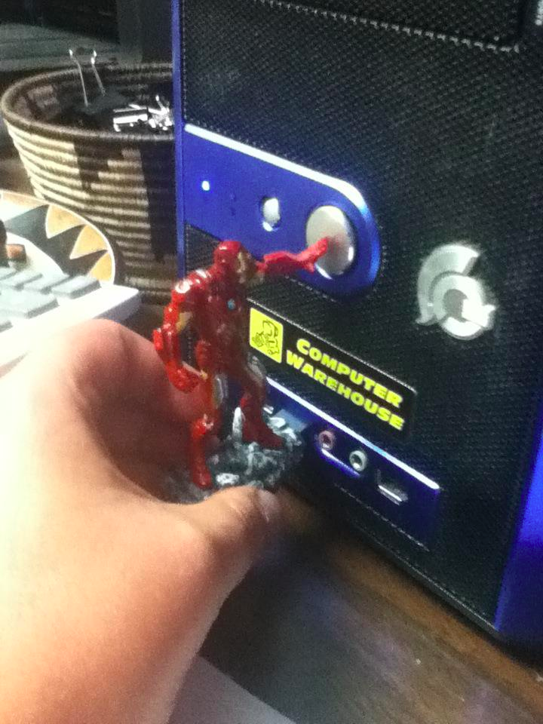
reddit.com
Notes:
http://www.reddit.com/r/funny/comments/10zcr2/i_just_got_trolled_by_the_iron_man_avengers_usb/

Slide 2
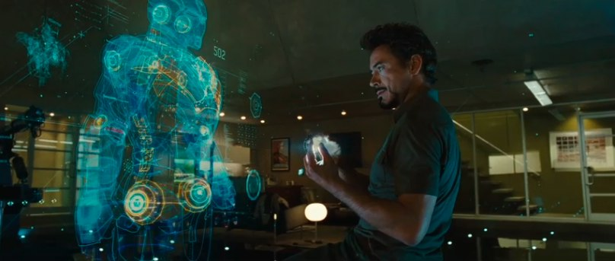
Cool video prototype
Notes:
Xkcd

Slide 3
Prototyping 2
CPSC 481: HCI I
Fall 2012
Anthony Tang, with acknowledgements to Julie Kientz, Saul Greenberg, Nicolai Marquardt, Ehud Sharlin

Slide 4
Last Time…
What are prototypes
Why should we use prototypes
Two dimensions of prototypes (lo vs. hi fidelity, vertical vs. horizontal)

Slide 5
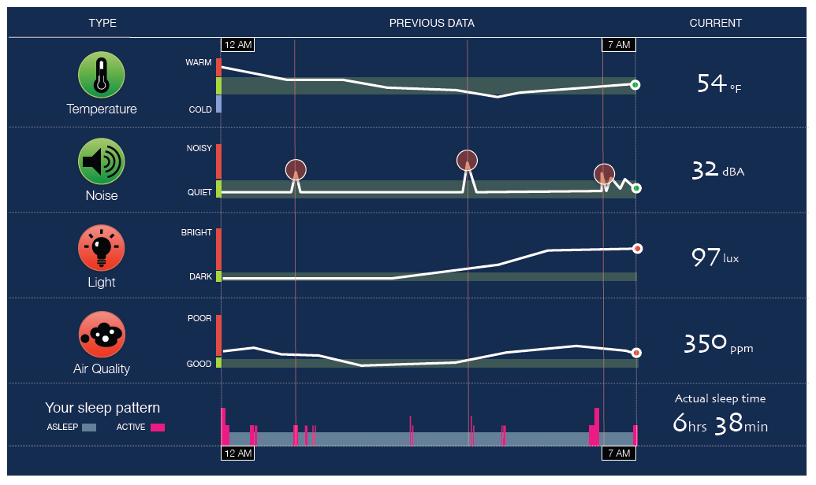
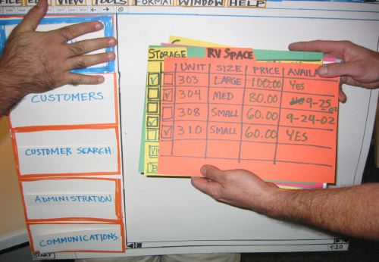
Hi vs. Lo Fidelity
Distinction: is the choice of medium close or far from that of final design? (high = software; low = paper prototype)
Hi fidelity
Lo fidelity

Slide 6
Pros and Cons
 | Lo-Fi | Hi-Fi
Advantages
Disadvantages
Notes:
Fill it in!

Slide 7
Hi-fi vs. Lo-fi: “From the experts…”
 | Lo-Fi | Hi-Fi
Advantages | » ***fast*** » cheap » easy – kindergarten skills! » can simulate actual product » great way to get feedback from stakeholders | » better sense of finished product » can judge aesthetic appeal » more realistic experience » can evaluate the experience better » probably more convincing for stakeholders
Disadvantages | » slow response time » can’t get feedback about aesthetics » user may question design quality | » users may focus on unnecessary details » takes a lot of time to make » users may lose track of big picture

Slide 8
Hi Fidelity Prototypes: More
Big part: prototyping the visual design
With the right tools, hi-fi prototypes can be done very nicely
Requires very little client imagination
Communicates the form very well
Very effective in persuasion

Slide 9
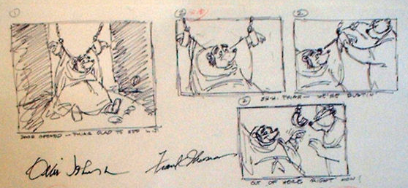
Prototyping through Storyboards
“comic book” approach, a series of keyframes as sketches—illustrates a sequence
originally from film; used to get the idea of a scene
snapshots of the interface at particular key points in the interaction
users can evaluate quickly the direction the interface is heading

Slide 10
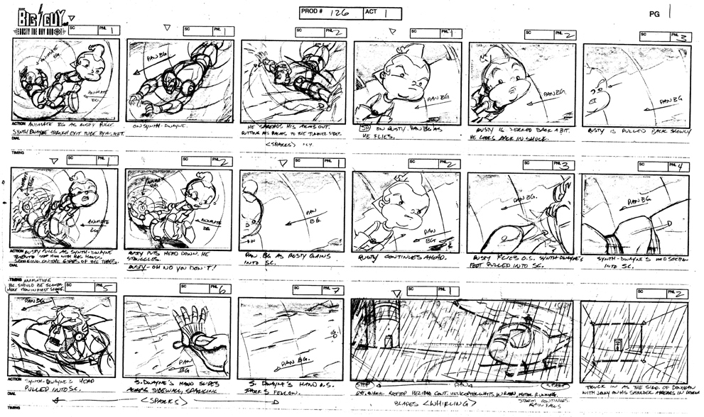
Notes:
Note use of annotation, both in the keyframe, and around it

Slide 11
Prototyping with PICTIVE
PICTIVE: Plastic Interface for Collaborative Technology Initiatives through Video Exploration
Designing with customers using office supplies
» multiple layers of sticky notes and plastic overlays
» different sized stickies represent icons, menus, windows etc.
Interaction demonstrated by manipulating notes
» new interfaces built on the fly
Session videotaped for later analysis
» usually end up with mess of paper and plastic!

Slide 12
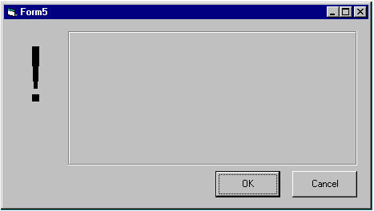

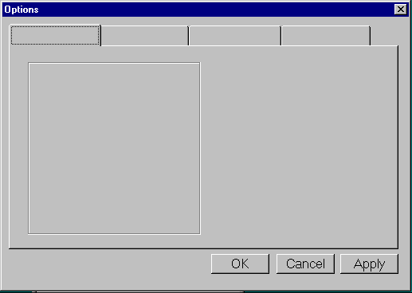
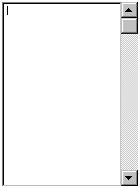
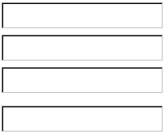
PICTIVE, designing with office supplies
Can pre-make paper interface components
buttons
menu
alert box
combo box
tabs
list box
entries

Slide 13
Prototyping with PowerPoint
PowerPoint can also be used to simulate very specific interaction scenarios
Problem: People give me gifts I don’t want
Solution: Maybe a web-based gift-list social networking site could help
Notes:
http://www.boxesandarrows.com/files/banda/interactive/SamplePrototype.ppt

Slide 14
Powerpoint prototype here

Slide 15
Prototyping Functionality: Wizard-of-Oz
Common problem: it’s difficult to prototype some piece of functionality
Need: test whether it is actually good
Solution: fake it! Make the interaction as authentic as possible
Key: user has no idea that the interaction is being faked

Slide 16
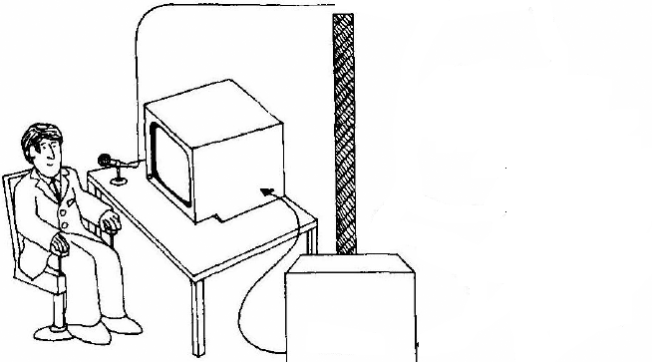
Wizard of Oz
A method of testing a system that does not exist
the listening typewriter, IBM 1983
Dear Henry
Speech Computer
What the user sees

Slide 17
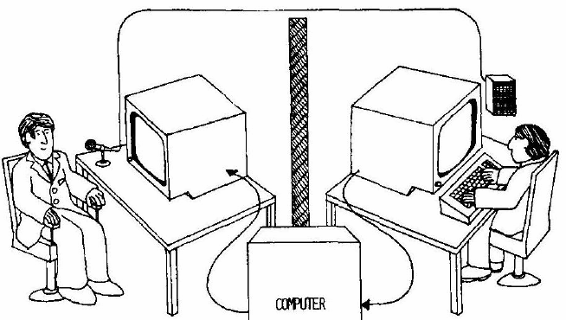
Wizard of Oz
A method of testing a system that does not exist
the listening typewriter, IBM 1984
Dear Henry
Dear Henry
Speech Computer
What the user sees
The wizard

Slide 18
Name Origin: Wizard-of-Oz
The Wizard of Oz: book and movie
clip

Slide 19
Wizard of Oz: The Point
Up until the point the wizard is discovered, the thoughts, feelings, and actions of Dorothy and the others were all genuine
They were genuinely experiencing what it would be like to talk to a powerful and terrible wizard

Slide 20
Wizard of Oz: Anti-Gravity Bar
http://www.youtube.com/watch?v=DL9cAcQ-gKQd

Slide 21
Prototyping Functionality: Video Prototyping
Video prototyping allows you to prototype functionality without needing to be physically present.
Paper prototypes and wizard-of-oz require you to be around to simulate functionality.
A video prototype frees you from that, but constrains you to a limited scenario.
You can also simulate this through a stitched together set of images (slow-mation).

Slide 22
iPhone paper+video prototype
Notes:
http://www.youtube.com/watch?v=6TbyXq3XHSc

Slide 23
Body Centric Interaction
New design concept. Realized as a medium-fidelity prototype, and captured as a video prototype.
Notes:
http://grouplab.cpsc.ucalgary.ca/grouplab/uploads/Publications/Publications/2012-BodyCentricInteraction.TEI.mp4

Slide 24
Vertical vs. Horizontal Prototypes
Horizontal prototype
(e.g., paper prototype)
Scenario
Full interface
Vertical prototype
(e.g., photoshop
mock up)
Notes:
• Two common types of compromise
- horizontal prototype: provide a wide range of
functions but with little detail
- vertical prototype: provide a lot of detail for only a
few functions

Slide 25
Fat-Thumb
High fidelity prototype, but very much a vertical one
Fat-Thumb video example w/ maps
Notes:
http://grouplab.cpsc.ucalgary.ca/grouplab/uploads/Publications/Publications/2012-FatThumb.MobileHCI.mp4

Slide 26
More specific narrow scenarios
VideoDraw

Slide 27
Yet Another Specific Narrow Scenario
ClearBoard
Notes:
https://vimeo.com/44544588

Slide 28
Next week
Tutorial: storyboards and paper prototypes
Monday tutorial students: please go to another tutorial section (preferably with your team)
Wednesday: Midterm
Friday: Guest lecture (SMART UX team)

Slide 29
Midterm – Wednesday, 10am
Coverage: everything up to the end of today
Focus: I am mainly interested that you understand the concepts, and can apply them in a logical way. I am not concerned that you memorize everything, but you should be able to explain the main concepts.
How to study: re-read notes from lecture, the reading that I assigned you, as well as your assignments.
Exam: Closed book. Arrive early. Be concise.

Slide 30
Sketch vs. Prototype
Difference is a contrast in purpose (always), and sometimes in form.
But, it’s a continuum.
sketch
prototype

Slide 31
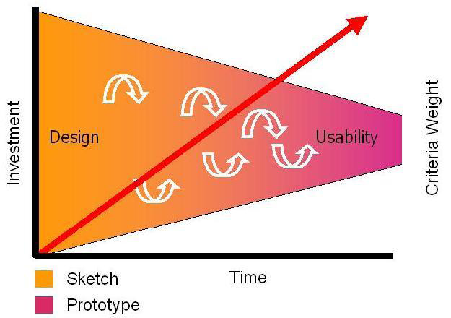
From Sketches to Prototypes
Sketches: early ideation stages of design
Prototypes: capturing /detailing the actual design
Image from Bill Buxton’s Book Sketching User Experiences (2007) Morgan Kaufmann
Notes:
Sketches dominate the early part of the design funnel. They have to be cheap and plentiful. Prototypes appear at the latter part (or even during engineering). They are more refined and perhaps appropriate for initial user testing. There are also fewer of them, as they are more expensive.

Slide 32
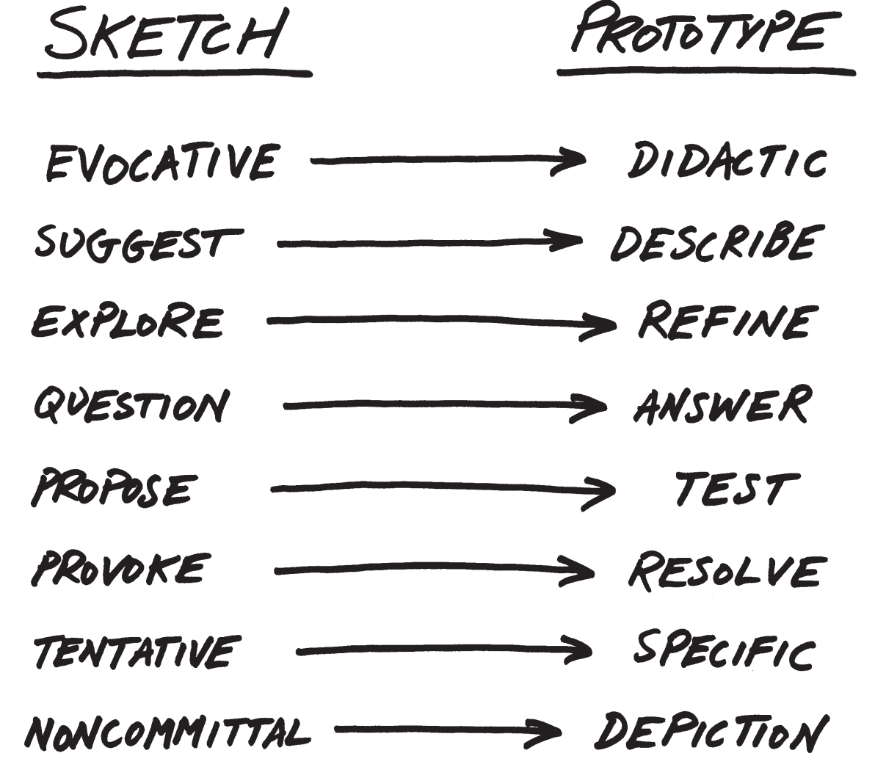
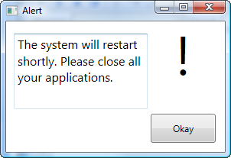
Notes:
Given this context, lets look at the differences.

