Slide 1
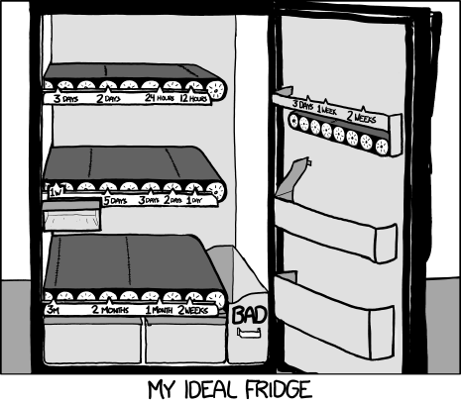
Source: xkcd.com
Notes:
Xkcd

Slide 2
Prototyping
CPSC 481: HCI I
Fall 2012
Anthony Tang, with acknowledgements to Julie Kientz, Saul Greenberg, Nicolai Marquardt, Ehud Sharlin

Slide 3
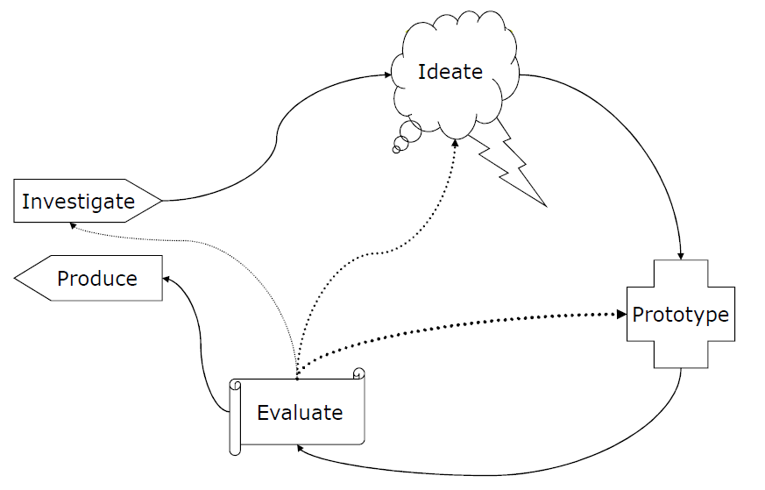
User Centered Design Process
Produce something tangible
Identify challenges
Uncover subtleties

Slide 4
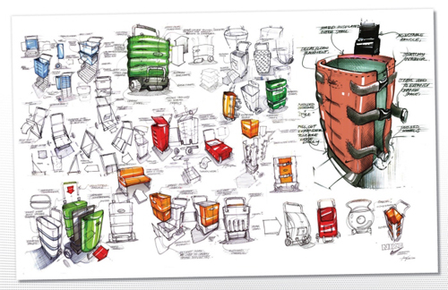
How to pick good ideas?
Notes:
http://www.idsketching.com/toolbox/toolbox-levels-of-sketching/
So, if you’ve been doing the ideate part right, then you should have a boatload of ideas and a ton of different design ideas.
Now, what? How do you select what to go with?

Slide 5
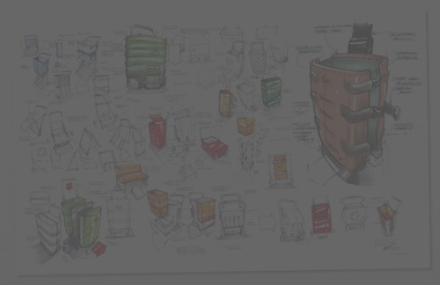
How to pick good ideas?
Try them out! Prototype multiple, and test them out with your users!
Quality metrics:
Ease of use
Utility vs. superfluous features
Effectiveness (task coverage)
Efficiency/performance
Notes:
http://www.idsketching.com/toolbox/toolbox-levels-of-sketching/
So, if you’ve been doing the ideate part right, then you should have a boatload of ideas and a ton of different design ideas.
Now, what? How do you select what to go with?
My suggestion: rather than choosing based on your gut, try it out! Your gut may be wrong, but you’d never know if you just went with your gut. If you can prototype several, then do it.

Slide 6

Dose of reality
Choices here may not be just “what makes the best experience.” Remember that design is about trade-offs.
Some design trade-offs you will need to deal with:
Technical constraints
Commercial feasibility
Resources (e.g. developer)
Notes:
http://en.wikipedia.org/wiki/Pointy-haired_Boss
BUT, prototypes still give us an opportunity to at least shape the direction of things, certainly if not for this iteration, then to at least shape mindshare moving forward (i.e. move resources to your project/design idea for the future)

Slide 7
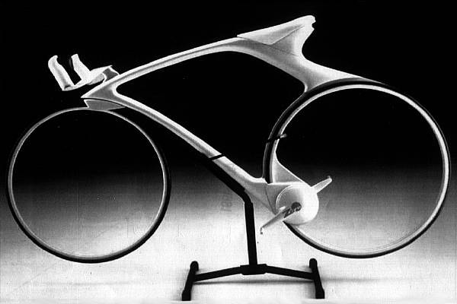
What is a prototype?
Notes:
http://www.csse.monash.edu.au/~aland/cycling.html
This is a concept bike. The idea is to have hubless, magnetically suspended wheels, and a magnetic drive.
Very cool idea, and this is perhaps a real prototype, or a vision prototype

Slide 8
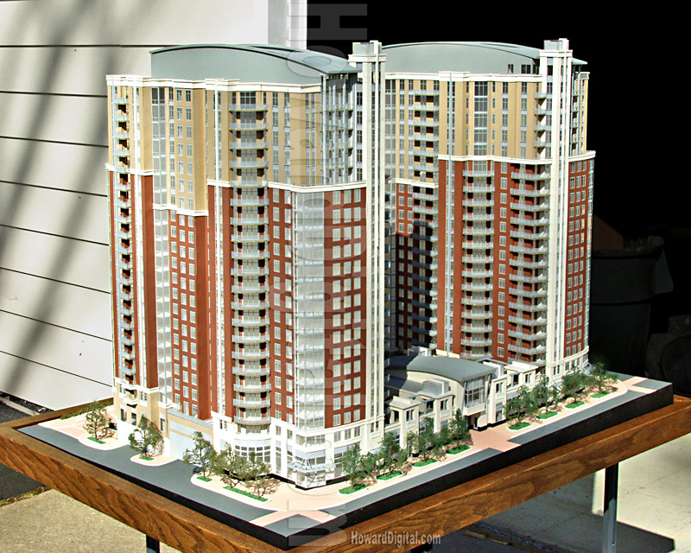
What is a prototype?
Notes:
http://www.howardmodels.com/architectural-models-07/reston/index.html
This is an architectural prototype. I used to love looking at these things.
Anyway, in it, you cansee to scale what things would look like – sidewalk to doors, windows to building height,

Slide 9
Prototype of a prototyping environment
Illuminating light video
Notes:
https://vimeo.com/48600709

Slide 10
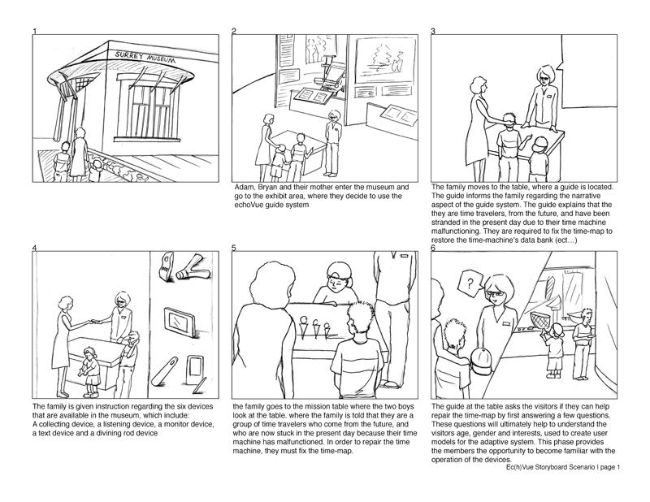
What is a prototype?
Notes:
http://www.kmuise.com/design/portfolio/kurio.php
This is a storyboard that expresses how people would interact in a new type of museum. IN it, what they do is to use these tangible objects that are like microphones, speakesr and cameras. There are digital tabletops and PDAs that work with these objects to help people better understand all the things that are going on in the museum

Slide 11
What is a prototype?
To me, a prototype is defined less by form, and more by its function:
A prototype expresses and realizes a design concept for the purpose communication.
Prototype qualities
Fast
Disposable
Focused
Role of prototypes
Test | Get feedback
Communicate
Persuade
Notes:
So, while sketches are used to provoke, and to express a general idea, or to elicit response, a prototype is used to actually depict what is going on as someone imagines it. In some sense, it is more or less concrete

Slide 12
Many different kinds of prototypes
Storyboards » museum example | your tutorial
PowerPoint slideshow » you’ll see one Friday
Video prototype » login page video
Paper prototype » email system video
Physical model » little apartment building
Software with limited functionality » your project
…

Slide 13
Video prototype
Login page video prototype
Notes:
http://e102.co.uk/?p=3
This is a paper prototype tat has been made into a video prototype.
As you will see in tutorial, the problem with paper prototypes is that you need someone there to “run it”
A video prototype, once you make it, can sort of “run itself.” Obviously, there’s only one user flow, but you get to see all the functionality that’s in it
A video prototype takes some time to develop, but it is actually often quite effective

Slide 14
“Tangible Prototypes”
URP video
Notes:
This is obviously a very very slick prototype, and it works
What did you see in there?
What does the video show?
What are the key ideas that are there?
Going beyond exactly the application they showed, what are they trying to tell us?

Slide 15
Why prototype?
Evaluation and user feedback is central in good design
Stakeholders can see, hold and interact with a prototype
Aids communication of an idea, and provides focus for a team
You can test out your ideas
Encourages reflection
Answers questions, and helps you make choices between different alternatives

Slide 16
Nordstrom video
Prototyping and user feedback in a tight loop
Notes:
http://www.youtube.com/watch?v=szr0ezLyQHY

Slide 17
What should be prototyped?
Task design & user flow
Based on expected tasks, what will the users see, what will they do?
Screen layouts and information display
How should information be laid out to provide information as users need it? How can this be optimized?
Graphic design and look & feel
What should it look like?
Technical aspects
Can we actually make this go?!
* Start with controversial and critical areas (e.g. security)

Slide 18
Which prototyping method to choose?
Choose the method that works best for what you are trying to achieve (pragmatics).
For example:
User flow » storyboard
Screen layouts/page flow » paper prototypes
Overall experience » video prototype
Look and feel » PowerPoint or PSD
Functionality » software
… etc.
Alternately, maybe you are at different stages in the design. Early on, use techniques that are cheap and quick; later on, use techniques that give a stronger sense of finished idea.

Slide 19
Prototype “Types”: Two Dimension Classification Scheme
High vs. Medium vs. Low Fidelity
» Choice of medium is close to or far from that of the final design
» e.g. high = software; low = paper prototype
Horizontal vs. Vertical (generally for software prototypes)
» Range of capabilities in the prototype
» horizontal = wide range of features without full “implementation” of any
» vertical = select features are “implemented” all the way through
Notes:
Horizontal prototypes are appropriate for understanding relationships across a broad system and for showing the range of abilities of a system.
Vertical prototypes are most appropriate when a certain complex feature of a system is poorly-understood and needs to be explored, e.g. as a proof-of-concept.

Slide 20
Some examples
Storyboard » low fidelity, vertical
Site/navigation/screen map » low fidelity, horizontal
Paper prototype » low fidelity
Software where everything reports, “not implemented yet” » high fidelity, horizontal
Software where only one feature is implemented » high fidelity, vertical

Slide 21
Sketch vs. Prototype
Difference is a contrast in purpose (always), and sometimes in form.
But, it’s a continuum.
sketch
prototype

Slide 22
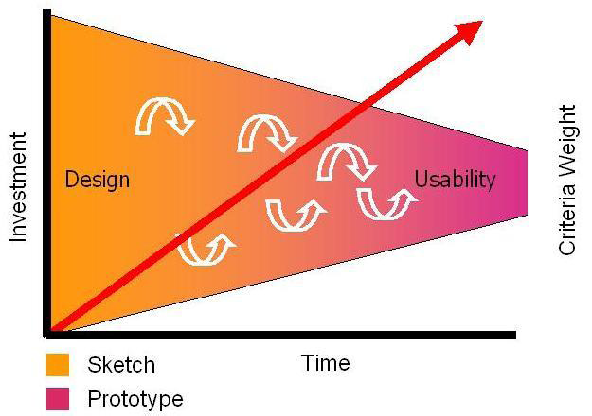
From Sketches to Prototypes
Sketches: early ideation stages of design
Prototypes: capturing /detailing the actual design
Image from Bill Buxton’s Book Sketching User Experiences (2007) Morgan Kaufmann
Notes:
Sketches dominate the early part of the design funnel. They have to be cheap and plentiful. Prototypes appear at the latter part (or even during engineering). They are more refined and perhaps appropriate for initial user testing. There are also fewer of them, as they are more expensive.

Slide 23
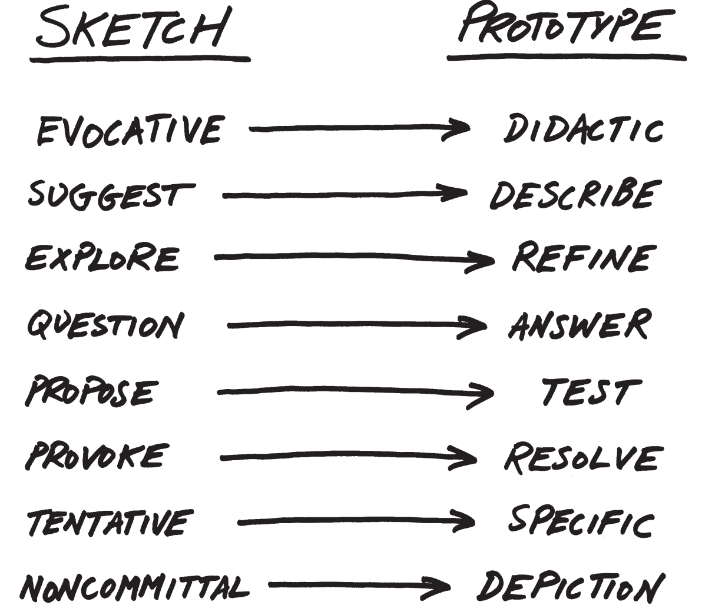
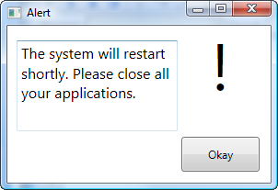
Notes:
Given this context, lets look at the differences.

