Slide 1

October 4, 2012

Slide 2

Imagine you are designing an application (website, mobile app, etc.) for a company that produces an annual book of coupons for local businesses
Who would you talk to?
What would you try to find out?
What are things that are important for such a design?
Do this with a partner. (5 mins)

Slide 3
Sketching
CPSC 481: HCI I
Fall 2012
Anthony Tang, with acknowledgements to Julie Kientz, Saul Greenberg, Nicolai Marquardt, Ehud Sharlin
Notes:
This was kind of a flat lecture.
Distinction between a sketch and a prototype was not clear, will need to make that clearer next time.

Slide 4
Sketching - Overview
Getting the design right vs. getting the right design
What is sketching?
Why should we sketch?
Properties of sketches
What is and what isn’t a sketch
Sketching vs. prototyping

Slide 5
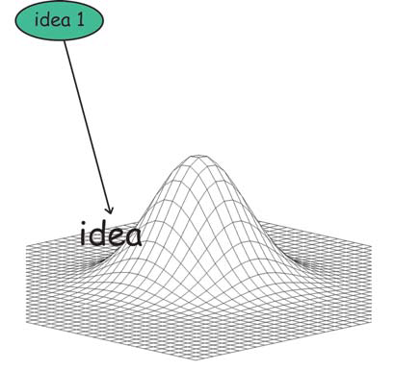
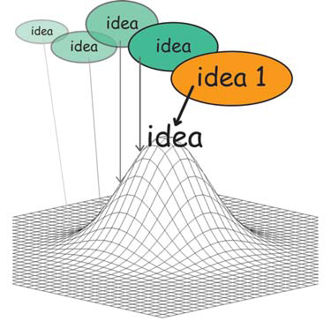
Getting the design right
Generate an idea
Iterate on the idea

Slide 6
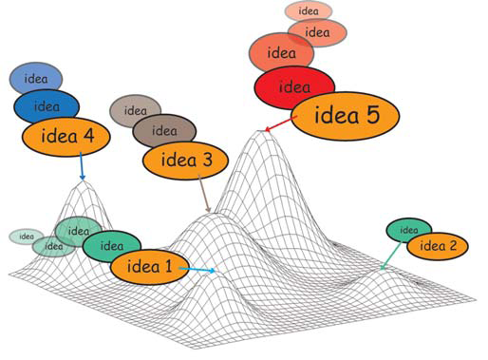
Problem
Is it the best idea? Issue: we often fixate on the first idea. Local maximum: hill climbing issue

Slide 7
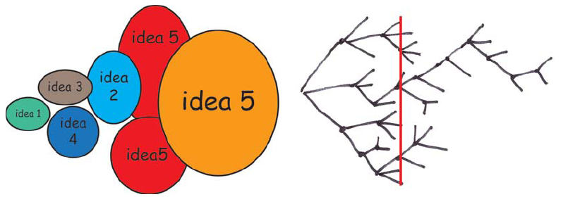
Getting the right design
generate many ideas and variations
reflect on all ideas
choose the ones that look most promisting
develop them in parallel
add new ideas as they come up
then iterate your final choice

Slide 8
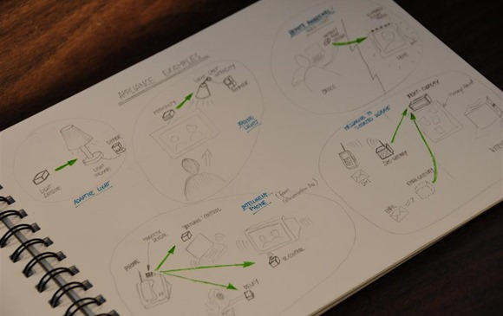
Sketching
A process that enables you to think through ideas and variations, and convey design ideas to others early in the design phase.
Notes:
http://www.nicolaimarquardt.com/blog/wp-content/uploads/2009/07/dsc0644large.jpg

Slide 9
Why sketching?
Early ideation that allows risk-taking and explorations of variations
Allows you to think through ideas
Active form of brainstorming

Slide 10
Why sketching?
Forces you to visualize how things come together
Communicates ideas to others (and oneself) to inspire new designs

Slide 11
Sketching as a dialog
Mind
(new knowledge)
Create
Sketch
(representation)
Read
Buxton, pp. 114

Slide 12
Buxton’s Properties of Sketches
Quick
Timely
Inexpensive
Disposable
Plentiful
Clear vocabulary
Distinct gesture
Minimal detail
Appropriate degree of refinement
Suggest and explore vs. confirm
Ambiguity

Slide 13
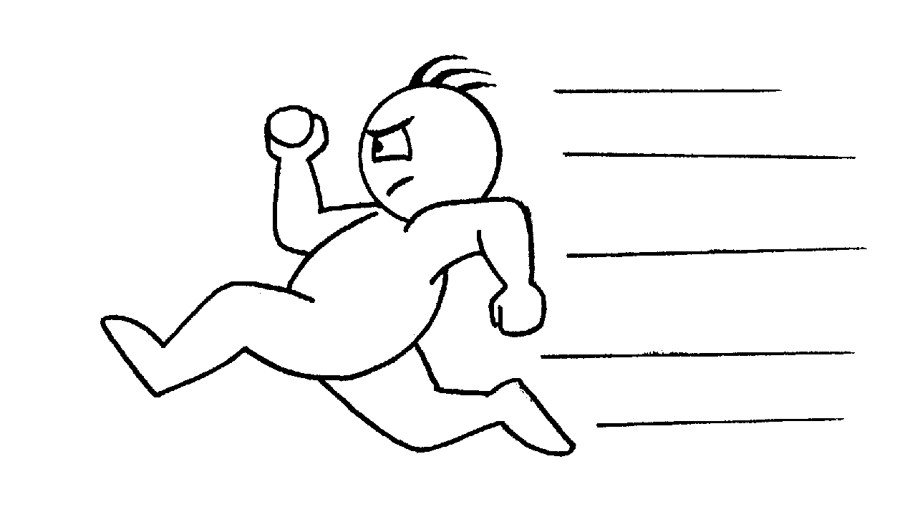

Quick
A sketch is quick to make, or at least gives that impression

Slide 14
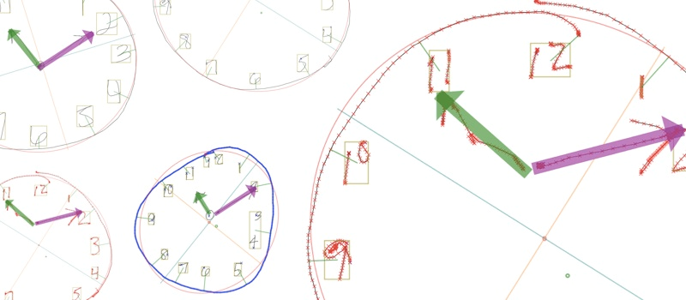
Timely
A sketch can be provided when needed

Slide 15
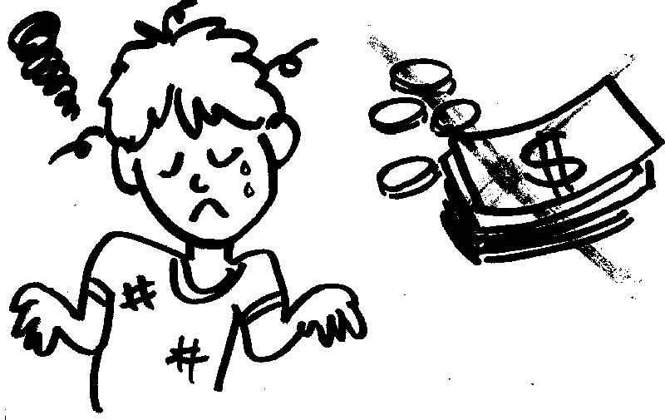
Inexpensive
Cost must not inhibit the ability to explore a concept, especially early in design

Slide 16

Disposable
If you can’t afford to throw it away, it’s not a sketch
Investment is in the process, not the physical sketch
However, sketches are not “worthless”

Slide 17
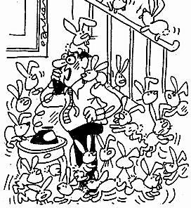
Plentiful
They don’t exist in isolation
Meaning & relevance is in the context of a collection or series

Slide 18
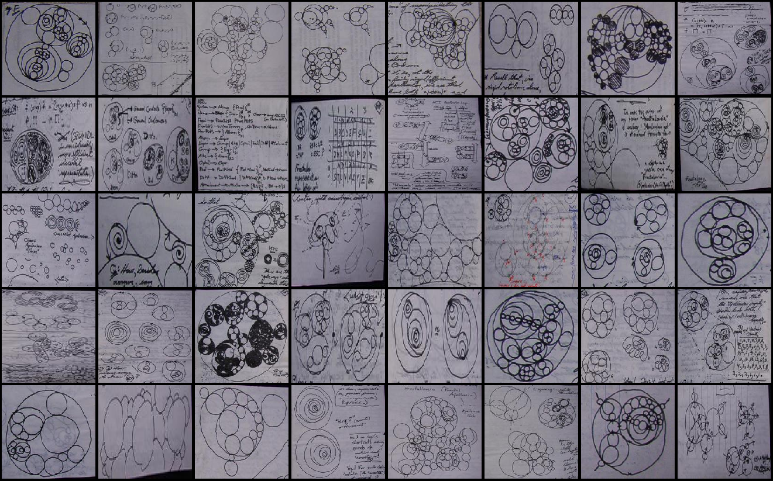
Example
Notes:
Variation
Trying to visualize ideas
Pen and paper is cheap and quick
Sketching is a strategy, not making premature commits, but exploring the
design space:
Why Sketches
(1) generate many ideas and variations
(2) reflect and choose
(3) then iterate and develop your choice

Slide 19
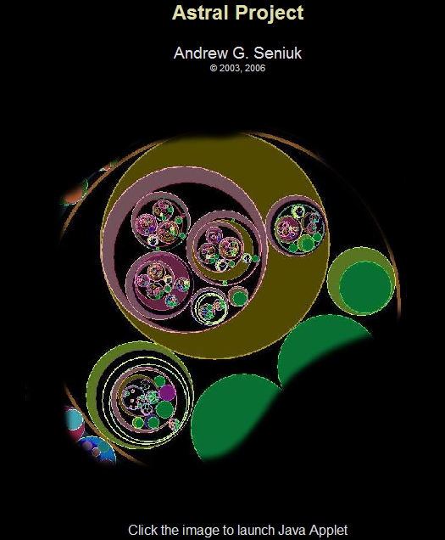
Example
The result
Computer science student Andrew Seniuk – a metaprogramming environment (with permission)
Notes:
When you really understand the design space and the choices available, you can then proceed to build the product

Slide 20
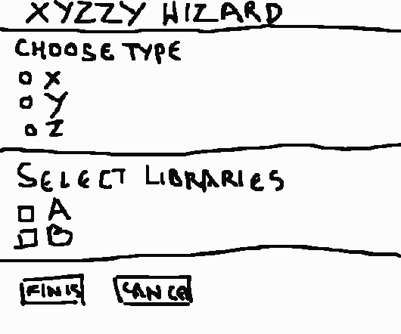
Clear vocabulary
The way it’s rendered (e.g., style, form, signals) makes it distinctive that it is a sketch
Could be the way that a line extends through endpoints

Slide 21
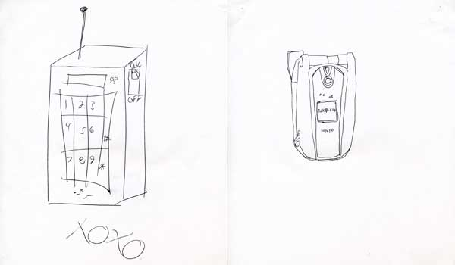
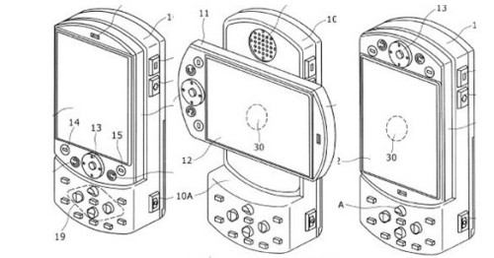
Distinct Gesture
Fluidity of sketches gives them a sense of openness and freedom
Opposite of engineering drawing, which is tight and precise
vs.

Slide 22
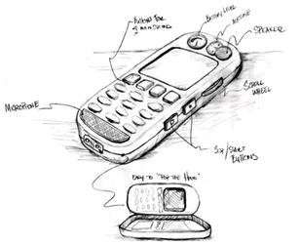
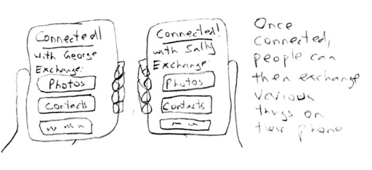
Minimal Detail
Include only what is required to render the intended purpose or concept

Slide 23
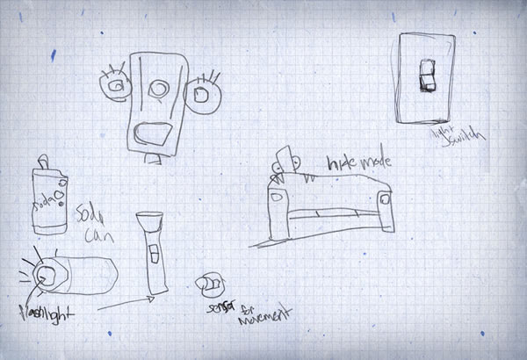
Appropriate Degree of Refinement
Make the sketch be as refined as the idea
If you have a solid idea, make the sketch look more defined
If you have a hazy idea, the sketch will look much rougher and less defined

Slide 24
Suggest and explore rather than confirm
Sketch should act as a catalyst to the desired and appropriate behaviors, conversations, and interactions

Slide 25
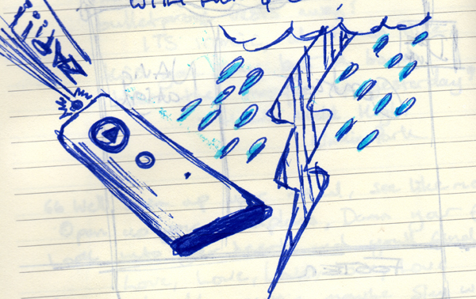
Ambiguity
Intentionally ambiguous
Value comes from being able to be interpreted in different ways, even by the person who created them

Slide 26
Forms of Sketching?
Can be pencil/pen drawing on paper (my preference)
Something scraped together in Photoshop
Quick-and-dirty prototyping
Magazine cut-outs
Modifications to existing objects

Slide 27
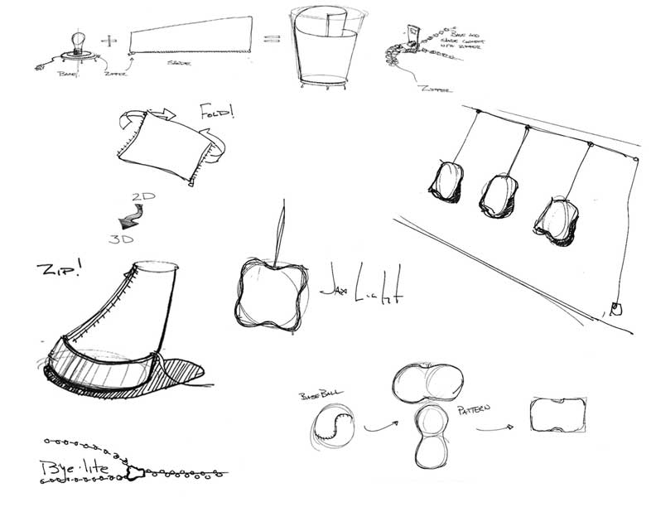
Is this a sketch? Why or why not?

Slide 28
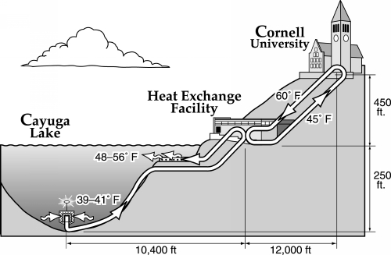
Is this a sketch? Why or why not?

Slide 29
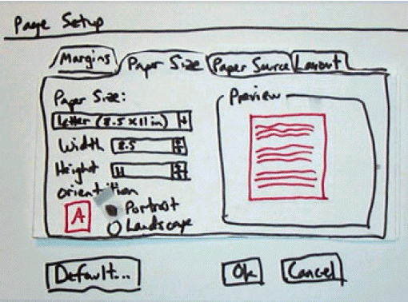
Is this a sketch? Why or why not?

Slide 30
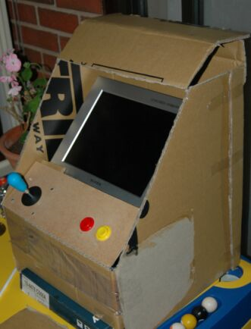
Is this a sketch? Why or why not?

Slide 31
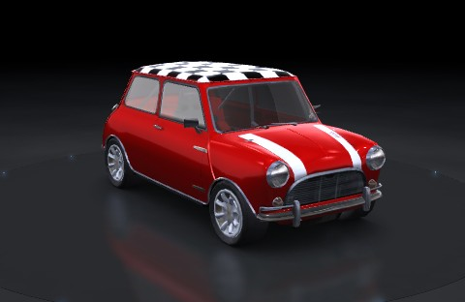
Is this a sketch? Why or why not?

Slide 32
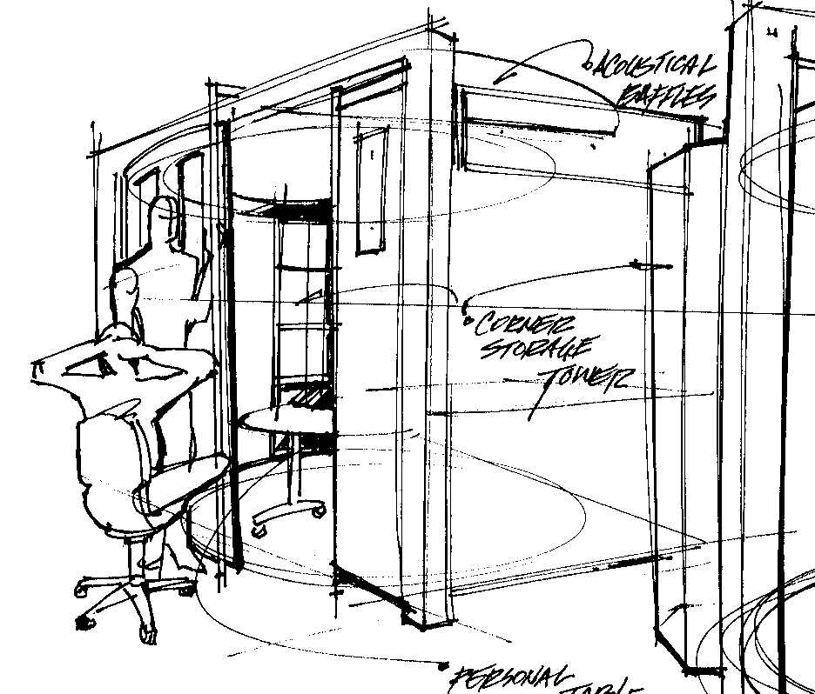
Is this a sketch? Why or why not?

Slide 33
In tutorial this week…
Practice sketching, and understanding how to sketch for the purpose of design
PLEASE: bring a pencil!!

