Slide 1
http://snipurl.com/CPSC481
Sign up at Piazza: http://piazza.com/
Look for our class: CPSC 481 at University of Calgary

Slide 2
Course Introduction
CPSC 481: HCI I
Fall 2012
Anthony Tang, with acknowledgements to Julie Kientz, Saul Greenberg, Ehud Sharlin, Jake Wobbrock, Dave Hendry, Andy Ko, Jennifer Turns, & Mark Zachry

Slide 3
Foundations of Human-Computer Interaction
Foundations of Human-X Interaction
Foundations of Design for Human-X Interaction

Slide 4
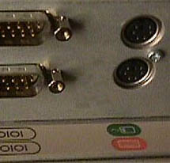

Slide 5


Notes:
www.baddesigns.com

Slide 6
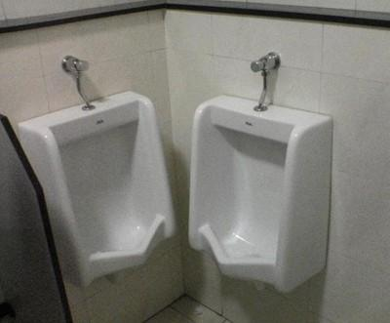
Bad Design is Everywhere

Slide 7
Bad Design Affects Us
Money
  A $200 withdrawal turns into $20000
  Bad font choice ➔ “,” looks like “.”
Lives: Therac-25 Radiation Machine
  Massive doses of radiation led to several deaths
  Cause: backing out and changing settings within 8s would not put the shield in place

Slide 8
Anticipated snarky response: “But, I wouldn’t make those mistakes!”
Maybe, but you’re not the only one working on most projects. Your team might still make that mistake.
Here’s the problem:
You are typically not the user.
You have your own biases.

Slide 9
What this course is about…
Understanding why bad design is so prevalent
Learning and practicing methods for “good” design
Hands-on experience with multiple design methods: involving users, prototyping, testing

Slide 10
Summary
Design is everywhere
Good design is hard
Poorly designed things have big consequences
Good design practices can help
You’re going to be a good designer

Slide 11
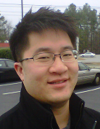
Introduction: Me
Instructor: Anthony Tang
  Call me Tony
Assistant Professor in the CS Department
  Ph.D. in Electrical and Computer Engineering from UBC
Research in Human-Computer Interaction
  Collaborative computing, personal informatics
Personal interests: Volleyball, Food, Video Games

Slide 12


Introduction: Your TAs
Teddy Seyed
  MSc student
  M,W Tutorials
Bon Aseniero
  MSc student
  T,F Tutorials
» Broke a Microsoft Surface
» Really likes snakes

Slide 13
Syllabus
Basic information
Assessment
Assignments
Project
Labs
Office hours/contact information

Slide 14
Basic Course Information
Website
  http://snipurl.com/CPSC481
  » password: hello481 (no spaces)
Q/A Forum
  http://piazza.com/
  » search CPSC 481 under University of Calgary
Readings
  Posted online at the main website

Slide 15
Assessment
Component | Worth
Class Participation | 10%
Assignments | 10%
Project | 40%
Mid-term | 15%
Final | 25%
Note: you must earn a passing grade on each component to pass the course.

Slide 16
Participation – 10%
Treat all with respect – be constructive in all discussions
Come to class prepared – read carefully prior to class meetings
Be an active listener – be attentive, be engaged, use in-class technology with discretion
Ask challenging questions
Comment, build on, or clarify others' contributions
Help your classmates use technologies
Post useful or interesting information to the class discussion board
Visit the instructor during office hours to chat, to ask questions, or to give feedback.

Slide 17
Assignments – 10%
Assignment | Worth | Due
A0: Profile post | 1% | 9/12
A1: Thinking about design | 5% | 9/21
A2: User-centered design | 5% | 10/3
Anticipated snarky response: “Hey, that totals to 12%!”

Slide 18
Project – 40%
Opportunity for you to engage in hands-on design with a real project
Groups of three (3) people; you will choose your groups in lab

Slide 19
Project – 40%
Project ideas:
  » System for people new to the city
  » Personal fitness tracker: able bodied or physiotherapy
  » Cross-family communication system
  » Communication system for video gamers
  » Paying the bill with a group
  » Ordering system at a restaurant/bar
  » Electronic course registration system
  » Trip planning for public transit
  » Buying movie tickets online (seat selection, etc.)

Slide 20
Project – 40%
Project Component | Worth | Due
P1: User research | 7.5% | 10/15
P2: Sketching, ideation and lo-fi prototype | 10% | 10/29
P3: Heuristic evaluation and hi-fi prototype | 15% | 11/23
P4: Final report and presentation | 7.5% | 12/7

Slide 21
Labs
Participation in these labs comprises part of your grade
Hands-on with specific skills and activities
  Design activities
  C#
  Presentations

Slide 22
Office Hours/Contact Information
Office hours: MW after class (10am) or by appointment
Questions: Use Piazza – http://piazza.com/
Do not email me or your TAs directly.

Slide 23
My Expectations of You
Be here on time
Turn in everything on time
Speak up in class
Turn off cell phones, no texting
No email, IM, web surfing during class
Respect each other
There are no stupid questions/ideas

Slide 24
What You Can Expect of Me
I will be here on time
Your assignments will be graded in a timely manner
  Typically within 1-2 weeks
Piazza posts will be responded to in a timely manner
  Typically within 1-2 days
If I don't know the answer to your question, I will find out
I will treat you as professional colleagues
You will have several chances to evaluate the course

Slide 25
Handing In Assignments
Assignments are due at the beginning of lecture on the day specified
You have a 10 minute grace period from the start of class
After that, I will not accept assignments

Slide 26
Policies – See Syllabus
Academic integrity
Grading
Extensions
Late assignments
Accommodation
Quality of written assignments
Attendance

Slide 27
Questions, comments, queries?
…

Slide 28
Coming up…
Wednesday:
What is a good interface?
Friday:
How do we design for people?

Slide 29
