Slide 1
CPSC 599.81: Interactive Collaborative Computing
Introduction

Slide 2
What is this class about?
computer supported cooperative work
  traditionally: systems for communication, collaboration and coordination
  today: everyday use of computation in collaboration, coordination and competition
What are some CSCW systems you used today?

Slide 3
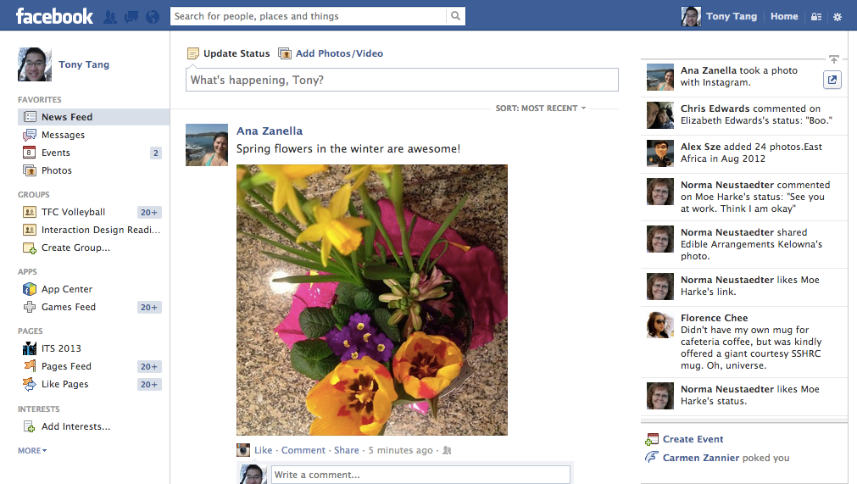

Slide 4
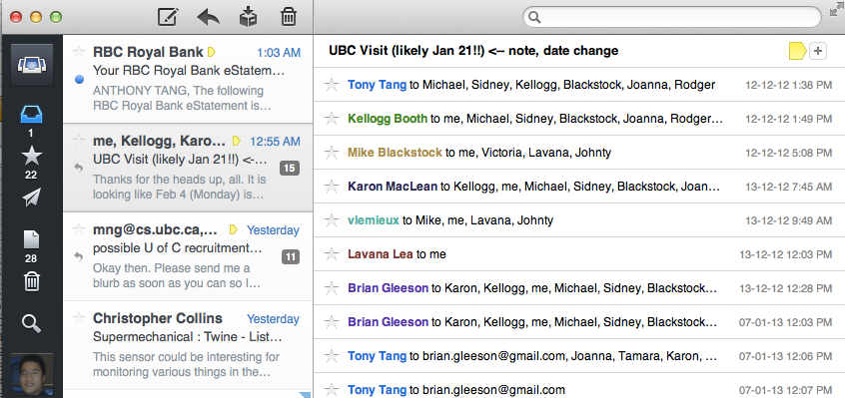

Slide 5
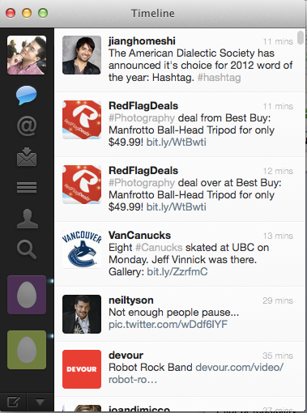

Slide 6
what is this class about?
introduction
How do people interact with and through computation?

Slide 7
Learning objectives
understand the unique challenges that exist for studying and designing collaborative technologies
analyze and critically reflect on the design and use of collaborative technologies
conduct informed presentations of collaborative technology design and use
understanding how to use software toolkits to build collaborative software

Slide 8
Administrivia
Meetings
  Mondays and Wednesdays @ 9:00am-10:15am
  MS680A (usually)
Office Hours
  by appointment
Course Webpages:
  http://hcitang.org/ -> follow link on left nav bar
  http://piazza.com/

Slide 9
Class (1 / 3)
Seminar-style class (40%)
  Lots of reading
    Note: no textbook, but I expect you to PRINT OUT every one of the papers (still works out to be cheaper than a text)
  Lots of discussion (15% - class participation), supported by online responses (15% - Piazza responses to readings)
  Some discussions will be led by me; others (later on) will be led by you and your classmates (10% - topic presentation)

Slide 10
Class (2 / 3)
Assignments (30%)
  The purpose of these is to understand how to code some basic collaborative systems
  We’re going to be building a lot of electronic whiteboards – it’ll be cool
  We will learn four different networking toolkits (.NetworkingGT, gt#, iNetworking, SDGToolkit)
  » tutorial assignment (15%): in a team of four, create and present a tutorial to the rest of the class on how to use a toolkit
  » replication assignment (3x5%): take the tutorial notes made by your classmates, and create an electronic whiteboard

Slide 11
Class (3 / 3)
Project (30%): Play
  You can work by yourself, or with a partner.
  What is play?
  How can play be supported through technology?
  Study project: understand a particular technology, or a type of interaction/context that could be supported through technology
  Design project: build something that supports play, and provide a rationale for the design of the system
  Project proposal, midterm project presentation, final project presentation, final project paper

Slide 13
Course website: http://hcitang.org/
Piazza: http://piazza.com/

Slide 15
Preparing for class…
read the papers
think about the papers
jot down some thoughts about the papers as you read them
write questions in the margins
prepare questions for discussion

Slide 16
Online Responses
response: a few paragraphs about the papers – summarize briefly, then give your thoughts on the ideas presented in the papers. (no real formula)
  » what did it make you think about?
  » can you relate to the ideas in the papers?
  » in ways are they right / in what ways are they wrong?
  » what was interesting?
  » what are some weaknesses / strengths?
  » how can you extend the work / what would you do differently?
Notes:
Mulligan

Slide 18
groupware matrix
introduction
 |  | Time
 |  | Same | Different
Place | Same
 | Different
(Johansen 1988)
Notes:
Letters
Telephone
Bulletin board
Whiteboard
Fridge
Calendar
Post-it notes
-=-=-=-
Google Docs
SharePoint
Facebook
Twitter
FourSquare
FPS game
Dark Souls
RTS game
Turn-based email chess game

Slide 19
groupware matrix
introduction
 |  | Time
 |  | Same | Different
Place | Same | Face-to-Face Meetings (electronic whiteboards) | Ongoing Shift Work (e.g nursing station) (team room tools)
 | Different | Distance Meetings (teleconferencing tools) | Ongoing Coordination (voice mail, email, bulletin boards)
(Johansen 1988)

Slide 20
what is this class about?
introduction
How do people interact with and through computation?
How does the design of technology affect those interactions?

Slide 21
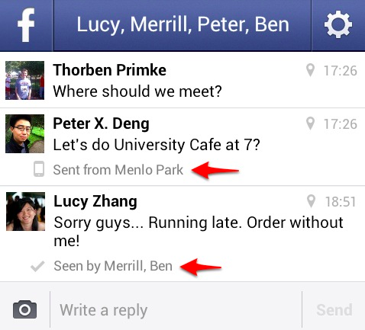
Notes:
No response.. No one cares?

Slide 22
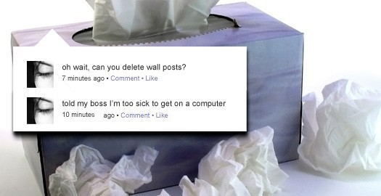
Notes:
http://www.switched.com/2009/04/27/woman-fired-for-logging-on-to-facebook-while-sick/

Slide 23
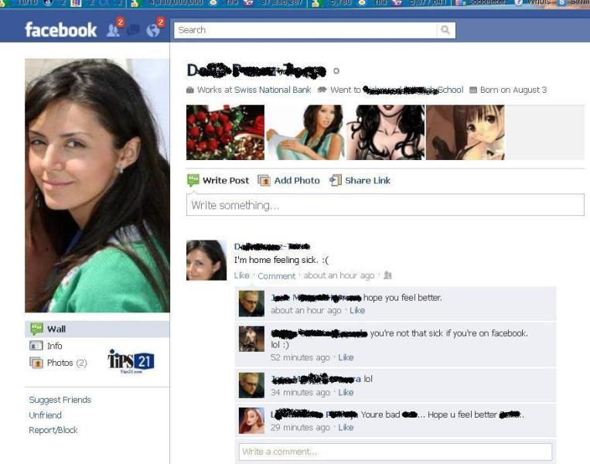
Friending your boss…
Notes:
http://tips21.com/fired-over-facebook-sick-for-work-but-not-for-facebook.html
She said she would be "Unable to work in front of a computer and needed to be able to lie in the dark"

Slide 24
Plausible deniability on IM

