Slide 1
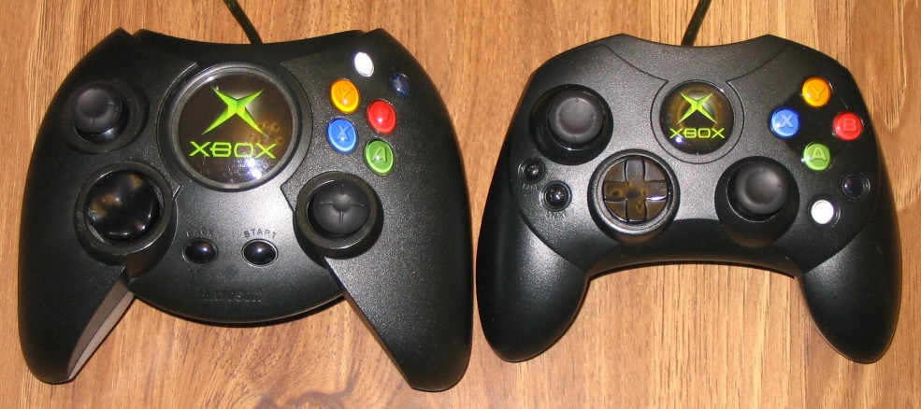
Notes:
Two original Xbox controllers. Left, “regular”, right side, “S-sized.”
Xbox: originally released in the US. People with big, honkin’ hands, apparently. Ergonomics are such that the regular sized one has buttons that are spaced further apart, and harder to reach things (e.g. thumbstick for right hand, and also start/select buttons).
Also, this is a case where /I/ was right, so I’m super happy about this one

Slide 2

Notes:
Xbox 360 comes out, and it’s only the s-sized controller any more. I win.

Slide 3
Design Methods: TRY
CPSC 481: HCI I
Fall 2012
Anthony Tang, with acknowledgements to Julie Kientz, Saul Greenberg, Ehud Sharlin, Jake Wobbrock, Dave Hendry, Andy Ko, Jennifer Turns, & Mark Zachry

Slide 4
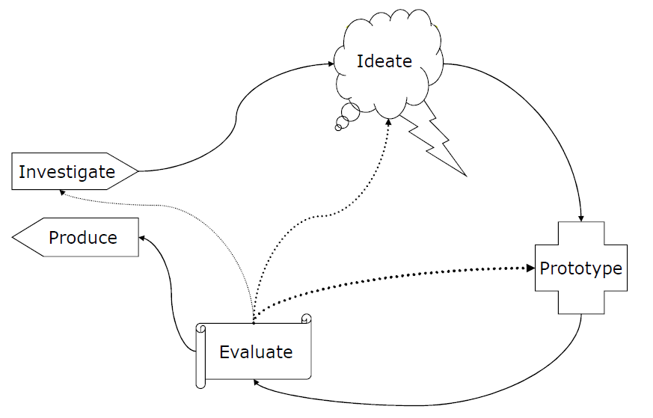
IDEO Methods in the UCD Process
Try
Learn
Look, Ask

Slide 5
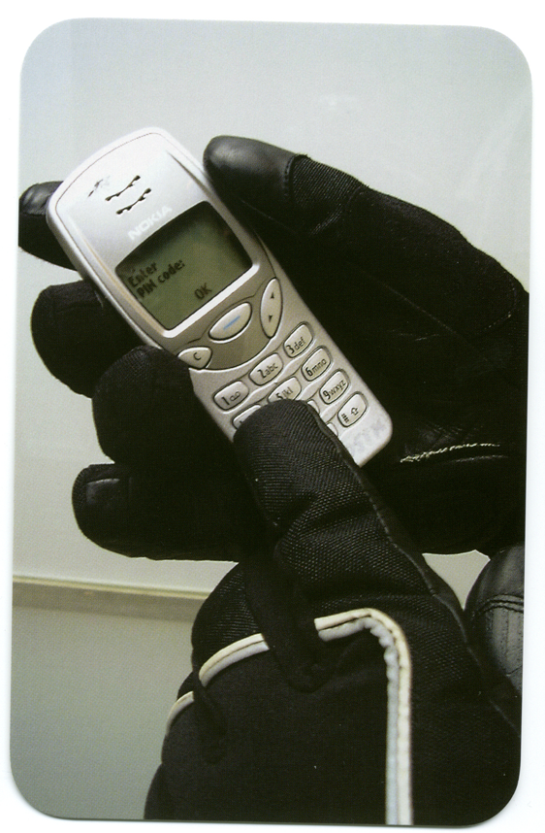
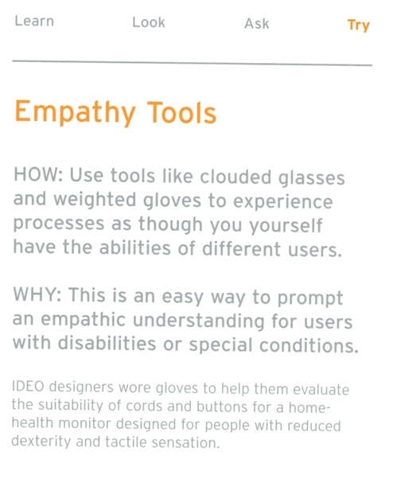

Slide 6
Empathy Tools in Vancouver
Three teams: wheelchair team, double stroller (twins), and blurred glasses+wonky joints.
Each assigned basic tasks. For example, go to the store and buy something; take the Skytrain station from one stop to another, etc.
Result: Vancouver still kind of stinks for people who are not fully able-bodied.
Notes:
http://uxdesignstrategy.com/empathy-and-user-centered-design

Slide 7
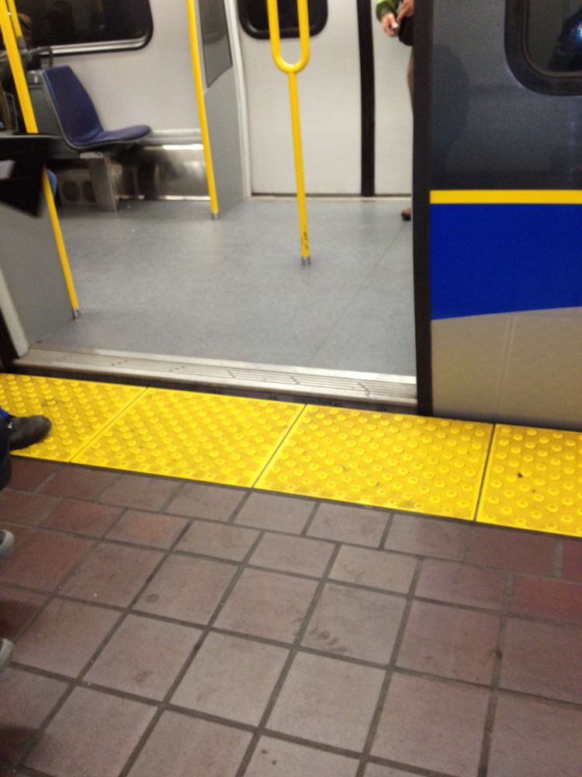
Team Wheelchair: SkyTrain Bail

Slide 8
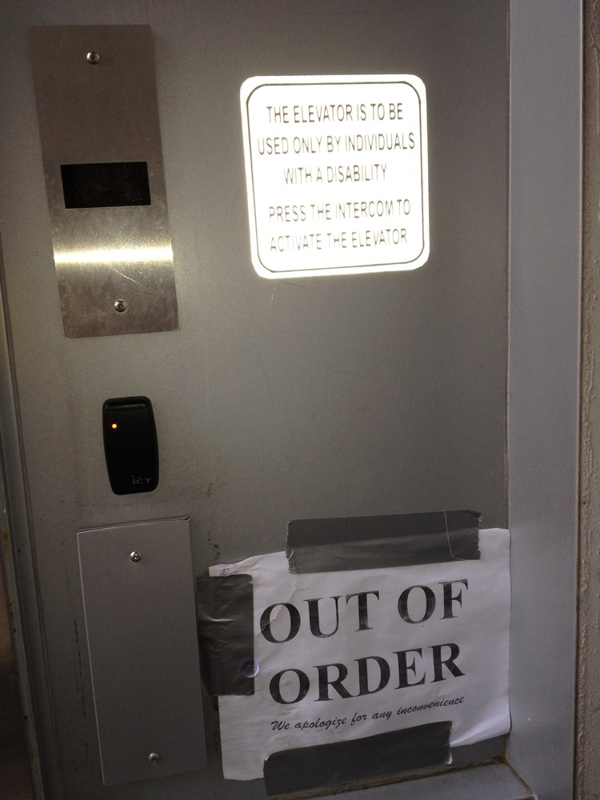
Team Wheelchair: SkyTrain Fail

Slide 9
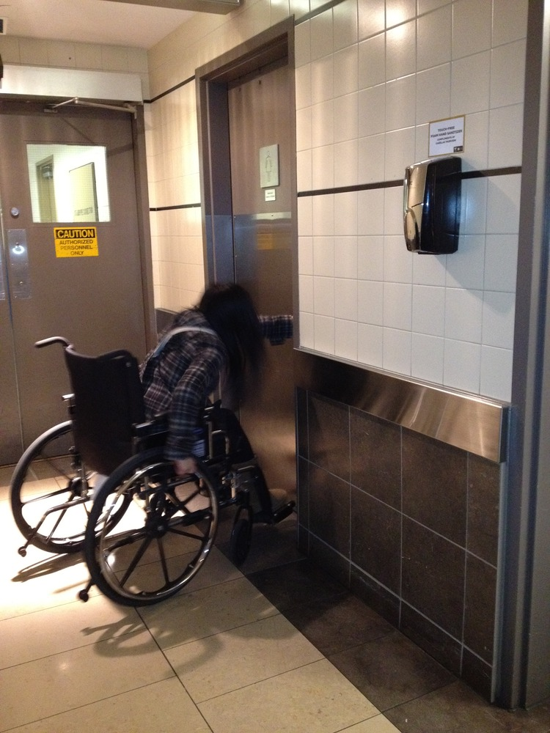
Team Wheelchair: Bathroom Fail

Slide 10
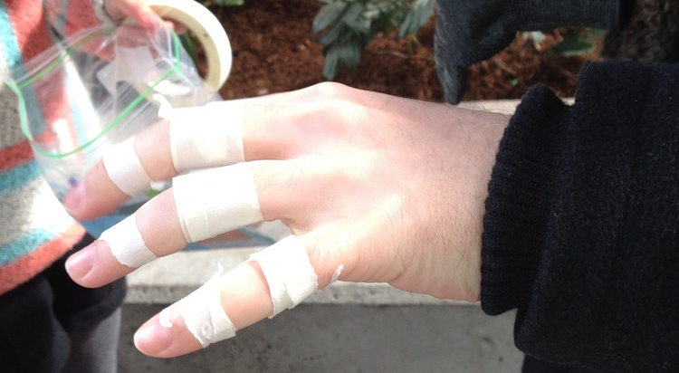
Team Elderly

Slide 11
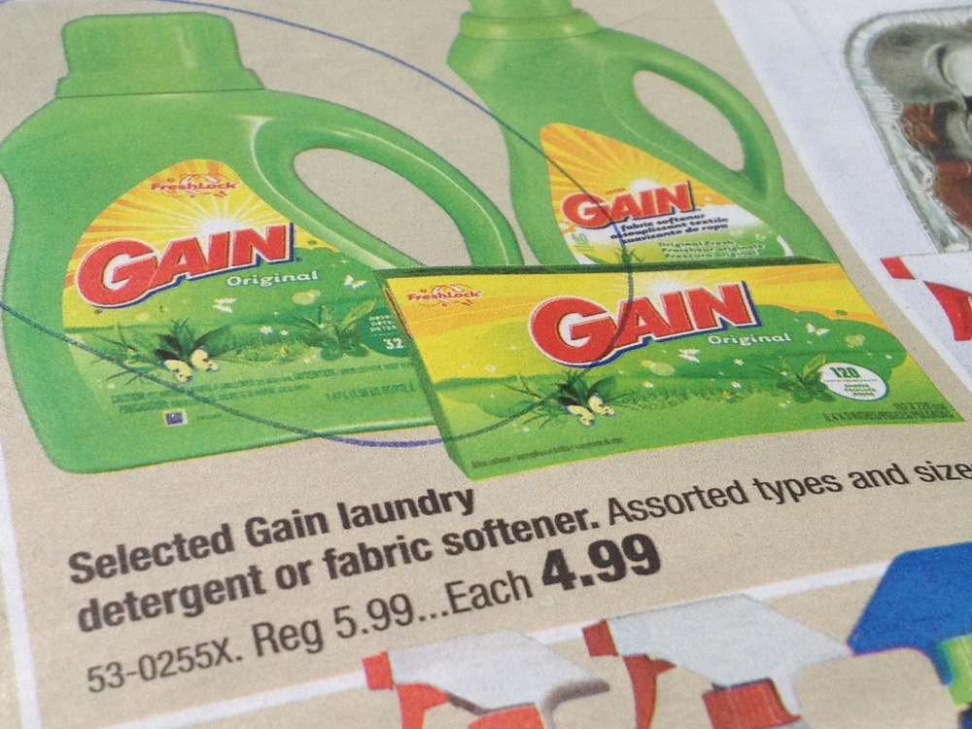
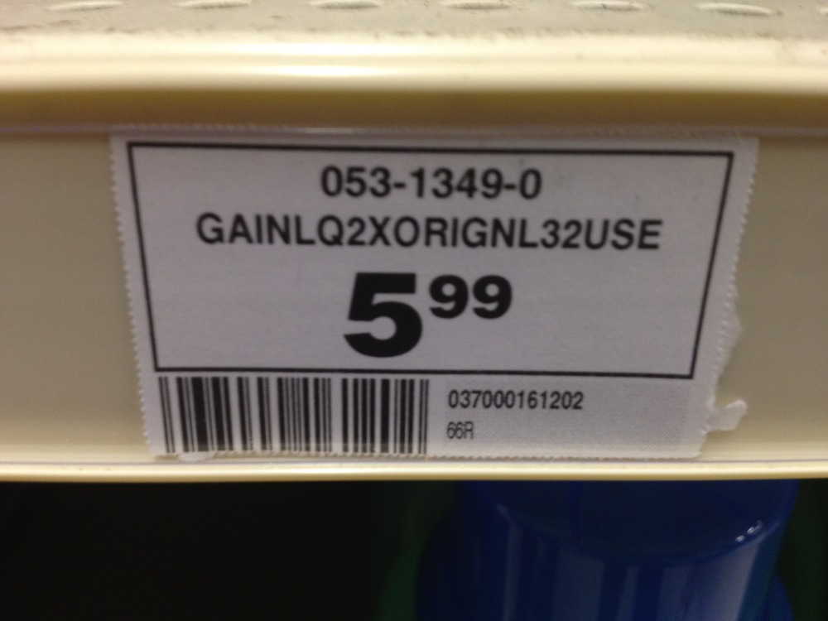
Team Elderly: Shopping Fail

Slide 12
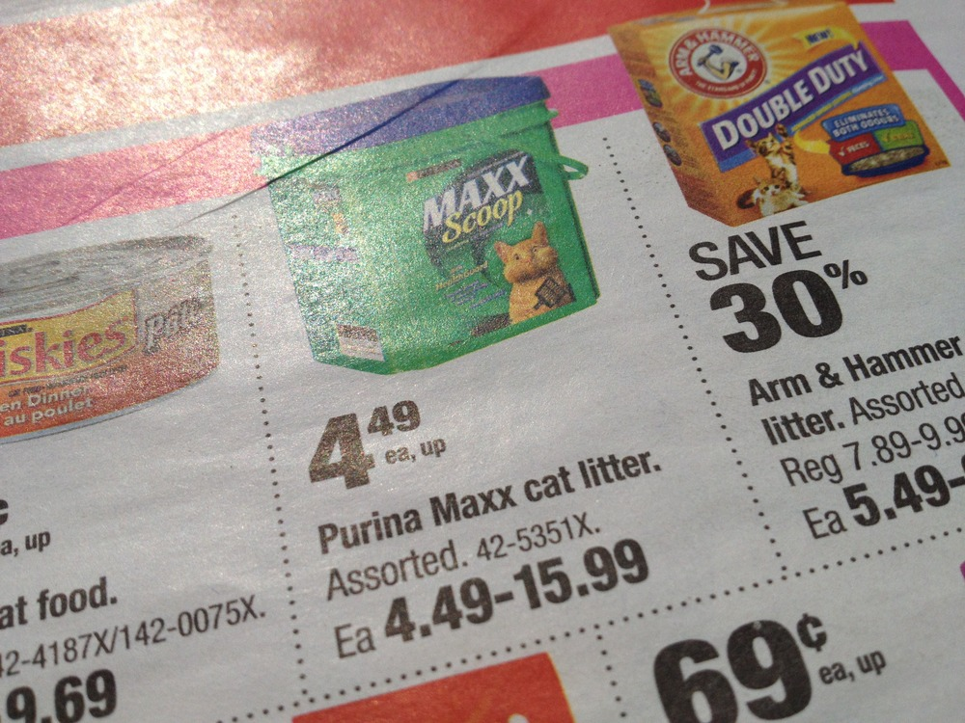
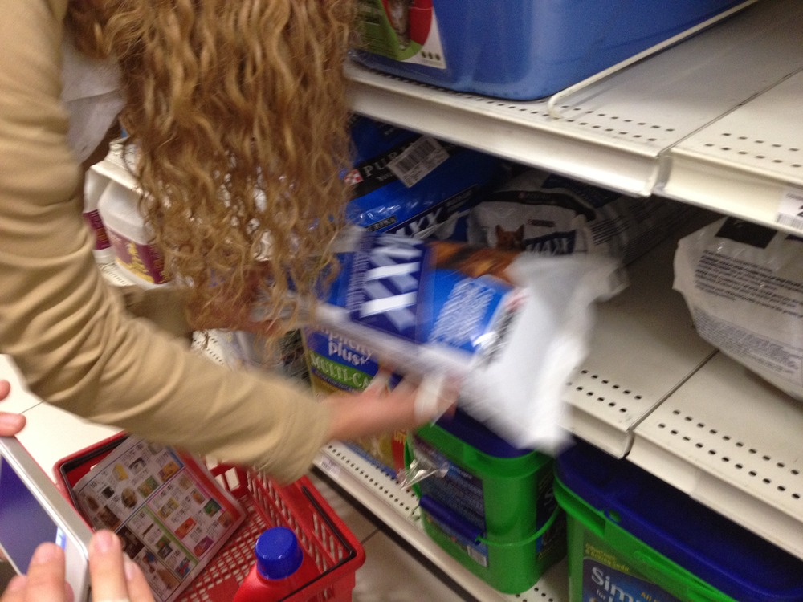
Team Elderly: Shopping Fail

Slide 13
Team Elderly: Coke Fail?
video

Slide 14
Quick Activity: Need 1 volunteer who has their cell phone with them that has text messaging
With one hand behind your back and your eyes focused on the window, try to send a text message to 403-805-6436
You have one minute.

Slide 15
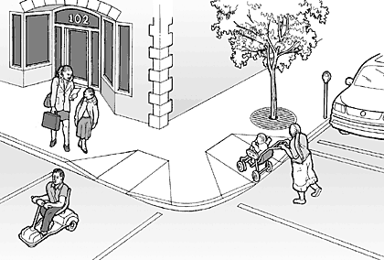
Why design for the most extreme conditions?
The designs can benefit everyone
Notes:
Think for a moment:
When are you sometimes blind?
When is it that you sometimes have mobility problems?
When is it that you have attentional issues?
http://www.lawalks.org/pedSurv/4V02.htm

Slide 16
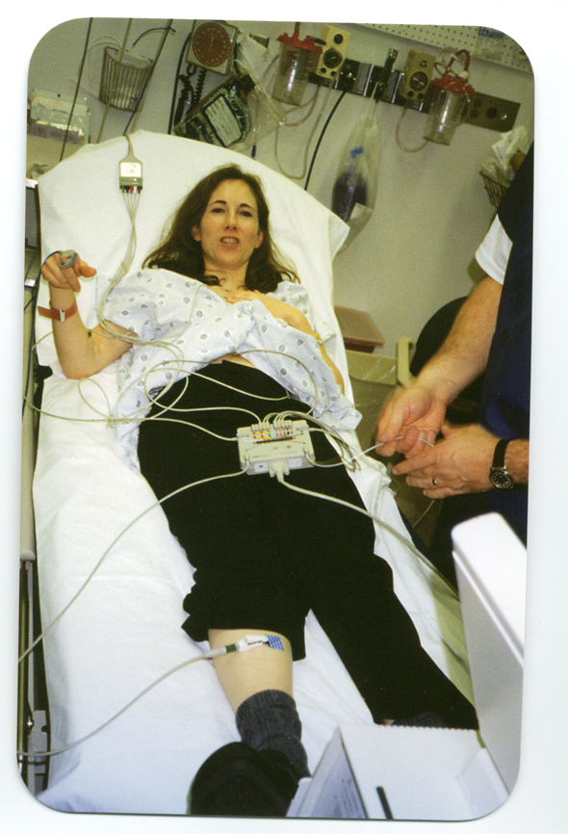
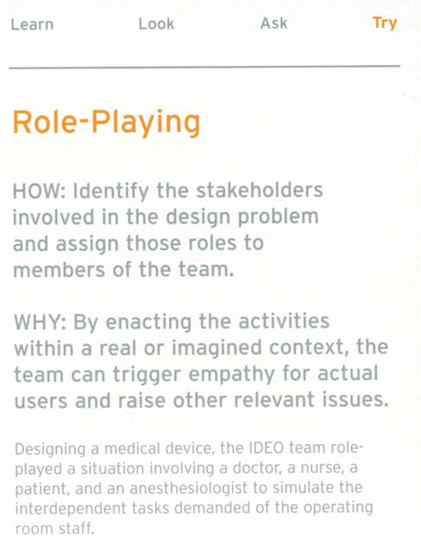

Slide 17

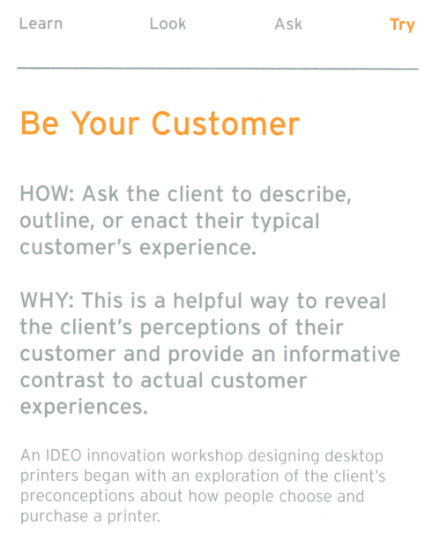

Slide 18
Quick exercise
Imagine that you are going to build technology that helps people to sleep better.
Who would you role-play? How would you role-play?
Take two minutes, and work with a neighbor, discussing these ideas.

Slide 19
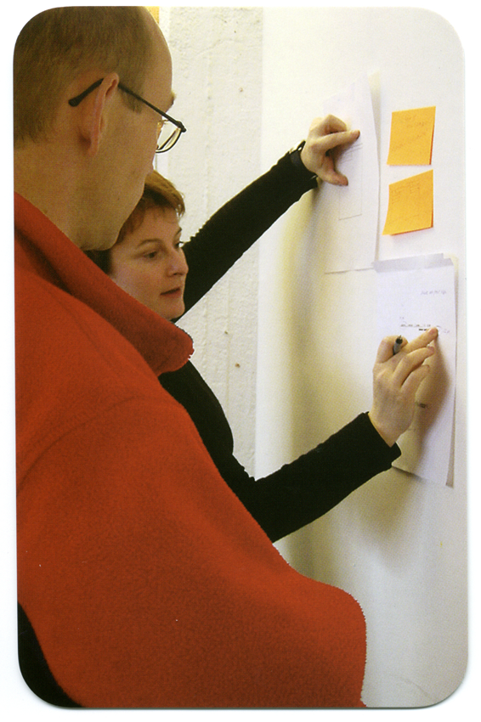
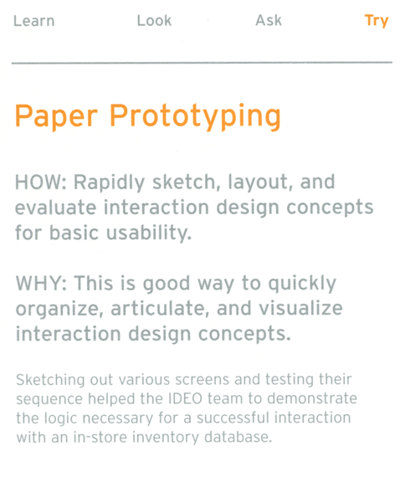

Slide 20
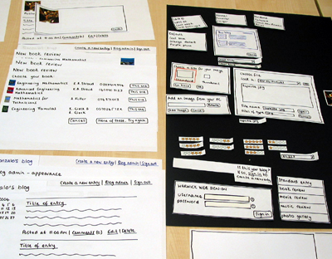
Notes:
http://speckyboy.com/2010/06/24/10-effective-video-examples-of-paper-prototyping/

Slide 21
Two videos on paper prototypes
Notes:
http://speckyboy.com/2010/06/24/10-effective-video-examples-of-paper-prototyping/

Slide 22
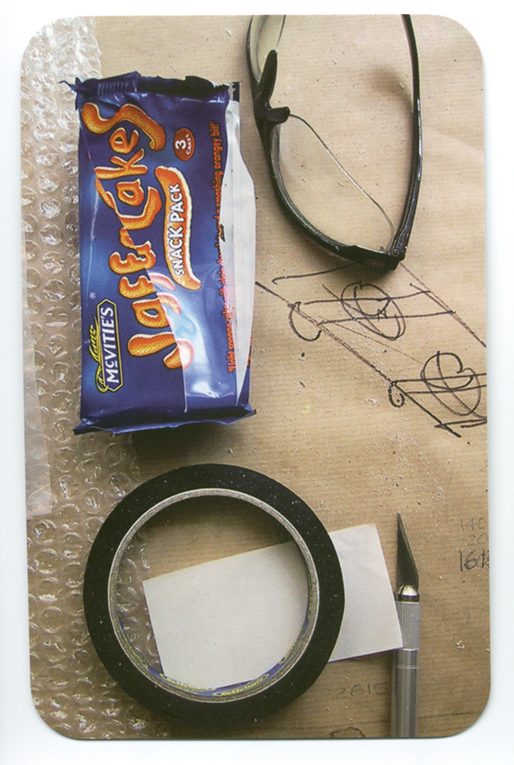
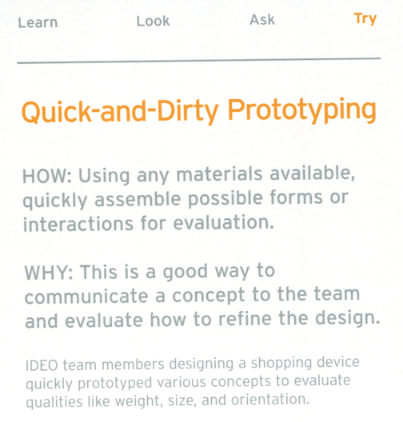

Slide 23
Quick & Dirty Prototyping
Quick Activity: Need 1 volunteer
Using this marker, paper, and tape, prototype a barcode scanner in 1 minute or less

Slide 24
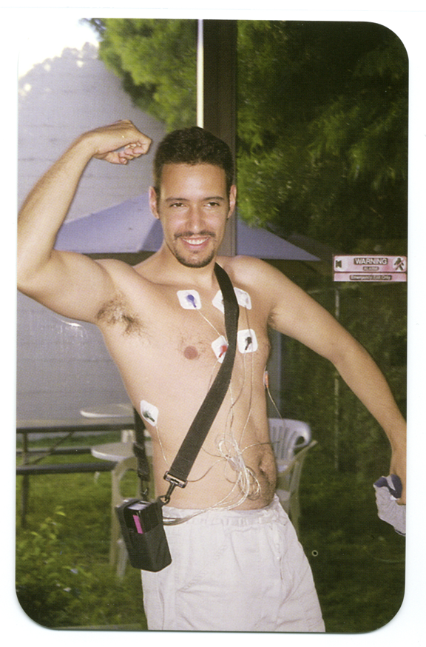
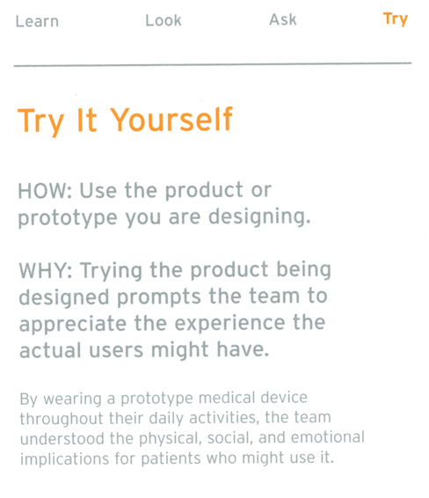

Slide 25

Notes:
http://www.wired.com/science/discoveries/news/1999/10/32010
Jeff Hawkins
http://uselog.blogspot.ca/2005/10/user-centered-design-immerse-yourself.html

Slide 26
Summary - Try
Apply “Try” techniques once you start getting ideas to test them early for their feasibility
  Can lead to more robust prototypes later

Slide 27
Summary – Design Methods
Choosing the right techniques can end up being trial and error
  Some will give you good insights, others might not
Try to recognize early on if you're not learning anything and move on to something else
Remember that above all, you should triangulate
  Use multiple, complementary methods to gain both a broad and deep understanding from multiple angles

Slide 28
Notes on Assignment 1
Please follow the instructions carefully
Hand it in on time.
Make sure to read through the instructions carefully: 3-4 pages (2 pieces of paper), Times font, 1” margin on each side, single spaced, double sided.
A cover sheet is nice, but instead, maybe just put your name and student ID in the top corner in the margins.

Slide 29
Assignment 2
I will post this on Piazza, as hcitang.org may be going down temporarily for maintenance.
Consider three different design scenarios.
For each scenario, choose one method from each of the four IDEO categories (look, ask, learn, try) that you would use to address the design scenario. Provide some detail as to how you would apply these methods, and importantly, justify your choice of methods.
Choose methods that allow you to triangulate your understanding of the situation—that is, the methods should all complement each other.

Slide 30
Students with DRC Forms
I have tried to get in contact with you by email.
If you have not received email from me, please get in touch with me ASAP.

