Slide 1
VisTACO: Visualizing Tabletop Collaboration
anthony tang, georgiatech
michel pahud, microsoft research
sheelagh carpendale, university of calgary
bill buxton, microsoft research

Slide 2
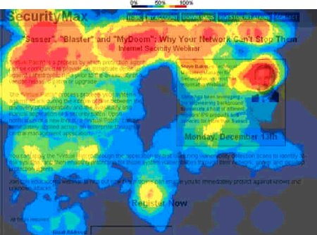
want: data-driven insight
challenge

Slide 3
is our tabletop system good?
challenge
“collaboration” metrics
working together? working independently?
how is space being used?
how does interaction change over time?

Slide 4
tabletop collaboration is complex
challenge

Slide 5
overview
an analytic framework for tabletop collaboration
vistaco: the first iteration
partial demo
example: distributed tabletop collaboration

Slide 6
toward an analytic tabletop collaboration framework…
what are important factors to study and consider?

Slide 7
spatial aspects of work
analytic tabletop collaboration framework
» where are people working?
» who works in this space?

Slide 8
entities
analytic tabletop collaboration framework
» what is happening to the objects on the table?

Slide 9
entities
analytic tabletop collaboration framework
» what is happening to the objects on the table?
» what are people doing?

Slide 10
entities
analytic tabletop collaboration framework
» what is happening to the objects on the table?
» what are people doing?
» what is this person doing?

Slide 11
temporal
analytic tabletop collaboration framework
» how does collaboration change over time?

Slide 12
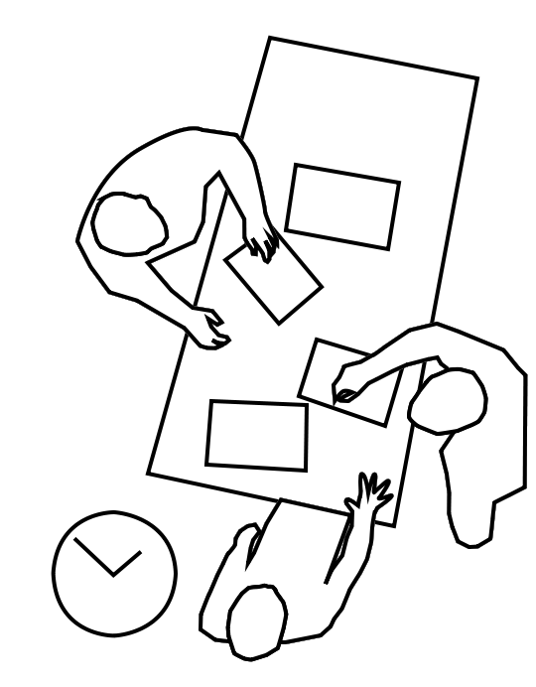
summary
analytic tabletop collaboration framework
spatial
global vs. local
subject
group vs. individual vs. objects
temporal
aggregate vs. specific

Slide 13
summary
analytic tabletop collaboration framework
spatial
subject
………………………………………..
temporal

Slide 14
summary
analytic tabletop collaboration framework
spatial
subject
temporal

Slide 15
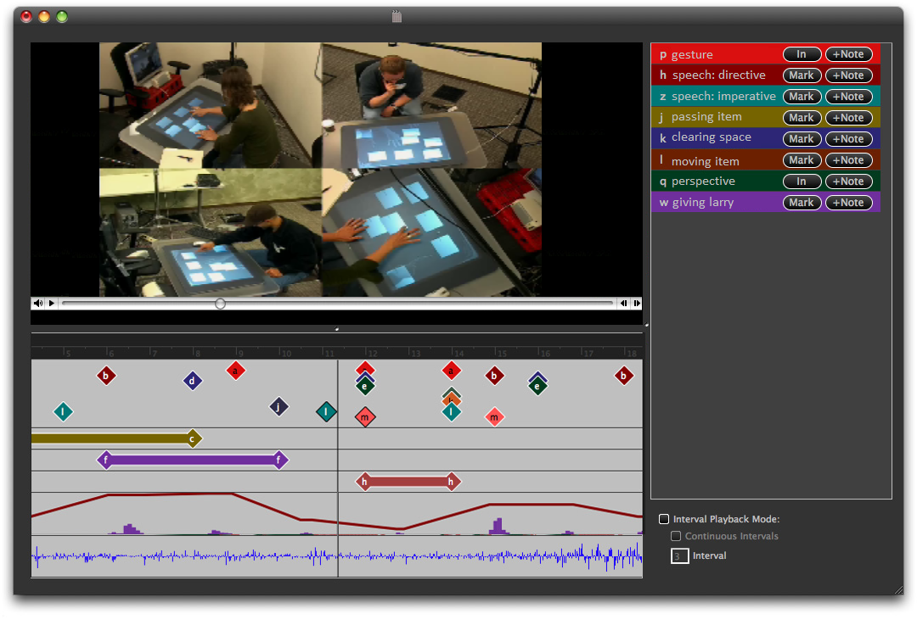
tedious work
analysis as we know it
spatial
subject
temporal
video data
Notes:
[picture or video of video coding]
[or an eventlog of an annotation approach]
Something happening quickly

Slide 16
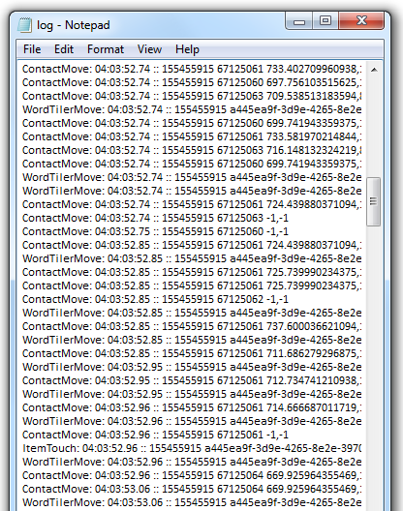
tedious work
analysis as we know it
spatial
subject
temporal
video data
log data
Notes:
[picture or video of video coding]
[or an eventlog of an annotation approach]
Something happening quickly

Slide 17
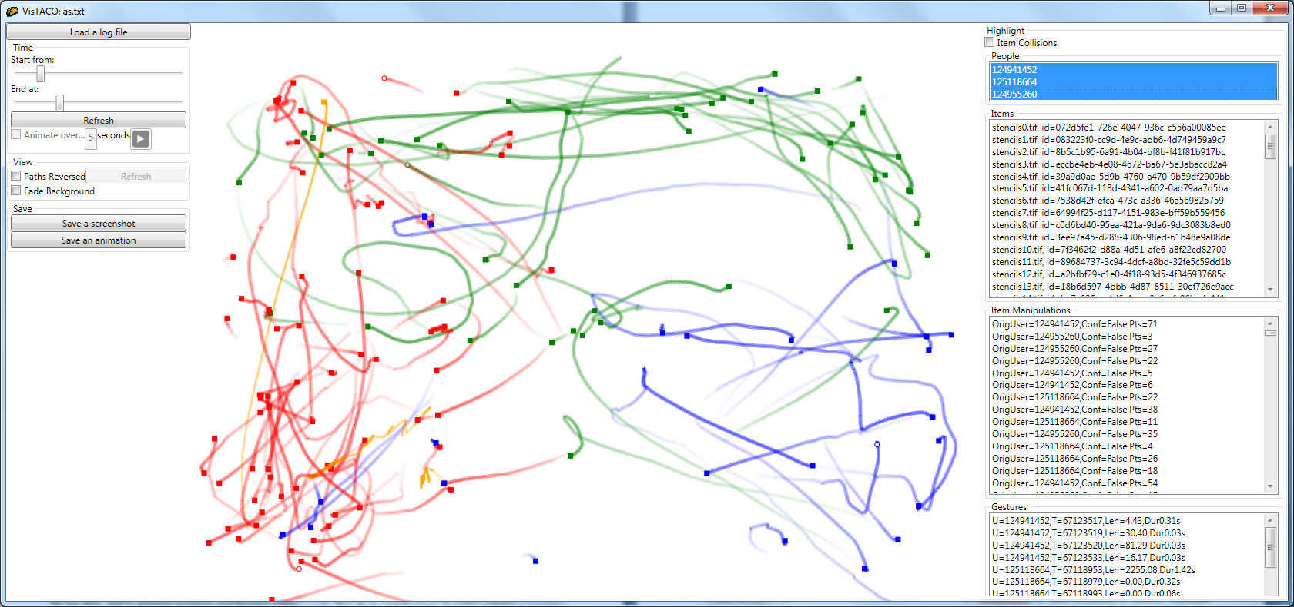
VisTACO
Notes:
VisTACO is a system that we designed to aid in this quick hypothesis generation/testing cycle
It supplements an analysis process by allowing us to quikly generate hypotheses and test them out
Allow me to describe this interface really quickly, and then we’ll move to a series of examples that allows us to demonstrate how the system worked to help us

Slide 18
feature tour
VisTACO
main visualization pane
Notes:
VisTACO is a system that we designed to aid in this quick hypothesis generation/testing cycle
It supplements an analysis process by allowing us to quikly generate hypotheses and test them out
Allow me to describe this interface really quickly, and then we’ll move to a series of examples that allows us to demonstrate how the system worked to help us

Slide 19
feature tour
VisTACO
spatial
subject
temporal
main visualization pane
Notes:
VisTACO is a system that we designed to aid in this quick hypothesis generation/testing cycle
It supplements an analysis process by allowing us to quikly generate hypotheses and test them out
Allow me to describe this interface really quickly, and then we’ll move to a series of examples that allows us to demonstrate how the system worked to help us

Slide 20
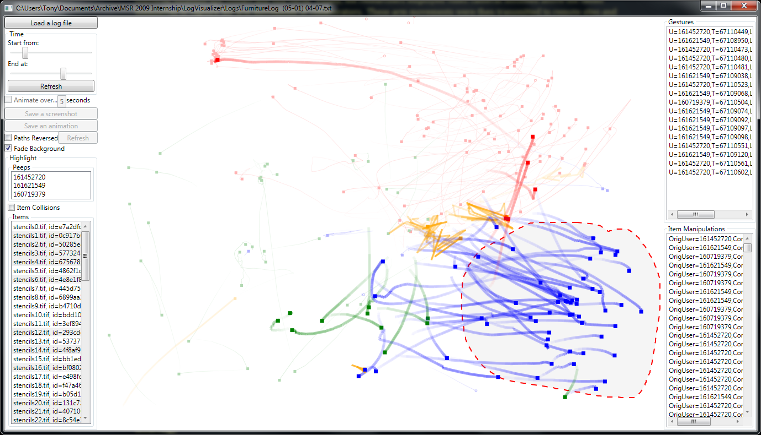
feature tour
VisTACO
spatial
subject
temporal
entity selection
» people
» items
» table gestures
spatial selection
Notes:
VisTACO is a system that we designed to aid in this quick hypothesis generation/testing cycle
It supplements an analysis process by allowing us to quikly generate hypotheses and test them out
Allow me to describe this interface really quickly, and then we’ll move to a series of examples that allows us to demonstrate how the system worked to help us

Slide 21
feature tour
VisTACO
spatial
subject
temporal
entity selection
» people
» items
» table gestures
Notes:
VisTACO is a system that we designed to aid in this quick hypothesis generation/testing cycle
It supplements an analysis process by allowing us to quikly generate hypotheses and test them out
Allow me to describe this interface really quickly, and then we’ll move to a series of examples that allows us to demonstrate how the system worked to help us

Slide 22
feature tour
VisTACO
spatial
subject
temporal
time selection &
playback
Notes:
VisTACO is a system that we designed to aid in this quick hypothesis generation/testing cycle
It supplements an analysis process by allowing us to quikly generate hypotheses and test them out
Allow me to describe this interface really quickly, and then we’ll move to a series of examples that allows us to demonstrate how the system worked to help us

Slide 23
feature tour
VisTACO
spatial
subject
temporal
time selection &
playback
Notes:
VisTACO is a system that we designed to aid in this quick hypothesis generation/testing cycle
It supplements an analysis process by allowing us to quikly generate hypotheses and test them out
Allow me to describe this interface really quickly, and then we’ll move to a series of examples that allows us to demonstrate how the system worked to help us

Slide 24
VisTACO
feature summary
see traces of users’ touches
highlight subsets of traces
playback
visualize and compare different conditions
nothing conclusive; but gives you something to look into
spatial
subject
temporal

Slide 25
“the task”
demo
make this...
... with (lots of) these...

Slide 26
cross your fingers…
demo

Slide 27
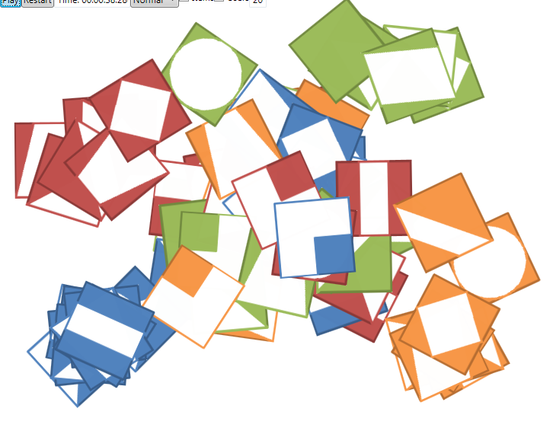
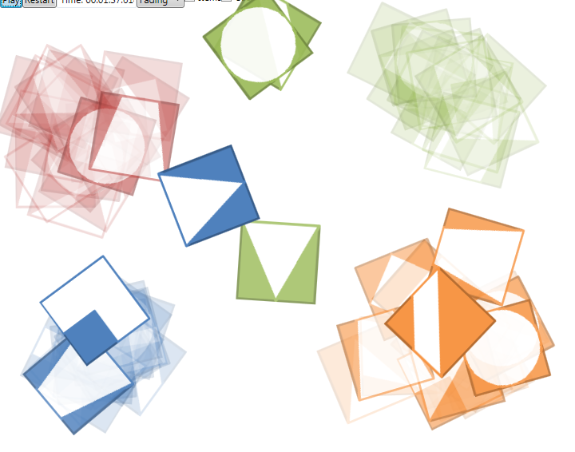
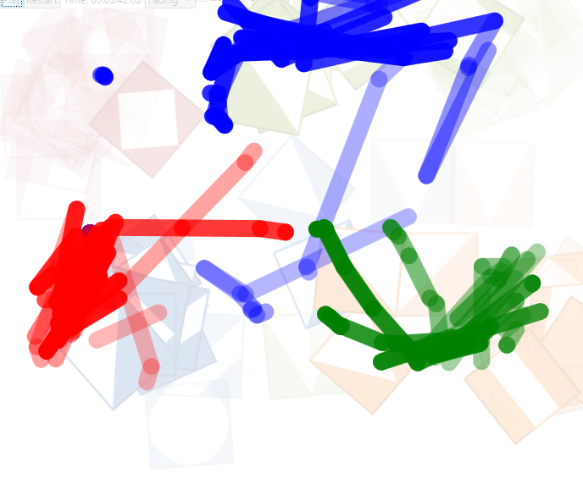
cross your fingers…
demo

Slide 28
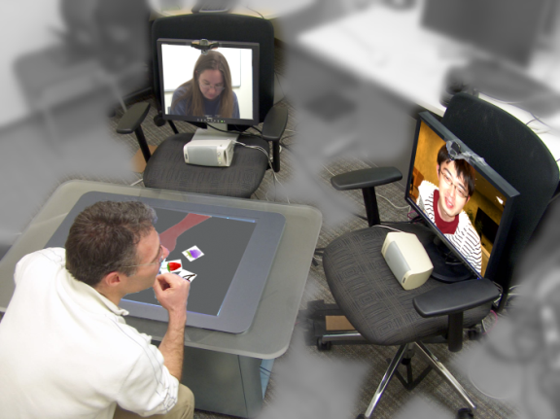
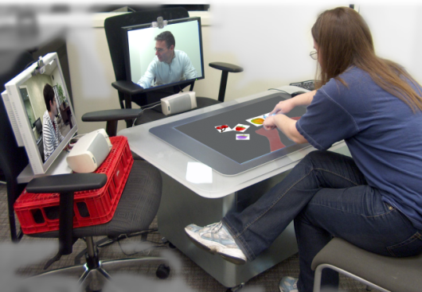
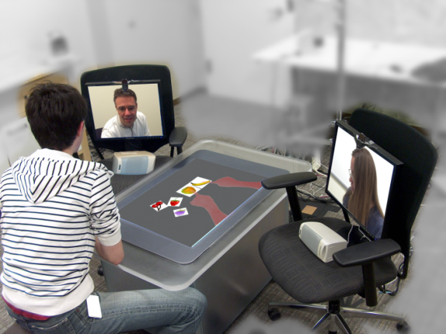
case study: 3-way collaboration
B
B
C
C
A
A
A
A
B
C
B
C
Notes:
Build a cool system – describe the system
Unleash the beast
What is going on

Slide 29
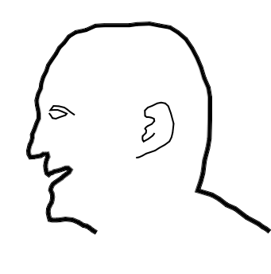
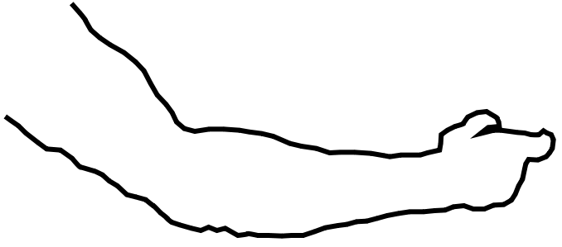
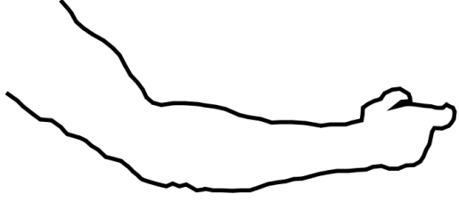
concept
case study » 3-way collaboration
person space
reference space
task space
Notes:
System setup

Slide 30
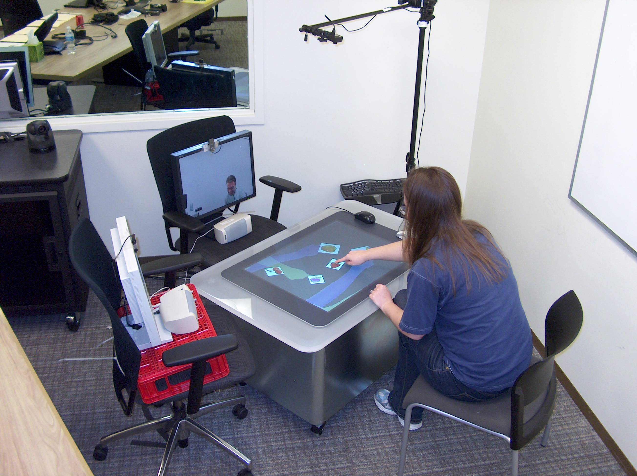
system
case study » 3-way collaboration
Notes:
System setup

Slide 31
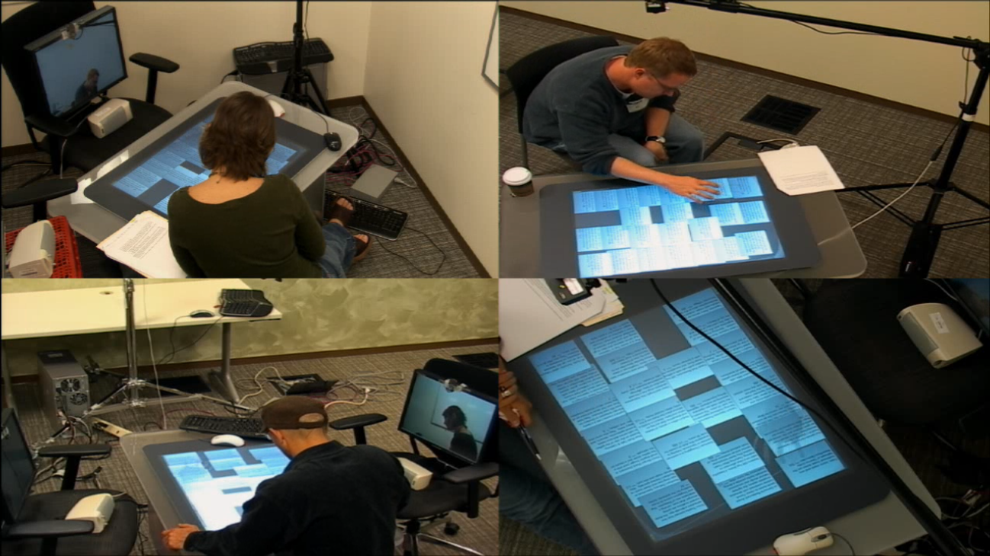
study details
case study » 3-way collaboration
logo task: constrained-creativity
24 participants (groups of 3)
90 min sessions
4 trials each: 1 trial per configuration
Notes:
I want to point out that these were designed to be early observational studies to explore the design space: see what was obviously wrong, and try to see what was probably going to be correct. We also took note of the kinds of things that stuck out and were interesting
Now, to kind of describe the kinds of things we saw, i’m going to play a bunch of videos.
I’ll give you a precursor as we go through the video, and then play them.
Notice the role that the reference space (the video of the arms) play. The behaviours that we see are a consequence of the presence of reference space, and in many cases, the equivalent behaviour would have been missing in conditions where reference space was missing.

Slide 32
case study » 3-way collaboration
q: effect of configuration?
» around-the-table configuration
» same-side configuration
Notes:
And we looked at four different conditions--- these are images as from your perspective as if you were a participant working with the microsoft surface.
The first has both a reference space and person space.
Then we added a face-to-face condition to see what the big differences were
Then we added a reference space only condition – no person space
Finally, we added a person-space only condition – no reference space

Slide 33
case study » 3-way collaboration
q: effect of configuration?
» around-the-table configuration
» same-side configuration
Notes:
And we looked at four different conditions--- these are images as from your perspective as if you were a participant working with the microsoft surface.
The first has both a reference space and person space.
Then we added a face-to-face condition to see what the big differences were
Then we added a reference space only condition – no person space
Finally, we added a person-space only condition – no reference space

Slide 34
case study » 3-way collaboration
q: effect of configuration?
» around-the-table configuration
» same-side configuration
Notes:
And we looked at four different conditions--- these are images as from your perspective as if you were a participant working with the microsoft surface.
The first has both a reference space and person space.
Then we added a face-to-face condition to see what the big differences were
Then we added a reference space only condition – no person space
Finally, we added a person-space only condition – no reference space

Slide 35
VisTACO vs. configuration
case study » 3-way collaboration
around-the-table
same-side
Notes:
System setup

Slide 36
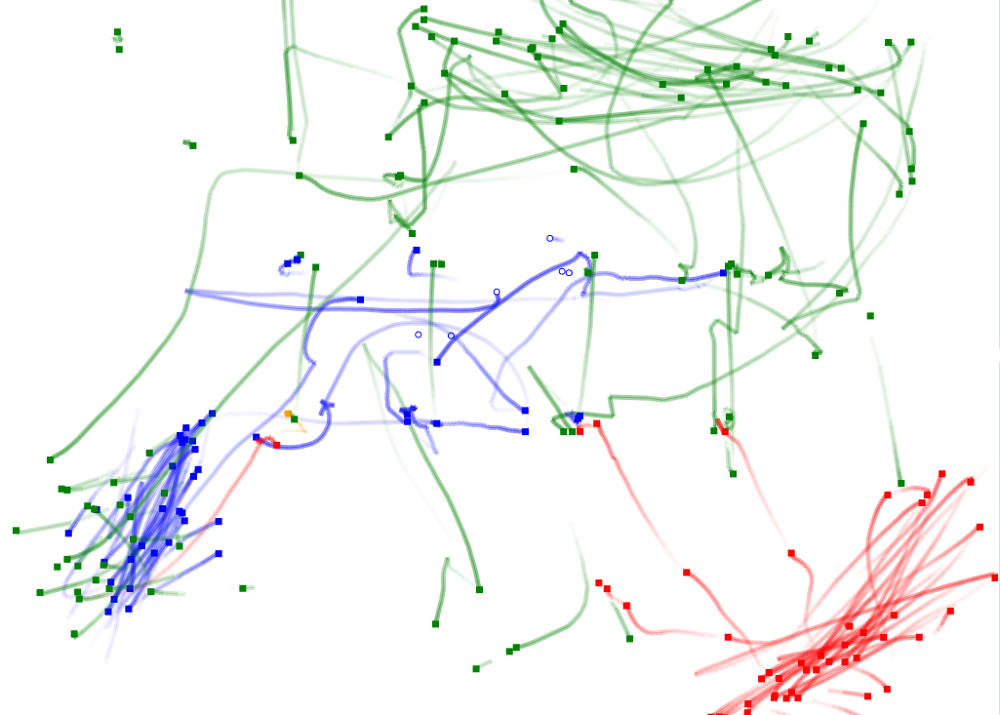
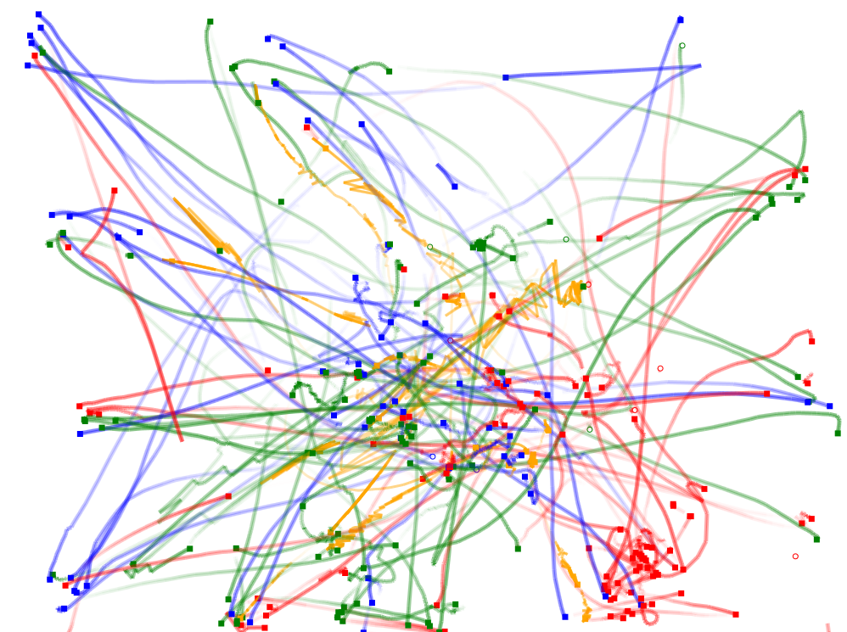
VisTACO vs. configuration
case study » 3-way collaboration
around-the-table
same-side
Notes:
System setup

Slide 37
q: effect of task?
case study » 3-way collaboration
logo task (no true orientation)
text task (oriented)
make this...
... with (lots of) these...
select only 10 of these:
...
Notes:
So, we had two types of tasks
The logo task that we used earlier doesn’t have a particular alignment – it has “multiple baselines”
In this study, we added a text-based tasks where participants were to read a bunch of text (on tiles), and then to make decisions about the tiles – selecting only a subset of them. Notice that there is a “right way up” for this kind of task – it has a “single baseline”

Slide 38
VisTACO vs. tasks
case study » 3-way collaboration
logo task
text task
...
Notes:
System setup

Slide 39
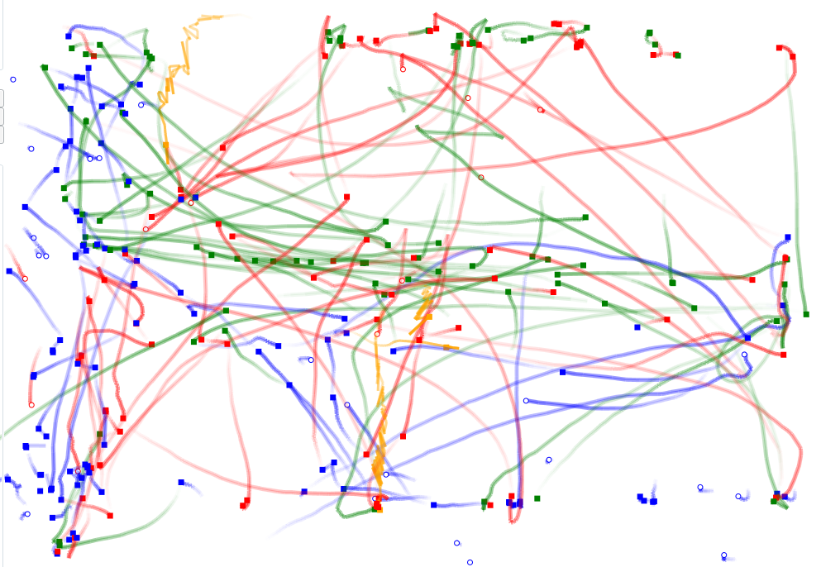
VisTACO vs. tasks
case study » 3-way collaboration
logo task
text task
...
Notes:
System setup

Slide 40
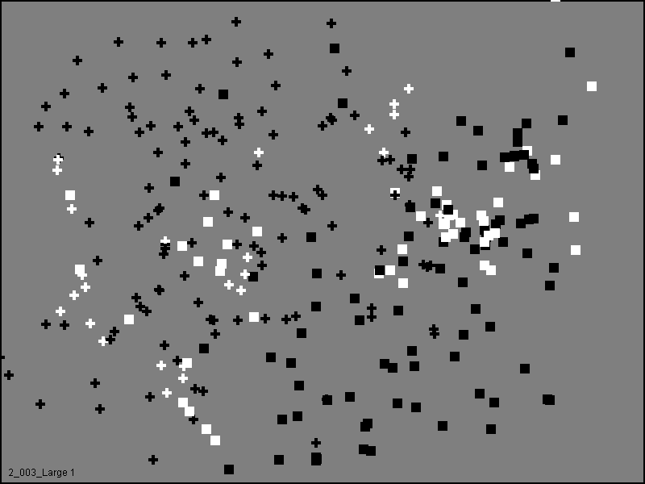
additional considerations
points vs. paths of interaction
Ryall et al. (2004)
Scott et al. (2004)

Slide 41
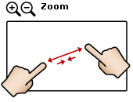
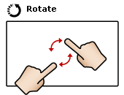
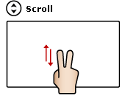
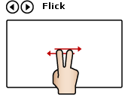
additional considerations
raw vs. semantic classification of interactions

Slide 42
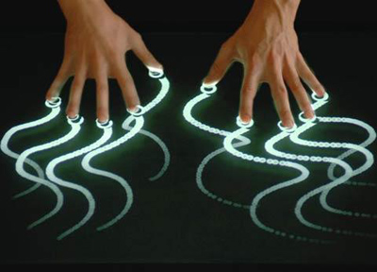
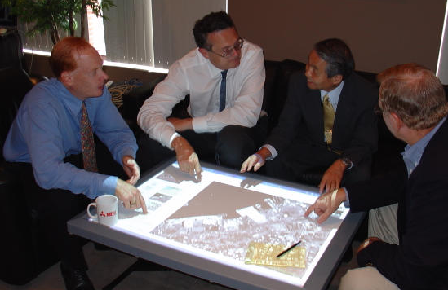
additional considerations
multitouch and user identification

Slide 43
message
visualizations of collaboration data can give us insights that might be otherwise difficult to spot—particularly patterns of interaction
VisTACO is a visualization system that aids the analysis of tabletop collaboration

Slide 45
B
C
A
Notes:
Build a cool system – describe the system
Unleash the beast
What is going on

Slide 46
B
B
C
C
A
A
A
A
B
C
B
C
Notes:
Build a cool system – describe the system
Unleash the beast
What is going on

Slide 47
there’s a lot going on!
challenge
Notes:
Play the video
What is going on, what is going on
What is interesting to pay attention to
Make sure to show some brief things

Slide 48
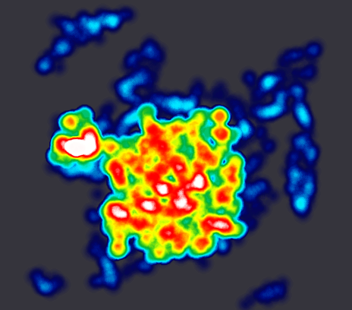
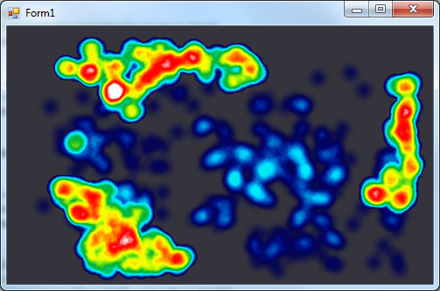

Slide 49
want: data-driven insight
challenge
“a lot of centralized interaction”
“storage along the side”

Slide 50
case study » 3-way collaboration
q: phases of interaction?
Notes:
System setup

Slide 51
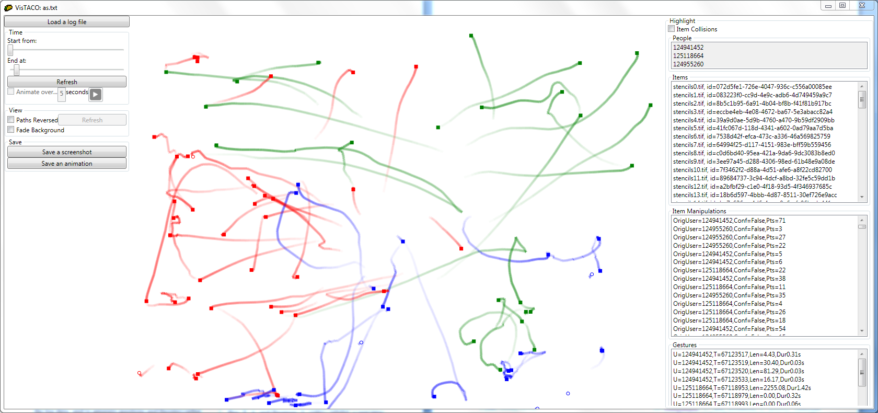
case study » 3-way collaboration
q: phases of interaction?
1st third: sorting/inspecting tiles
Notes:
System setup

Slide 52
case study » 3-way collaboration
q: phases of interaction?
2nd third: constructing/searching
Notes:
System setup

Slide 53
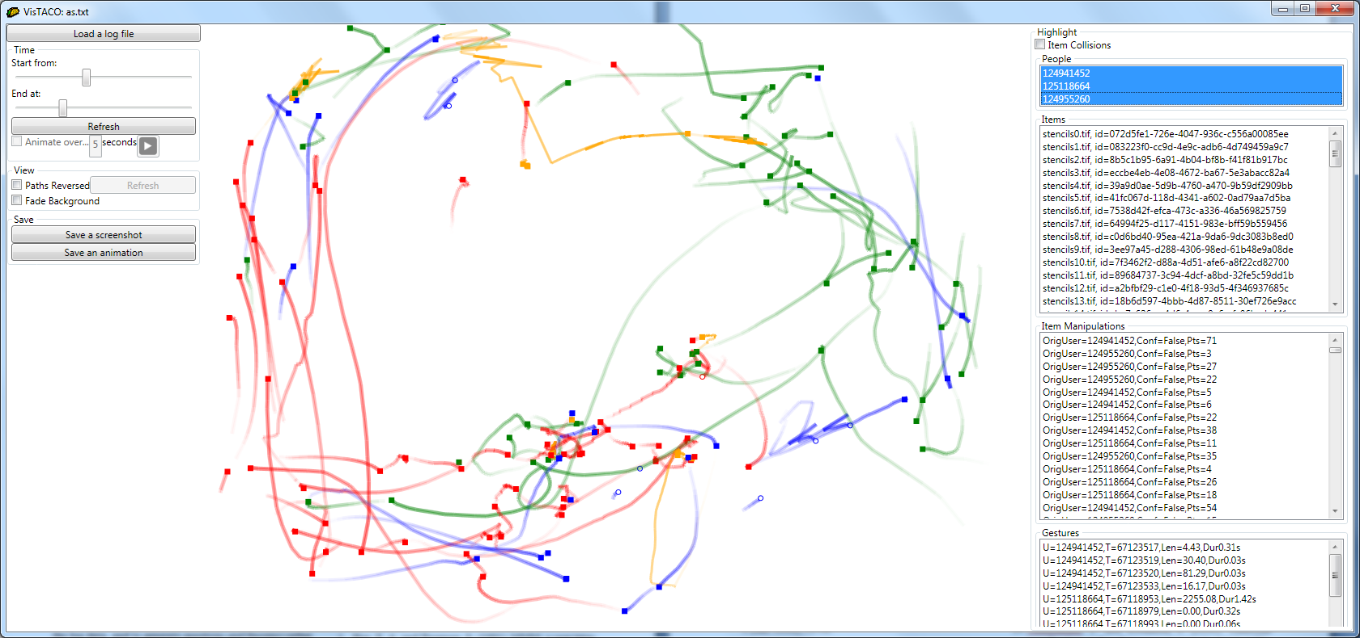
case study » 3-way collaboration
q: phases of interaction?
last third: fine tuning
Notes:
System setup

Slide 54
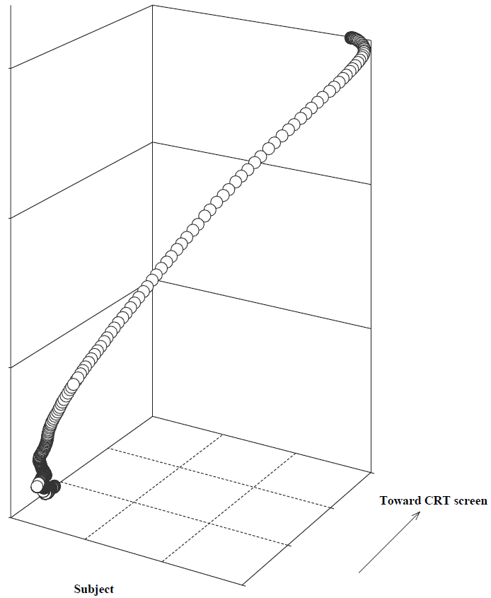
infovis to the rescue
approach
t
2d targeting
Notes:
We have seen a number of great visualizations of tabletop activity in the recent past

Slide 55
infovis to the rescue
approach
t
x
y
2d targeting
Notes:
We have seen a number of great visualizations of tabletop activity in the recent past

Slide 56
infovis to the rescue
approach
“ballistic motion”
t
2d targeting
Notes:
We have seen a number of great visualizations of tabletop activity in the recent past

Slide 57
infovis to the rescue
approach
“ballistic motion”
t
“corrective motion”
2d targeting
Notes:
We have seen a number of great visualizations of tabletop activity in the recent past

Slide 58
infovis to the rescue
approach
Jacob et al. (1994)
Notes:
We have seen a number of great visualizations of tabletop activity in the recent past

Slide 59
infovis to the rescue
approach
Ryall et al. (2004)
Jacob et al. (1994)
Scott et al. (2004)
Notes:
We have seen a number of great visualizations of tabletop activity in the recent past

